Slide 1
Coding Simple Calculator with Graphical Interface using PYTHON
NAVEEN CHAUDHARY
01-09-2024

Slide 2
INTRODUCTION
OBJECTIVE : Code a simple calculator using python as programming language
Scope : Function catered in calculators are Addition/ Subtraction/ Multiplication and Division
Tools Used : Python programming language with Tkinter for basic GUI support

Slide 3
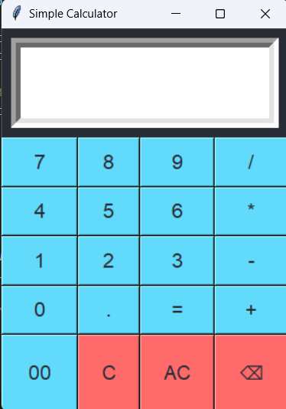
Basic gui

Slide 4
Overview
Calculator Features:
The application caters to Basic arithmetic operations
It is very User-friendly interface and almost replica of pocket calculator used
Approach:
Simple code in paython for arithmetic operation.
Graphical User Interface (GUI) with libraries like Tkinter

Slide 5
Interface
Components:
Input: User provides numbers and operation (+, -, *, /)
Processing: Perform the chosen arithmetic operation
Output: Display the result (using =)
C and AC are used to clear screen
Entry Box : To display the results.
Flow:
User inputs numbers and operator
Calculator processes the input
Result is displayed

Slide 6
Future integration
Features:
Advanced mathematical functions (e.g., square root, exponents)
Memory functions (e.g., memory recall, memory store)
Actual usage of C and AC in actual.

Slide 7
Conclusion
Summary: A simple yet functional calculator built with Python.
Key Takeaways:
Basic arithmetic operations implemented
Option to expand with GUI and additional features

Slide 8
References
Python Documentation: GeeksforGeeks | A computer science portal for geeks
Other Resources: Ref. class tutorials

Slide 9
Thanks!

