Slide 1
Improved Metastability of True Single-Phase Clock D-Flipﬂops With Applications in Time-to-Digital Converters
Batch:12
G.Manikanta -1602-20-735-081
K.Bharath-1602-20-735-069
P.Naveen-1602-20-735-085
K.R.DEEPTHI

Slide 2
Contents of the PPT
Introduction.
AIM and Objectives.
What is TDC?
Literature Survey.
Mathematical Analysis.
References

Slide 3
INTRODUCTION
This project aims to investigate the metastability of true single-phase clock (TSPC) D flip flops (DFFs) and propose a shunt capacitor technique to reduce setup time and hold time with no power and delay penalty. The project will analyze the impact of PVT(Power,Voltage,Temperature) on the effectiveness of the proposed technique and design and simulate time-to-digital converters (TDCs) with both untuned and tuned DFFs. The simulation results will be used to compare the TDCs with tuned DFFs and untuned DFFs in terms of conversion error. The project will contribute to the development of more efficient and accurate TDCs, which have applications in various fields such as radar, communication, and instrumentation

Slide 4
AIM and OBJECTIVES
The aim of the document is to investigate the impact of a shunt capacitor technique on the resolution of Vernier Time-to-Digital Converters (TDCs).
The objective is to propose a method that can reduce the setup time and hold time of True Single-Phase Clock (TSPC) D Flip-Flops (DFFs) to zero, without any penalty in terms of area, power, and speed.

Slide 5
What is TDC?
It is a type of electronic circuit or device used to measure time intervals between two events with high precision.
TDCs are commonly used in various applications, including physics experiments, communications,radar systems, and more, where accurate time measurements are crucial.

Slide 6
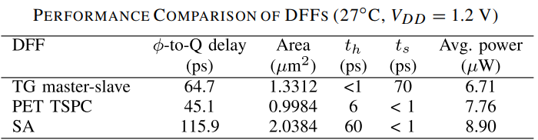
Literature survey
Types of D flip flops exists.[4]-[6]
TG Master slave
PET and NET TSPC
SA

Slide 7
Literature survey
From the survey we have decided that setup time and hold time of PET TSPC is mostly because of slow drop of voltages at second stage.so we need to fasten the drop voltage at second stage.
Why Shunt capacitance technique is used :
A shunt array of capacitors are attached at output of stage 1,this will lowers the rate of voltage drop at stage 1 and fasten the voltage drop at stage 2 is faster.
Zero Setup Time
Zero Hold Time
No Power and Delay Penalty

Slide 8
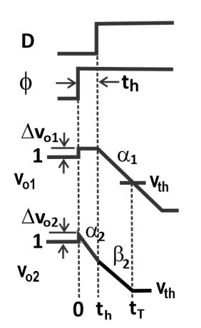
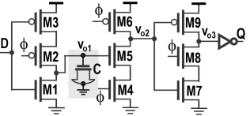
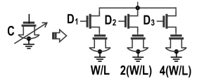
Circuits

Slide 9




Mathematical analysis
For PET-DFF setup and hold time:
For NET-DFF setup and hold time:

Slide 10
References
[1] Base paper: Parth Parekh, Fei Yuan and Yushi Zhou “Improved Metastability of True Single-Phase Clock D-Flipﬂops With Applications in Vernier Time-to-Digital Converters”
[2] Anwesha Deb, Shobha Sharma, Amita De “Analysis of Various TSPC Based D Flip Flops.”
[3] Priyanka Sharma and Rajesh Mehra “TRUE SINGLE PHASE CLOCKING BASED FLIP-FLOPDESIGN USING DIFFERENT FOUNDARIES.”
[4]G. Gerosa et al., “A 2.2 W, 80 MHz superscalar RISC microprocessor,” IEEE J. Solid-State Circuits, vol. 29, no. 12, pp. 1440–1454, Dec. 1994.
[5]V. Stojanovic and V. G. Oklobdzija, “Comparative analysis of masterslave
latches and flip-flops for high-performance and low-power systems,”
[6] M. V. Krishna, M. A. Do, K. S. Yeo, C. C. Boon, and W. M. Lim, “Design and analysis of ultra low power true single phase clock CMOS 2/3 prescaler,”

