Slide 1

“Course enroll + ,Online Course Registration”
Mind gamers & Team Members
25ad162 Rajamathalai priyaesh V
25ad145 poovaragavan k
25ad127 Naveen kumar m
25ad168 Ranjith kumar c
U23CS381 – Application Design and Development

Slide 2
Website Workflow / User Flow
Start →
Home Page →
Course Selection Form →
Select Subjects →
Select Schedule →
Calculate Credits →
Validate Form →
Submit →
Confirmation Message →
End
U23CS381 – Application Design and Development

Slide 3
Page Layout & Structure
1.HTML Form Structure is used to collect user inputs such as name, subjects and schedule.Checkbox Inputs with Data Attributes (data-credits) store credit values for each subject.
2.CSS Styling & Flexbox Layout make the page visually neat and responsive.JavaScript DOM Manipulation is used to select elements and update content dynamically.
3.Event Listeners (change and submit) detect actions like selecting subjects and submitting the form.
4.Dynamic Credit Calculation adds the credit values of selected subjects and displays the total immediately.
5.Form Validation & Confirmation Message ensures correct input and shows a success message using template literals.
U23CS381 – Application Design and Development

Slide 4
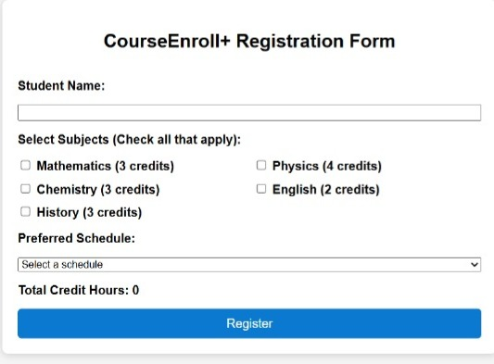
Screenshots
U23CS381 – Application Design and Development

