Slide 1
Capstone Project1 : Data Storytelling

Slide 2
Agenda:
Business Objective
Find the patterns / trends
Visualizations & Conclusion

Slide 3
Business Objective:
To create a predictive model that answers the question : “what sorts of people were more likely to survive on titanic shipwreck?” using passenger data (i.e. name, age, gender, socio-economic class, etc).

Slide 4
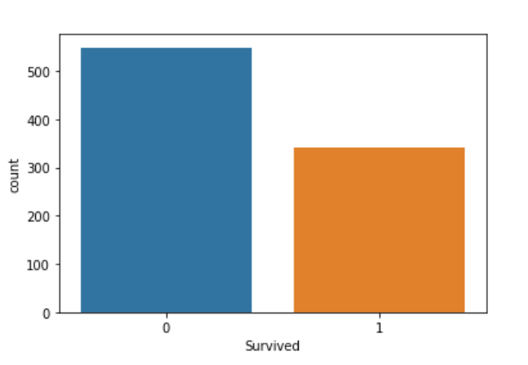
Survival % : 38.38
Only 342 survived out of 891.
0 – No
1 – Yes

Slide 5
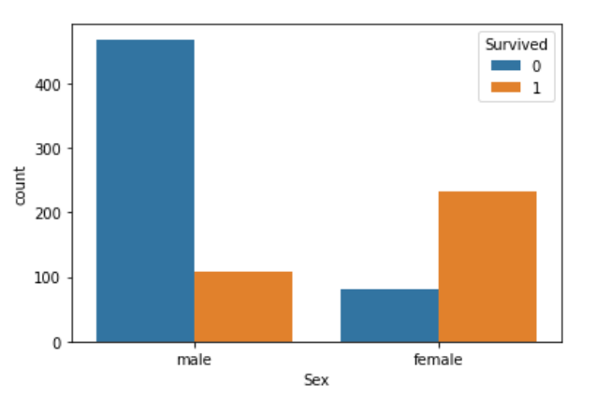
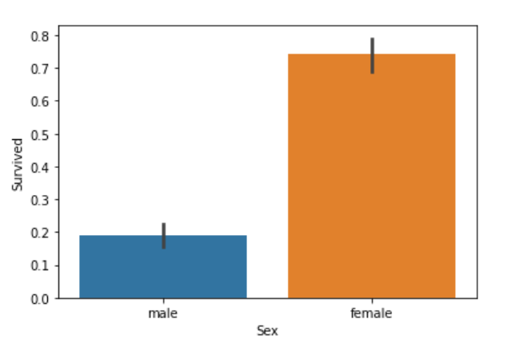
Survival Pattern on Gender :
From the graphs
0 – No & 1 – Yes
% of Female Survived : 74.20 %
% of Male Survived : 18.89 %
Very clear survival rate more in Female passengers

Slide 6
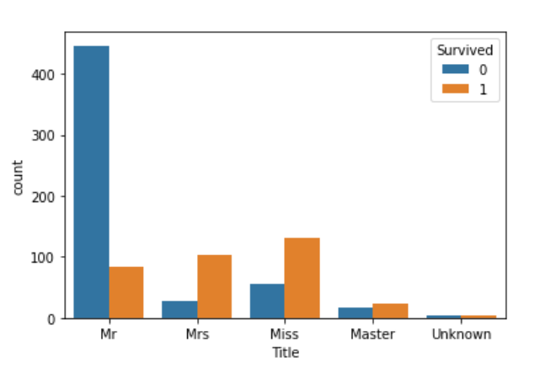
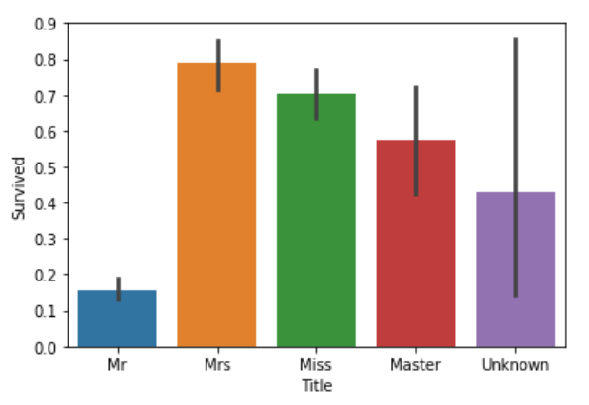
Survival trend on Age Group:
From The Graphs
0 – No & 1 – Yes
Clearly the trend is that children, young & Mid age people have high survival rate

Slide 7
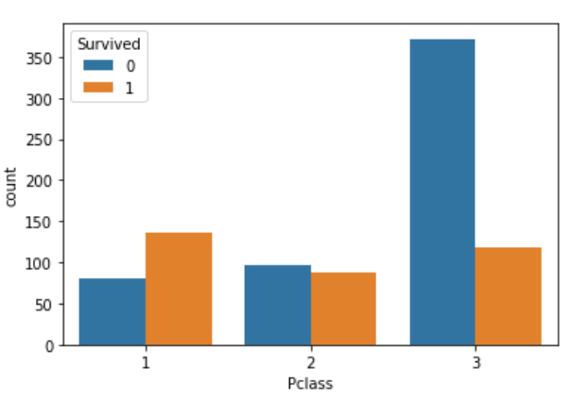
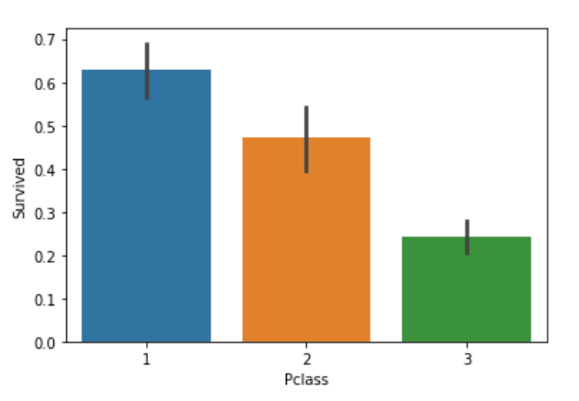
Survival Pattern on Passenger Class:
From the graphs
0 – No & 1 – Yes
Survival rate follows decreasing trend from class 1 to class 3.

Slide 8
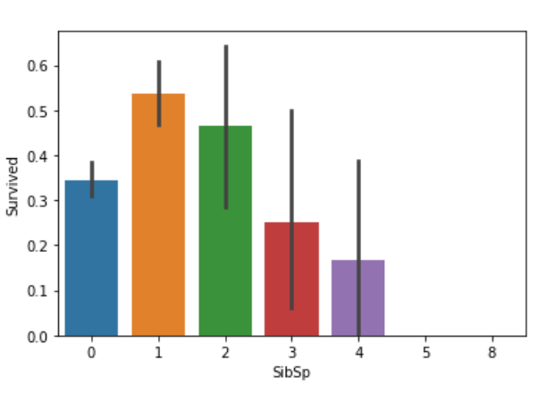
Survival trend on # of Siblings & Spouses aboard :
Survival rate also follows decreasing trend from 1 to 4.
However, there is an exception i.e. survival rate for SibSp 0 is better than 3.

Slide 9
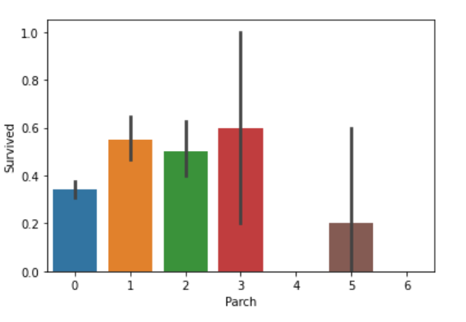
Survival Trend on # of parents / children :
Survival rate is good for parch values 1,2 & 3.

Slide 10
Conclusions:
After exploring the training data, I conclude that survival of a passenger depends on below features. Same will be used to develop a predictive model.
Gender
Age
Passenger Class
# Of Siblings / Spouses
# Of Parents / Children

Slide 11
Thank You ☺

