Slide 1
ABC Call Volume Trend Analysis
BY:
KUNDA NAVEEN KUMAR DAS

Slide 2
Project Description
A customer experience (CX) team consists of professionals who analyze customer feedback and data, and share insights with the rest of the organization.
Typically, these teams fulfil various roles and responsibilities such as:Customer experience programs (CX programs),Digital customer experience,Voice of the customer (VoC),User experiences,Customer experience management,Journey mapping,Customer success,Customer support,Handling customer data.
Advertising is a way of marketing your business in order to increase sales or make your audience aware of your products or services. Until a customer deals with you directly and actually buys your products or services, your advertising may help to form their first impressions of your business.

Slide 3
Approach
I downloaded the dataset.
I understood the dataset.
I gave insights according to the questions.
I used visualization for better understanding.

Slide 4
Tech-Stack Used
I used MSExcel for analysis and visual representation of dataset.

Slide 5
Insights
a) Calculate the average call time duration for all incoming calls received by agents (in each Time_Bucket).
I used pivot table to calculate the average call time duration for all answered calls.
The total average call time is 198.6227745.

Slide 6
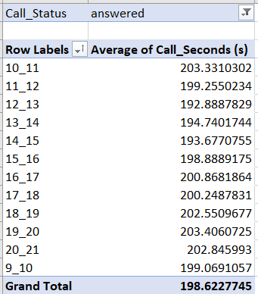

Slide 7
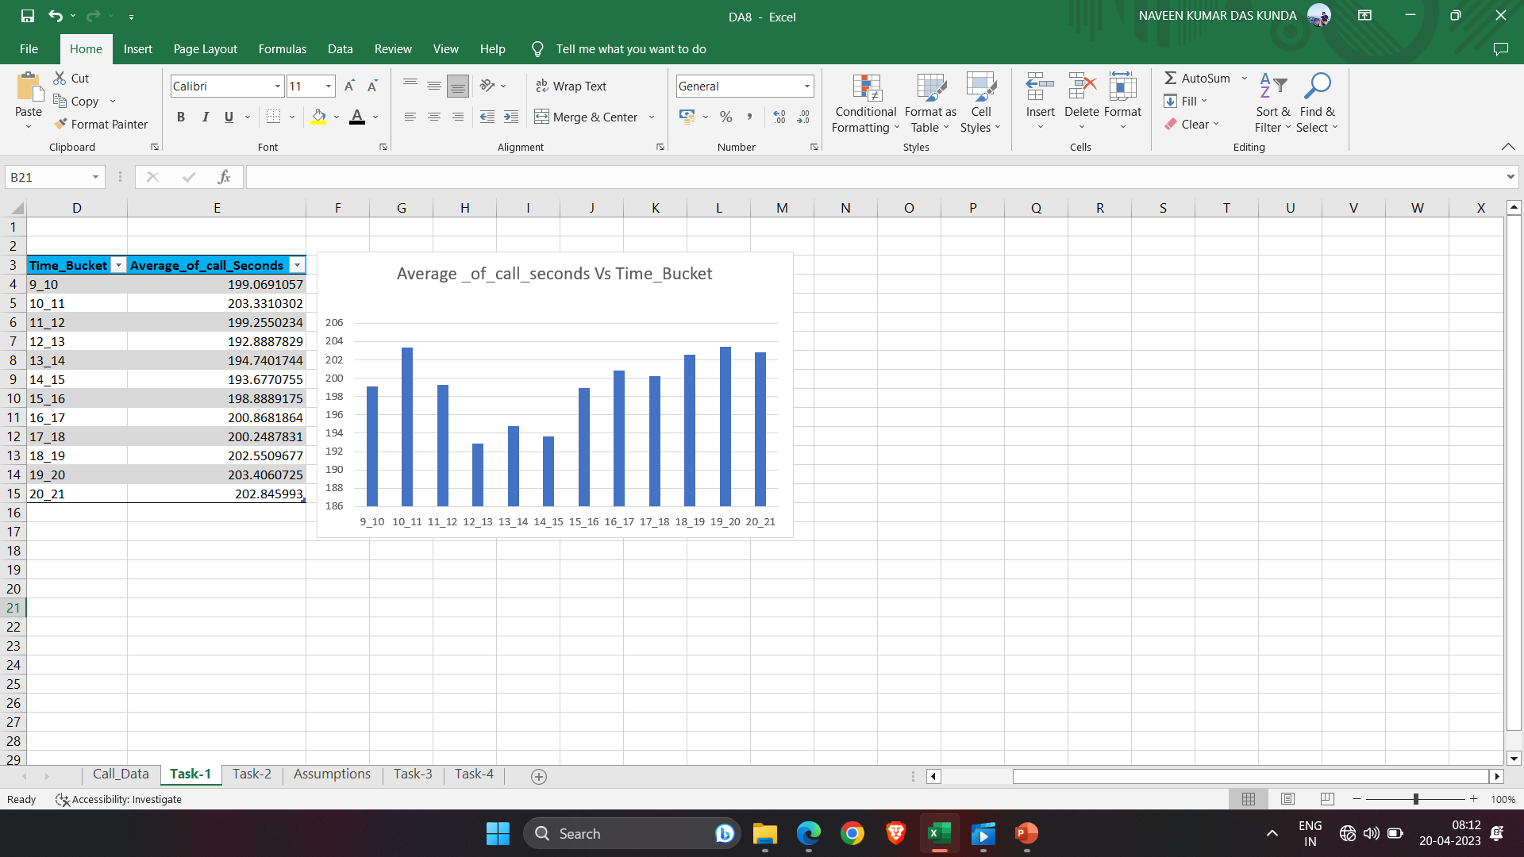
I used column chart to visualize the relation between Time_Bucket and Average_of_call_seconds.

Slide 8
b) Show the total volume/ number of calls coming in via charts/ graphs [Number of calls v/s Time]. You can select time in a bucket form (i.e. 1-2, 2-3, …..).
I used pivot table to calculate the number of incoming calls over time_bucket.
It seems like in the time period 11 to 12 the agents received many calls compared to other time periods.

Slide 9
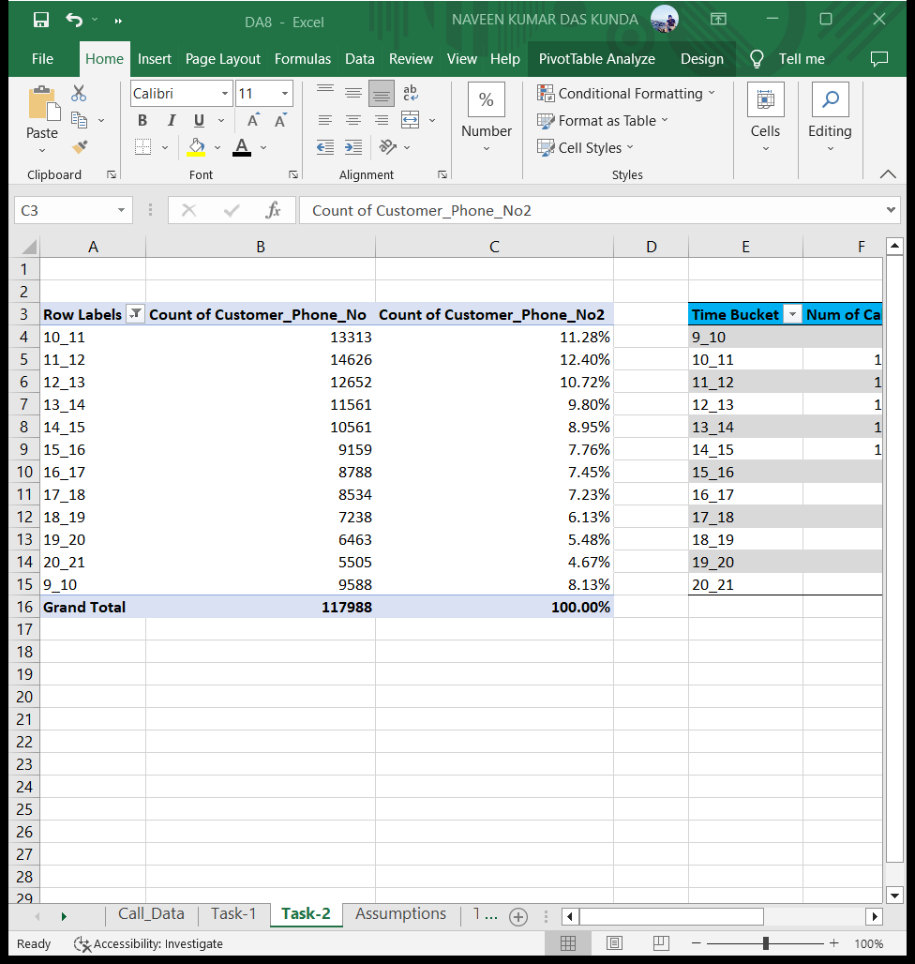

Slide 10
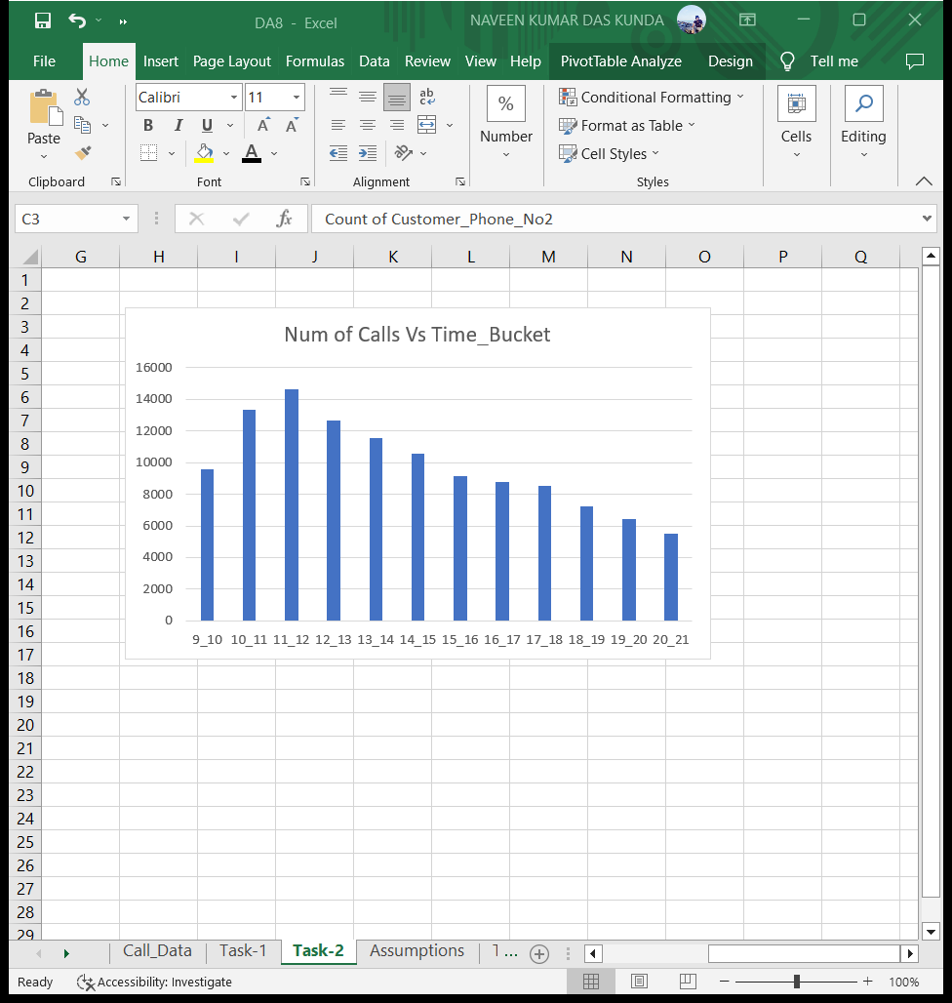
I used column chart to visualize the relation between Number of calls and the Time_Bucket.

Slide 11
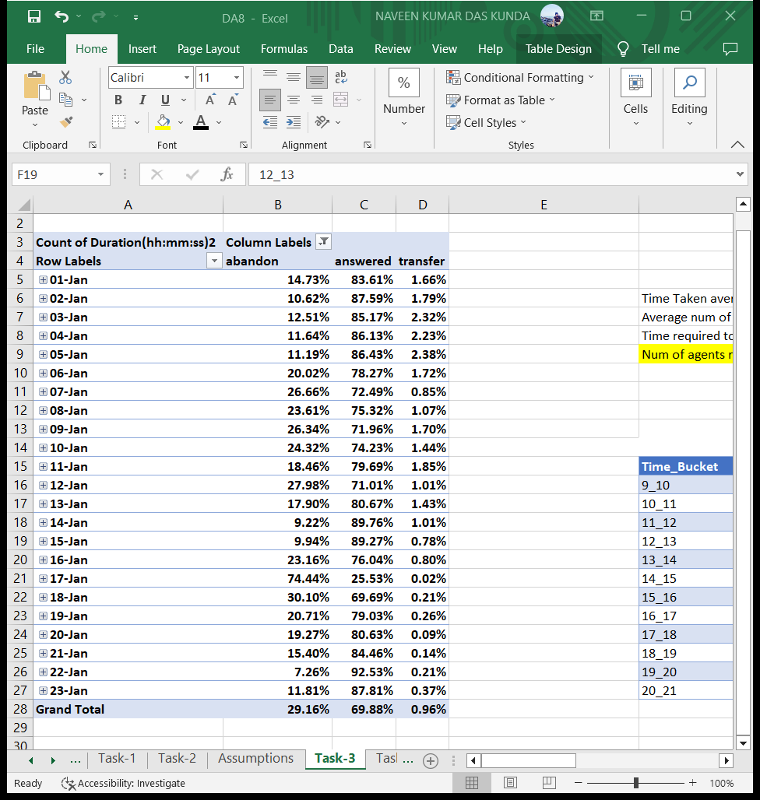
c) As you can see current abandon rate is approximately 30%. Propose a manpower plan required during each time bucket [between 9am to 9pm] to reduce the abandon rate to 10%.(i.e. You have to calculate minimum number of agents required in each time bucket so that at least 90 calls should be answered out of 100).

Slide 12
Assumptions
Working hours of a agent per day is 9hrs.
Time for lunch and snack break is 1.5rs.
Actual working hours of agent=9-1.5=7.5hrs.
Time of agent in a call=4.5hrs.
Total days in a month=30.
Working days of agent per week=6.
Average total unplanned leaves per agent in a month=4.

Slide 13
Based on the previous insights we found average time taken and num of calls per day.
I found the time to answer 90% of calls per day by multiplying average num of calls per day with 0.9 and the result is multiplied with average time taken.we will get result in seconds,converted it into hours.
I found the minimum agents required by dividing the time required to answer 90% of calls with 4.5.

Slide 14
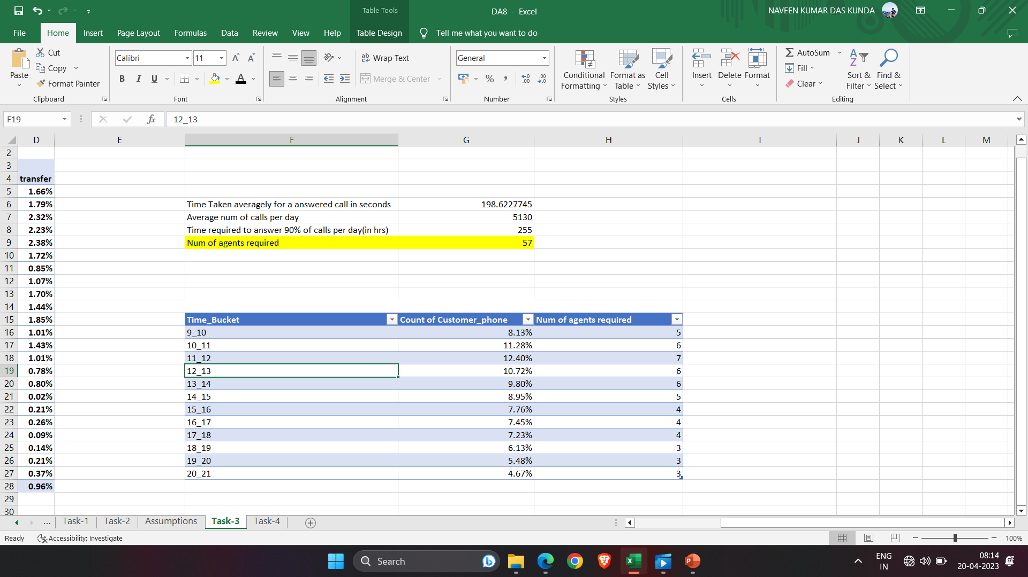

Slide 15
The number of agents required per time_bucket is given below.

Slide 16
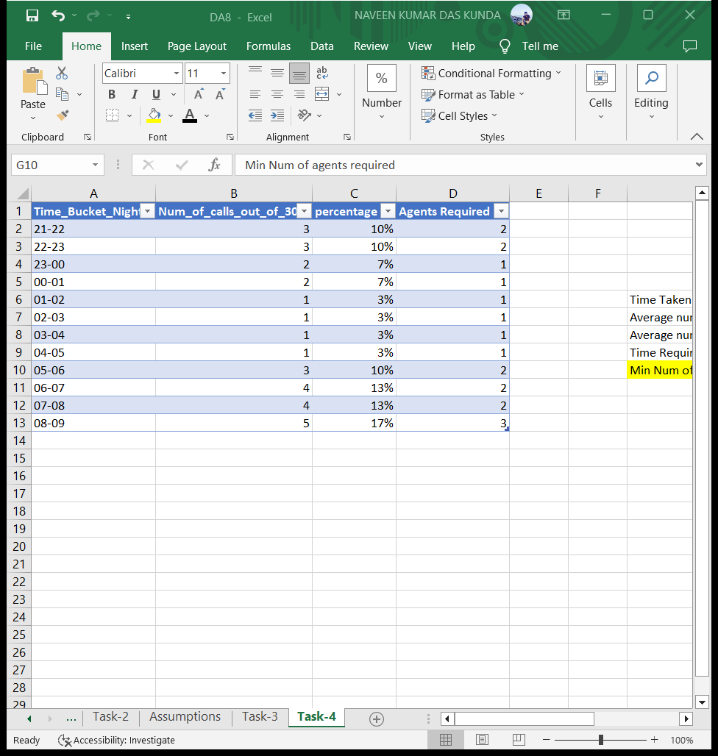
d) Let’s say customers also call this ABC insurance company in night but didn’t get answer as there are no agents to answer, this creates a bad customer experience for this Insurance company. Suppose every 100 calls that customer made during 9 Am to 9 Pm, customer also made 30 calls in night between interval [9 Pm to 9 Am] and distribution of those 30 calls are as follows:
Now propose a manpower plan required during each time bucket in a day. Maximum Abandon rate assumption would be same 10%.

Slide 17
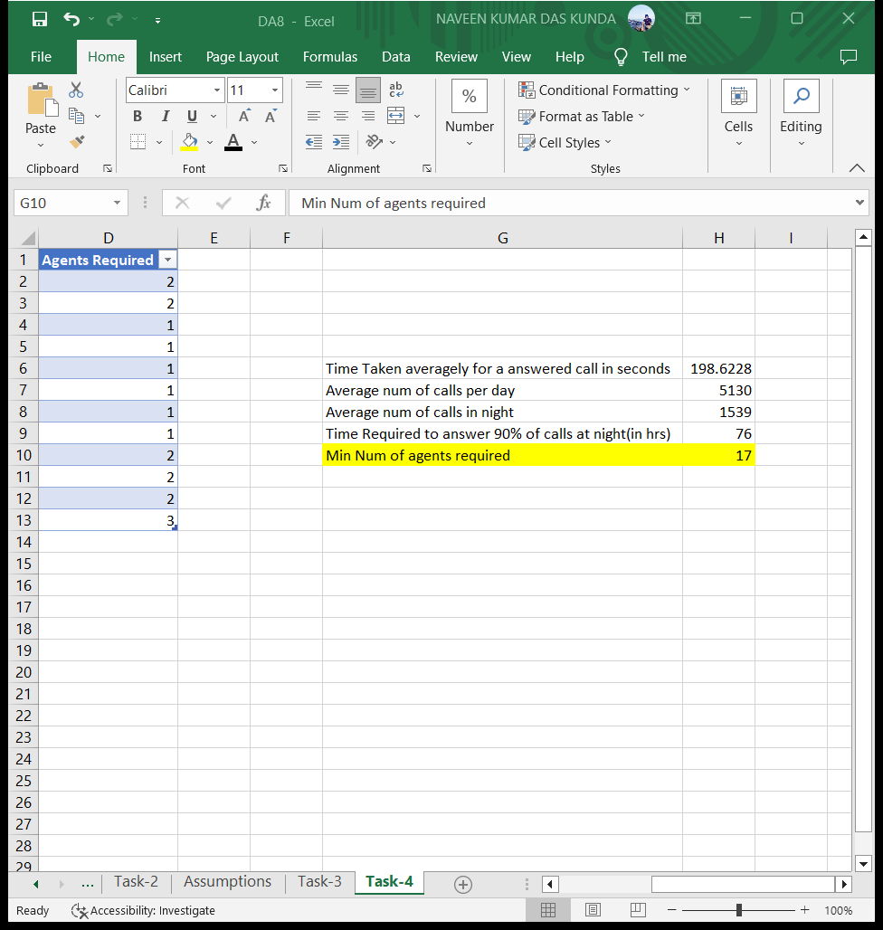
Similar to the previous question,I found the below parameters which are required to answer this question.

Slide 18
The number of agents required per time_bucket at night is given below.

Slide 19
Result
By working on this project,I learnt how a staffing plan in a company might affect their productivity and customer satisfaction.As a data analyst this has helped to get some domain knowledge about customer service team and helped me in deriving useful insights from the analysis which is the main role of a data analyst.

Slide 20
THANK YOU!!!

