Slide 1
Analyzing the Impact of Car Features on Price and Profitability
By:
KUNDA NAVEEN KUMAR DAS

Slide 2
Project Description
The automotive industry has been rapidly evolving over the past few decades, with a growing focus on fuel efficiency, environmental sustainability, and technological innovation.
With increasing competition among manufacturers and a changing consumer landscape, it has become more important than ever to understand the factors that drive consumer demand for cars.
A data analyst could provide valuable insights to a car manufacturer and help them optimize their pricing and product development decisions to maximize profitability while meeting consumer demand.

Slide 3
Approach
I downloaded and understand the dataset that is provided.
I filled the nulls using mode.
I gave insights accordingly to the questions.
I used visualisation for better understanding.

Slide 4
Tech-Stack Used
I used MSExcel to finish this project and I used data analysis toolkit to perform regression analysis.

Slide 5
Insights
Data cleaning:
I find the null values present in the dataset.
I filled those null values with mode value of that column because we can’t use mean because the columns like num of doors,num of cylinders,HP cannot be in decimal.

Slide 6
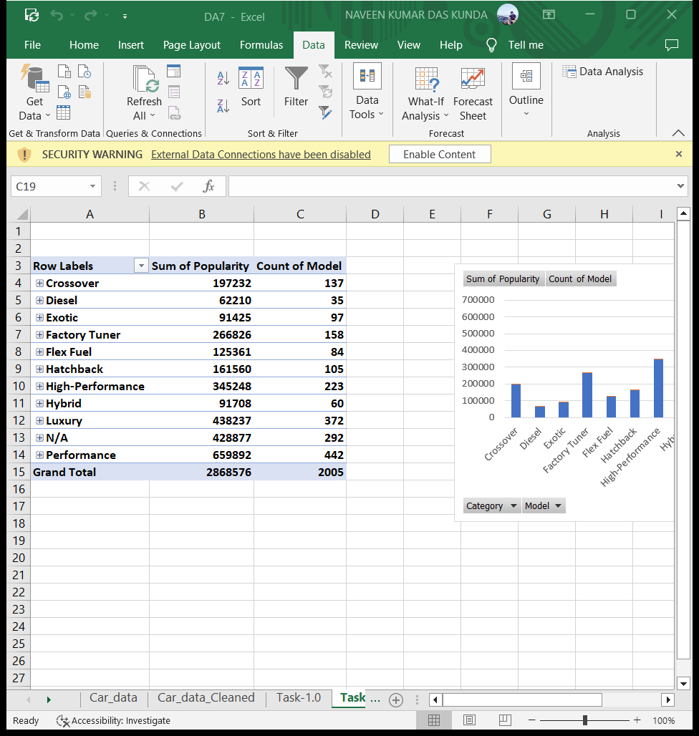
I used the pivot table to get the number of car models in each market category and their corresponding popularity scores.
The count of models is higher for performance category.

Slide 7
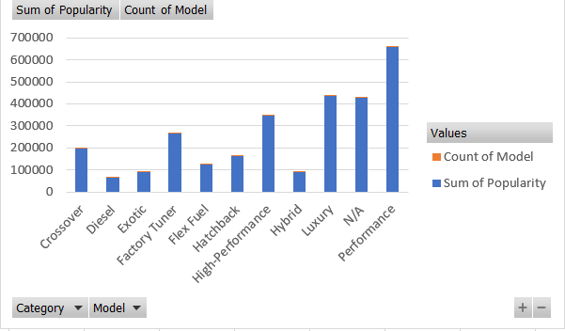
I used stacked column chart to plot the relationship between market category,sum of popularity and the count of models in each category.

Slide 8
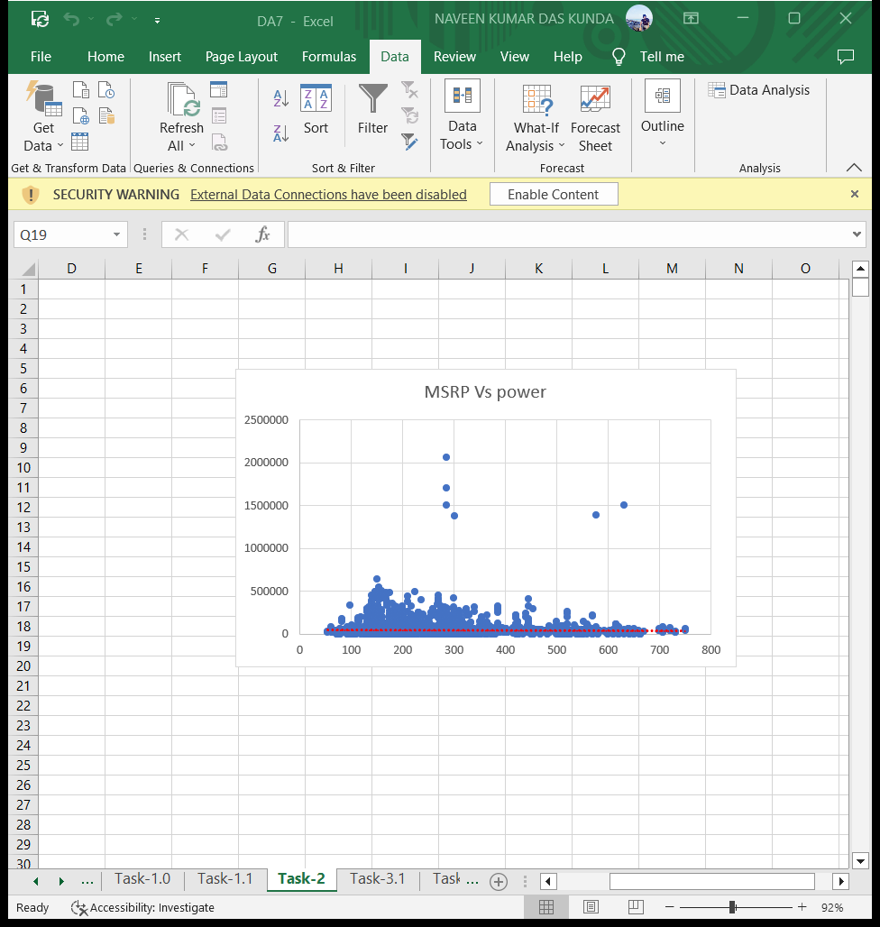
I used scatter chart to plot engine power on the x-axis and price on the y-axis. I added a trendline(which is red color in the chart) to the chart to visualize the relationship between these variables

Slide 9
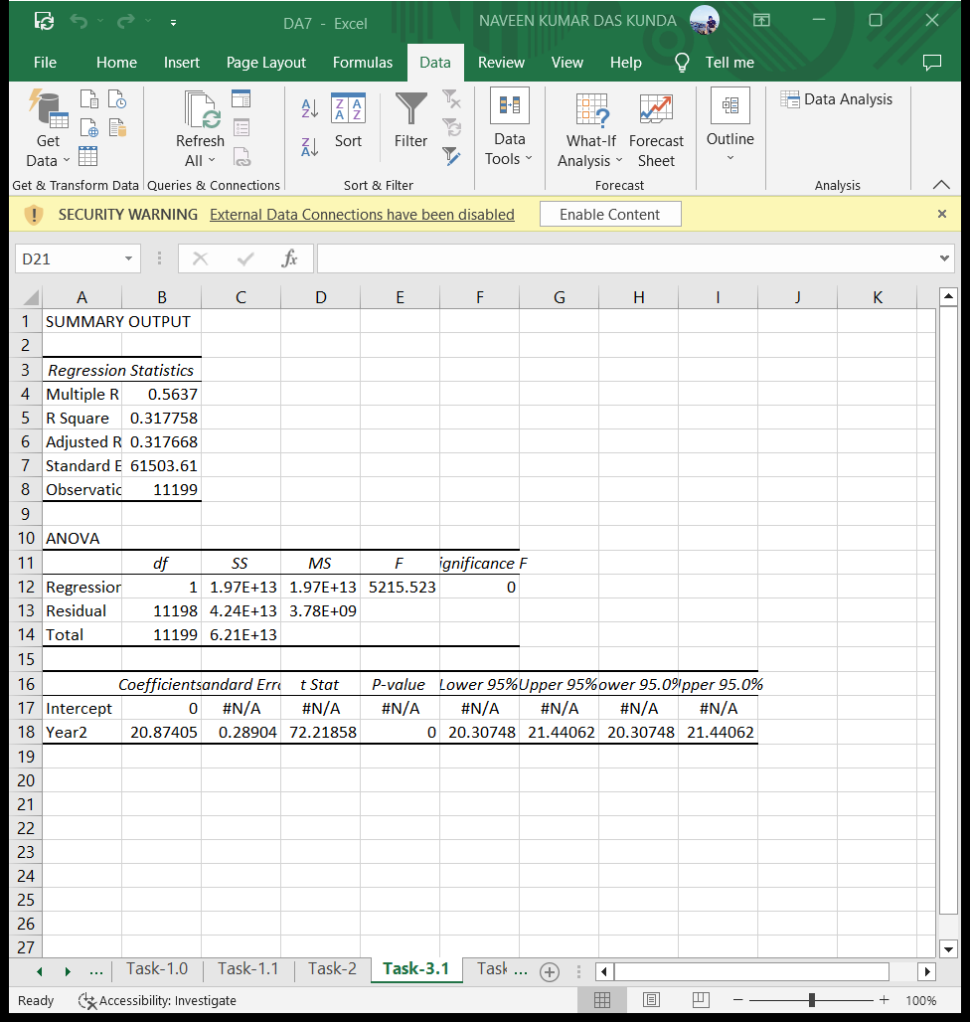
I used data analysis toolkit to perform the regression analysis. I performed the regression analysis on price with every other numerical column. The summary output of year variable is given below.

Slide 10
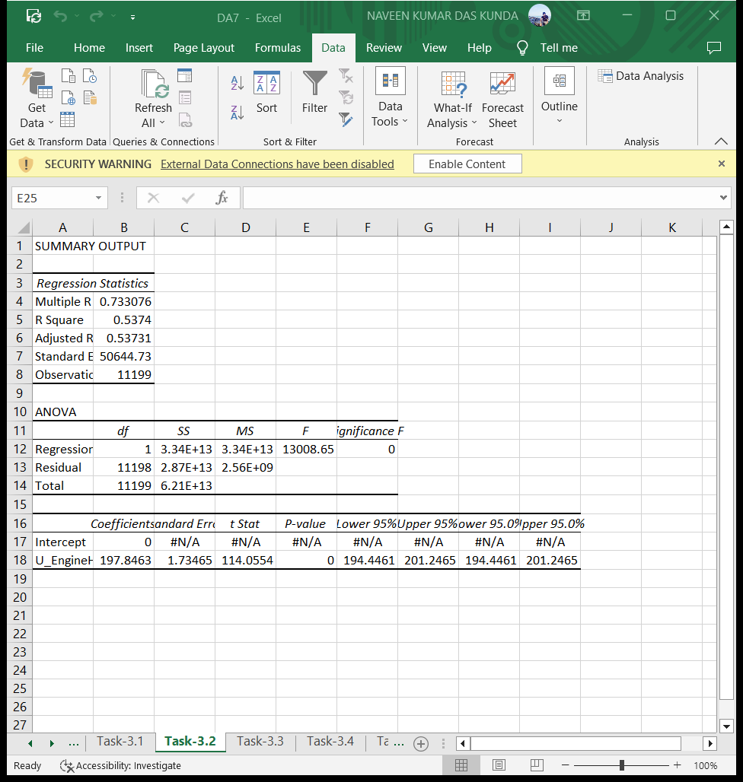
The summary output of EngineHP variable is given below.

Slide 11
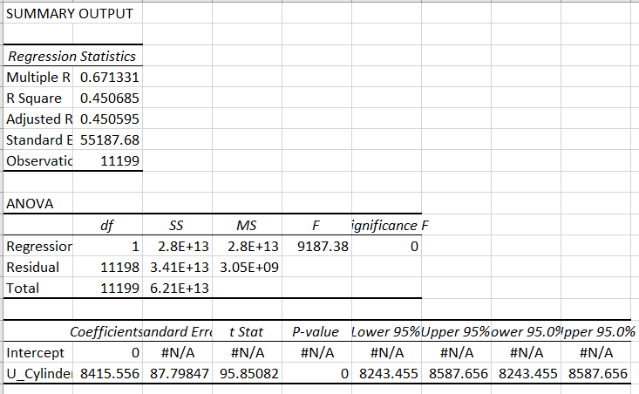
The summary output of Num_of_cylinders variable is given below.

Slide 12
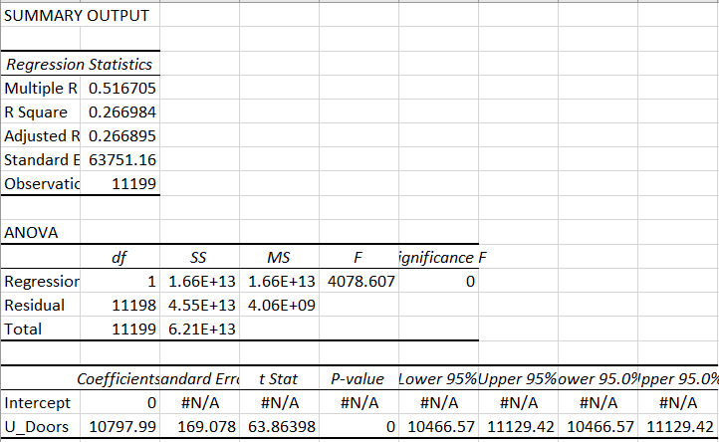
The summary output of Num_of_doors variable is given below.

Slide 13

The summary output of highwayMPG variable is given below.

Slide 14

The summary output of cityMPG variable is given below.

Slide 15
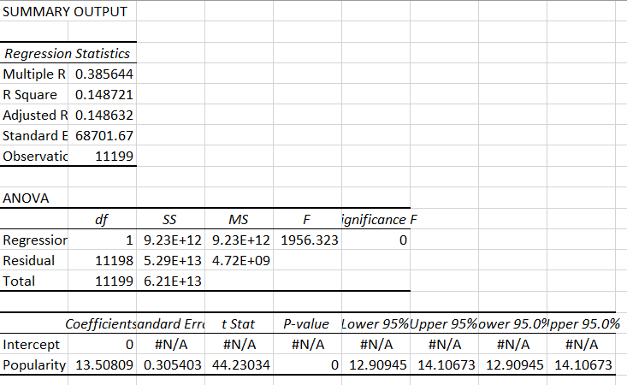
The summary output of Popularity variable is given below.

Slide 16
INFERENCE
The term multiple R gives the relation between variables the higher the multiple R means the stronger the relation.
From all the above summary outputs,we can say that the multiple R value is higher between price and Engine HP.
The varibles price and EngineHP has the strongest relationship.

Slide 17
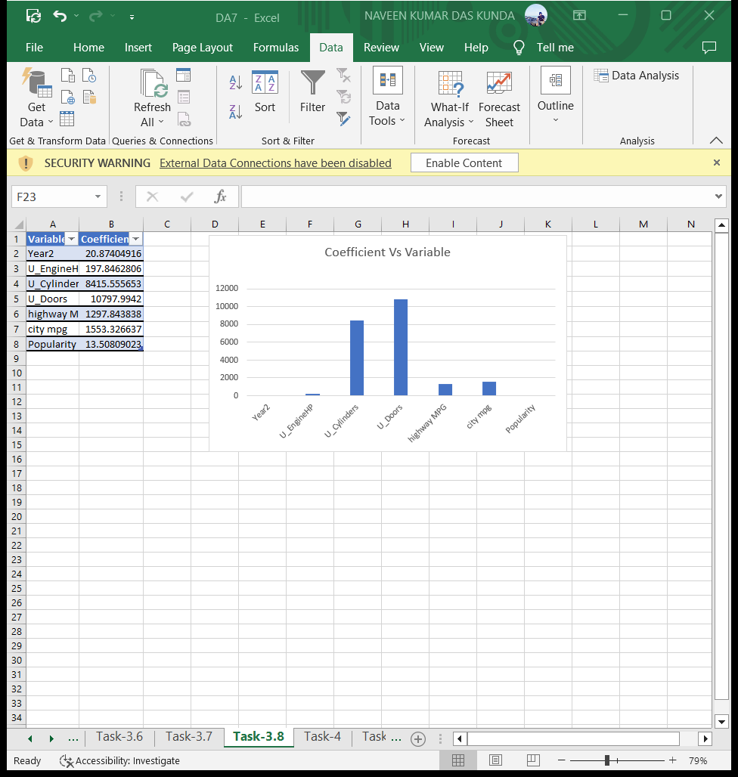
I used bar chart to show the coefficient values for each variable to visualize their relative importance.

Slide 18
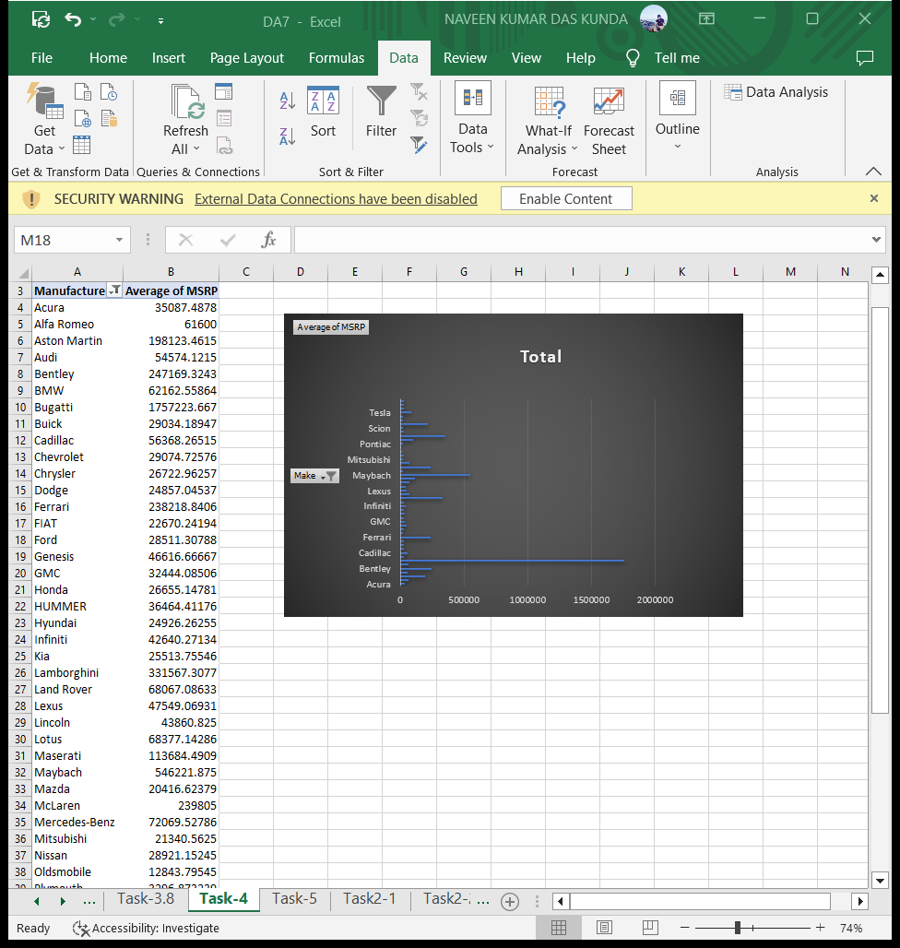
The Average price of cars for each manufacturer is given below.

Slide 19
I used bar chart to visualize the relationship between manufacturer and average price. The average price of buggati is high.

Slide 20
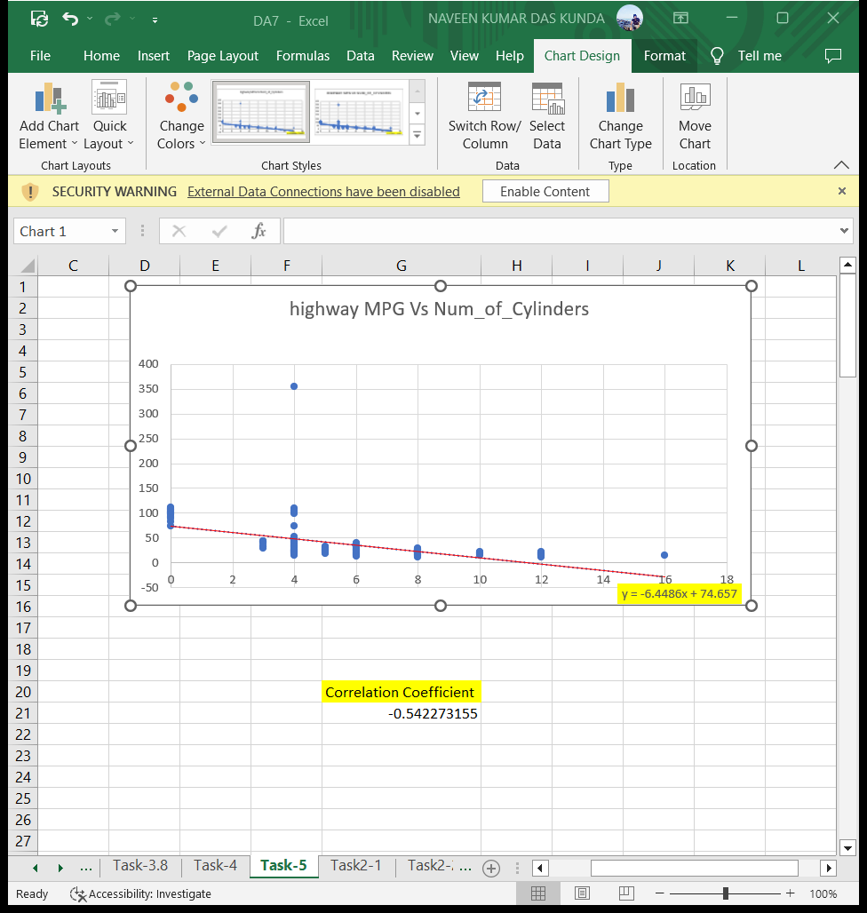
I used scatter plot to visualize the number of cylinders on the x-axis and highway MPG on the y-axis. I created trendline(red color) on the scatter plot to visually estimate the slope of the relationship and assess its significance. The equation of trendline is also shown and highlighted with yellow color at the end.

Slide 21
The correlation coefficient between the number of cylinders and highway MPG is –0.54. The correlation coefficient is negative that means if num of cylinders increases the highway mpg decreases and viceversa.

Slide 22
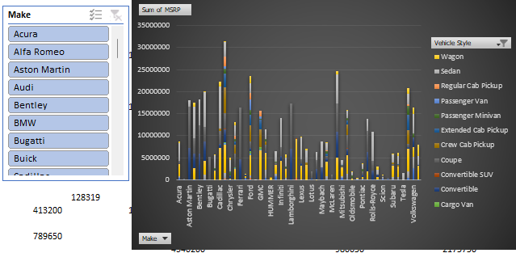
I used pivot table and Stacked column chart to show the distribution of car prices by brand and body style. I used slicer of brands to make the chart interactive.

Slide 23
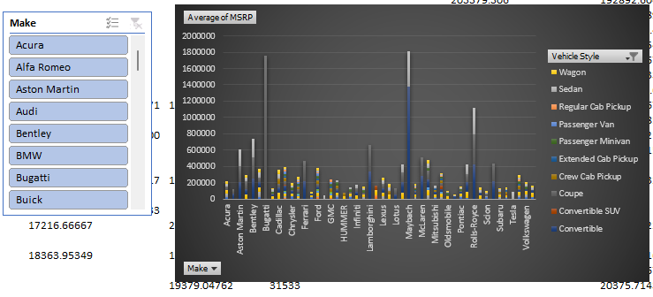
I used pivot table and stacked column chart to compare the average MSRPs across different car brands and body styles. I used slicer of brands to make the chart interactive.

Slide 24
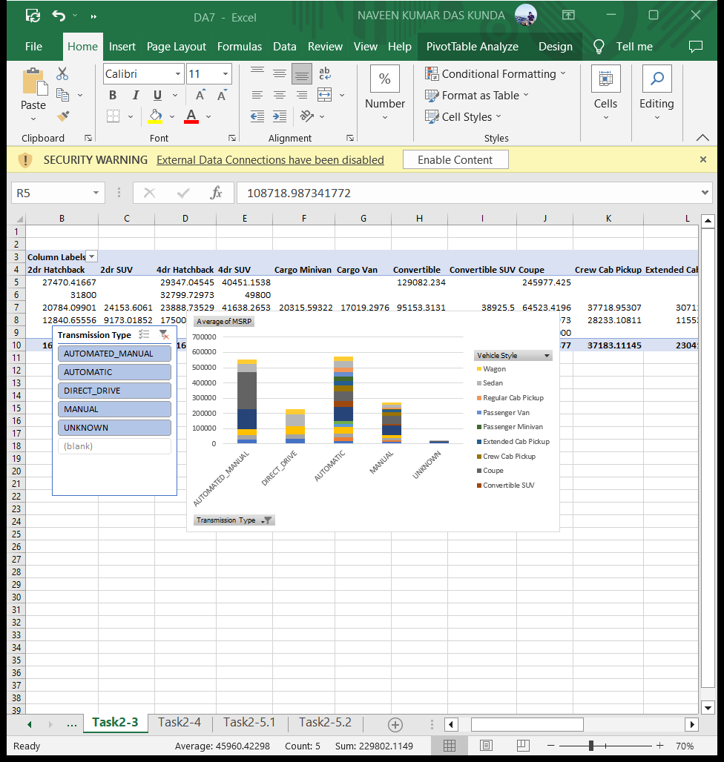
I used pivot table and Stacked column chart to visualize the relationship between MSRP and transmission type. I used slicer for transmission type to make chart interactive.

Slide 25
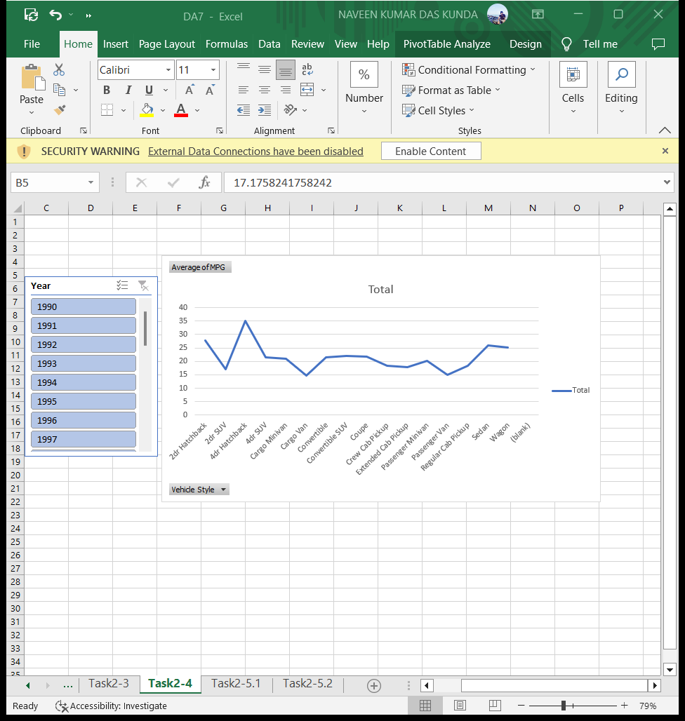
I calculated the fuel efficiency by doing the average of highway MPG and city MPG. I used pivot table and Line chart to show the trend of fuel efficiency (MPG) over time for each body style.

Slide 26
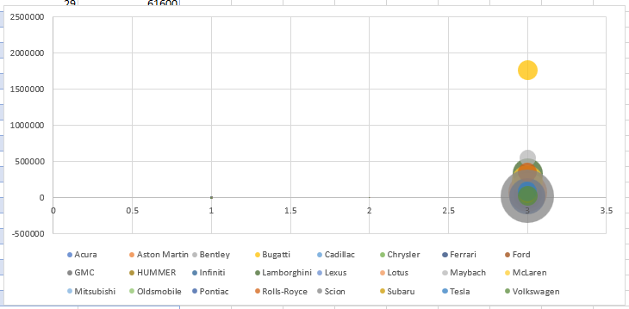
I used Bubble chart to visualize the relationship between horsepower, MPG, and price across different car brands.

Slide 27
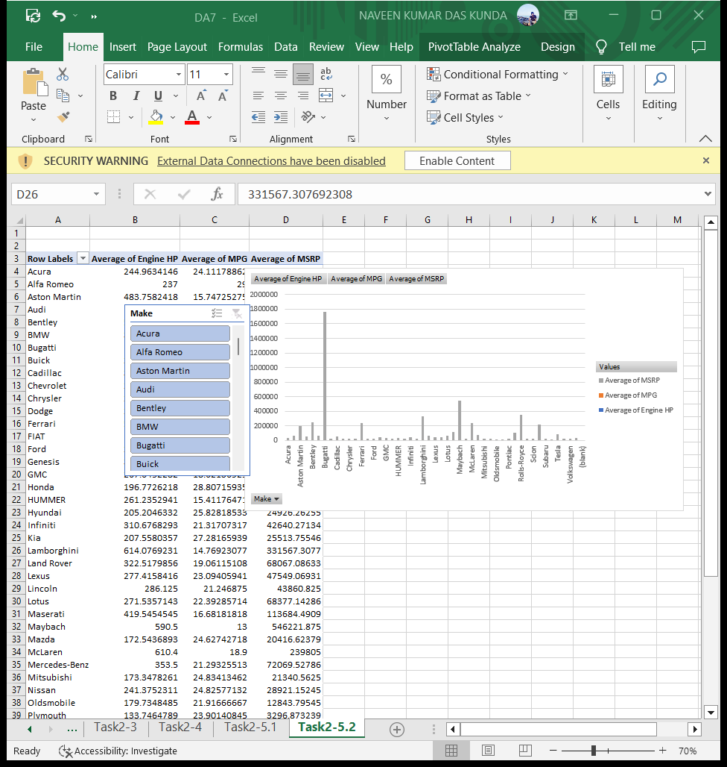
The bubble chart looks clumsy that is why I am stacked column chart to visualise and brand as slicer.

Slide 28
Result
From all the insights provided above we can say that the price of the car mainly depends on Engine Hp and the mpg.The maximum average price is for the buggati brand.

Slide 29
THANK YOU!!!

