Slide 1
Hiring Process Analytics
BY:
KUNDA NAVEEN KUMAR DAS

Slide 2
Project Description
Hiring process is the fundamental and the most important function of a company. Here, the MNCs get to know about the major underlying trends about the hiring process.
Trends such as- number of rejections, number of interviews, types of jobs, vacancies etc. are important for a company to analyse before hiring freshers or any other individual.
Thus, making an opportunity for a Data Analyst job here too!

Slide 3
Approach
At first I studied the database and understand.
I did the necessary exploratory data analysis.
After that I understand the questions and gave insights for those questions using dataset and MSExcel.

Slide 4
Tech-Stack Used
In this project I used MSExcel to give insights about the data.

Slide 5
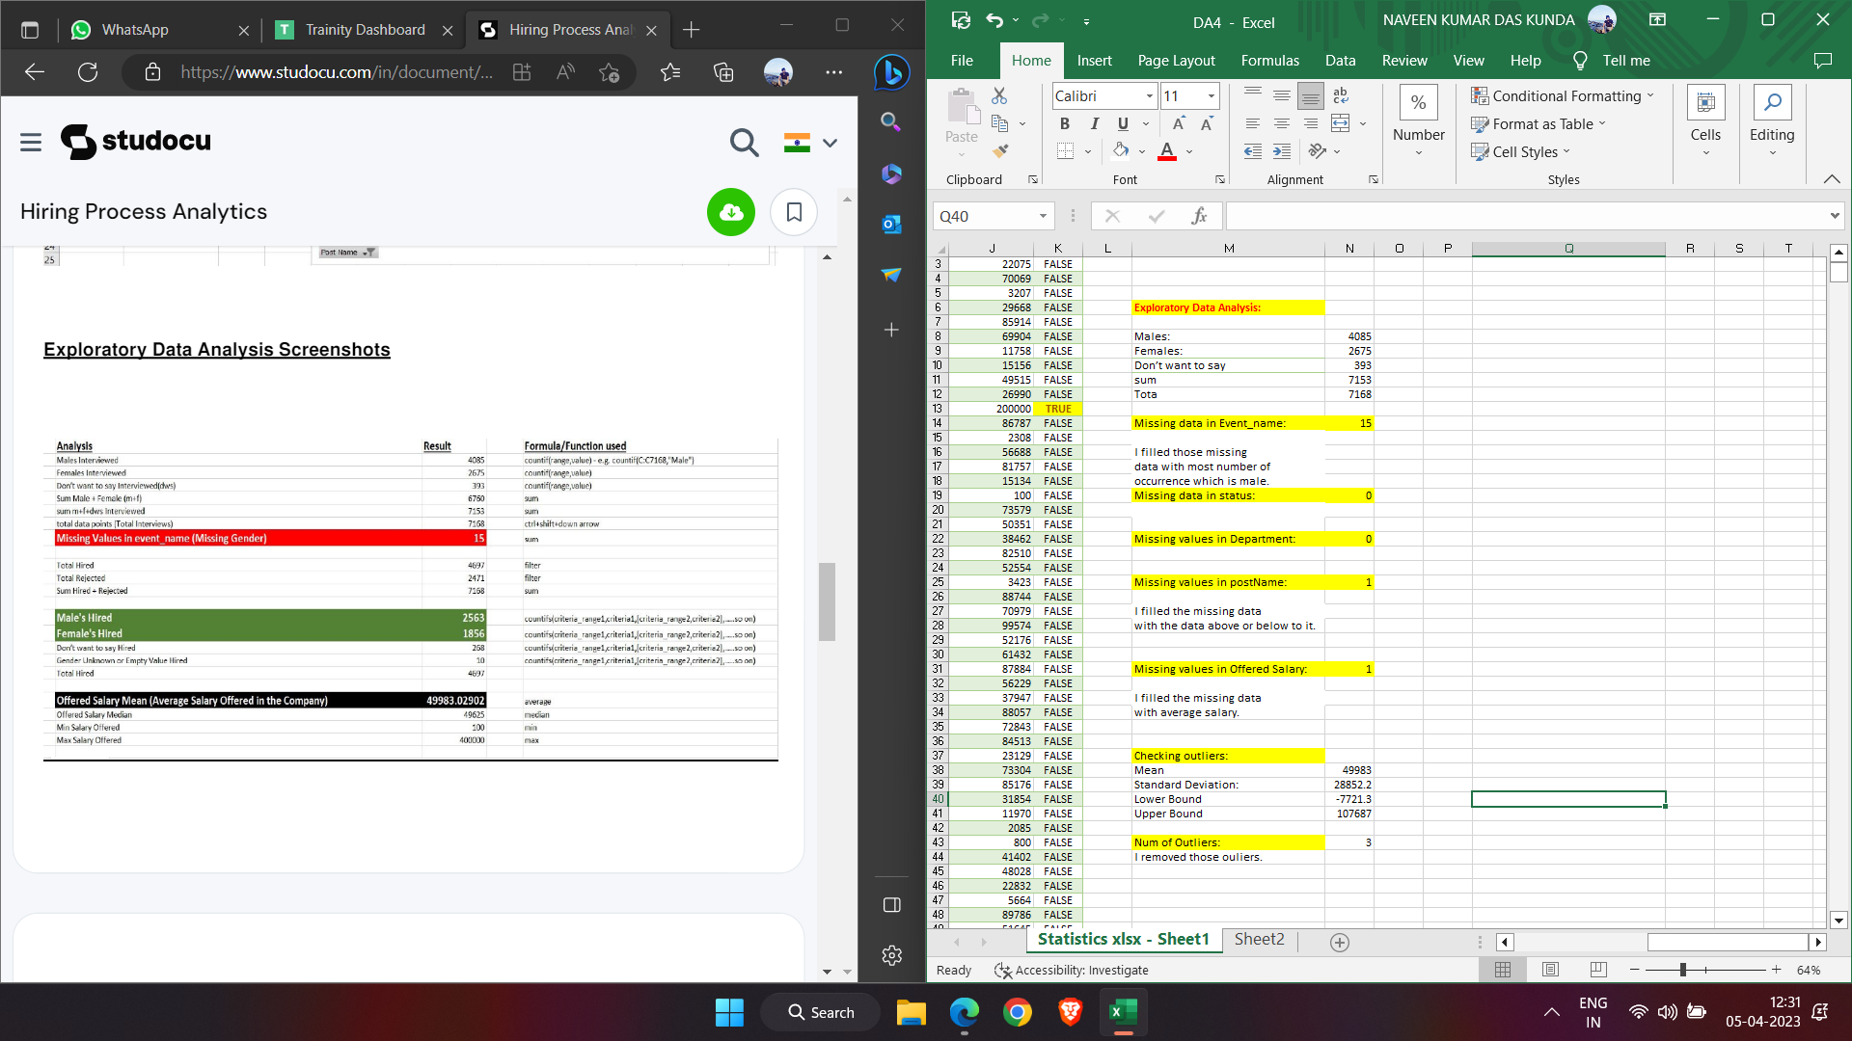
Exploratory Data Analysis
Checking for missing data

Slide 6
Checking outliers:
I used mean and standard deviation to find the outliers.

Slide 7
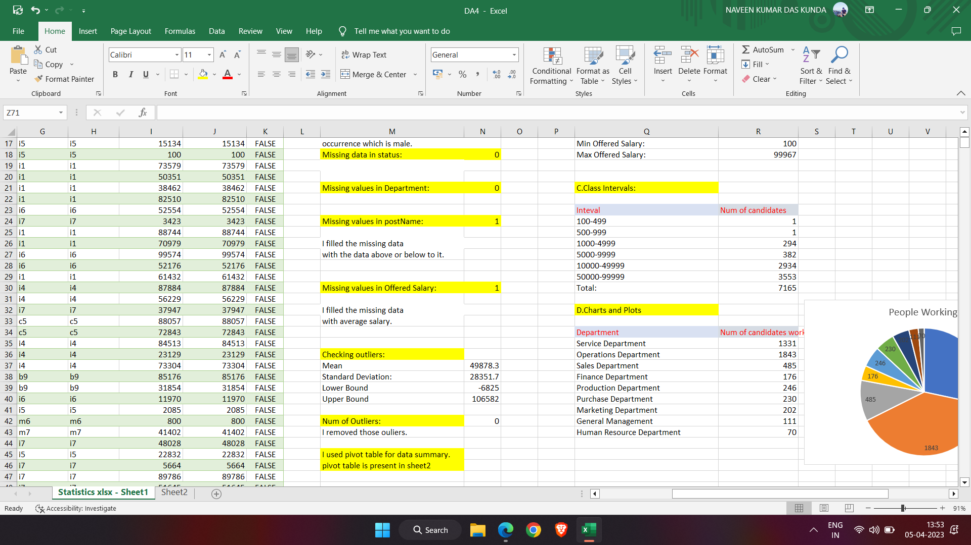
After removing the outliers:

Slide 8
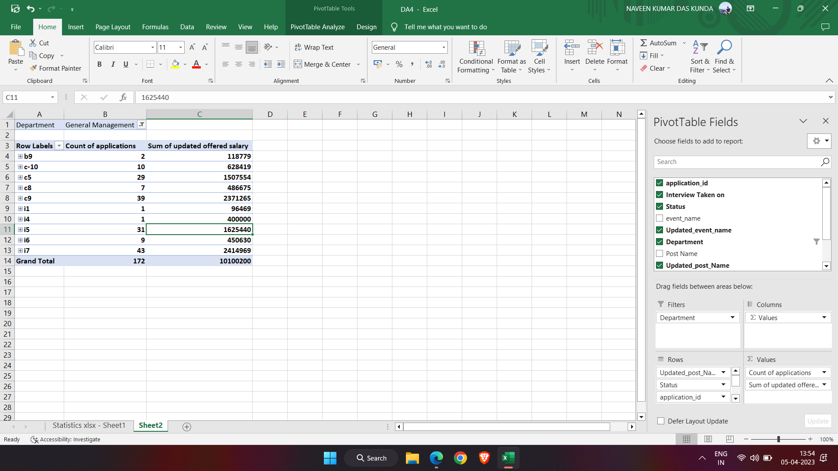
Drawing data summary
I used pivot table for data summary.

Slide 9
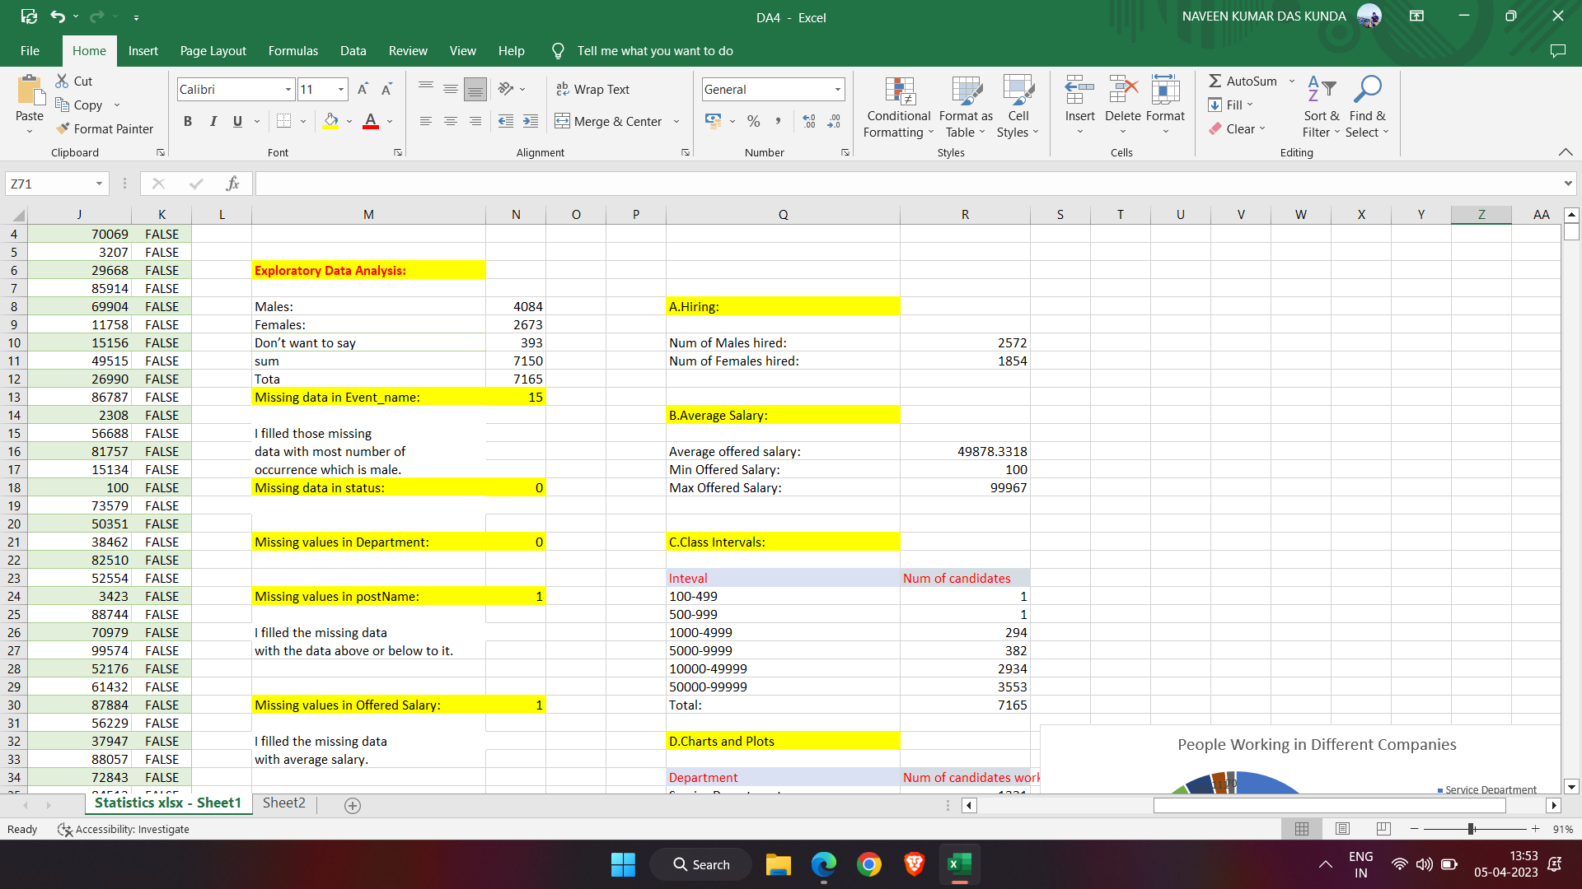
Insights
Hiring:
Num of males and females are Hired.

Slide 10
Average Salary:
Adding all the salaries for a select group of employees and then dividing the sum by the number of employees in the group

Slide 11
Class intervals:
The class intervals for salary in the company.

Slide 12
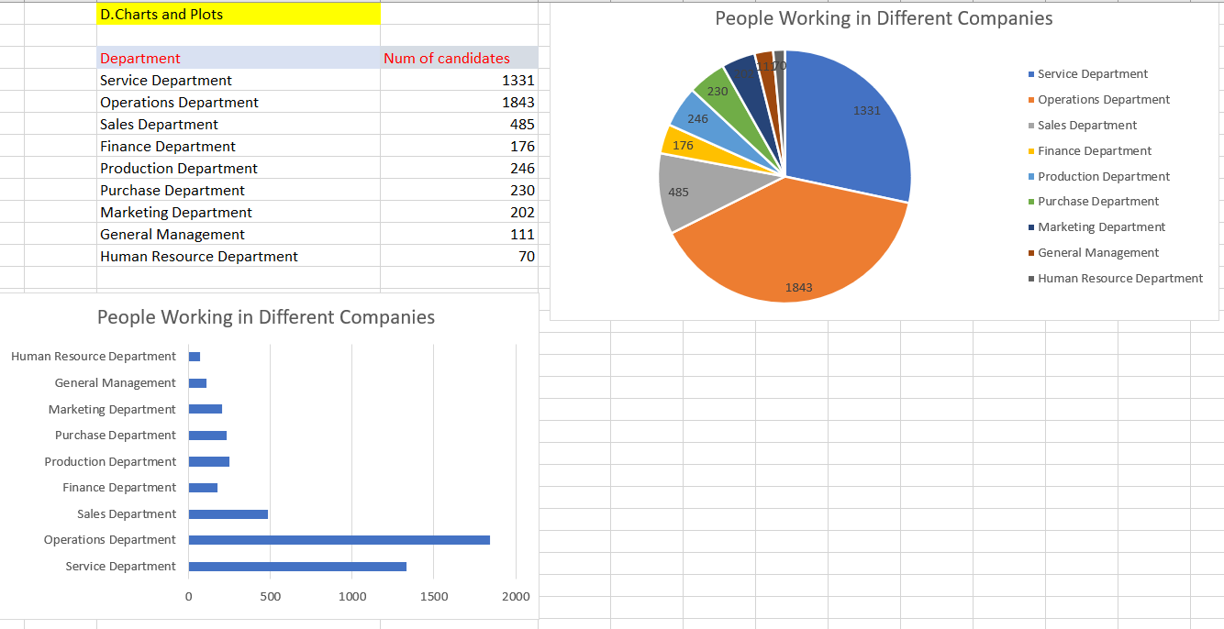
Charts and plots:
Pie Chart and Bar Graph to show proportion of people working different department.

Slide 13
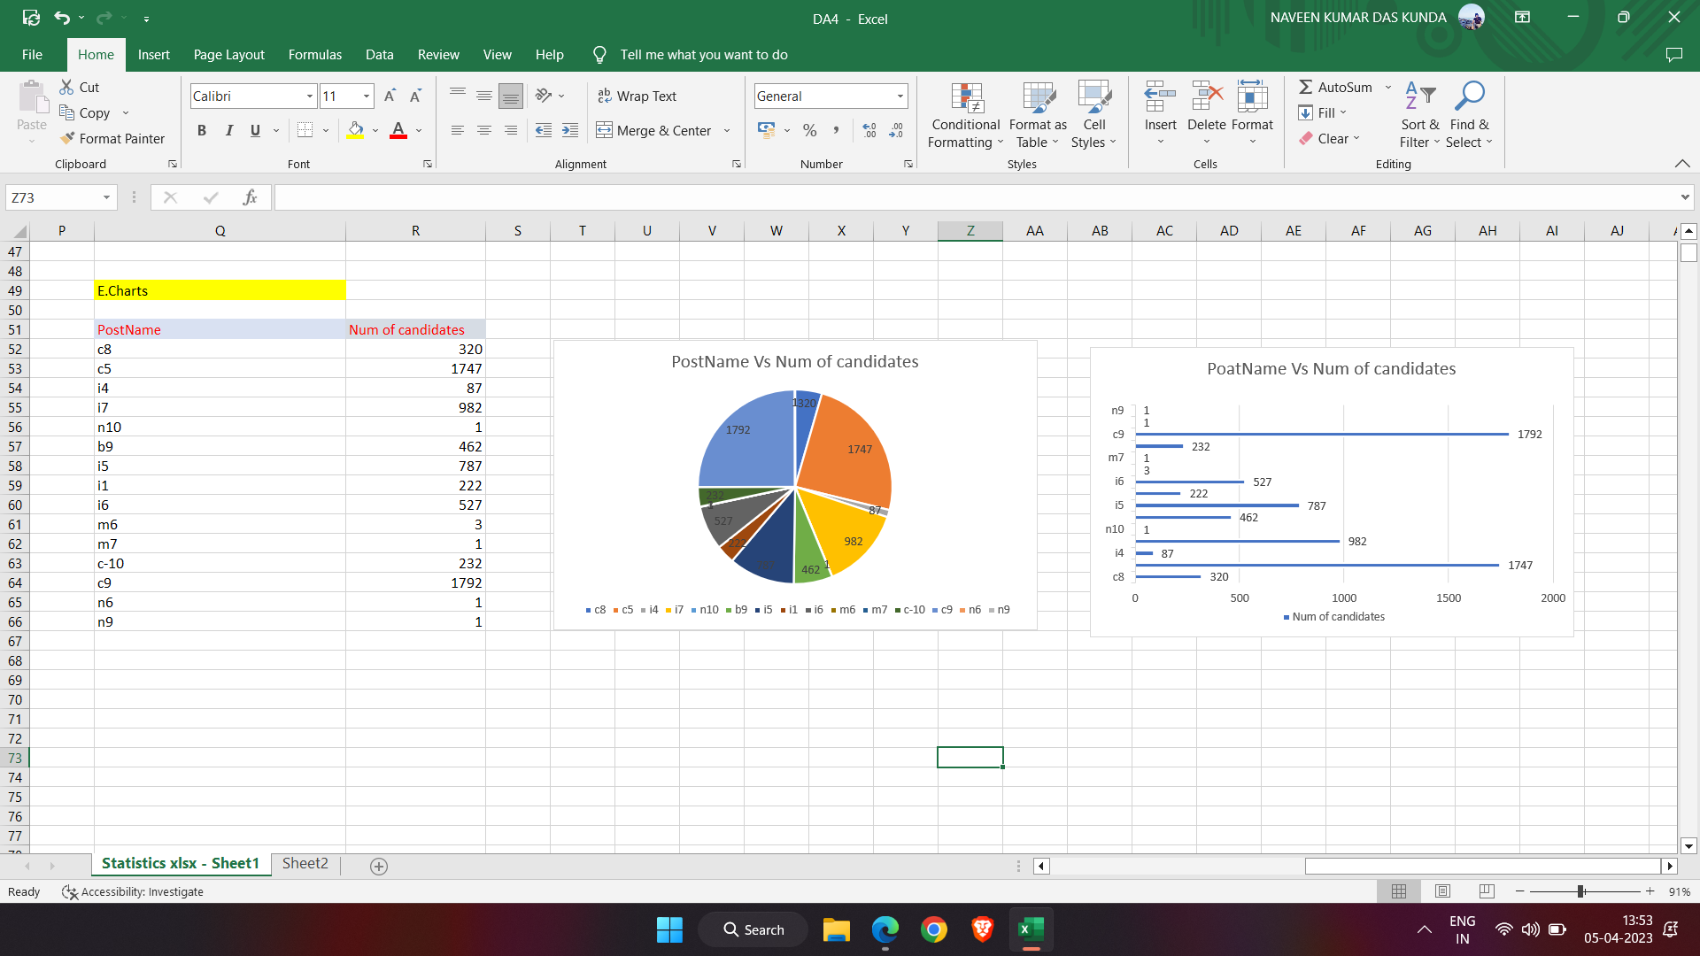
Charts:
Representation of different post tiers using chart and graph.

Slide 14
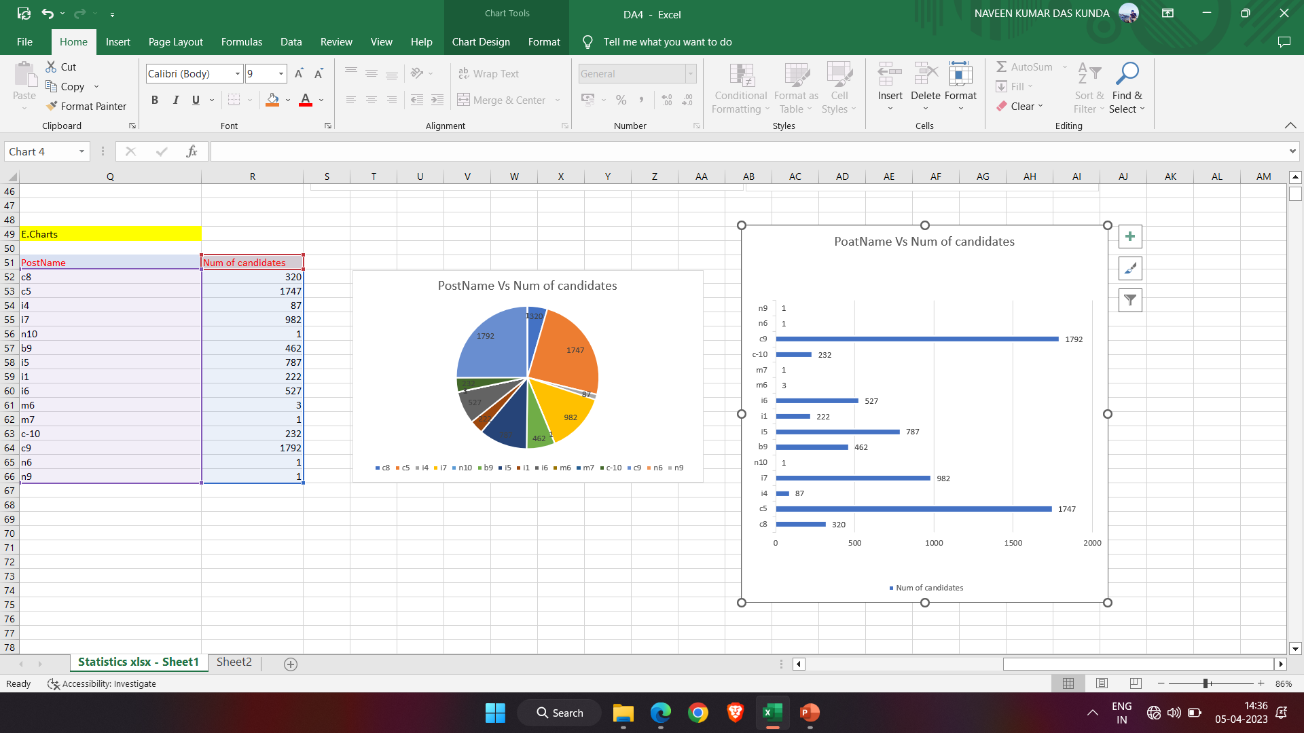

Slide 15
Result:
While making the project I achieved in finding the trends in hiring process and gave insights to the company.By doing this,I gained a deep knowledge about excel and how it is used.
Link for Excel
https://docs.google.com/spreadsheets/d/1PYcXfqY21kqWbbHMdtIYrFHnBDzTDLOR/edit?usp=share_link&ouid=113396113522280131351&rtpof=true&sd=true

Slide 16
THANK YOU!!!

