Slide 1
IMDB Movie Analysis
By:
KUNDA NAVEEN KUMAR DAS

Slide 2
Project Description
We have given with imdb movie dataset which has details about moives.
The details are: movie_name.director_name,title,release_year,Actor_name,budget,Gross etc.
By using this dataset,we need to give insights .

Slide 3
Approach
Download the Data provided
Understanding the data
Give insights accordingly.

Slide 4
Tech-Stack Used
I used MSEXCEL to give insights.

Slide 5
Data Cleaning
Insights
Found the null values for every column using countblank().
Drop the columns that are not necessary.
I dropped the columns which are highlighted in below picture.
Removed the duplicate rows.
Convert the dollars into million dollars for easy evaluation.
Filled the null values for numerical columns with their average.

Slide 6
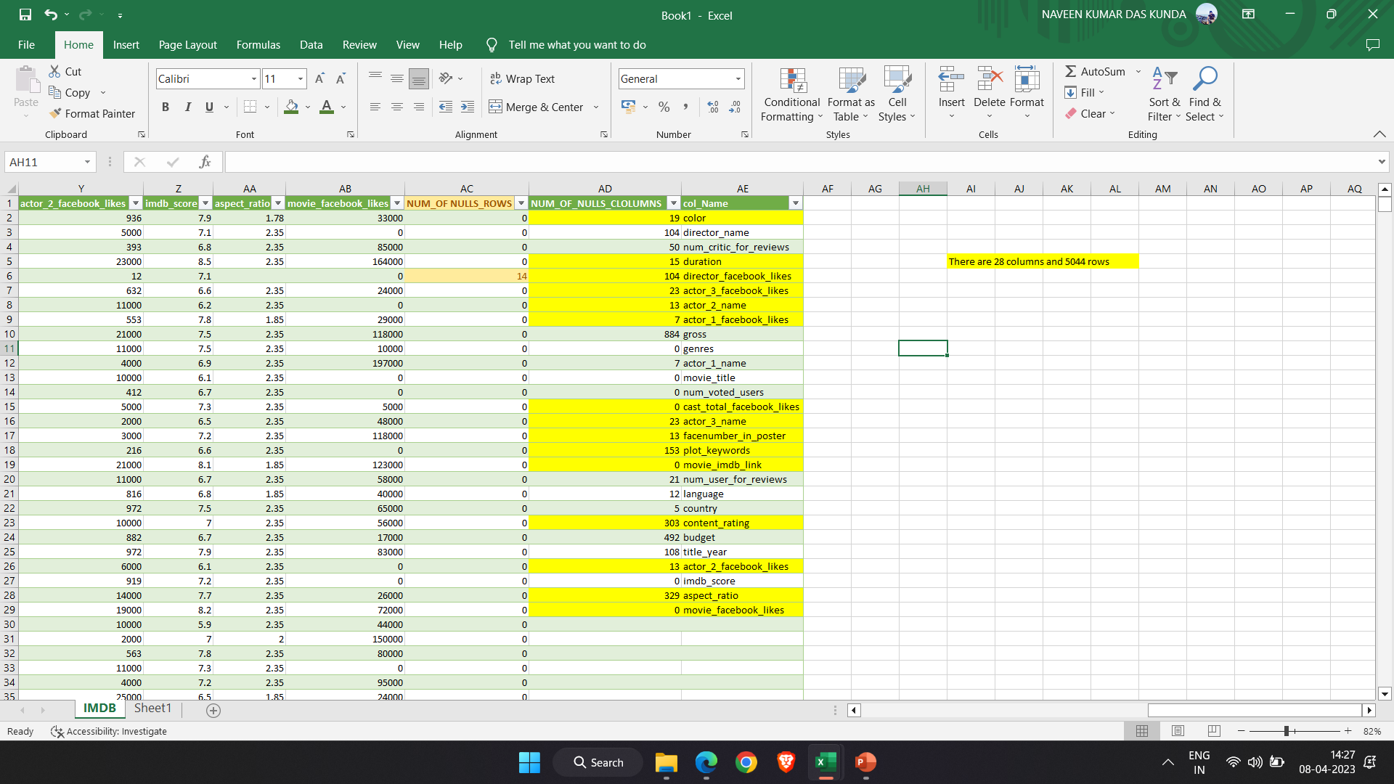

Slide 7
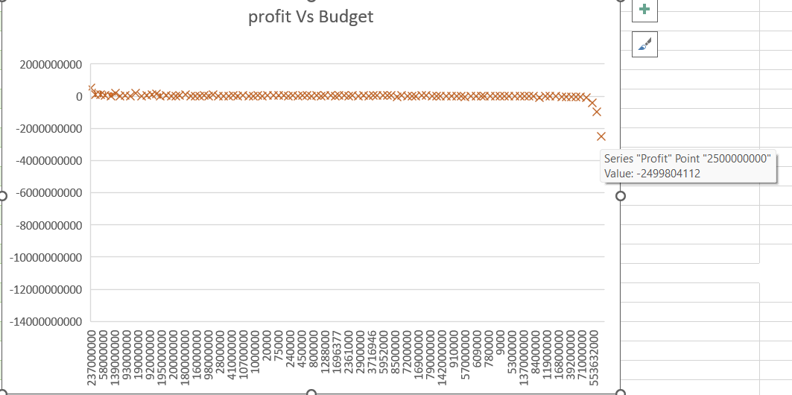
The chart for ouliers is given below.
I used Box and Whisker chart.The outlier is given in chart.

Slide 8
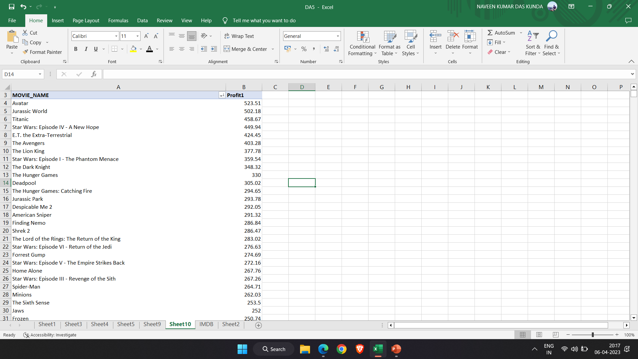
Movies with highest profit
Created a column profit which is the difference between gross and budget.
The most profited movie is: Avatar.

Slide 9
Top 250
I used pivot table to get top 250 imdb rated movies which has number of voted users
are greater than 25,000.
The list of top 30 movies are given below in the screenshot.
For remaining visit the excel link.
The top movie is THE SHAWSHANK REDEMPTION.

Slide 10
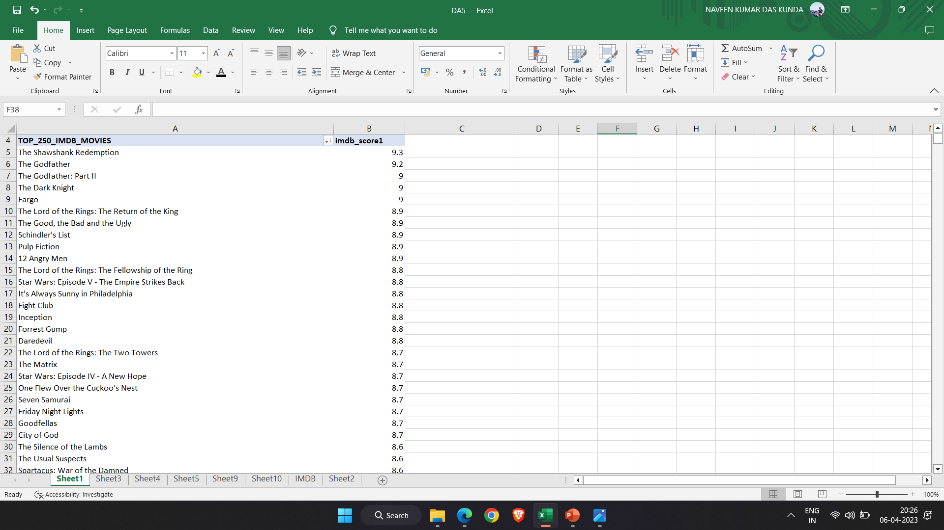

Slide 11
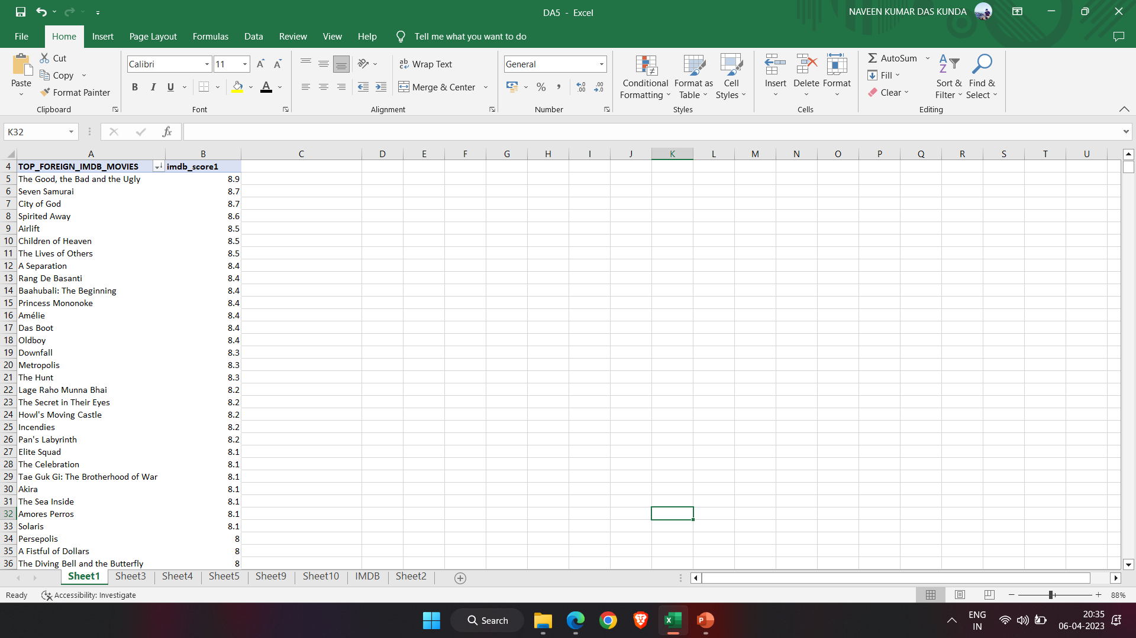
The foreign movies in that top 250 imdb rated movies are given below.
The top movie is THE GOOD,THE BAD AND THE UGLY.

Slide 12
Best Directors
I used pivot table to get directiors who has the mean of the imdb score of their movies is higher.
From the pivot table I calculated mean of imdb score of every director.
From the picture below,we can see that the name of the director and the list of movies he did.
The average is calculated as sum of imdb scores divided with num of movies.
We can also see the count of movies sorted in descending order of average of imdb score.
I copied the top 10 directors and pasted in IMDB worksheet.After that I sorted the directors based on their names.
I think I made it clear.

Slide 13
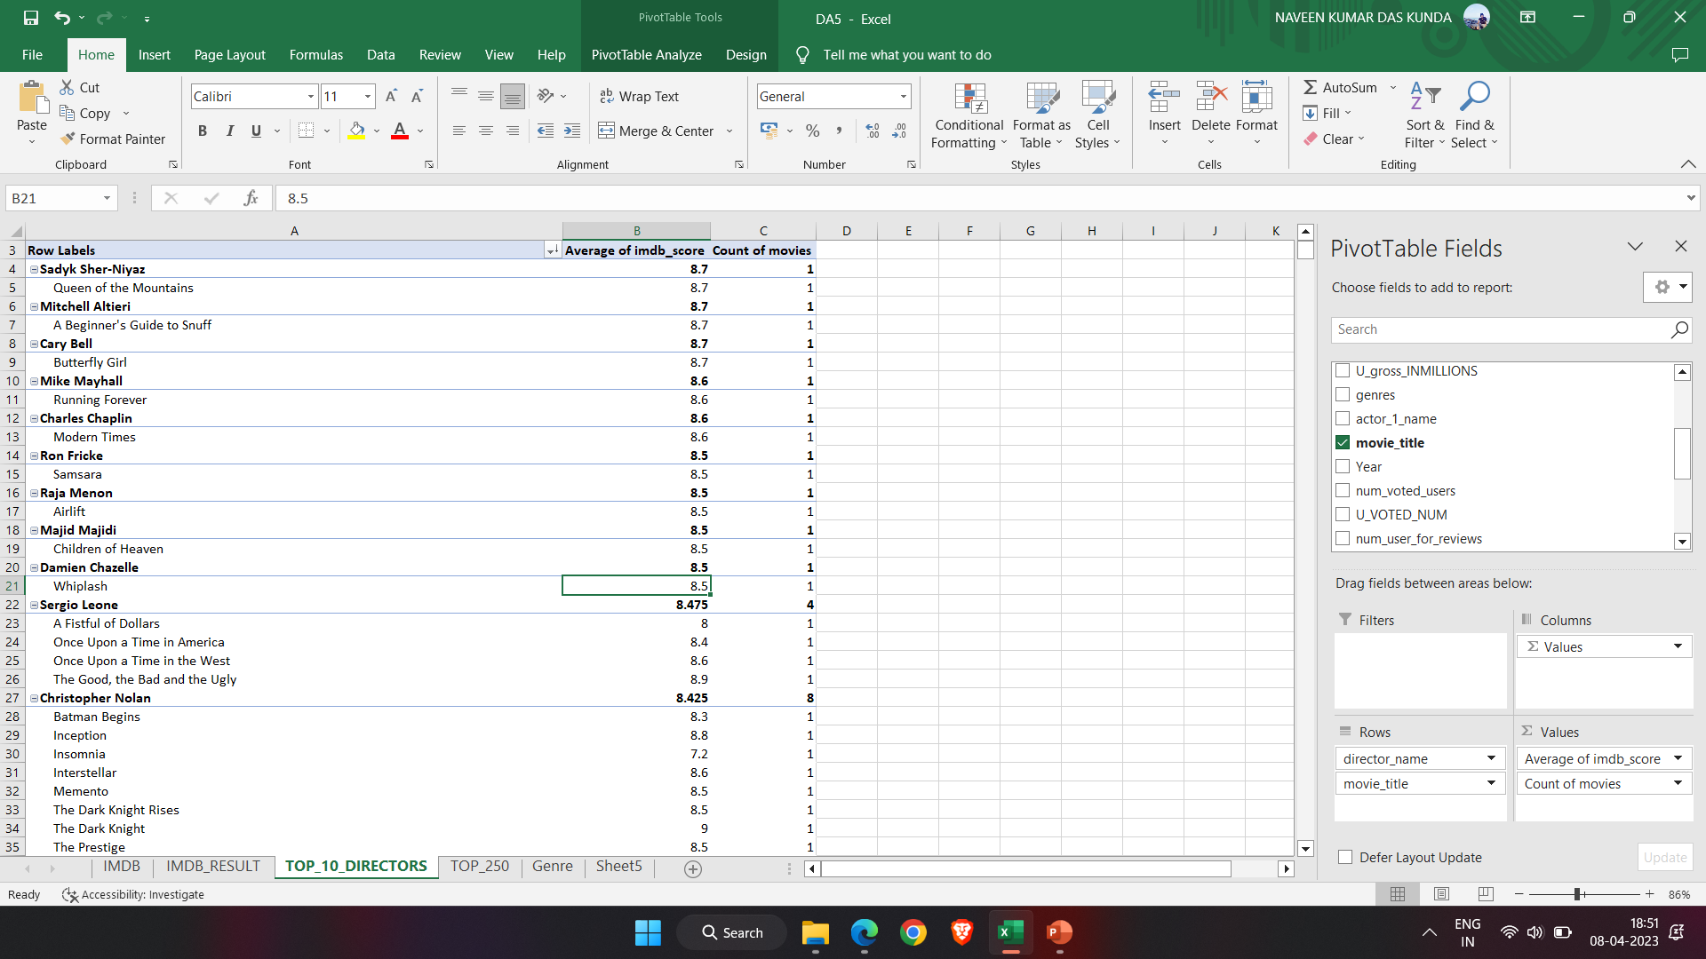
The director with high mean imdb score is SADYK SHER-NIYAZ.

Slide 14
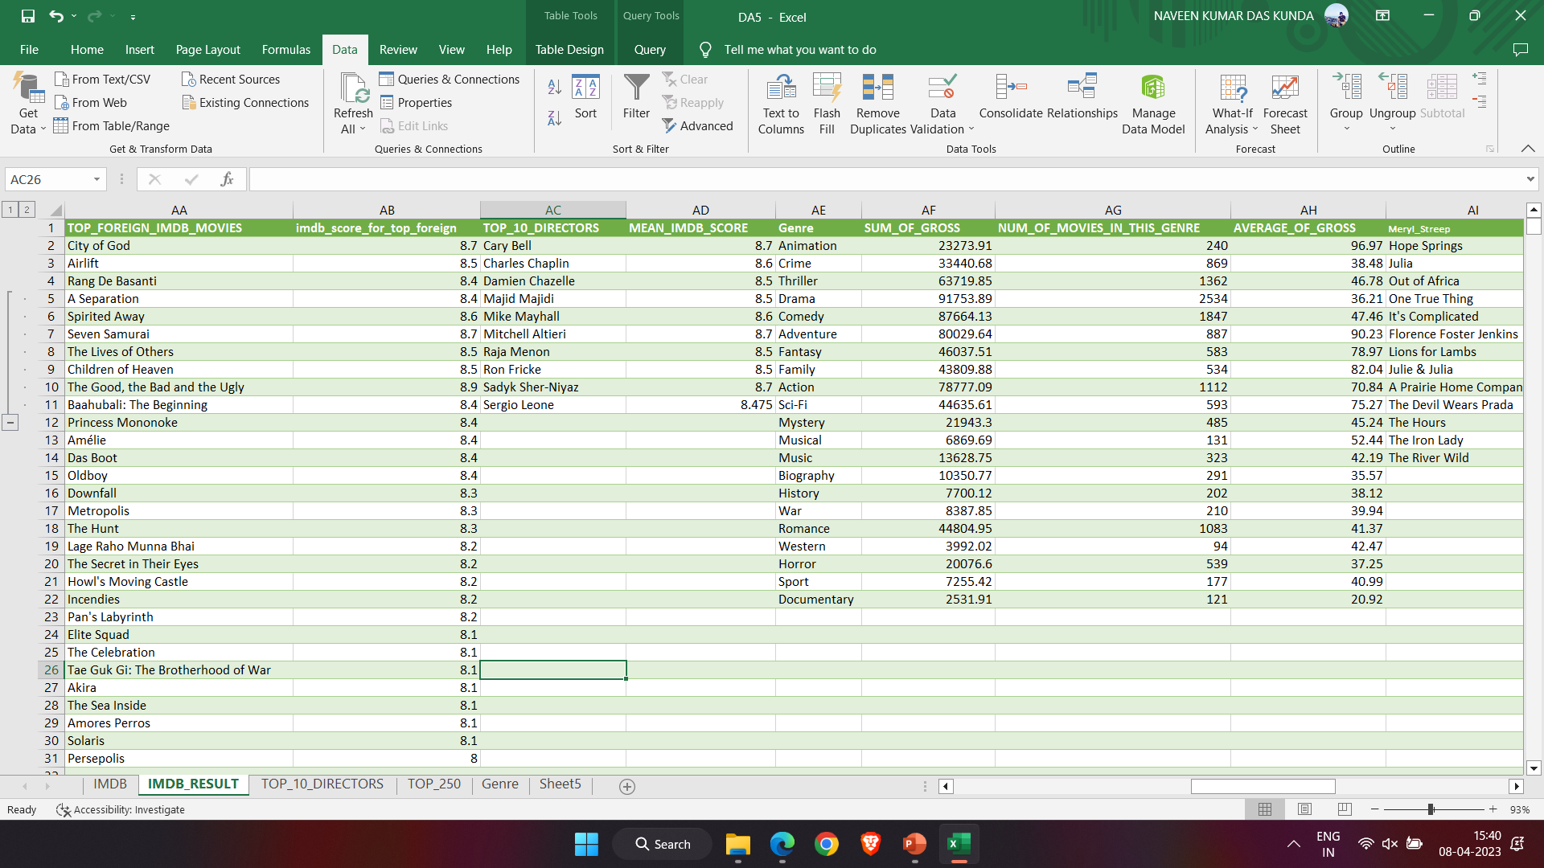
Below are the top 10 directors.These directors are sorted in alphabetical order.

Slide 15
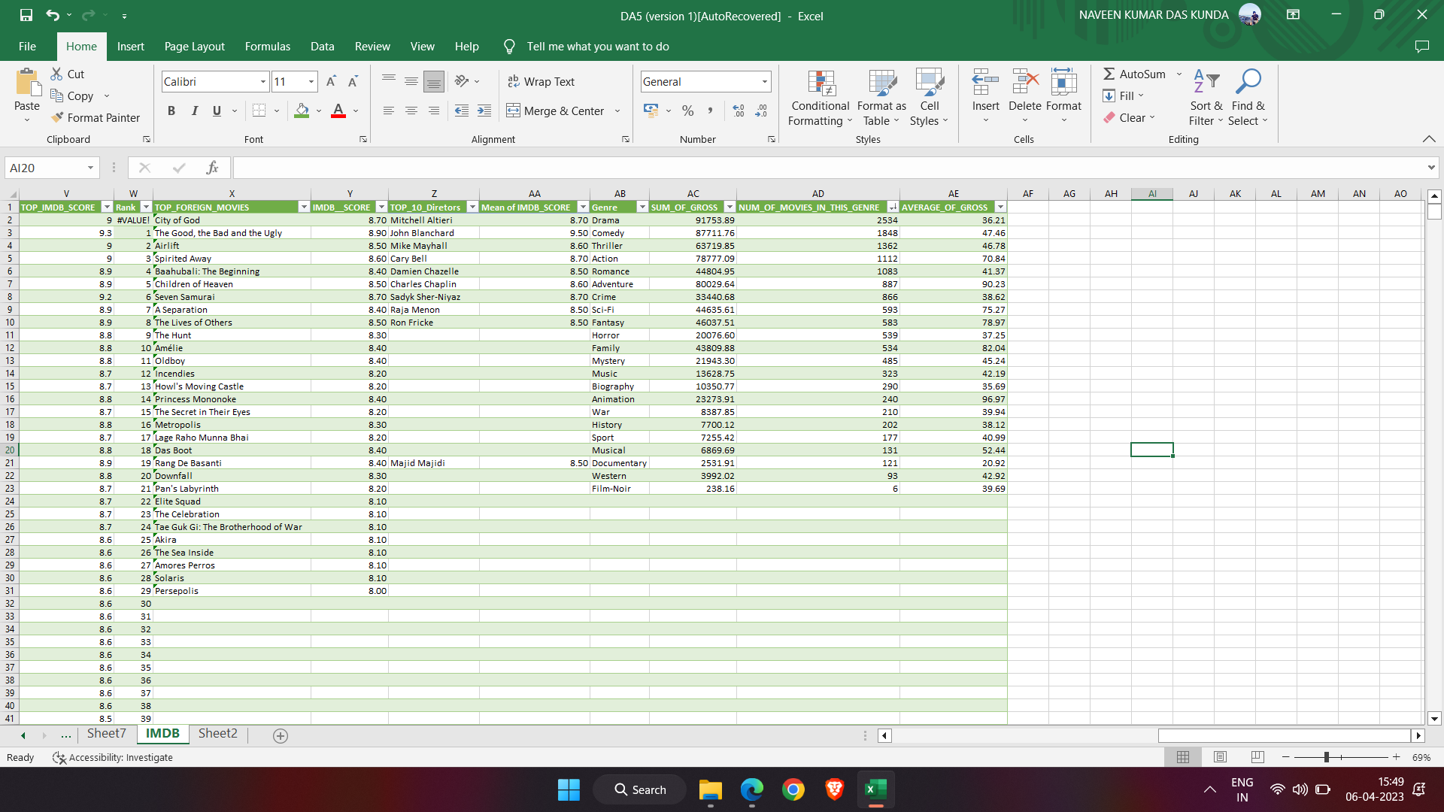
Popular Genres
The genre that are most popular based on number of movies in that genre and sum of gross of movies in that genre is Drama.

Slide 16
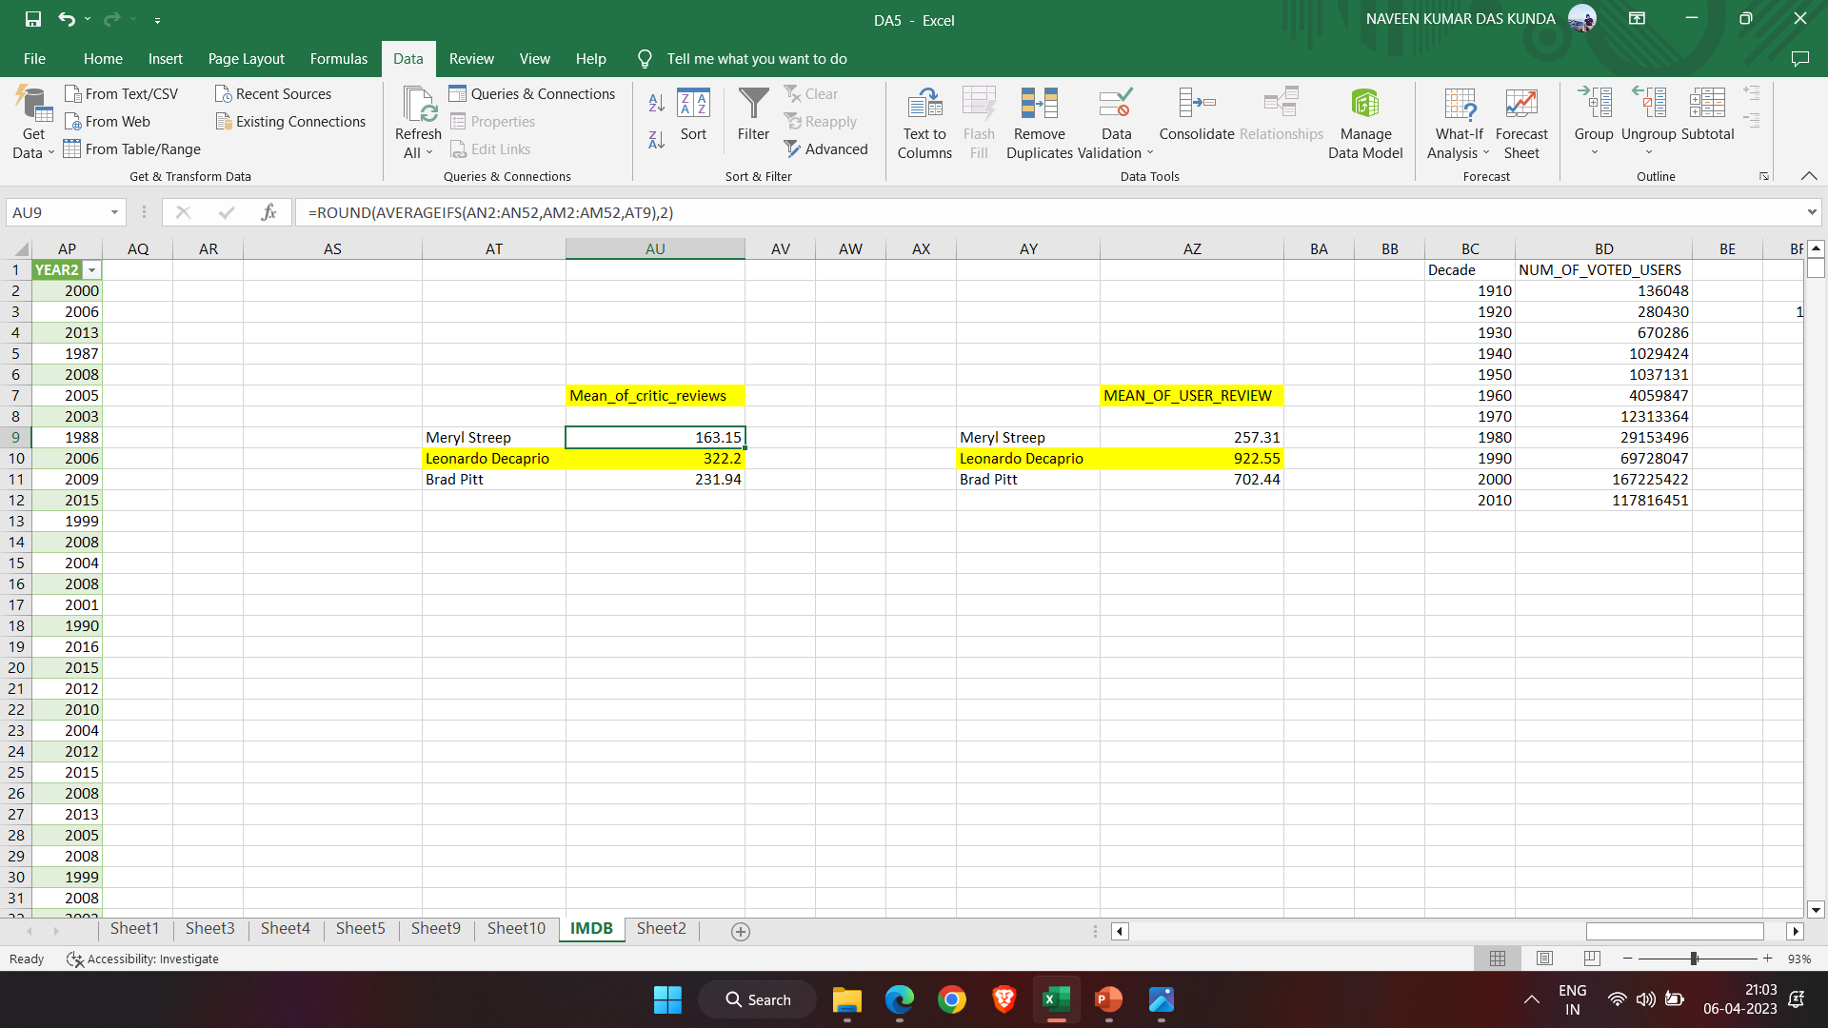
Charts
Critics-favorite and audience-favourite actor is Leonardo Decaprio.

Slide 17
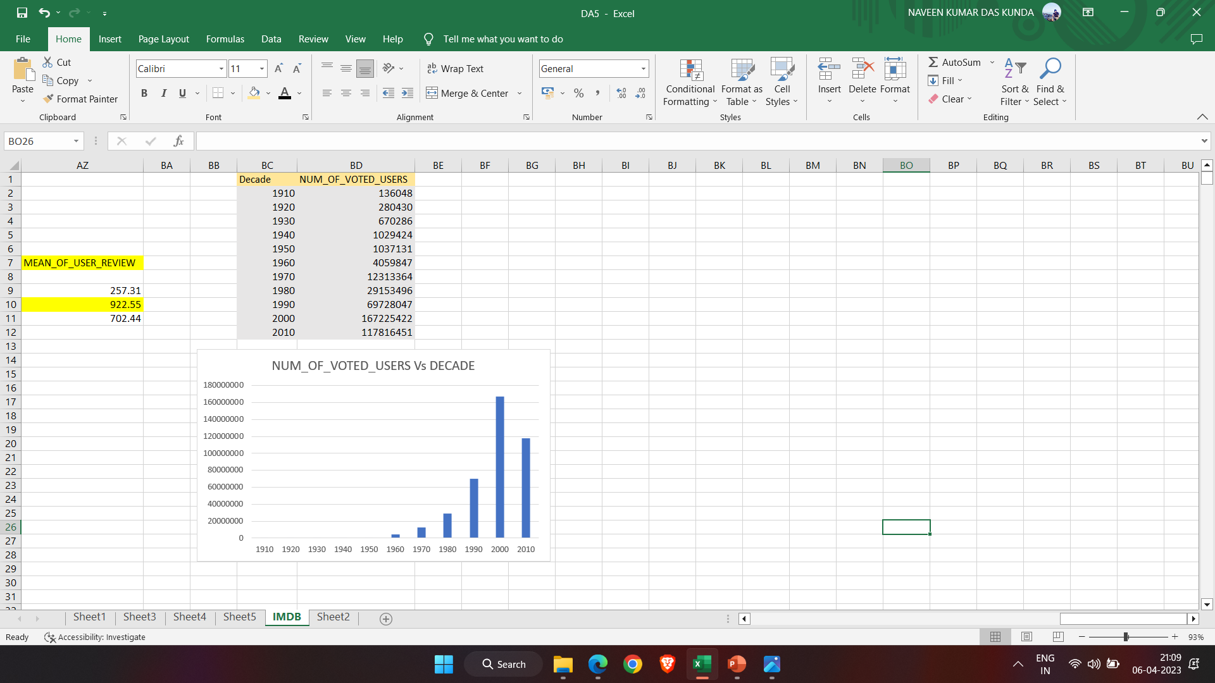
Change in number of voted users over decades.

Slide 18
Result:
I achieved in giving insights on the movies based on dataset provided.It helped how to think analytically and I gained so much knowledge about movies.

Slide 19
Thank You!!!

