Slide 1
Operation Analytics and Investigating Metric Spike
by:
KUNDA NAVEEN KUMAR DAS

Slide 2
Project description
Operation Analytics is the analysis done for the complete end to end operations of a company.
Investigating metric spike is also an important part of operation analytics as being a Data Analyst you must be able to understand or make other teams understand questions like- Why is there a dip in daily engagement? Why have sales taken a dip? Etc.
By using dataset provided we gonna analyse the dataset and provide the insights.

Slide 3
Approach
At first, I created a database using mysql and imported the data from the given dataset.
I understood the question.
I analysed the database and gave insights (given below) to the questions according to the data.

Slide 4
Tech-Stack used-MYSQL
I used MYSQL command line client to create a database and to execute the queries to answer the questions provided.

Slide 5
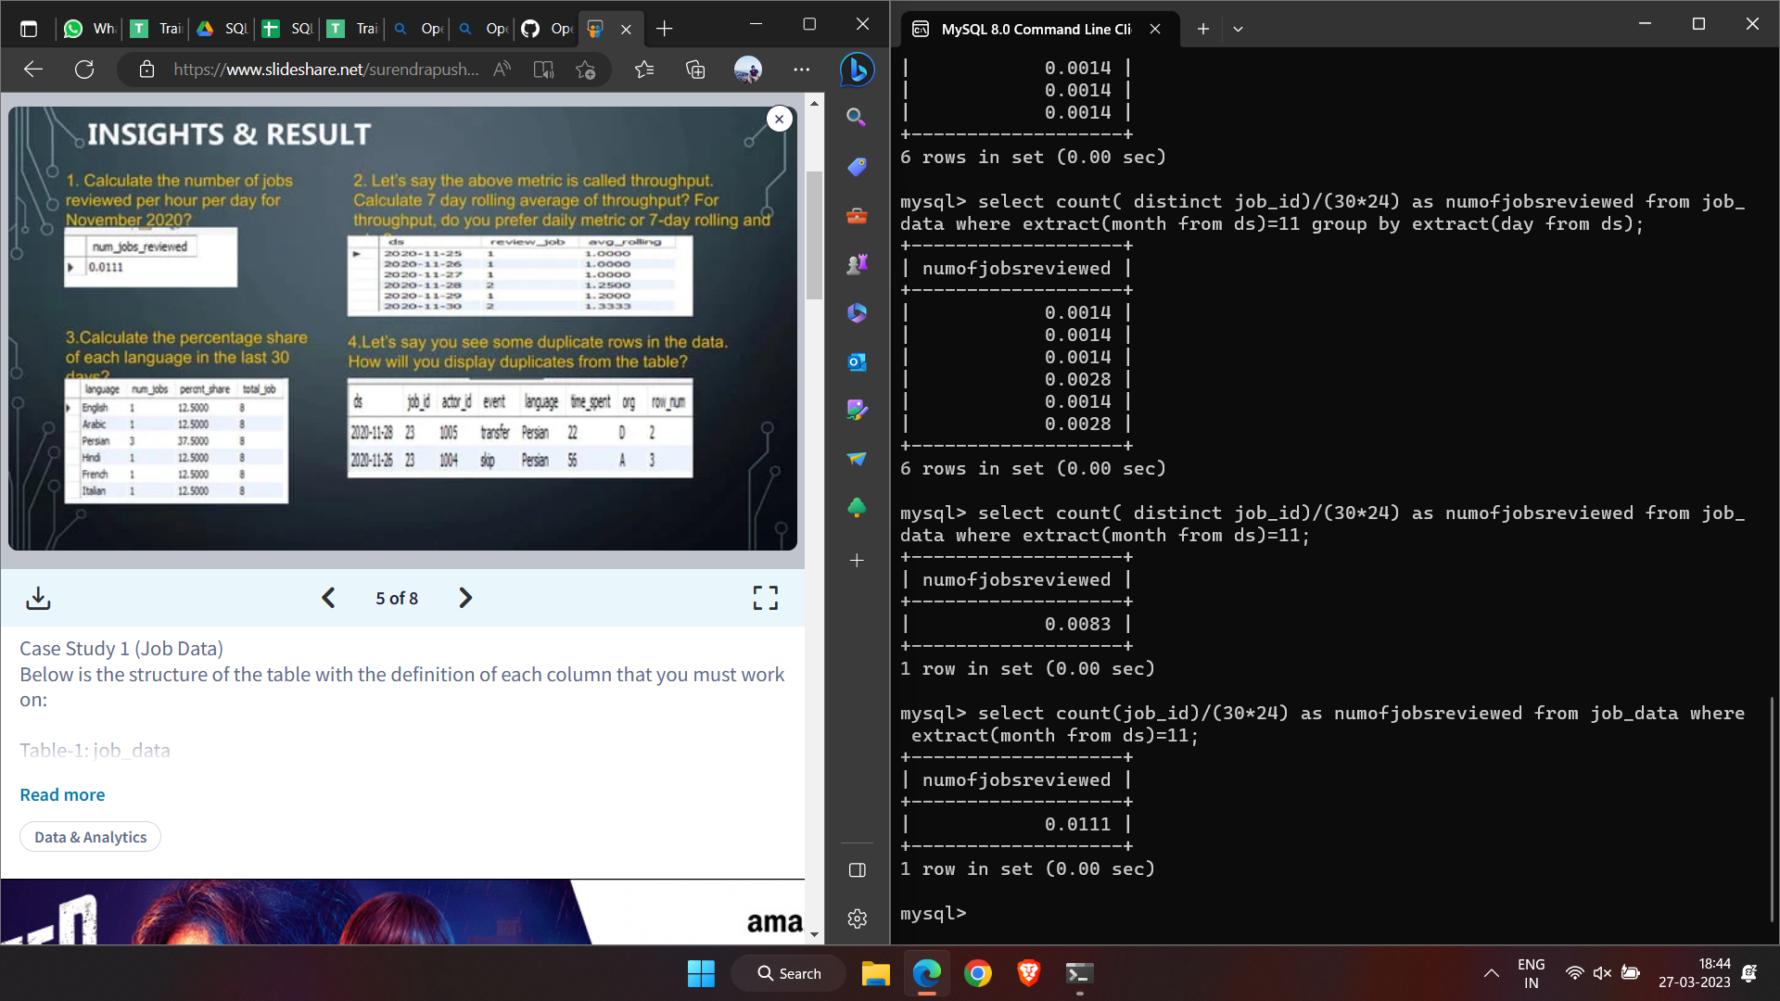
Insights
1a)Number of jobs reviewed

Slide 6
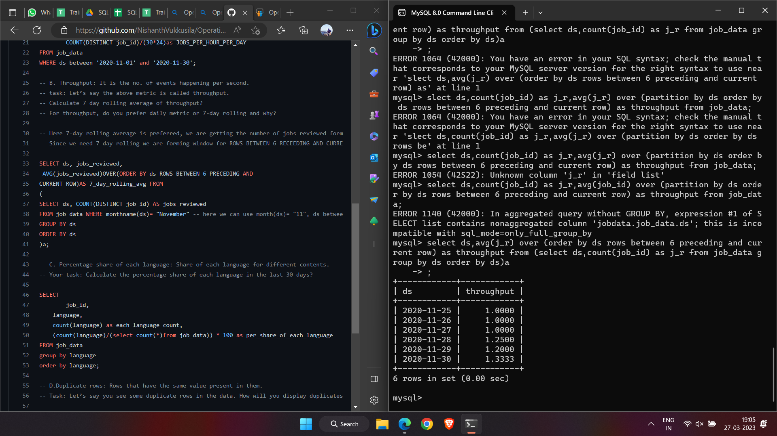
1b)Throughput
To calculate throughput,I prefer 7-day rolling average because daily metric gives num of events happening in a particular day and the rolling average gives the average of num of events in a particular gap.

Slide 7
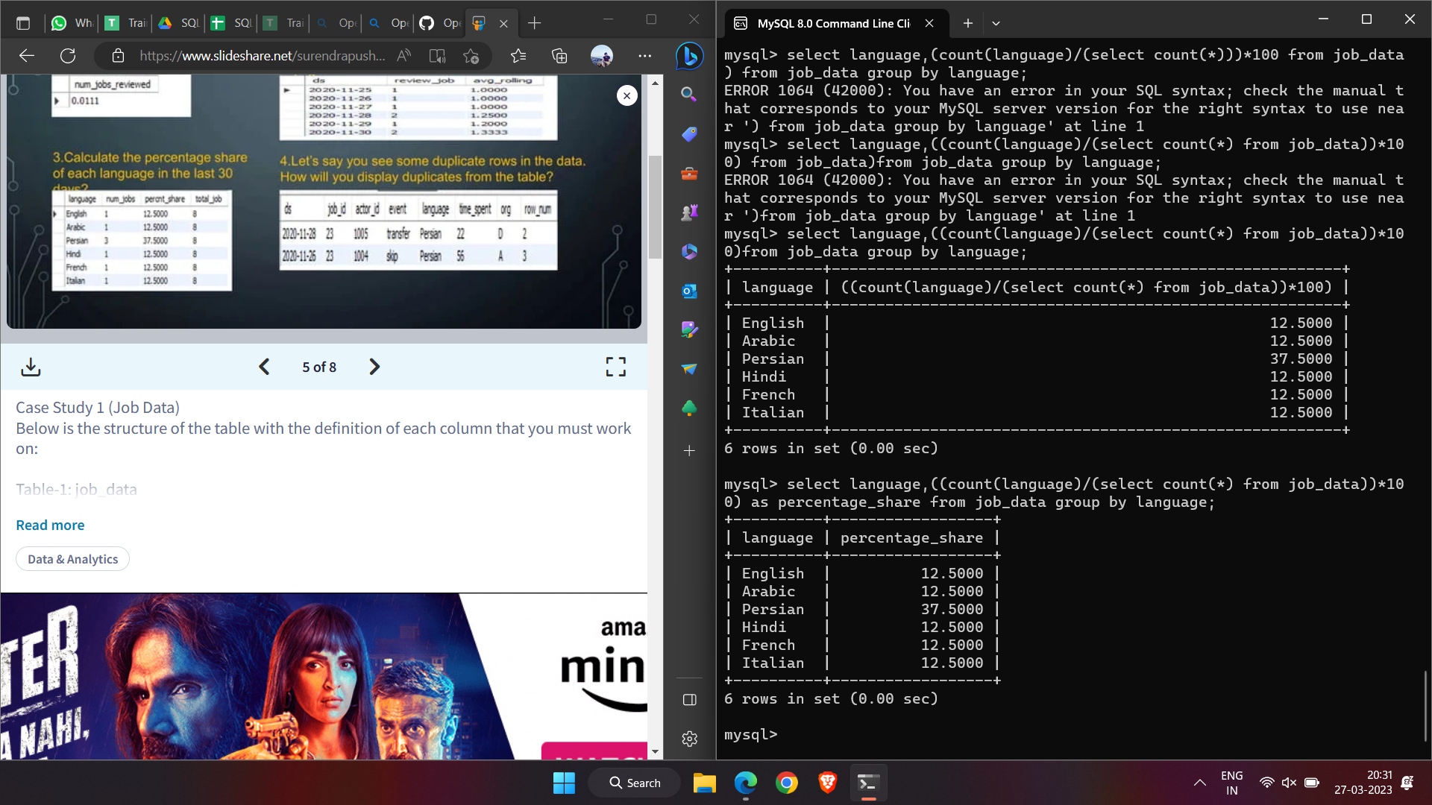
1c)Percentage share of each language

Slide 8
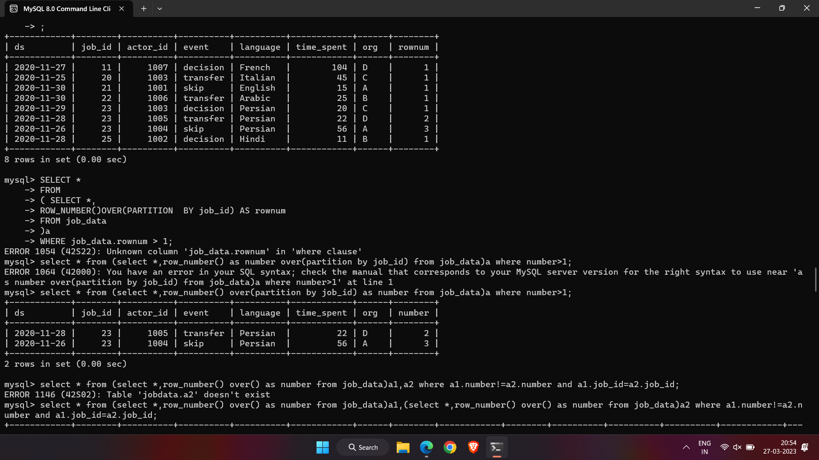
1d)Duplicate rows

Slide 9
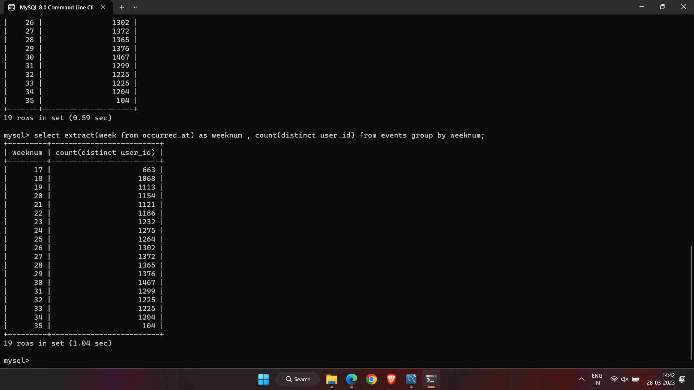
2a)User Engagement

Slide 10
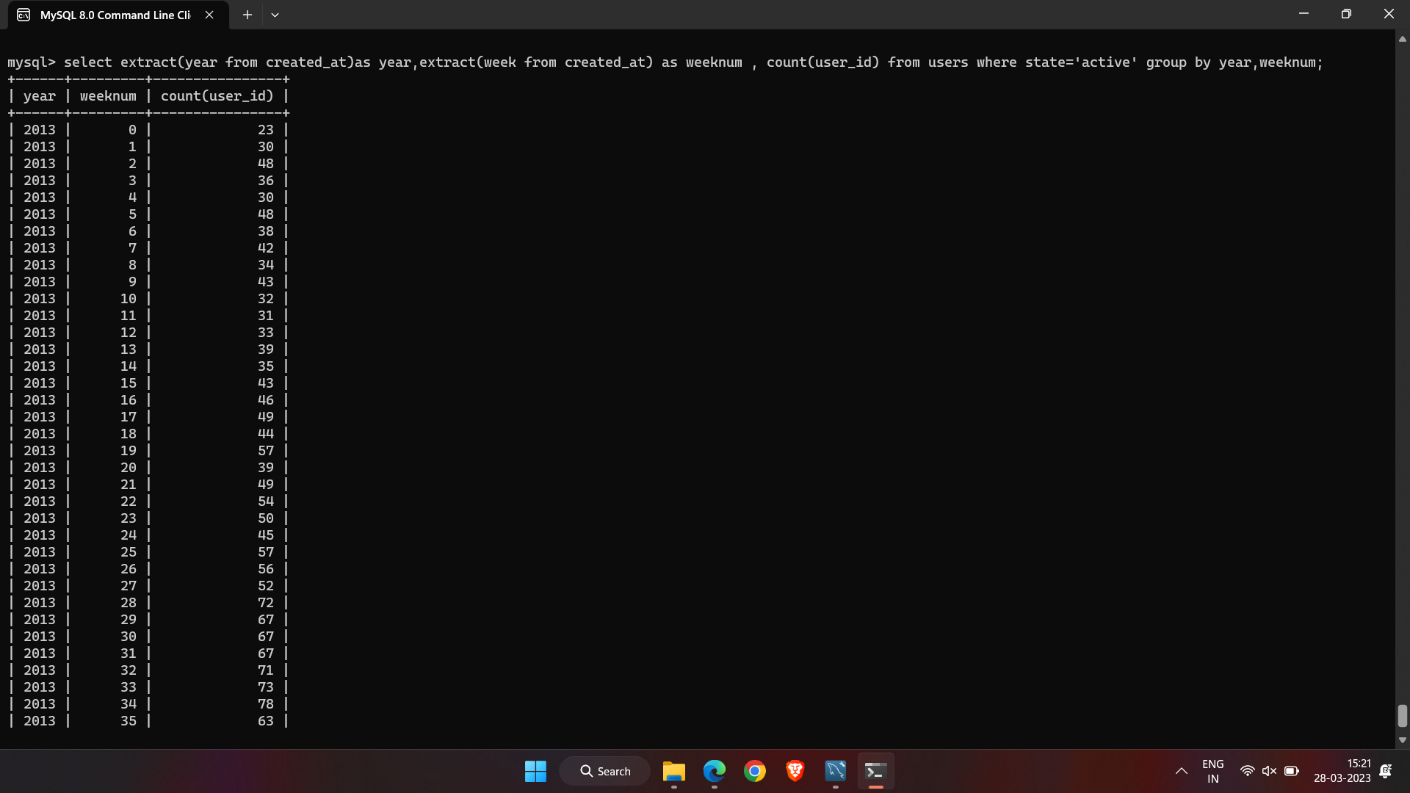
2b)User Growth
There are so many rows after this,it takes more space to include those screenshots that’s why I didn’t included those.

Slide 11
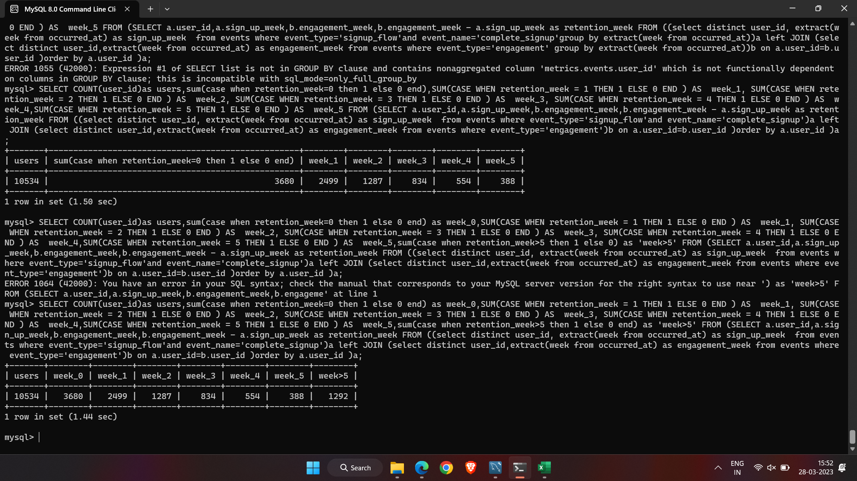
2c)Weekly Retention

Slide 12
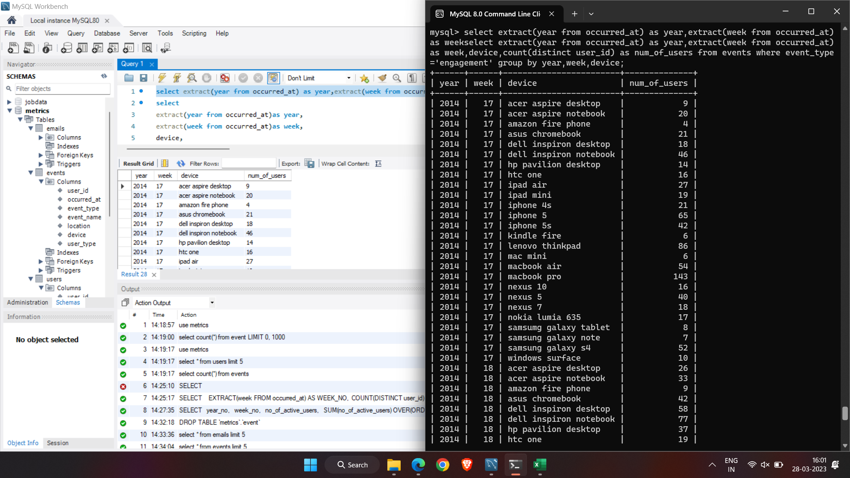
2d)Weekly Engagement
There are so many rows after this,it takes more space to include those screenshots that’s why I didn’t included those.

Slide 13
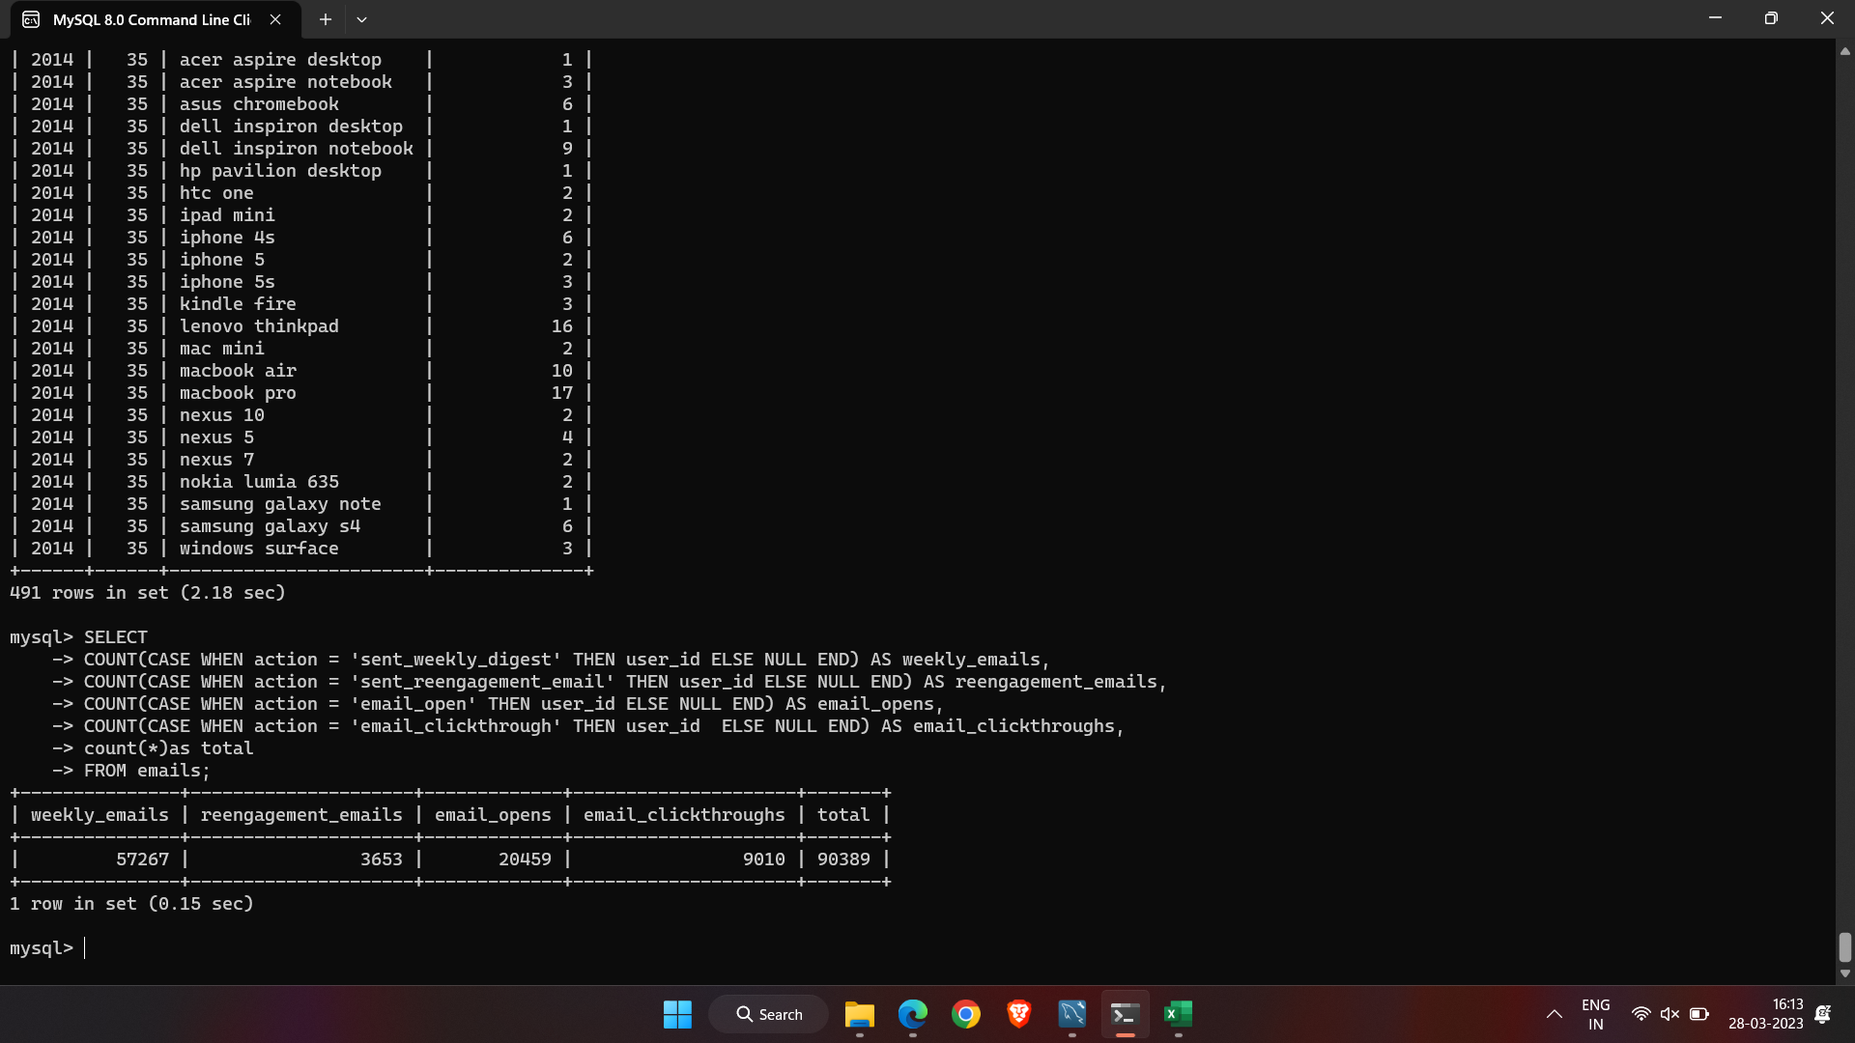
2e)Email Engagement

Slide 14
Result
While making the project,I got the better understanding about SQL queries and how SQL is used in to gain insights in business perspective and also it helped me to solve any problem of this kind.

Slide 15
Thank you!!!

