Slide 1


HONEYPOT – AN INTRUSION DETECTION &
DEFLECTION SYSTEM
A PRESENTATION DONE BY
NAVEEN KUMAR.S
230282601086
UNDER THE GUIDANCE OF
Mrs. T. PANDIYAVATHI
ASSISTANT PROFESSOR(Senior Grade)
MASTER OF COMPUTER APPLICATION (2025)
DEPARTMENT OF COMPUTER APPLICATIONS

Slide 2

PRESENTATION AT A GLANCE
Abstract
Literature Survey
Problem Identified
Objective
Existing System
Proposed System
Architecture Diagram
Detailed Algorithm For Each Module
Result with Analysis
Conclusion and Future Scope
Technology Certification
DEPARTMENT OF COMPUTER APPLICATIONS

Slide 3
ABSTRACT
The Honeypot System is a cybersecurity tool designed to detect, analyze and mitigate unauthorized access attempts by simulating vulnerable network services.
This project implements two primary honeypot modules an SSH Honeypot and an HTTP WordPress Honeypot, both integrated with a comprehensive dashboard for real time data visualization and analysis.
The SSH Honeypot emulates a secure shell server to capture attacker credentials and commands, while the HTTP Honeypot mimics a WordPress login page to log unauthorized access attempts.
Both modules employ logging mechanisms to record attacker interactions, including IP addresses, usernames, passwords and executed commands.
The collected data is parsed and processed using Python based data analysis tools, including Pandas for log parsing and Dash for creating an interactive web based dashboard
DEPARTMENT OF COMPUTER APPLICATIONS

Slide 4
LITERTURE SURVEY
Title | Author | Year of Publication | Journal Name | Description | Limitation
Utilizing virtualized honeypots for threat hunting, malware analysis, and reporting | Reilly Holbel, Johnathan Yerby, Warner Smith | 2024 | International Association for Computer Information Systems | The deployment of a virtualized honeypot system on a university network to analyze cyber threats in real time. By integrating (SIEM) with Elastic Stack, the study successfully captured and analyzed malware samples, attacker behavior | Some obfuscation techniques might have bypassed detection, leading to potential false negatives.
Detection and Analysis of Active Attacks using Honeypot | Waqas Ahmad, Arsalan Raza, Sabreena Nawaz, Farhana Waqas | 2023 | International Journal of Computer Applications | Dionaea honeypot was selected to capture, predict, and learn about the attack methods used by the attackers. As already discussed before, it is a low interaction honeypot and the performance of low interaction honeypots | There are constraints in terms of attack correlation and analysis, as honeypots may miss important attack vectors
DEPARTMENT OF COMPUTER APPLICATIONS

Slide 5
LITERTURE SURVEY
Title | Author | Year of Publication | Journal Name | Description | Limitation
An Advanced Intrusion Detection Solution for Networks based on Honeypot Servers | K. Veena, K. Meena, Mercy Theresa M, Hemalatha C, D.Rajalakshmi | 2023 | IEEE | This system has demonstrated that this specific approach has a detection rate of more than 95% and a false alarm rate of less than 1% that can successfully identify unidentified attacks | These solutions may have limitations in detecting zero-day attacks or previously unknown threats that don't match established attack signatures.
Fine-tuned LSTM-Based Model for Efficient Honeypot-Based Network Intrusion Detection System in Smart Grid Networks | Abdullatif Albaseer , Mohamed Abdallah | 2022 | IEEE | The system approach can employ just 25% of the features from each collected network packet while attaining 99.8% testing accuracy with a 13% improvement compared to the benchmarks. | The reliance on honeypot-based data collection, which may not always reflect real-world attack scenarios accurately.
DEPARTMENT OF COMPUTER APPLICATIONS

Slide 6
LITERTURE SURVEY
Title | Author | Year of Publication | Journal Name | Description | Limitation
Containerized cloud‑based honeypot deception for tracking attackers | V. S. Devi Priya & S. Sibi Chakkaravarthy | 2022 | Scientific reports | The system ensures easy deployment, scalability, and resource efficiency. The experiment provided insights into attack trends, including Distributed Denial-of-Service (DDoS) patterns, malicious URLs, and attacker IPs | Honeypots were deployed in the cloud, attackers could potentially identify them as decoy systems, reducing the effectiveness of deception.
A Novel AI-based Methodology for Identifying Cyber Attacks in Honey Pots | Muhammed AbuOdeh, Christian Adkins, Omid Setayeshfar, Prashant Doshi, Kyu H. Lee | 2021 | AAAI Digital Library | The approach involves preprocessing system events from audit logs, inferring attack sequences (storylines) using a probabilistic model, and classifying them into specific attack phases with a machine learning classifier | It requires training data for each attack phase, making it less effective for detecting previously unseen attack patterns.
DEPARTMENT OF COMPUTER APPLICATIONS

Slide 7
BASE PAPER
TITLE : Utilizing virtualized honeypots for threat hunting, malware analysis,
and reporting
YEAR : 2024
Utilizing Virtualized Honeypots for Threat Hunting, Malware Analysis, and Reporting explores the deployment of a portable, virtualized honeypot on a university network to analyze real-time cyber threats. By integrating Security Information and Event Management (SIEM) with Elastic Stack, the researchers captured attacker behavior, identified malware, and analyzed threat actor tactics, techniques, and procedures (TTPs). The honeypot successfully detected and analyzed various cyber threats, including ransomware, brute-force attacks, and privilege escalation exploits, contributing to cybersecurity intelligence and proactive defense strategies.
DEPARTMENT OF COMPUTER APPLICATIONS

Slide 8
PROBLEM IDENTIFIED
Detection by Attackers : Attackers may recognize your honeypot and avoid interacting with it
False Positives: Non-malicious users or automated scanners (like search engine bots) may trigger alerts.
Insufficient Logging & Monitoring :Not capturing enough data to analyze attacker behavior.
Performance Issues: If the honeypot is poorly optimized, it may slow down or crash under heavy traffic.
Lack of Real-Time Alerts:No instant notifications when an attacker interacts with the honeypot.
DEPARTMENT OF COMPUTER APPLICATIONS

Slide 9
OBJECTIVE
Threat Detection and Analysis : Monitor and identify new attack patterns and malicious activities in real-time.
Network Security Enhancement : Early warning system for potential security breaches.
Research and Intelligence Gathering : Document new malware strains and their behaviors.
Defense Improvement : Identify vulnerabilities in network architecture and systems.
Attacker Deception : Create convincing decoy systems to trap and observe attackers.
DEPARTMENT OF COMPUTER APPLICATIONS

Slide 10
EXISTING SYSTEM
The existing systems for honeypot deployment can be categorized into two main approaches. Traditional honeypots typically consist of standalone systems or virtual machines configured to mimic real production environments.
These systems often use tools like Honeyd, KFSensor, and HoneyBot to emulate various services and operating systems.
They are manually configured and maintained, requiring significant expertise to set up and monitor effectively.
These conventional systems usually operate in isolation and may lack advanced integration capabilities with modern security infrastructure.
DEPARTMENT OF COMPUTER APPLICATIONS

Slide 11
PROPOSED SYSTEM
The proposed Honeypot System is designed to address the limitations of existing cybersecurity tools by offering an integrated, scalable and user friendly framework for detecting, analyzing and visualizing cyber threats.
The system comprises two primary low interaction honeypot modules—an SSH Honeypot and an HTTP WordPress Honeypot—coupled with a robust data logging mechanism and an interactive web based dashboard.
By simulating commonly targeted network services, the system attracts malicious actors, captures their interactions and provides actionable intelligence to enhance network security. The modular architecture ensures flexibility, enabling seamless integration of additional honeypot types or analytical tools in the future, making it adaptable to evolving cyber threats.
DEPARTMENT OF COMPUTER APPLICATIONS

Slide 12
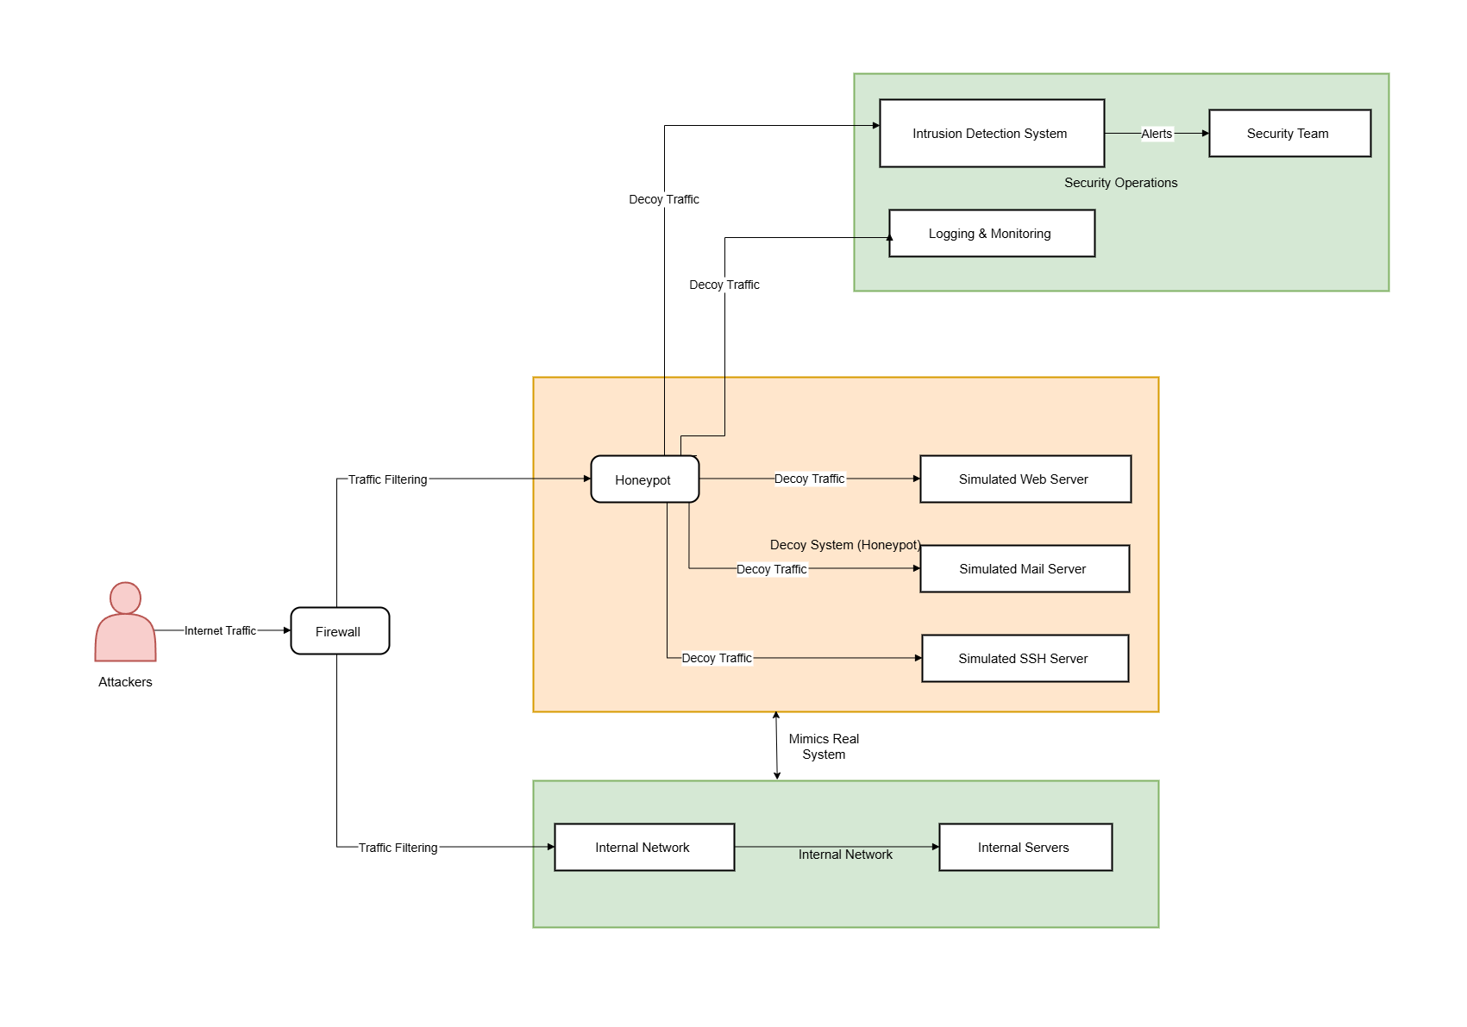
ARCHITECTURE DIAGRAM
DEPARTMENT OF COMPUTER APPLICATIONS

Slide 13
DETAILED ALGORITHM FOR MODULE
MODULE 1: Initialization and Setup
Configure the honeypot with essential settings:
Set HOST = "0.0.0.0" to listen on all network interfaces.
Define SSH_PORT = 2280 and WEB_PORT = 8050.
Specify LOG_FILE = “cmds_audits.log“ and creds_audits.log for logging attacker activity.
Start two network services:
A fake SSH service to capture unauthorized login attempts.
DEPARTMENT OF COMPUTER APPLICATIONS

Slide 14
DETAILED ALGORITHM
MODULE 2: SSH Server Setup
Create a TCP socket and bind it to SSH_PORT.
Listen for incoming connections from remote users.
When a connection is established:
Retrieve and log the attacker's IP address.
Send a fake SSH banner (SSH-2.0-OpenSSH_8.2p1).
Receive user input (username/password attempts).
Identify attack patterns such as brute force attempts.
Log attacker details (IP, timestamp, login attempts).
Close the connection after interaction.
DEPARTMENT OF COMPUTER APPLICATIONS

Slide 15
DETAILED ALGORITHM
MODULE 3: Attack Detection & Logging
Extract the IP address from connection requests.
Determine the geolocation of the attacker:
If local (192.168.* or 127.*), label as "Local Network". Otherwise, use an IP geolocation API to determine the region.
MODULE 4: Identify Attack Types
If a common username is used (root, admin), classify as Brute Force Attack.
If the password is long and complex, classify as Dictionary Attack. Otherwise, mark it as Suspicious Activity.
Store logs in honeypot_log.txt with details: Attacker IP, location, attack type, login attempts, timestamps.
DEPARTMENT OF COMPUTER APPLICATIONS

Slide 16
DETAILED ALGORITHM
MODULE 5: Continuous Monitoring
The honeypot remains active, waiting for incoming SSH login attempts and fake web login submissions.
Every detected attack attempt is logged for further analysis.
The script continues running indefinitely to gather threat intelligence
DEPARTMENT OF COMPUTER APPLICATIONS

Slide 17
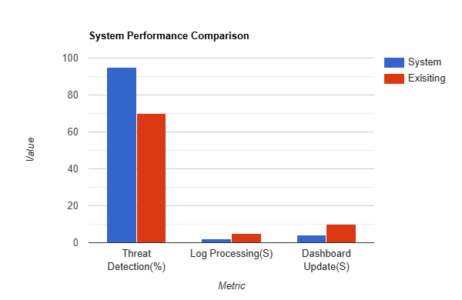
System Performance Comparison
DEPARTMENT OF COMPUTER APPLICATIONS

Slide 18

CODE IMPLEMENTATION
DEPARTMENT OF COMPUTER APPLICATIONS

Slide 19
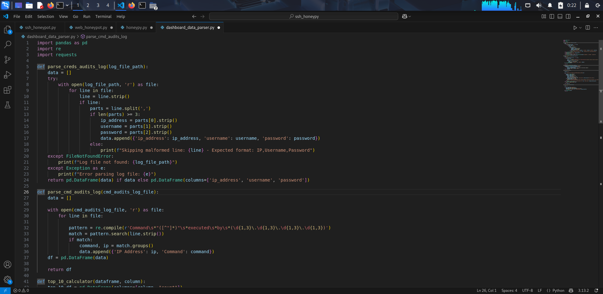
CODE IMPLEMENTATION
DEPARTMENT OF COMPUTER APPLICATIONS

Slide 20
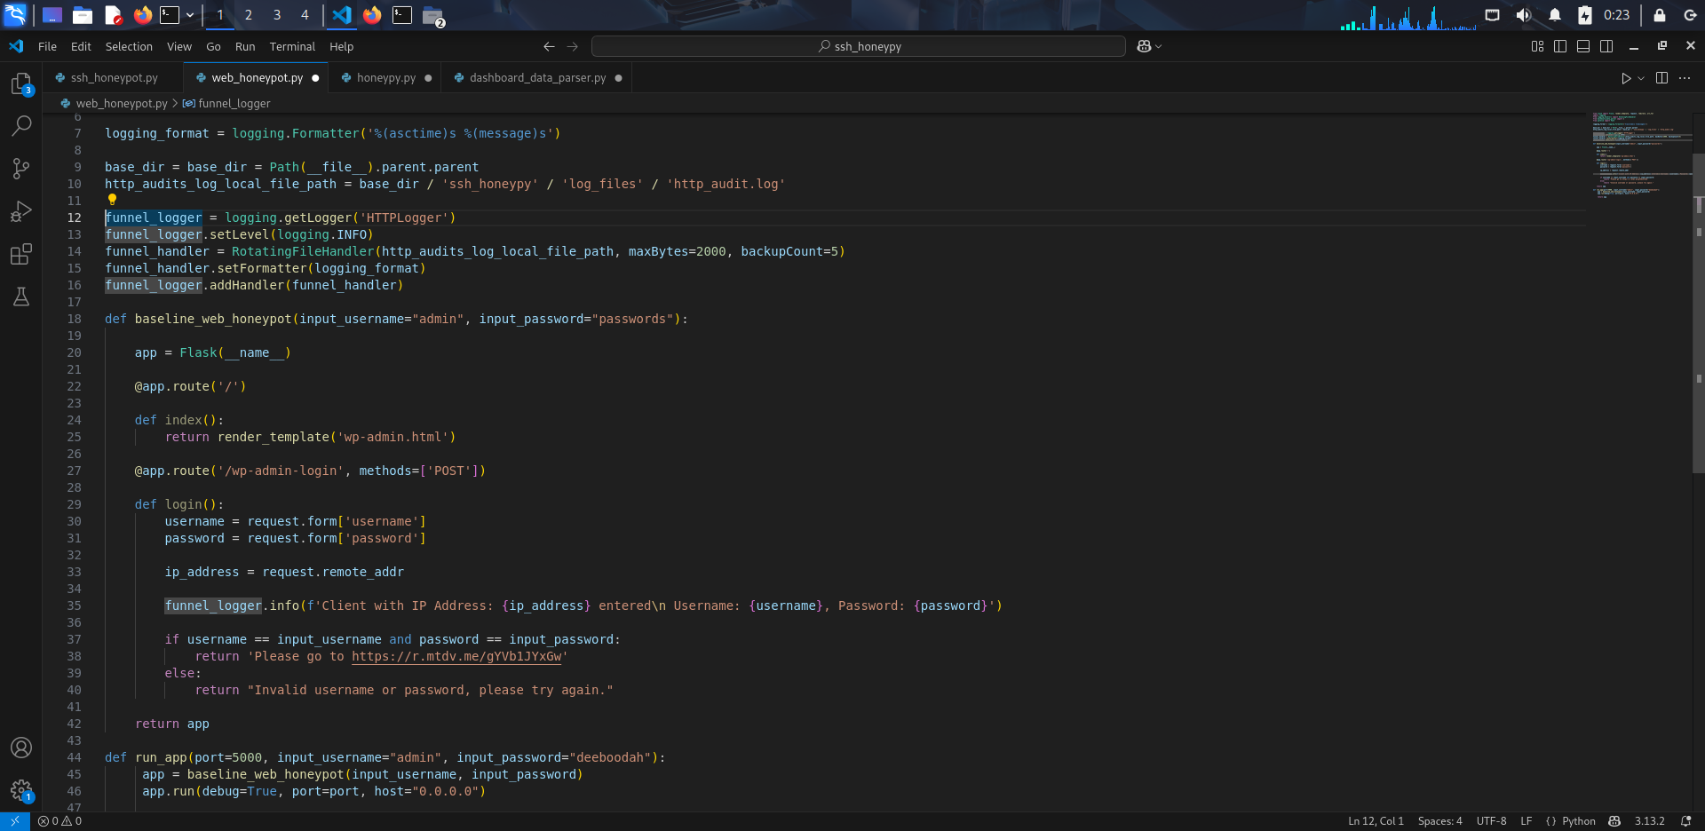
CODE IMPLEMENTATION
DEPARTMENT OF COMPUTER APPLICATIONS

Slide 21
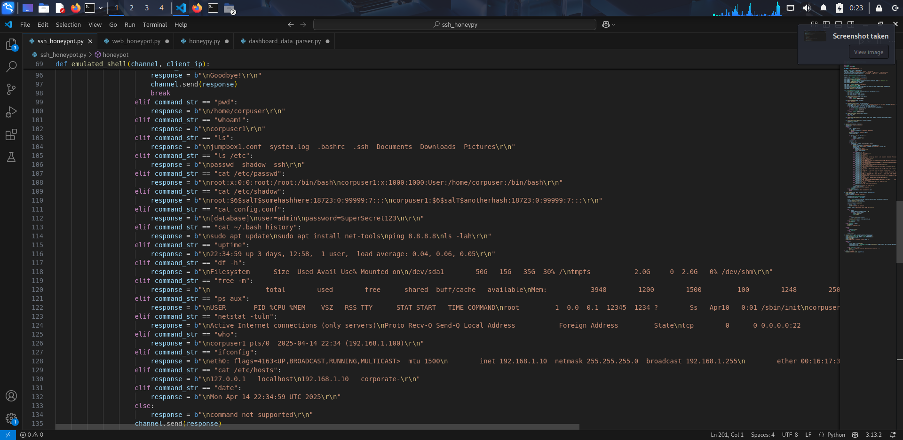
CODE IMPLEMENTATION
DEPARTMENT OF COMPUTER APPLICATIONS

Slide 22
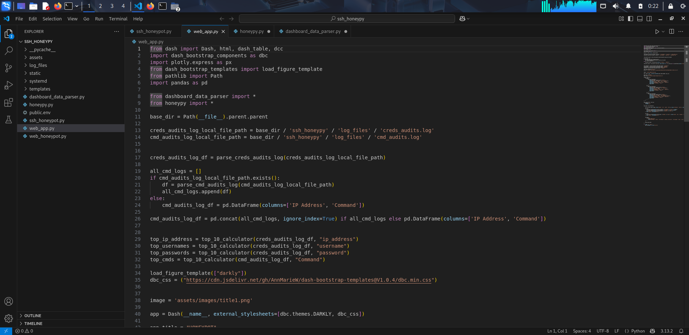
CODE IMPLEMENTATION
DEPARTMENT OF COMPUTER APPLICATIONS

Slide 23
CODE IMPLEMENTATION
DEPARTMENT OF COMPUTER APPLICATIONS

Slide 24
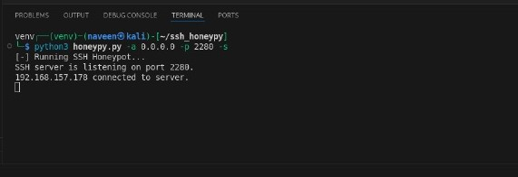
RESULT WITH ANALYSIS
DEPARTMENT OF COMPUTER APPLICATIONS

Slide 25
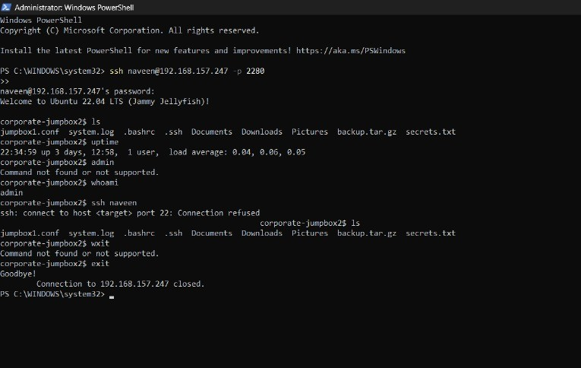
RESULT WITH ANALYSIS
DEPARTMENT OF COMPUTER APPLICATIONS

Slide 26
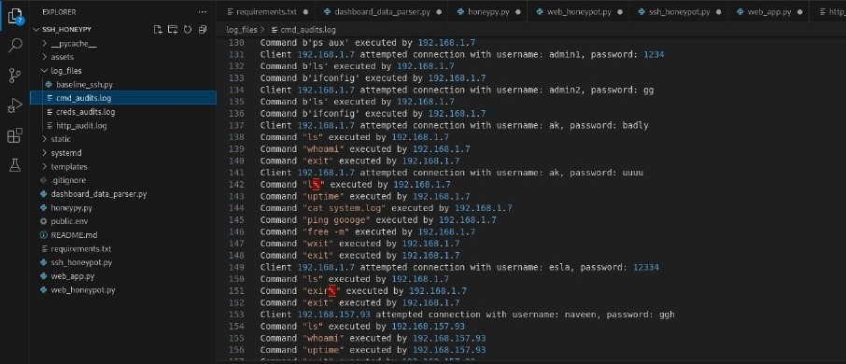
RESULT WITH ANALYSIS
DEPARTMENT OF COMPUTER APPLICATIONS

Slide 27
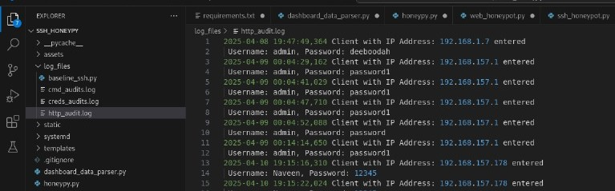
RESULT WITH ANALYSIS
DEPARTMENT OF COMPUTER APPLICATIONS

Slide 28
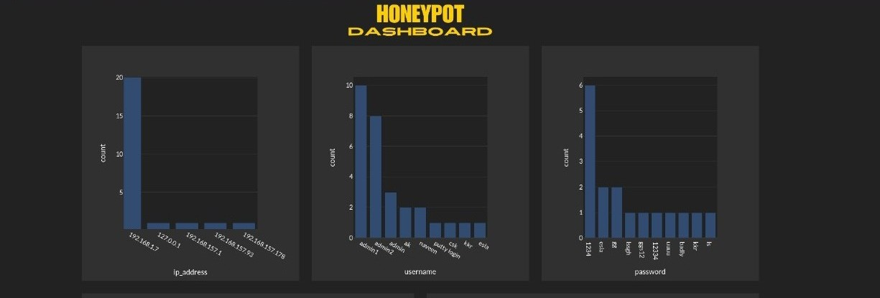
RESULT WITH ANALYSIS
DEPARTMENT OF COMPUTER APPLICATIONS

Slide 29
CONCLUSION
The honeypot project successfully delivers a lightweight, modular system designed to deceive attackers, capture their interactions and provide actionable cybersecurity intelligence. By simulating vulnerable SSH and HTTP services mimicking an SSH server and a WordPress login page the system effectively attracts malicious activity, logging critical details such as IP addresses, credentials and commands. The integration of a command line launcher, robust data parsing and an interactive dashboard ensures that users can easily deploy the system and interpret its findings. This project fulfills its primary objective of offering an affordable, accessible tool for understanding attacker behavior.
Looking forward, the honeypot system offers substantial potential for expansion and real world impact. Its modular architecture supports the addition of new deception layers, such as FTP or Telnet honeypots and enhanced analytics, like machine learning based attack pattern detection. With further optimization and broader testing, it could scale to serve enterprise environments or contribute to open source cybersecurity research. Ultimately, this project not only achieves its goal of providing a practical, low cost tool for threat intelligence but also lays a foundation for future innovations, empowering users to stay ahead of evolving cyber threats with minimal resources.
DEPARTMENT OF COMPUTER APPLICATIONS

Slide 30
FUTURE SCOPE
The honeypot project, while effective in its current form, can be significantly enhanced by expanding its deception capabilities to cover a wider range of services beyond SSH and HTTP. Future iterations could incorporate additional protocols such as FTP, Telnet, or SMTP, each designed to mimic vulnerable servers commonly targeted by attackers. For instance, adding an FTP honeypot could involve integrating a library like pyftpdlib to simulate file transfer services, capturing credentials and file upload attempts. This expansion would broaden the system’s appeal as a comprehensive threat intelligence tool, attracting diverse attack vectors and providing richer data for analysis, all while maintaining the modular structure already established.
Finally, the project could evolve into a collaborative, open source platform with broader community impact. By refining documentation and hosting the codebase on a platform like GitHub, it could invite contributions from developers to add features, fix bugs, or tailor it for specific use cases, such as educational labs or IoT security research.
DEPARTMENT OF COMPUTER APPLICATIONS

Slide 31
REFERENCES
[1] Priya, V. D., & Chakkaravarthy, S. S. (2023). Containerized cloud-based honeypot deception for tracking attackers. Scientific Reports, 13(1), 1437.
[2] Hussein, M. A. (2023). A Proposed Multi-Layer Firewall to Improve the Security of Software Defined Networks. International Journal of Interactive Mobile Technologies, 17(2).
[3] Jadhav, Y. C., Sable, A., Suresh, M., & Hanawal, M. K. International Journal of Computer Applications Securing Containers: Honeypots for Analysing Container Attacks. (2023) International Conference on Communication Systems & NetworkS (COMSNETS) (pp. 225-227). IEEE.
[4] Amal, M. R., & Venkadesh, P. (2022). Review of cyber attack detection: Honeypot system. Webology, 19(1), 5497-5514.
[5] AlZoubi, W., & Alrashdan, M. (2022). The effect of using honeypot network on system security. International Journal of Data and Network Science, 6(4), 1413-1418
DEPARTMENT OF COMPUTER APPLICATIONS

Slide 32

INTERNATIONAL CONFERENCE
Presented My Paper at International Conference on Contemporary Trends in Advanced Computing Technologies (ICCTACT) at New Prince Shri Bhavani Arts and Science College.
DEPARTMENT OF COMPUTER APPLICATIONS

Slide 33

CERTIFICATION
CYBERSECURITY FUNDAMENTALS (NEW DESIGN) - IBM SKILLSBULID
CYBERSECURITY (SHORT COURSES) – OHSC
DEPARTMENT OF COMPUTER APPLICATIONS

Slide 34

DEPARTMENT OF COMPUTER APPLICATIONS

