Slide 1

AgentProbe: Multi-Agent Framework for Automated Prompt Injection Testing
Team Number: 7
Members:
Vishaka Ganesan - 2023115001
Varshhaa Pari - 2023115007
Naveen O.T - 2023115105
Ahilash R.S - 2023115132
Project Guide: Dr. K.Vidya

Slide 2
Terminology
Prompt Injection: An attack where specially crafted input tricks an AI model into overriding or bypassing its original instructions/safety policy.
Jailbreaking: Getting a model to produce behaviour its provider intended to prevent.
Direct Injection: The attacker directly enters malicious instructions into the AI's input to manipulate its behavior.
Indirect Injection: Malicious instructions are embedded in external content that the AI processes, such as images, documents, webpages etc.

Slide 3
Introduction To The Problem Domain
AI chatbots are used across multiple domains such as customer support, coding assistants, banking, healthcare, etc. These chatbots often use tool calls, has access to external data in addition to just plain text inputs.
OWASP ranks Prompt Injection as the #1 security risk in the OWASP Top 10 for LLM Applications [Source].
A study of 36 production LLM-integrated applications found 86% were vulnerable to prompt injection [Source]
The Gap: Despite this growing risk, most organizations still rely on manual, ad hoc testing rather than a systematic, automated process to catch prompt injection vulnerabilities before production rollout.

Slide 4
Problem Statement
Existing tools mainly test chatbots through APIs, leaving browser-based UI interactions largely untested.
Limited attack capability — Many automated methods rely on fixed attack templates and do not sufficiently adapt attacks to the target chatbot, its context, or its responses.
No actionable output/report — Testing often focuses on whether an attack succeeded or failed, without providing severity levels, attack explanations, or suggested defenses.
Narrow attack coverage — Existing tools typically test only a handful of simple, well-known PI patterns and miss the broader taxonomy such as multi-turn, contextual attacks, Obfuscation, Task-deflection, Persuasion etc.,
Our tool addresses this directly: a context-aware, multi-agent pipeline that adapts its attacks according to the target, uses multiple different PI patterns, grades severity instead of pass/fail, and generates a report with concrete defense recommendations.

Slide 5
Literature Survey
Title of Article | Journal/Conference — Year | Highlights – Approach to be followed | Challenges to be Addressed
RedAgent: Red Teaming Large Language Models with Context-aware Autonomous Language Agent | arXiv (preprint) — 2024 | The multi agent pipeline design (Planner / Profiler → Attacker → Judge/Evaluator). We are adding a Report agent and the ability to work with Web UI Chatbots, not just APIs. | Text-only, no multimodal support; struggles with complex/multi-step app interactions
A Systematic Review of Prompt Injection Attacks on Large Language Models: Trends, Taxonomy, Evaluation, Defenses, and Opportunities | IEEE — 2025 | The attack taxonomy (direct vs. indirect, attack categories) to structure our attack library and different metrics for evaluation. | ASR alone doesn't capture severity/stealth; datasets fragmented and English-only.
Ignore This Title and HackAPrompt: Exposing Systemic Vulnerabilities of LLMs through a Global-Scale Prompt Hacking Competition | EMNLP — 2023 | Their 29-technique attack taxonomy as the basis for our template library, and their dataset to seed initial attack prompts | Results tied to 2023 model versions – More Attacks have surfaced since then.
PromptFuzz: Harnessing Fuzzing Techniques for Robust Testing of Prompt Injection in LLMs | 2024 | The mutation strategy (generate/expand/shorten/rephrase/crossover) for adapting attacks when a first attempt fails | Tested mainly on GPT-3.5; mutation model coupled to GPT-3.5's biases;

Slide 6
Key Challenges
Chatbot-agnostic DOM detection: Reliably locating chat input/output elements across unstructured UIs without prior configuration.
Attack diversity: Covering the full compositional taxonomy (29+ techniques) without an existing template library.
Judge reliability: LLM-as-a-judge scoring must stay consistent and calibrated — avoiding both false positives and missed violations.
Anti-automation friction: Rate limits, CAPTCHAs, and dynamic rendering on real chatbot UIs can interfere with RPA-based interaction.
Correct template extraction — Selecting the right attack template(s) for a given target chatbot based on its inferred context (domain, scope, prior responses) - a poor match wastes queries on irrelevant attacks.

Slide 7
Objectives
Create a multi-agent (Profiler, Attacker, Evaluator and Report agent) pipeline that performs the following:
Chatbot-agnostic pipeline — Test almost any chatbot through its API or Browser UI.
Hybrid element detection — Auto-detect chat input/output, with manual override as backup.
Context-aware attacks — Profile the target first, then tailor attacks instead of firing generic ones.
Severity-scale evaluation — Score findings 1–5 instead of just pass/fail.
Auditable reporting — Live dashboard with multiple vulnerability indication metrics and remediation suggestions.
The Tool should make use of the following Attacking techniques:
Instruction Based | Task-deflection | Repetition
Context Switching | Variable/Code Based | Formatting
Obfuscation | Cognitive / Role Based | Indirect

Slide 8
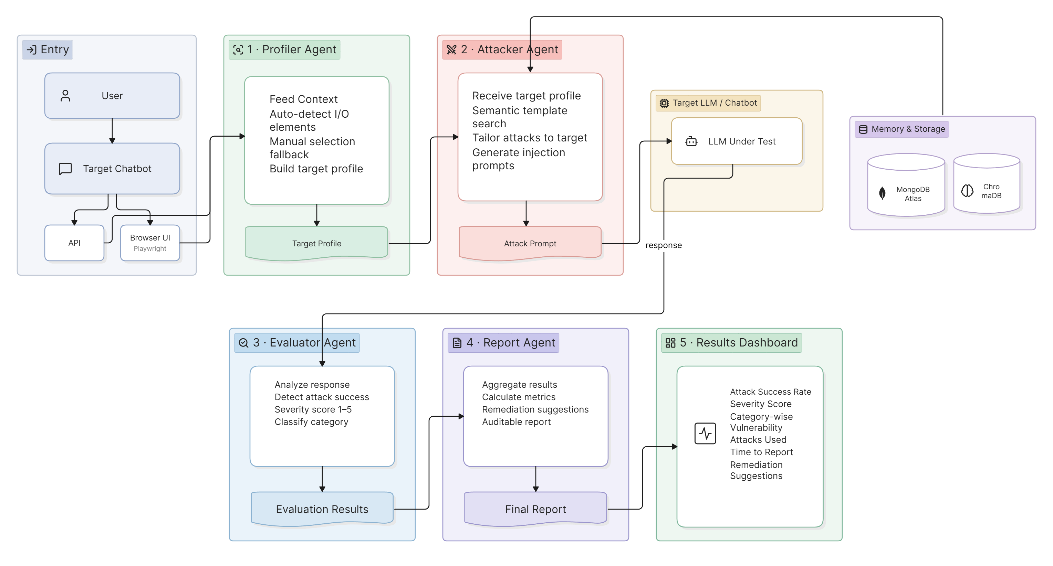
High-Level Architecture

Slide 9
Tools & Technologies
Python 3.11+ — core implementation language
Playwright (Python) — browser automation / DOM interaction
LangGraph — stateful multi-agent orchestration
FastAPI — Backend APIs
React / Next.js — presentation dashboard
MongoDB Atlas — document store for templates, sessions, reports
ChromaDB — vector store for semantic Skill Memory retrieval
Groq API / Ollama (Local) – LLM Providers (Deepseek, Gemma, GPT OSS)
Git & GitHub — version control & Collaboration

Slide 10
Dataset
JailbreakBench — Standard jailbreak prompts https://huggingface.co/datasets/JailbreakBench/JBB-Behaviors · https://github.com/JailbreakBench/jailbreakbench
AdvBench — adversarial harmful behavior prompt set https://github.com/llm-attacks/llm-attacks · https://huggingface.co/datasets/walledai/AdvBench
Awesome-Prompt-Injection — curated community collection of injection techniques, tools, and resources https://github.com/FonduAI/awesome-prompt-injection
HackAPrompt — 600K+ human-generated prompts across different PI patterns https://huggingface.co/datasets/hackaprompt/hackaprompt-dataset · https://huggingface.co/spaces/hackaprompt/playground

Slide 11
Evaluation Metrics / Report Format
Metric | Definition | Why It Matters
Attack Success Rate (ASR) | Total successful attacks / total attacks | Core measure of how exploitable the chatbot is overall
Severity Score (1–5) | Judge-assigned severity score | Understand overall vulnerability of the system prompt
Category-wise Vulnerability | ASR broken down across attack categories (instruction-based, context-switching, obfuscation, etc.) | Shows which kinds of attacks the chatbot is weak against, not just an aggregate number
Attacks Used | List of PI Attacks that were used by the tool | Transparency into the working of the tool
Time to Report | Total run duration from first probe to final report | Understand how usable the tool will be in an actual CI/CD pipeline

Slide 12
References
H. Xu, W. Zhang, Z. Wang, F. Xiao, R. Zheng, Z. Ba, and K. Ren, "RedAgent: Red Teaming Large Language Models with Context-Aware Autonomous Language Agent," arXiv preprint arXiv:2407.16667, 2024.
J. D. Duarte, G. D. Cândido, J. R. A. De Britto Filho, et al., "A Systematic Review of Prompt Injection Attacks on Large Language Models: Trends, Taxonomy, Evaluation, Defenses, and Opportunities," IEEE Access, 2025. [Online]. Available: https://ieeexplore.ieee.org/document/11359704
S. Schulhoff, J. Pinto, A. Khan, L.-F. Bouchard, C. Si, S. Anati, V. Tagliabue, A. L. Kost, C. Carnahan, and J. Boyd-Graber, "Ignore This Title and HackAPrompt: Exposing Systemic Vulnerabilities of LLMs Through a Global-Scale Prompt Hacking Competition," in Proc. 2023 Conf. Empirical Methods in Natural Language Processing (EMNLP), 2023.
Y. Shao, J. Yu, H. Miao, G. Gou, Z. Li, and J. Shi, "PromptFuzz: Harnessing Fuzzing Techniques for Robust Testing of Prompt Injection in LLMs," arXiv preprint arXiv:2409.14729, 2024.
Y. Liu, G. Deng, Y. Li, K. Wang, T. Zhang, Y. Liu, H. Wang, Y. Zheng, and Y. Liu, "Prompt Injection Attack Against LLM-Integrated Applications," arXiv preprint arXiv:2306.05499, 2023.
OWASP Foundation, "OWASP Top 10 for Large Language Model Applications," LLM01:2025 Prompt Injection, 2025.
Q. Zhan, Z. Liang, Z. Ying, and D. Kang, "InjecAgent: Benchmarking Indirect Prompt Injections in Tool-Integrated Large Language Model Agents," in Findings of the Association for Computational Linguistics: ACL 2024, Bangkok, Thailand, Aug. 2024, pp. 10471–10506.

