Slide 1
Introduction to the C++ Multithreading Libraries

Slide 2
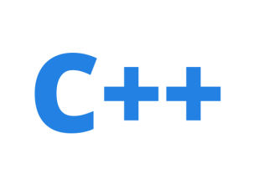
Concurrent Models
Generally there are 2 types of concurrent programming models
Multiprocessing
Multithreading
Multiprocessing
Each process has only one thread running.
All the processes communicate with each other thru a inter-process communication channel, such as files, pipes, message queues etc.,
Advantage: Can be run on distributed system
Dis-advantage:Slow to start and involves a lot of overheads.
Multithreading
A single process may contain two or more threads .
Each of these threads communicate with each other thru a shared memory.
Advantage: Very fast to start and low overhead.
Dis-advantage: Cannot be run on distributed system & difficult to implement.
Process 1
Process 2
Inter-process communication
Shared Memory
Single Process
11

Slide 3
Multithreading in C++ 11
Objective: How to create or write C++ code that make use of multi-core processors
Thread : A thread is a software entity and it represents an independent unit of execution in a program.
A std::thread object represents a single thread of execution.
C++ 11 multithreading library abstracts away all the platform-specific code, you can easily write sophisticated and portable code that runs across all major platforms.
For example: on POSIX systems, a std::thread uses the Pthreads API, and on Win32 it uses the native CreateThread and related calls.
A std::thread object is normally constructed by passing the threading function or method it is to run.
11

Slide 4
Life of a thread
Each process starts with one thread, the master or main thread.
Before a new thread can be used, it must be created.
The main thread can have one or more child threads.
Each thread executes independently of the other threads.
An application should make the best use of its threads because each thread may run on its own processor and the presence of idle threads is synonymous with resource waste.
11

Slide 5
Life of a thread (contd...)
Parameter to a thread object can be any callable entity, that is
A global function
A static method of a class
A named Function object
A nameless Function object, subject to it is wrapped within parenthesis.
Joining of thread or detaching it can only be done once.
It is a good idea to verify whether a thread is 'joinable' before trying to 'join' it.
The decision of joining a thread or detaching thread has to be made before the thread object goes out of scope.
The thread objects cannot be copy constructed & can only be 'moved' [Transfer ownership]
Parameters to a thread object are always passed by value.
Blindly calling a 'join' on a detached thread is not advisable.
11

Slide 6
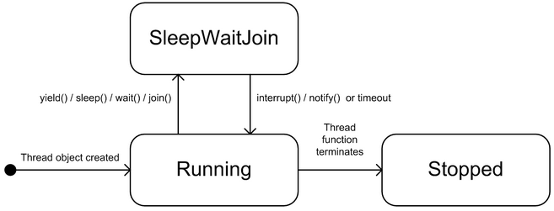
Life of a thread (contd)
What is happening in a thread after it has been created and it is yet to be destroyed? A general answer is that it is either executing or not executing. The latter state may have several causes:
It is sleeping.
It is waiting on some other thread.
It is blocked, that is it is waiting on system resources to perform an input or output operation.
The scheduler is responsible for some of the transitions between states:
Running: the thread has been created and is already started or is ready to start (this is a runnable state). The scheduler has allocated processor time for the thread.
SleepWaitJoin: the thread is waiting for an event to trigger. The thread will be placed in the Running state when this event triggers.
Stopped: the thread function has run its course (has completed).
11

Slide 7
How threads communicate
A multi-threaded application consists of a collection of threads.
Each thread is responsible for some particular task in the application.
In order to avoid anarchy we need to address a number of important issues:
Synchronisation:
Ensuring that an event in one thread notifies another thread. This is called event synchronisation.
Another type of synchronisation is mutual exclusion that gives a thread exclusive access to a shared variable or to some other resource for a certain amount of time. This ensures the integrity of the shared variable when multiple threads attempt to access and modify it. We place a lock on the resource and failure to do this may result in a race condition. This occurs when multiple threads share data and at least one of the threads accesses this data without using a defined synchronisation mechanism.
Scheduling:
we order the events in a program by imposing some kind of scheduling policy on them. In general, there are more concurrent tasks to be executed than there are processors to run them. The scheduler synchronises access to the different processors on a CPU. Thus the scheduler determines which threads are currently executing on the available processors.
11

Slide 8
The C++ 11 thread class
This class represents a thread. It has member functions for creating threads, firing up threads, thread synchronisation and notification, and finally changing thread state.
There are three constructors in thread:
Default constructor.
Create a thread with an instance of a callable type (which can be a function object, a global or static function) as argument. This function is run when the thread fires up that is, after thread creation.
Create a thread with a callable type and its bound arguments to the thread constructor.
The callable type – which plays the role of the thread function – can be a free function, a static member function or a function callable object.
The thread function has a 'void' return type and when it has finished the thread that called it will stop executing.
11

Slide 9
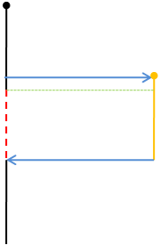
Multithreading in C++ 11
When working with std:thread you should use the following header file:
#include <thread >
and the following namespace:
(a)
using namespace std;
The application starts, and the main thread runs at (a).
Then at (b), the main thread spawns the worker thread by constructing a thread object with the worker function.
Right after, at (c), the main thread calls join on the thread, which means it will go to sleep (and not consume any CPU time) until the worker thread has completed.
As soon as the worker thread is created at (b), it will start execution.
At some point later at (d), the worker completes.
Since the main thread was joining on its completion, main wakes up and continues running.
It finishes at (e) and the process terminates.
(b)
(c)
(d)
11
(e)

Slide 10
Thread creation
Type 1: A Thread Function
std::thread Thread1(&function-name);
Type 2: Function with Arguments
void fun(const char *p, int x);
std::thread Thread1(&fun, “Hello”, 100);
Type 3: Functor
class Func {…}; //expected to have function operator overloaded
Func fObject;
std::thread Thread1(fObject);
Type 4: Object method
class Func {…}; //expected to have function ‘myFun’
Func fObject;
std::thread Thread1(&Func::myfun, &fObject); // Syntax 1, if this statement is inside a global function.
std::thread Thread1(&Func::myfun, this); // Syntax 2, if this statement is inside a member function
11

Slide 11
packaged_task<>
A thread class instance cannot help us hold return values of the function spawned as a thread directly. To overcome this deficiency, we wrap the function that has to be spawned as thread in an object of the type ‘packaged_task’.
And then provide the packaged_task instance as a parameter to the thread instance. By using ‘get_future’ member function we can access the functions return result, which would be stored in a special memory called “shared memory”.

Slide 12
// Create a packaged_task<> that encapsulated the callback i.e. a function
std::packaged_task<std::string (std::string)> task(getDataFromDB);
task
getDataFromDB
-------------
String(*fp)(string);
String* pointee;
// Fetch the associated future<> from packaged_task<>
std::future<std::string> result = task.get_future();
Upon thread getting spawned with ‘task’ as its object, the result returned by the function is stored on the shared memory.
result
String* pointee;
Data fetched from DB by Filter ::Args
Shared_memory

Slide 13
// Create a packaged_task<> that encapsulated the callback i.e. a function
std::packaged_task<std::string (std::string)> task(getDataFromDB);
task
getDataFromDB
-------------
String(*fp)(string);
String* pointee;
// Fetch the associated future<> from packaged_task<>
std::future<std::string> result = task.get_future();
data
Data fetched from DB by Filter ::Args
Upon thread getting spawned with ‘task’ as its object, the result returned by the function is stored on the shared memory.
result
String* pointee;
result.get();
Data fetched from DB by Filter ::Args
Upon the value getting retrieved from the shared memory with the help of ‘get’ function call, the shared memory will get de-allocated.
Shared_memory

Slide 14
Thread synchronization
One of the attention points when writing multi-threaded code is to determine how to organise threads in such a way that access to shared data is done in a controlled manner.
This is because the order in which threads access data is non-deterministic and this can lead to inconsistent results; called race conditions. A classic example is when two threads attempt to withdraw funds from an account at the same time. The steps in a sequential program to perform this transaction are:
Check the balance (are there enough funds in the account?).
Give the amount to withdraw.
Commit the transaction and update the account.
When there are two threads involved then steps 1, 2 and 3 will be interleaved which means the threads can update data in a non-deterministic way. For example, the scenario in following table shows that after withdrawing 70 and 90 money units the balance is -60 money units which destroys the invariant condition.
Thread 1 | Thread 2 | Balance
If(70 > balance) |  | 100
 | If(90 > balance) | 100
balance = balance - 70 |  | 30
 | balance = balance - 90 | -60
11

Slide 15
Mutex
Helps in synchronization of accessing a common resource.
In general any global resource under a lock can still be accessed by a some other thread by by-passing the lock.
Any global resource if it has to be totally protected by an mutex completely, a mutex must be completely bounded to the resource it is protecting.
Design interface appropriately such that the data is thread safe.
It is a good idea to lock mutexes in the same order across functions, failing which it could lead to situation called dead-lock.
In other words encapsulate the resource, that is make both the resource as well as the mutex object as class data member.
11

Slide 16
Regular Mutex
The simplest form of mutex is a regular std::mutex.
You lock and unlock it, and only one thread can lock the mutex at a time.
Any thread that calls lock() on a mutex held by another thread will block indefinitely (an important factor when considering synchronisation).
11

Slide 17
Timed Mutex
The std::timed_mutex class is a subtype of std::mutex, which adds the ability to specify a timeout.
For example, you may wish to try to lock the mutex but give up after a certain time if you cannot obtain a lock.
This takes either an absolute time, or a relative time.
If the mutex cannot be obtained within the time specified, the call will return false and the mutex is not held.
If the mutex is locked within the timeout period, it returns true.
11

Slide 18
Recursive Mutex
Normally a mutex is locked only once, then unlocked.
Depending on the structure of your application, there may be times when it would be useful to be able to lock a mutex multiple times on the same thread (in very special circumstances, such as nested method calls).
By using a recursive mutex, it can be locked as many times as necessary, provided it is unlocked the same number of times.
Thus all these methods can be called individually, as they all lock the resources, and in a nested fashion, as the mutex can be locked multiple times.
Provided the mutex is unlocked the same number of times (which is a matter of care and thought), the mutex will be correctly released by the end of the nested operation.
11

Slide 19
Shared Mutex
Some concurrency scenarios involve having one writer and many readers.
For example, one thread may be downloading data from the network, while another thread is displaying the data on the screen, and a third thread is saving the data to a database.
So the downloading thread will be locking for writing, and the other two only for reading.
There is therefore no reason why the display thread and the database thread (which both only read the shared resource) need to exclude the other; concurrent reading is perfectly safe.
17

Slide 20
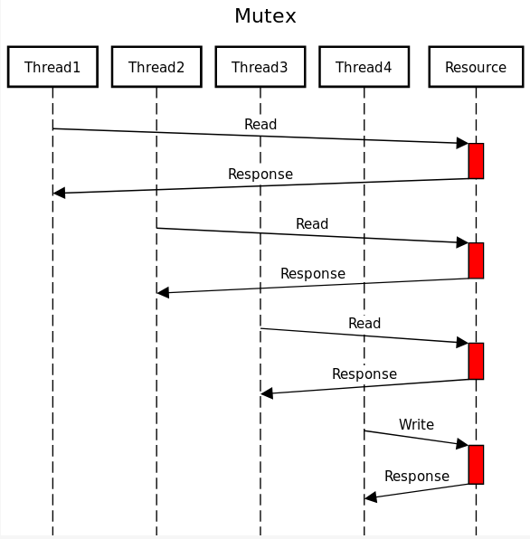
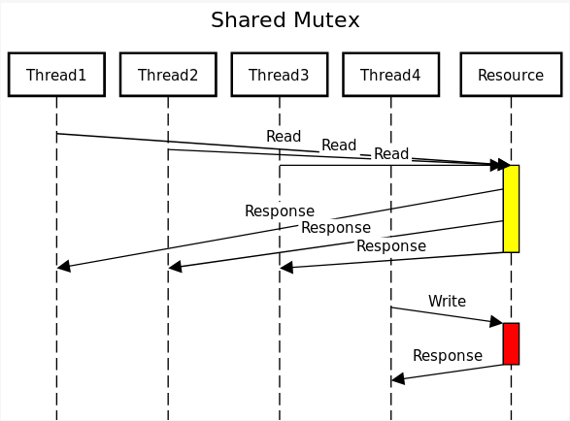
Shared Mutex
The image shows how multiple readers can access the same resource at the same time, but when a writer has the resource, nobody else can access it. If we were using a regular mutex, the program would run slower because all threads would have to wait for the mutex:
17

Slide 21
Summary
The table below summarises the difference mutex types, and their main distinguishing features:
std::mutex | Normal mutex, most commonly used, blocking lock | has lock() and try_lock()
std::timed_mutex | Adds ability to timeout waiting for a lock | adds timed_lock() to wait for lock with a timeout
std::recursive_mutex | `lock()` can be called multiple times on the “same” thread
std::shared_mutex | lock can be upgraded to allow multiple readers or a single writer | can upgrade locks (R->W)

Slide 22
Dead Locks
In a non-trivial application, there may be several threads and numerous mutexes.
When more than one thread locks more than one mutex, there arises the potential for a condition known as a deadlock.
This is where one thread is holding a lock while waiting for another to become available, while a second thread is holding the second lock and waiting for the first lock to become available.
Since they are both waiting for each other to finish, neither can run.
This deadlocked situation can be more involved, whereby several threads form a ring of holding and waiting for locks.
This is illustrated in the following diagram.
11

Slide 23
Avoiding Dead Locks
Prefer locking single mutex.
Avoid locking a mutex and then calling a user provided function
Use the global 'lock' to lock more than one mutex, other wise
Lock the mutex in the same order.
11

Slide 24
Thread Notification
wait(): thread A releases the lock when wait() is called; A then sleeps until another thread B calls notify().
notify(): signals a change in an object related to thread B. Then one waiting thread (in this case A) wakes up after the lock has been released.
notify_all(): this has the same intent as notify() except that all waiting threads wake up.
11

Slide 25
Condition Variable
Whenever threads need to asynchronously signal to one another that an event has occurred or a condition is true, A condition variable becomes handy.
A condition variable, which acts like a flag or signal that can be used to safely and efficiently notify() one or more other threads asynchronously that a condition is true.
The code which manages the state creates the condition variable and updates it, using the condition to notify others of the change in state.
Implementation details: There are two important details relating to how condition variables are implemented that affect their use:
A condition variable must be protected by a mutex, and
A condition variable needs an actual variable to be used as a flag.
Declaring a Condition variable
std::condition_variable data_ready_cond;
std::mutex data_ready_mutex;
bool data_ready = false;
The code which is interested in monitoring the state can wait() (a blocking call) on the condition (which means it needs to be in a separate thread) where it will consume no cycles until the condition is raised.
11

Slide 26
std::future
The std::future<> template is used to represent the result of a computation that potentially happens in the future.
An object of type std::future<T> represents a proxy for an object of type T that will potentially be produced in the future.
Loosely speaking, std::future enables a calling code to wait or block for an event to happen—the event of producing a value of a certain type.
This mechanism can be used to signal events and pass values or exceptions from one thread to another.
11

Slide 27
std::promise
The producer of the value or the source of the event needs a way to communicate with the future object in the calling thread.
For this, an object of type std::promise<T>,associated with the future object in the calling thread, is used to signal events and send values.
Thus std::future and std::promise objects work in pairs to signal events and pass values across threads.
11

Slide 28
std::promise & std::future
A std::promise is a input channel & std::future is an output channel, Objects of both these classes establish a safe communication channel between threads
Thread A
Thread B
std::promise<string> prms;
promise
When a promise object gets constructed a shared state is allocated automatically.
It is in this shared state memory the value will be stored.
Shared State
11

Slide 29
std::promise & std::future
A std::promise is a input channel & std::future is an output channel, Objects of both these classes establish a safe communication channel between threads
Thread A
Thread B
The next step is to obtain the future from the promise.
promise
std::promise<string> prms;
std::future<string> ftr;
ftr = prms.get_future();
future
At this point both future and promise share the shared_state memory.
This shared_state memory is reference counted, when both objects promise and future go out of scope the memory is automatically released.
Shared State
11

Slide 30
std::promise & std::future
A std::promise is a input channel & std::future is an output channel, Objects of both these classes establish a safe communication channel between threads
Thread A
Thread B
We create a thread and pass (move) the promise to the thread.
promise
future
std::promise<string> prms;
std::future<string> ftr;
ftr = prms.get_future();
std::thread th(&thFun, std::move(prms));
The synchronization of the shared state is automatically provided by the system.
If a future object tries to get the value even before promise could set the same, then it will block & wait until the promise sets the value.
Shared State
11

Slide 31
std::promise & std::future
A std::promise is a input channel & std::future is an output channel, Objects of both these classes establish a safe communication channel between threads
std::promise<string> prms;
std::future<string> ftr;
ftr = prms.get_future();
std::thread th(&thFun, std::move(prms));
Thread A
Thread B
promise
future
Thread B
prms.set_value("Hello from future");
Sets the data
Shared State
Hello from future
11

Slide 32
std::promise & std::future
A std::promise is a input channel & std::future is an output channel, Objects of both these classes establish a safe communication channel between threads
std::promise<string> prms;
std::future<string> ftr;
ftr = prms.get_future();
std::thread th(&thFun, std::ref(prms));
Thread A
Thread B
promise
future
Thread A receives the data from shared memory thru future object
As the data gets moved out, the shared state would become invalid thereafter
Shared State
Gets the data
Thread A
std::string str = ftr.get();
Hello from future
11

Slide 33
std::promise & std::future
A std::promise is a input channel & std::future is an output channel, Objects of both these classes establish a safe communication channel between threads
std::promise<string> prms;
std::future<string> ftr;
ftr = prms.get_future();
std::thread th(&thFun, std::move(prms));
Thread A
Thread B
promise
future
After this stage, the shared state changes to an invalid state as the value gets moved.
Under the circumstances calling 'get' for the second time would be an error.
Gets the data
Shared State
Thread A
Hello from future
std::string str = ftr.get();
11

Slide 34
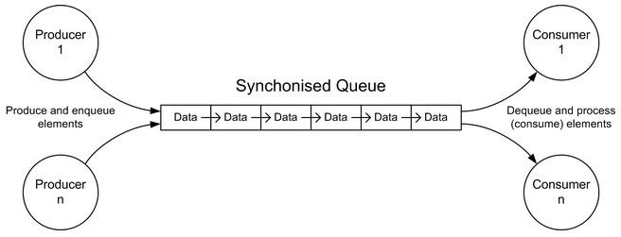
Producer-Consumer Pattern
This pattern is useful in a variety of situations.
There are many applications of this pattern. In general, one or more producer agents write information to a synchronised queue while one or more consumer agents extract information from the queue.
It is possible to extend the pattern to support multiple queues.
The Producer-Consumer Pattern is depicted in Figure
11

Slide 35
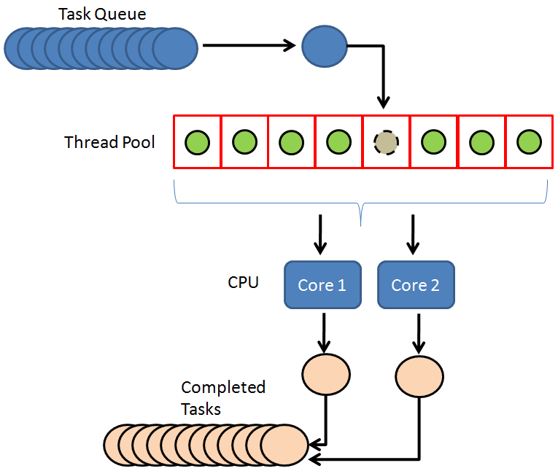
Thread Pool
A thread pool consists of 'm' of threads, created to perform a number n of tasks concurrently. Typically 'm' is not equal to 'n';
Instead, the number of threads is tuned to the computing resources available to handle tasks in parallel (processors, cores, memory).
While the number of tasks depends on the problem and may not be known upfront.
Reasons for using a thread pool, rather than the obvious alternative of spawning one thread per task, are to
prevent the time and memory overhead inherent in thread creation,
and to avoid running out of resources such as open files or network connections (of which operating systems allocate a limited number to running programs).
A common way of distributing the tasks to threads (scheduling the tasks for execution) is by means of a synchronized queue known as a task queue. The threads in the pool take tasks off the queue, perform them, then return to the queue for their next task.
11

