Slide 1
C++20 Modules
For decades, C++ developers have organized their code the same way C does: using header and source code files.
This approach has serious drawbacks such as unnecessary recompilations, weak visibility control, symbol redefinitions, and inclusion order dependencies.
Precompiled headers, pre-processor implementations, and include guards exist solely to work around these problems.
The core issue with the header file mechanism is that it depends on two separate tools: the preprocessor and the linker.
C++20 introduced Modules as a new way to organize the source code.
Modules are a C++20 language feature.
It means that compilers are (mostly) responsible for managing inter-module dependencies.
So, the source code organization is part of the language instead of being delegated to other phases of the building.

Slide 2
C++20 Modules
So far, the most common way to organize C++ source code is by declaring the public interface in a header file, for example in the "My_library.h"
And defining the implementation in a source code file like My_library.cpp
#include <iostream>
#include “My_library.h”
namespace my_namespace
{
// Public method
void CA::print()
{
std::cout << "CA::print() called" << std::endl;
}
// Public function but with incorrect signature (formal parameter is 'int')
void global_Function(int n)
{
std::cout << "PublicFunction(" << n << ")" << std::endl;
}
// Private function. Should not be visible outside this translation unit
static void local_Function()
{
std::cout << "local_Function() called" << std::endl;
}
}
#ifndef MY_LIBRARY_H
#define MY_LIBRARY_H
namespace my_namespace
{
class CA
{
public:
void print();
};
void global_Function(double n);
}
#endif // MY_LIBRARY_H

Slide 3
C++20 Modules
Whoever wants to use or consumer this library, must include the header. The main.cpp file exemplifies this.
#include "My_library.h"
// Forward declarations uncover hidden symbols, postponing error
// checking to the linker
namespace my_namespace
{
void local_Function();
}
int main()
{
// OK: accessing a public symbol
my_namespace::CA ob1;
ob1.print();
// ERROR: using a function that doesn't exist (has an incorrect signature)
my_namespace::global_Function(1.2);
// ERROR: accessing local (i.e. static or private) symbol
my_namespace::local_Function();
return 0;
}

Slide 4
C++20 Modules
The header file works as a contract between My_library.cpp's object file and the consuming main.cpp.
The incorrect use of a symbol is detected only during linking:
$ g++ -c My_library.cpp -o My_library.o
$ g++ -c main.cpp -o main.o
$ g++ main.o My_library.o -o myapp
The header file inclusion is handled by the preprocessor, while their implementation requires linker support.
This means that dependency management depends on two tools in disjoint building phases.
Some dependency errors happen during preprocessing, others during linking.
No single tool has a complete view of the dependencies.
This limits the capability of error diagnostics. Not to mention delaying the error reporting.

Slide 5
C++20 Modules
Modules introduced in C++20 are a replacement for header files with faster compilation times and a syntax that is more familiar to programmers coming from different programming languages.
In contrast to the header’s approach, Modules are a language feature.
This means that dependency management is done during compilation, instead of preprocessing and linking.
Modules boast the following benefits:
You can have just a single file instead of header and source files and not pay the price of a longer compilation time.
This applies to clean compilation.
Recompilation times will still be lower if you split the implementation into a .cpp file.
Dependent units can only see symbols you want them to see.
This extends to macros that don’t propagate outside of their module.
Freely intermix legacy headers with modules for easier adoption.

Slide 6
C++20 Modules
Modules are partially built around the idea that motivated precompiled headers, but on a language level.
Each module interface unit is compiled into a binary representation that can be then consumed by dependent units.
A module interface unit or file would go with the following extension.
MSVC : .ixx
G++ : .cxx
CLANG : .cppm
This means that the dependent units don’t need to parse the source code of the module in every single place where it is being referenced ( import module_name; ) as with included headers.
In other words, module file is compiled only once, while header files are compiled in place of every single #include directive. You can probably see already how that can speed up the compile time.
As the binary representation is more computer friendly than the plaintext header file, it is also faster for the compiler to look for symbol definitions, further speeding up the process.

Slide 7
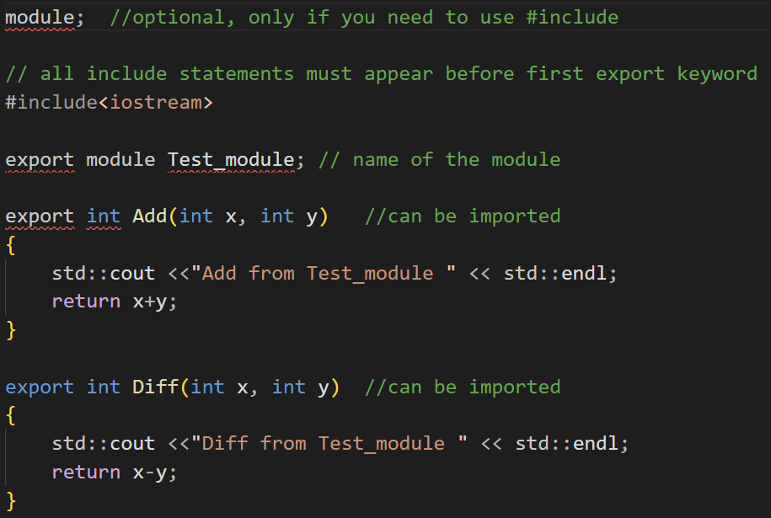
C++20 Modules
Anatomy of a C++ module:
The .cpp file that consumes or imports the module has to explicitly include all headers that were included in the .ixx (or) .cxx (or) .cppm file, as includes are not exported.
The same goes for modules that were imported without the export keyword.

Slide 8
C++20 Modules
As an example, the file My_module.cxx declares a module unit.
/*
Global Module Fragment is used to include headers when
importing the headers is not possible.
*/
module;
/*
Inclusion of header files between the "Global Module Fragment" and
the "Module Declaration".
*/
#include <iostream>
// Module Declaration creates a module unit
export module My_module;
// Namespaces and modules are orthogonal: one module can have multiple
// namespaces, and the same namespace might exist across multiple //modules.
namespace my_namespace
{
// The "export" keyword makes symbols visible outside the
// module.
export class CA
{
void CA::print()
{
std::cout << "CA::print() called" << std::endl;
}
};
// Declaration and definition in the same statement,
//reducing the chances for signature mismatch
export void global_Function(int n)
{
std::cout << "PublicFunction(" << n << ")" << std::endl;
}
// The default visibility is private
static void local_Function()
{
std::cout << "local_Function() called" << std::endl;
}
} // my_namespace ends
We compile this module file using the following command, and then ship to the library consumer.
$ g++ -std=c++20 -c My_module.cxx -fmodules-ts -o My_module.o

Slide 9
C++20 Modules
To use this module, a translation unit (e.g. main.cpp) imports the module by its name.
/*
The "import" declaration makes available in this
(main.cpp) translation unit all declarations and
definitions exported by the "my_module" module
interface unit.
*/
import my_module;
// Forward declarations will no longer be able to
// circumvent the visibility control
namespace my_namespace
{
void local_Function();
}
Misuse of modules is detected during the compilation.
By detecting dependency errors at an earlier stage of the building process, modules save development time.
It optimizes the overall building process, especially for large-scale applications.
int main()
{
// OK: accessing an exported symbol
my_namespace::CA ob1;
ob1.print();
// ERROR: using the incorrect function signature
// detected during compile-time.
my_namespace::global_Function(1.2);
// ERROR: accessing non-exported symbol
// again detected during compile-time.
my_namespace::local_Function();
return 0;
}

Slide 10
C++20 Modules
Modules and Templates
The source code using templates requires access to the template definition to instantiate (i.e. create) a proper implementation of it.
This is why the inclusion model, a header file approach, is the most common way to use templates.
Each template user instantiates its template version and duplicated symbols are managed by the One Definition Rule (ODR).
Depending on the compiler, we can place templates inside modules.
Recent versions of GCC/G++ compiler handle the template instantiation.
There is one caveat though. If the templates use templates themselves, we have to instantiate the templates that they use.
The compiler doesn’t know ahead of time which specializations to create during the module compilation.
Explicit template instantiation can generate these specializations.

Slide 11
C++20 Modules
For example, the module_tmpl.cxx file declares a class and a function template.
module;
#include <iostream>
export module module_tmpl;
namespace my_namespace
{
// export a template class
export template <typename T> class GenericClass
{
public:
void print(T param)
{
std::cout << "GenericClass::print(" << param << ")" << std::endl;
}
};
// export a template function
export template <typename T> void GenericFunction(T param)
{
std::cout << "GenericFunction(" << param << ")" << std::endl;
}
} // namespace my_namespace

Slide 12
C++20 Modules
And the main.cpp file uses/consumes the templates in the module file.
#include <ostream>
import my_module;
int main()
{
my_namespace::GenericClass<int> ob1;
ob1.print(14);
my_namespace::GenericFunction(1.2);
my_namespace::GenericFunction("a string");
return 0;
}
Compiling modules containing templates is the same as compiling regular code.
$ g++ -std=c++20 -c module_tmpl.cxx -fmodules-ts -o module_tmpl.o
$ g++ -std=c++20 -c main.cpp -fmodules-ts -o main.o
$ g++ -std=c++20 main.o module_tmpl.o -o MyApp
$ ./MyApp

