Slide 1
C++ 11
TEMPLATE FEATURES OVERVIEW
VARIADIC TEMPLATES:
These are templates that allow a template to take arbitrary number of arguments.
- Very useful as they perform type computation at compile-time
- They help in implementing type safe functions with arbitrary no. of arguments.
- Help perform argument forwarding.
Syntax :-
An ellipsis is used in two ways by variadic templates. To the left of the parameter name, it signifies a parameter pack, and to the right of the parameter name, it expands the parameter packs into separate names.
Here's a basic example of variadic template class definition syntax:
template<typename... Arguments> class classname;
(OR)
template<typename ...Arguments> class classname;
(OR)
template<typename ... Arguments> class classname;

Slide 2
C++ 11
TEMPLATE FEATURES OVERVIEW
A variadic class template:-
Arguments is template parameter pack
template<typename... Arguments> class classname
{
};
By using a variadic template class definition, you may require at least one parameter:
template<typename T1, typename... Arguments> class classname
{
};
Here's a basic example of variadic template function syntax:
template <typename... Arguments> returntype functionname(Arguments... args){…}
args is function template parameter pack
As with variadic template class definitions, you can make functions that require at least one parameter:
template <typename First, typename... Rest>
returntype functionname(const First& first, const Rest&... args);

Slide 3
C++ 11
TEMPLATE FEATURES OVERVIEW
There are generally 2 operations on an parameter pack…
PARAMETER PACK
EXPANSION
COUNT
A variadic function template expansion:-
template<typename T1, typename... T2> void fun(T1 value, T2...args)
{
cout << value << ",";
fun(args...);
}
template<typename T1> void fun(T1 x)
{
cout << x << endl;
}

Slide 4
C++ 11
TEMPLATE FEATURES OVERVIEW [A variadic function template expansion]
int main()
{
fun(10, 23, 45.12f, 56.78, 200, 'a');
return 0;
}
value
args…
10
23, 45.12f, 56.78, 200, 'a'
23
45.12f, 56.78, 200, 'a'
45.12f
56.78, 200, 'a'
template<typename T1> void fun(T1 x)
{
cout << x << endl;
}
template<typename T1, typename... T2>
void fun(T1 value, T2 ...args)
{
cout << value << ",";
fun(args...);
}
56.78
200, 'a'
200
'a'
'a'

Slide 5
C++ 11
TEMPLATE FEATURES OVERVIEW
Template instantiation & un-packing of the function template parameter pack of the variadic template function in the previous slide can be seen like this…
fun(10,20,45.12f,'c');
STEP 1
template<int, <...>> void fun(int value, <...>args){ }
STEP 2
template<int, <...>> void fun(int value, <...>args){ }
STEP 3
template<float, <...>> void fun(float value, <...>args){ }
STEP 4 - finally
template<char,<>> void fun(char value, <> args){ }
template<char> void fun(char value){ }
Pack has values to process
Pack is now emptied

Slide 6
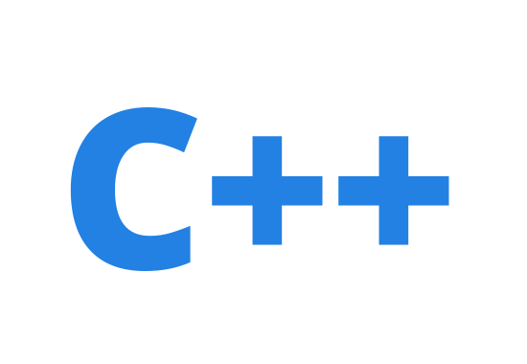
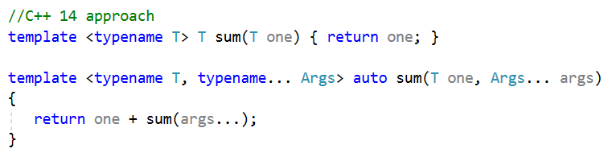
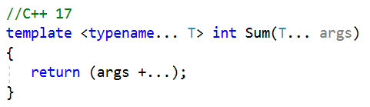
Fold Expression :
17
A very convenient feature in C++17 now, where-in we can do away with explicit unpacking of the parameter pack and an overloaded function to terminate recursion.
Needed to break recursion
Needed to for manual unwinding of parameter pack

Slide 7
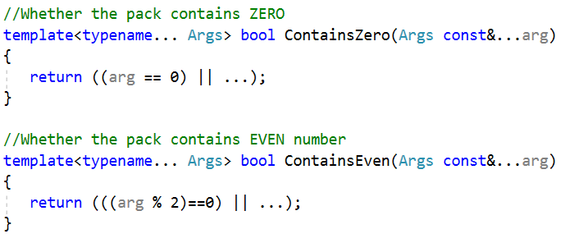
Fold Expression :
17
Also we can make use of this new feature to concatenate an expanded pattern not by a comma separated list but by using an operator for a parameter pack.
For eg: fold expressions allow you to apply the same unary or binary operator to all elements of a parameter pack without going to the trouble of manually expanding the pack.
Where it would be expanded as
((arg1 == 0) || (arg2 == 0) || ... || (argN == 0))

Slide 8


Fold Expression :
17
Unary right fold: If args is an empty pack, this is ill-formed for any operators but ||, && and , which will yield false, true and void(), respectively.
(arg1 + (arg2 + ( ... + argN)))
Binary right fold: Where X is some expression that is not a parameter pack. If arg is empty, this evaluates to X
(arg1 * ( ... * (argN * X))
Unary left fold: Like unary right fold, but with left association. The restrictions of unary right fold apply.
(((arg1 | arg 2) | ... ) | argN)
Binary left fold:
(((X > arg1) > ... ) > argN))

Slide 9
C++ 11
TEMPLATE FEATURES OVERVIEW
VARIADIC CLASS : A type that is capable of holding zero or more values, the types of which are specified as template arguments.
template<typename... Values> class Variadic;
A Variadic with zero arguments are easy to handle, because an empty specialization suffices:
template<> class Variadic <>{ };
The most important part of the Variadic class implementation is the recursive case, where we peel off the first argument (the Head) to be stored in the head data member, then derive from a Variadic class containing the remaining arguments (the Tail).
template<typename Head, typename... Tail>
class Variadic<Head, Tail...> : private Variadic<Tail...>
{
private:
Head head;
//...
};

Slide 10
C++ 11
TEMPLATE FEATURES OVERVIEW
Template instantiation & un-packing of the template parameter pack of the variadic class template can be seen like this…
Pack is empty
Variadic<int> obj1
class Variadic<int,< >>:private Variadic <Variadic< >>
{ };
Variadic<int, float> obj1;
class Variadic<int,<...>>:private Variadic<<...>> //step 1
{ };
class Variadic<int,float,<>>:private Variadic<< >> //step 2
{ };
Variadic<int, float, double> obj1;
class Variadic<int, <...>>:private Variadic<<...>> //step 1
{ };
class Variadic<int, float, <...>>:private Variadic<<...>> //step 2
{ };
class Variadic<int, float, double, < >>:private Variadic<< >> //step 3
{ };
Pack has values to process
Pack is now emptied

