Slide 1
Penumacha Naveen Kumar
05-06-2024

Slide 2


Executive
Summary
Introduction
Methodology
Results
Conclusion
Appendix

Slide 3
Executive Summary
Summary of methodologies
Summary of all results

Slide 4
Introduction
Project background and context.
_{the cost} The most prosperous business of the commercial space era, SpaceX has reduced _{start at} of space travel. On its website, the firm promotes Falcon 9 rocket flights, which _{dollars} 62 million dollars; in comparison, other suppliers charge up to 165 million
_{to reus} per launch; a large portion of the cost savings are attributable to SpaceX's ability e the first stage. Thus, we can calculate the launch cost if we can ascertain if the
first stage will land. We will forecast if SpaceX will reuse the first stage based on
available data and machine learning techniques.
Problems you want to find answers
-How do variables such as payload mass, launch site, number of flights, and orbits affect the success of the first stage landing?
-Does the rate of successful landings increase over the years?

Slide 5


Slide 6
Methodology
Executive Summary
Data collection methodology:
Using SpaceX Rest API
Using Web Scrapping from Wikipedia
Perform data wrangling
Filtering the data , Dealing with missing values.
Using One Hot Encoding to prepare the data to a binary classification
Perform exploratory data analysis (EDA) using visualization and SQL
Perform interactive visual analytics using Folium and Plotly Dash
Perform predictive analysis using classification models
Building, tuning and evaluation of classification models to ensure best results

Slide 7
Data Collection
Data collection process involved a combination of API requests from
SpaceX REST API and Web Scraping data from a table in SpaceX’s Wikipedia entry.
We had to use both of these data collection methods in order to get complete information about the launches for a more detailed analysis.
Data Columns are obtained by using SpaceX REST API: FlightNumber,
Date, BoosterVersion, PayloadMass, Orbit, LaunchSite,Outcome,
Flights, GridFins, Reused, Legs, LandingPad, Block, ReusedCount, Serial, Longitude, Latitude
Data Columns are obtained by using Wikipedia Web Scraping: Flight
No., Launch site, Payload, PayloadMass, Orbit, Customer, Launch outcome, Version Booster, Booster landing, Date, Time

Slide 8
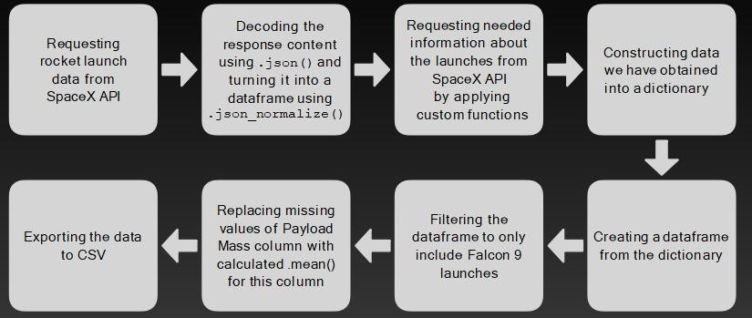
Data Collection – SpaceX API

Slide 9
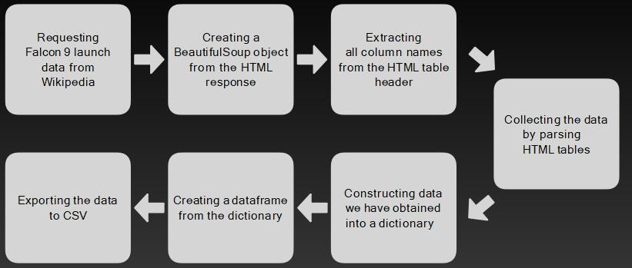
Data Collection - Scraping

Slide 10
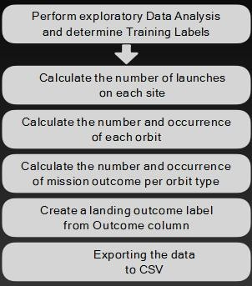
Data Wrangling
There are multiple instances in the data set where the booster failed to land successfully. Sometimes a landing attempt was made but was unsuccessful due to an accident; for instance, a landing that was successful in reaching a particular area of the ocean is known as a True Ocean, whereas a landing that was unsuccessful in reaching a certain area of the ocean is known as a False Ocean. If the mission was successful, the landing on a ground pad is indicated by true RTLS.
A false RTLS indicates an unsuccessful landing. Real ASDS denotes a mission outcome that was accomplished through a drone ship landing. False ASDS refers to a drone ship landing that was unsuccessful.
Mostly, we turn those results into Training Labels, where "0" denotes an unsuccessful booster landing and "1" indicates a successful booster landing.

Slide 11
EDA with Data Visualization
Charts plotted are:
Flight Number vs. Payload Mass, Flight Number vs. Launch Site, Payload Mass vs. Launch Site, Orbit Type vs. Success Rate, Flight Number vs. Orbit Type,
Payload Mass vs Orbit Type and Success Rate Yearly Trend
why you used those charts
Scatter plots show the relationship between variables. If a relationship exists, they could be used in machine learning model.

Slide 12
EDA with SQL
Performed SQL Queries :
Displaying the names of the unique launch sites in the space mission
Displaying 5 records where launch sites begin with the string ‘CCA’
Displaying the total payload mass carried by boosters launched by NASA (CRS)
Displaying average payload mass carried by booster version F9 v1.1
Listing the date when the first successful landing outcome in ground pad was achieved
Listing the names of the boosters which have success in drone ship and have payload mass
greater than 4000 but less than 6000
Listing the total number of successful and failure mission outcomes
Listing the names of the booster versions which have carried the maximum payload mass
Listing failed landing outcomes in drone ship, their versions and launch site names for months
in year 2015
Ranking the count of landing outcomes (such as Failure (drone ship) or Success (ground pad))
between the date 2010-06-04 and 2017-03-20 in descending order

Slide 13
Build an Interactive Map with Folium
Markers of all Launch Sites:
_{Space Center usi}- Added Marker with Circle, Popup Label and Text Label of NASA Johnson ng its latitude and longitude coordinates as a start location.
- Added Markers with Circle, Popup Label and Text Label of all Launch Sites
using their latitude and longitude coordinates to show their geographical locations and
proximity to Equator and coasts.
Colored Markers of the launch outcomes for each Launch Site:
_{Marker Cluster t}- Added colored Markers of success (Green) and failed (Red) launches using o identify which launch sites have relatively high success rates.
Distances between a Launch Site to its proximities:
_{39A (as an exa} - Added colored Lines to show distances between the Launch Site KSC LC- mple) and its proximities like Railway, Highway, Coastline and Closest City.

Slide 14
Build a Dashboard with Plotly Dash
Launch Sites Dropdown List:
- Added a dropdown list to enable Launch Site selection.
Pie Chart showing Success Launches:
- Added a pie chart to show the total successful launches count for all sites
and the Success vs. Failed counts for the site, if a specific Launch Site was selected.
Slider of Payload Mass Range:
- Added a slider to select Payload range.
Scatter Chart of Payload Mass vs. Success Rate for the different Booster Versions:
_{Launch Success.} - Added a scatter chart to show the correlation between Payload and

Slide 15
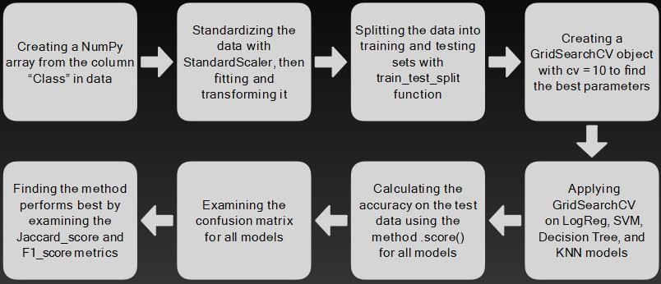
Predictive Analysis (Classification)

Slide 16

Results
Exploratory data analysis results
Interactive analytics demo in
screenshots
Predictive analysis results

Slide 17

EDA with visualization

Slide 18
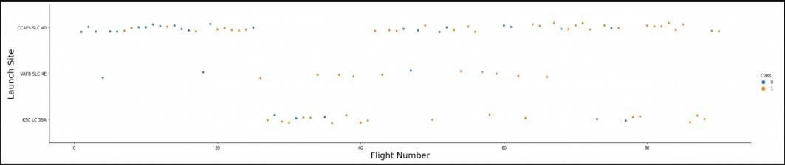
Flight Number vs. Launch Site
Flight Number vs. Launch Site
The earliest flights all failed while the latest flights all succeeded.
The CCAFS SLC 40 launch site has about a half of all launches.
VAFB SLC 4E and KSC LC 39A have higher success rates.
It can be assumed that each new launch has a higher rate of success.

Slide 19
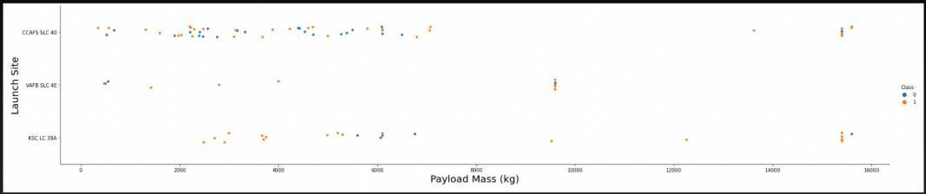
Payload vs. Launch Site
Payload vs. Launch Site
For every launch site the higher the payload mass, the higher the success rate.
Most of the launches with payload mass over 7000 kg were successful.
KSC LC 39A has a 100% success rate for payload mass under 5500 kg too.

Slide 20
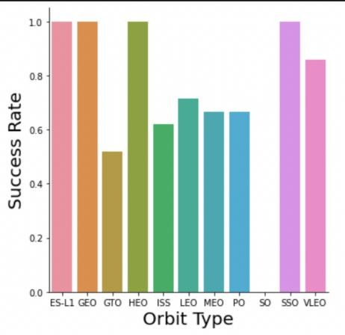
Success Rate vs. Orbit Type
Orbits with 100% success rate:- ES-L1, GEO, HEO, SSO.
Orbits with 0% success rate:- SO.
Orbits with success rate between 50% and 85%:- GTO, ISS, LEO, MEO, PO.

Slide 21
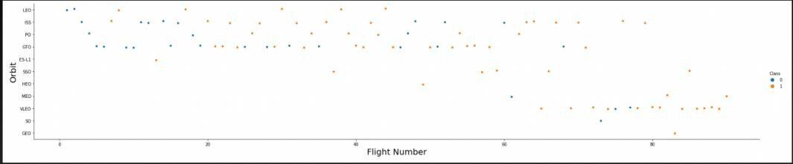
Flight Number vs. Orbit Type
In the LEO orbit the Success appears related to the number of flights on the other hand, there seems to be no relationship between flight number when in GTO orbit.

Slide 22
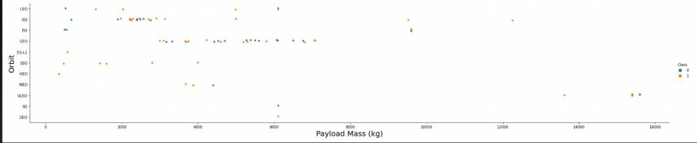
Payload vs. Orbit Type
Heavy payloads have a negative influence on GTO orbits and positive on GTO and Polar LEO (ISS) orbits.

Slide 23
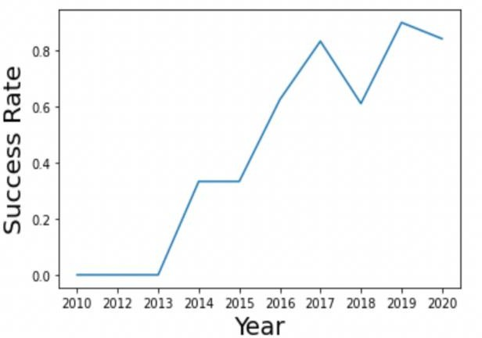
Launch Success Yearly Trend
The success rate since 2013 kept increasing till 2020 and there is a slight decrease in year 2017.

Slide 24
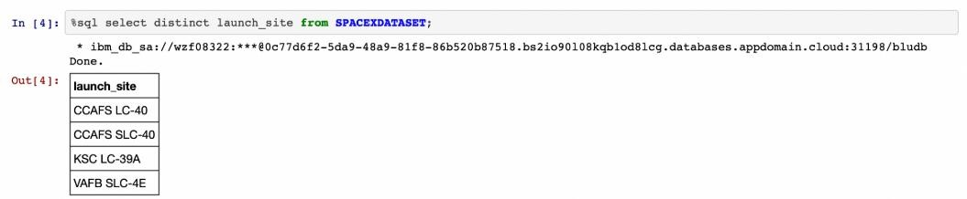
All Launch Site Names
Displaying the names of the unique launch sites in the space mission.

Slide 25
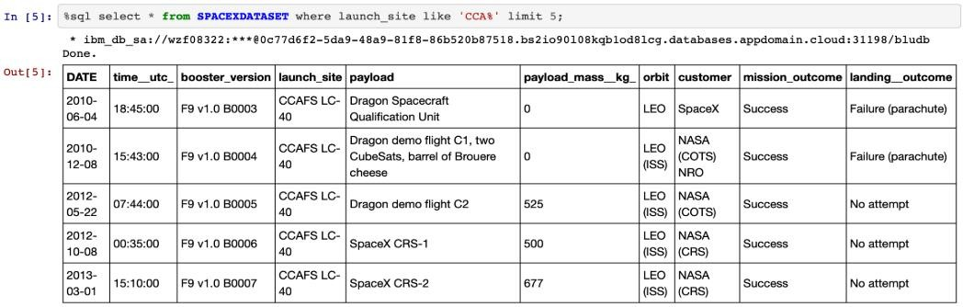
Launch Site Names Begin with 'KSC'
Displaying 5 records where launch sites begin with the string 'CCA'.

Slide 26
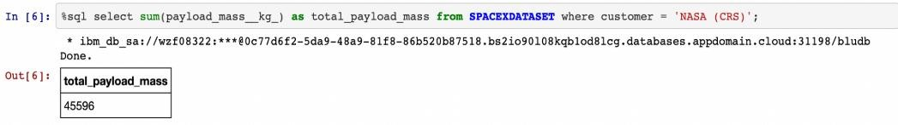
Total Payload Mass
Displaying the total payload mass carried by boosters launched by NASA (CRS).

Slide 27
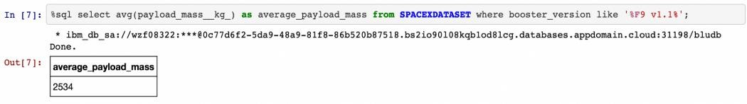
Average Payload Mass by F9 v1.1
Displaying average payload mass carried by booster version F9 v1.1.

Slide 28
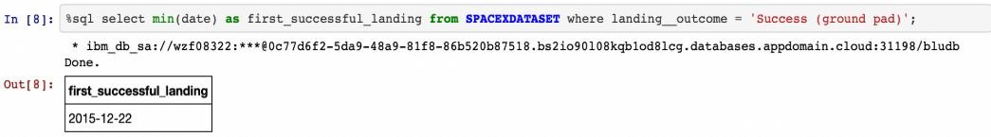
First Successful Ground Landing Date
Listing the date when the first successful landing outcome in ground pad was achieved.

Slide 29
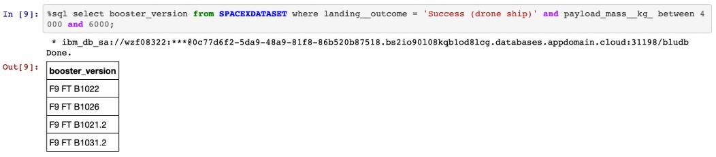
Successful Drone Ship Landing with
Payload between 4000 and 6000
Listing the names of the boosters which have success in drone ship and have payload mass greater than 4000 but less than 6000.

Slide 30
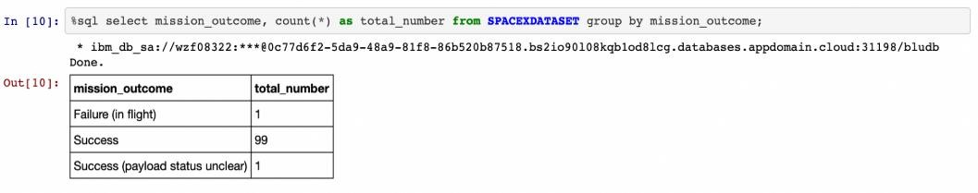
Total Number of Successful and
Failure Mission Outcomes
Listing the total number of successful and failure mission outcomes.

Slide 31
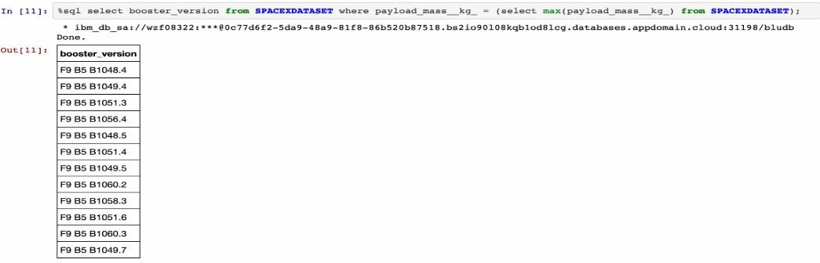
Boosters Carried Maximum Payload
Listing the names of the booster versions which have carried the maximum payload mass.

Slide 32
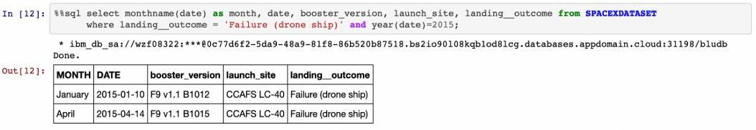
2015 Launch Records
Listing the failed landing outcomes in drone ship, their booster versions and launch site names for the months in year 2015.

Slide 33
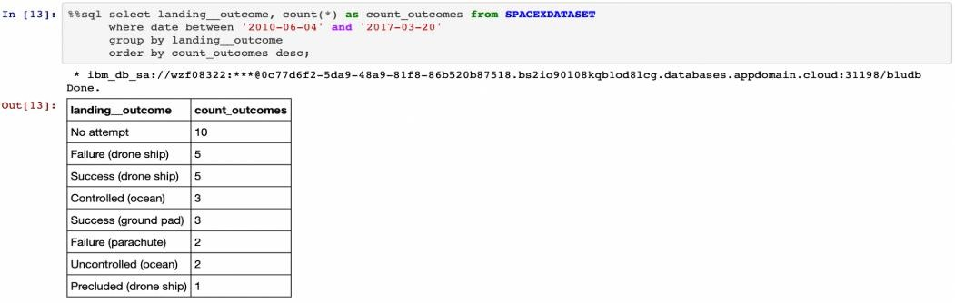
Rank Landing Outcomes Between
2010-06-04 and 2017-03-20
Ranking the count of landing outcomes (such as Failure (drone ship) or Success(ground pad)) between the date 2010-06-04 and 2017-03-20 in descending order.

Slide 34


Slide 35
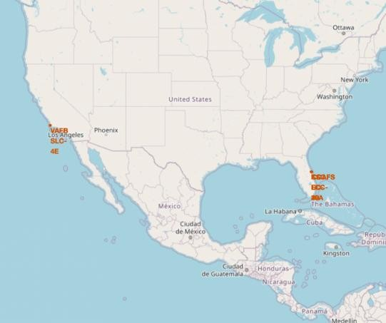
All launch sites’ location markers on a
global map
The majority of launch sites are close to the Equator. At the equator, land moves more quickly than it does anywhere else on Earth's surface. At the equator, everything on Earth is already travelling at a speed of 1670 km/h. A ship launched from the equator travels through space at the same speed as it did prior to launch, as well as around the planet. Inertia is the cause of this. This velocity will assist the spacecraft in maintaining a sufficient speed to remain in orbit.

Slide 36
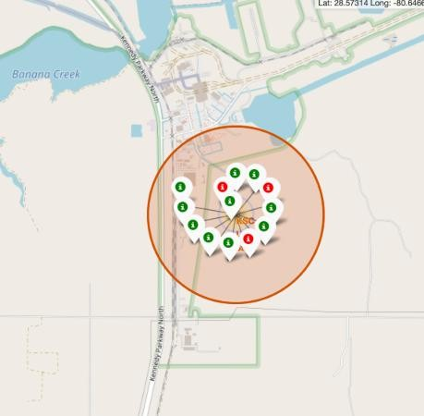
Color-labeled launch records on the
map
Explanation :
From the color-labeled markers we should be able to easily identify which launch sites have relatively high success rates.
Green Marker = Successful Launch
Red Marker = Failed Launch
Launch Site KSC LC-39A has a very high Success Rate.

Slide 37
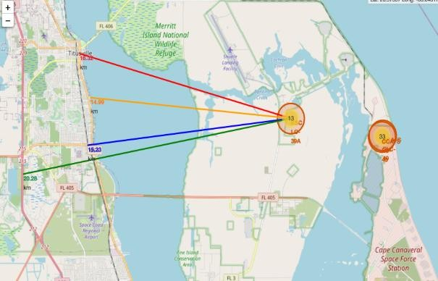
Distance from launch site KSC LC-39A
to its proximities
Explanation :
From the visual analysis of the launch site KSC LC- 39A we can clearly see that it is: relative close to railway (15.23 km), relative close to highway (20.28 km), relative close to coastline (14.99 km)
Also the launch site KSC LC-39A is relative close to its closest city Titusville (16.32 km).
Failed rocket with its high speed can cover distances like 15-20 km in few seconds. It could be potentially dangerous to populated areas.

Slide 38

Dashboard

Slide 39
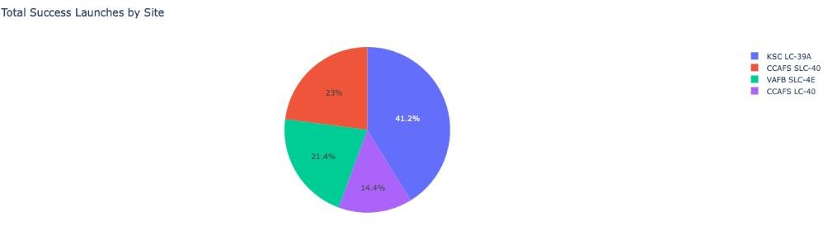
Launch success count for all sites
The chart clearly shows that from all the sites, KSC LC-39A has the most successful launches.

Slide 40
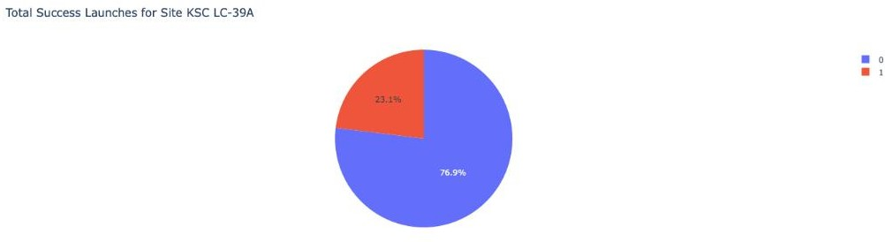
Launch site with highest launch success ratio
KSC LC-39A has the highest launch success rate (76.9%) with 10 successful and only 3 failed landings.

Slide 41
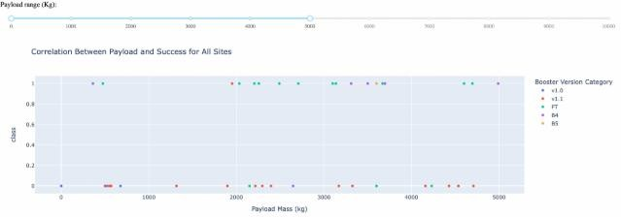
Payload Mass vs. Launch Outcome for all sites
The charts show that payloads between 2000 and 5500 kg have the highest success rate.

Slide 42


Slide 43
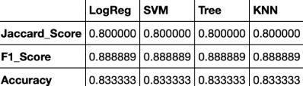
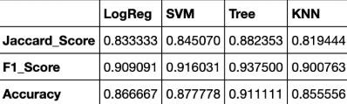
Classification Accuracy
Explanation :
Based on the scores of the Test Set, we can not confirm which method performs best.
Same Test Set scores may be due to the small test sample size (18 samples). Therefore, we tested all methods based on the whole Dataset.
The scores of the whole Dataset confirm that the best model is the Decision Tree Model. This model has not only higher scores, but also the highest accuracy.

Slide 44
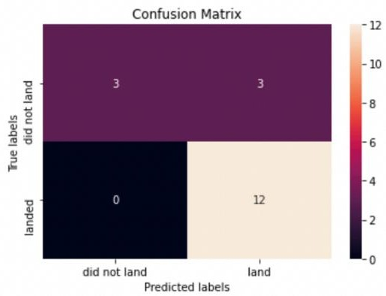
Confusion Matrix
Examining the confusion matrix, we see that logistic regression can distinguish between the different classes. W e s e e t h a t t h e m a j o r problem is false positives.

Slide 45

Conclusions
For this dataset, the optimal algorithm is the Decision Tree Model.
Results from low-payload mass launches are superior to those from large-payload mass launches.
The majority of launch locations are located near the Equator, and every site is extremely close to the coast.
Over time, the success rate of launches rises.
Out of all the locations, KSC LC-39A has the best success percentage for launches.
The success rate for orbits ES-L1, GEO, HEO, and SSO is 100%.

Slide 46


