Slide 1
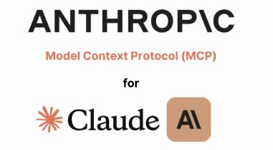
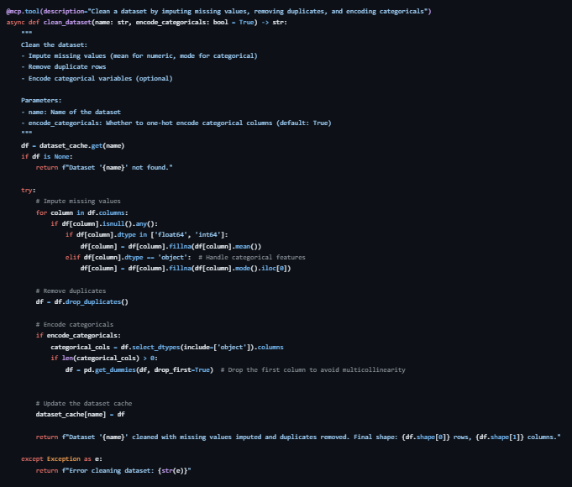
Final Applied AI Project
5/9/2025
AI 2010 - Introduction to Applied AI - Project Poster
Naveen Prabakar
MCP-Auto ML
Model Context Protocol is essentially a server that is built for Large Language Models to use. For example, apps use restful API for functionality and usage of external tools. LLM’s are restricted to text generation and image creation for the most part. With MCP, LLM’s gain access to external API’s and code execution.
With MCP, Auto ML was built. Auto ML is to take in any downloadable dataset for Kaggle and run through a basic machine learning workflow. It will provide brief insights through data statistics and visualization, then train a specified Machine Learning model. After the model is trained, hyperparameter tuning is performed to be able to optimize the model. The model is then saved to AWS S3 for further optimization while the data is saved to MongoDB for future usage.
The workflow below is how the MCP server is set up. Claude AI, which is the front-end for this application, will use the tools in this order to do its tasks upon request. The workflow starts with the submission of a link to a Kaggle dataset
Download Data
Preview Data
Visualize Data
Clean & Transform
This is the starting point of the workflow. Upon a Kaggle URL, Claude will use the download tool to download the dataset and save it in cache
After the download of the dataset. Claude uses the tool to give the users a preview of the dataset. Users can verify the download of the dataset.
After the preview, Claude will use the visualization tool to display histograms of the numerical columns
MongoDB Storage
AWS Storage
Hyper-Parameter
Machine Learning
The dataset is then stored into MongoDB. It can be used for letter use and prevents the repetition of redownloading a dataset
The optimized model is saved to AWS S3. It’s stored in a bucket for future use or optimization
After the training. Hyperparameter is done to optimize the model. Optimization is restricted due to timeout errors
After transforming the dataset. Machine Learning is done on a specified model. The model is then saved to the cache
This is an example code snippet of a MCP tool. This tool transforms the dataset by Label encoding for categories and Normalizing values for numbers
Acknowledgments

