Slide 1
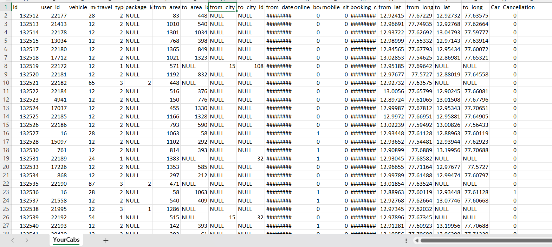
YourCabs Dataset with target as car cancellation

Slide 2
Analysis
ID – need to remove because it is not repeating and no pattern as it is a unique id of booking
User_id – need to remove because it is not repeating and no pattern as it is a unique id of a user as per his mobile number and is comes under PII(personal information identifier) as here we are not removing any one or blocking a customer it just we are predicting whether to go ahead for booking or cancel at initial stage of booking by saying unable to book for now.
vehicle_model_id – it has multiple values of ids and in that we have id 12 which is occurring > 70% times(31859 out of 43431) so it will create a bias so it is better to remove and make a new column with vehicle_model_12 with 0 and 1
Travel_type_id – keep….has 1 ,2 and 3 values .. 1=long distance, 2= point to point, 3= hourly rental
Package_id – keep for hourly rental only we have package id and no values for long and point to point travel

Slide 3
travel_type_id = 1, we have package id, to_area, to_lat, to,_long as null we can drop them all.
travel_type_id = 2, we have package id, to_city, from_city is NULL so we can drop them all.
travel_type_id = 3, we have to_area_id, from_city_id, to_city_id, to_lat and to_long as NULL, so we can drop.
So for this One ML model is not good enough we need minimum 3 ML models.

Slide 4
So now we do 1 st model for travel_type_id 1 ML_model_1, so we can remove package id, to_area, to_lat, to_long.
From_city has some null values, as this is categorical variable we can fill this with mode,
From_area_id we can keep as it is as this has info for long distance travel, by this we can divide high, medium, low cancellations
From_date we can get month of the year, week of the month, day of the week, whether this is in morning, afternoon, evening or night
Online_booking and mobile_booking we can keep as it is as these are dummy variables
Booking_created, month of the year, weekday, weekend, morning, afternoon, evening, night, how many hour before like early, late etc by this we can get how many hours before the booking was created by that we can differentiate by trip start time.
From_lat, from_long no need because this info is already captured from from_area_id
Package_id column will be removed completely
Here we will get city routes as city is having definite values

Slide 5
ML_Model_2, for travel_type_id 2 i.e point to point travel, we need to remove package_id, from_city_id, to_city_id, and we can use long and lot for from and to by that will get distance b/w two points.
From_area_id=24, to_area_id=463 can be used to make route by that we can say can cancellation %50, so that we can make predictions by this many from and to we can make high, medium, low cancellation rates and make a column
Package id will be null so need to remove,
From_lat, from_long, to_lat, to_long by this we can get distance b/w two places
Here we can take area_routes as city_routes are null because from_city, to_city are null.
By area routes we will get cancellation %, so that we can decide what % of cancellations are their

Slide 6
ML_model_3-by travel_type_id 3
Package id has values
From_area_id by this we can get is it high, medium, or low cancellation area and we will create a newcol and will remove this from_area_id col
Booking_created and from_date of start we get time diff so that advance booking, late day of the week, month of the year etc
As to_lat, to_long is not their we can drop them along with from_lat, from_long both

