Slide 1
Intelligent Traffic Control and Tracking of Emergency Vehicle

Slide 2
OUTLINE
Introduction to the system
Literature survey
Block diagram
Flowchart
Hardware specifications
Software specifications
Results
References

Slide 3
INTRODUCTION
The growing number of vehicles, traffic congestion and transportation delay on urban arterials are increasing worldwide. Therefore it is practically important to develop, verify and validate simple yet powerful models that help in designing and improving the safety and efficiency of transportation.
The Project focuses in detecting Emergency vehicles and chooses an algorithm which chooses a smart way to automatically use the traffic lights.
Existing system: The existing system uses Traffic policemen who regulate the signals on the Green Corridor .
The route has to be decided beforehand and requires a lot of manpower and can’t accommodate any sudden changes in the route.

Slide 4
Proposed system: In this system we will clear the path for emergency vehicle. We intend to take control of the traffic lights and track location of the emergency vehicle. Hence the hospital would be ready to treat the patient.
This project seeks to create a flawless and seamless path for the emergency vehicle to reach the treatment facility as fast as possible. This was conceived keeping in mind the increasing deaths in the ambulance or any other emergency vehicle. We have used the present world technologies to digitize the concept of Green Corridor.
This project falls under the broad classification of “Embedded Systems” Embedded system is a combination of Hardware and Software. Specific task is repeated continuously.
Example: Washing machine, laptop.

Slide 5
The main features of Embedded System are given below.
Tightly constrained.
Reactive and real time system.
Memory architecture is of two types: Harvard and Von Neumann architecture.
Two types of instruction set: RISC & CISC.

Slide 6
Literature Survey
Sl. no | Author | Title | Abstract | Conference/ Year
1. | Saaid,M.F; Kamuludin, M.A; Megat Ali,M.S.A | Vehicle location finder using GPS and GSM system for mobile. | A control system to find the location of the vehicle using GPS and communicating with vehicle using GSM | Vehicular electronics and safety [ICVES] -2014.
2. | QiangLiu; Huapu Lu; Hongliang Zhang,Bo Zou | Research & Design Of Intelligent Vehicle Monitoring System Based On GPS / GSM | Uses GIS , wireless positioning and communication. | ITS telecomm proceedings- 2009.
3. | Nagaraja B.G; Rayappa,R; Mahesh. M; Patil C.M,Manjunatha T.C | Design And Development Of A GSM Based Vehicle Theft Control System | Uses embedded system based on GSM technique interfacing mobile to MC. | Advanced Computer Control [ICACC] – 2009.

Slide 7
Sl. No | Author | Title | Abstract | Conference / Year
4. | Ahmed,A.A.A; Ahmed A.M.E; Mohammed,A.H; Akram, M.A.A | Design And Implementation Of Vehicle Tracking And Theft Control System[4] | Tracking system based on GSM and radio comm. | Computing control , Networking, Electronics & Embedded system Engg. [ICCNEEE] – 2015.

Slide 8
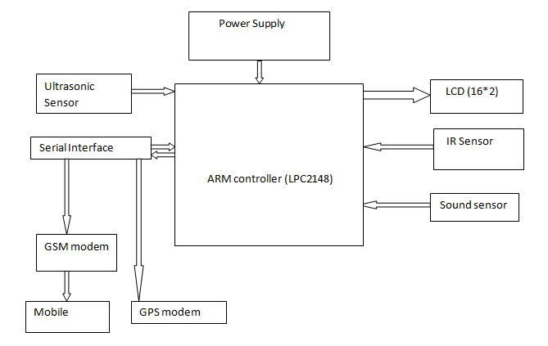
BLOCK DIAGRAM
Figure: Block Diagram of Intelligent Traffic Control

Slide 9


Flow chart of the whole working system
Emergency vehicle is arriving
NO
Siren is ON
Emergency Vehicle is not detected and assume it is as normal vehicle
Yes
No Action is Performed
Ultrasonic Sensor is triggered and GSM sends message to Traffic police
End
Obstacle is detected whether it is Long/Short range
Accordingly Traffic light changes from Red to Green
Once Ambulance crosses the Traffic pole, IR Sensor turns the Traffic light from Green to Red
Location of Ambulance is sent by GPS to Hospital authority

Slide 10
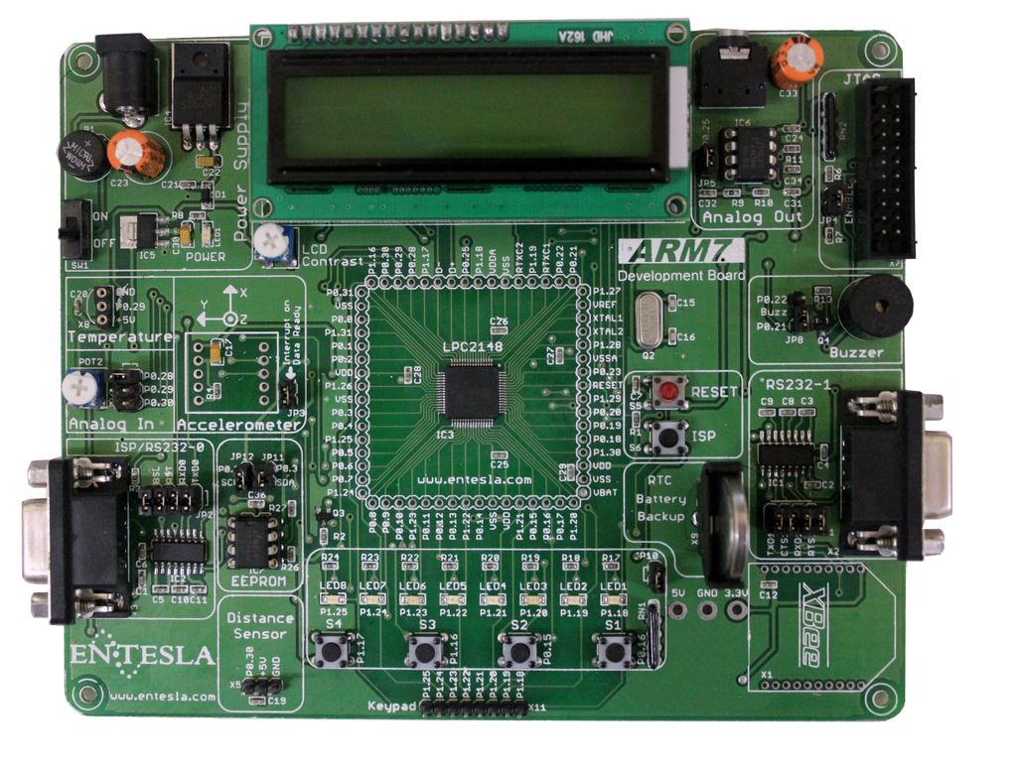
HARDWARE DEECRIPTION
.
LPC2148
Figure: LPC2148 Board
Microcontroller used here is ARM7-LPC2148 microcontroller.
It has a 128-bit wide memory interface and unique accelerator architecture enable 32-bit code execution at the maximum clock rate.

Slide 11
LPC2148 operates in The 16-bit Thumb mode.
Due to their tiny size and low power consumption, LPC2141/42/44/46/48 is ideal for applications where miniaturization is a key requirement, such as access control.
Serial communication interfaces ranging from a USB 2.0 full-speed device, multiple UARTs, SPI, SSP to I2C-bus and on-chip SRAM of 8 KB up to 40 KB are also available. It is very well suited for communication gateways and protocol converters ,large buffer size.
Several 32-bit timers, single or dual 10-bit analog-to-digital converter (s), 10-bit digital-to-analog converter, Pulse-width modulation channels and 45 fast General-purpose input/output lines with up to nine edge or level sensitive external interrupt pins make these microcontrollers suitable for industrial control and medical systems.

Slide 12
Figure: GSM Network Architecture
A GSM network consists of several functional entities, whose functions and interfaces are defined.
The Mobile Station (MS).
The Base Station Subsystem (BSS).
Mobile equipment/terminal (ME).
The Network Switching Subsystem (NSS).
Network management system (NMS).

Slide 13
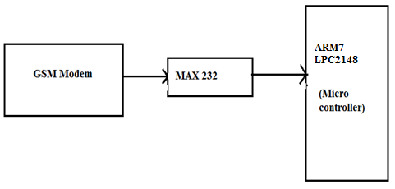
GSM
Figure: GSM Modem to LPC2148 interface
There are many GSM modems available in the market and most of them are on TTL logic but some of them use RS232 standards and again it becomes a problem to communicate with GSM modem by using Micro controller, Aurdino or any other TTL platform.MAX232 is used to solve this problem.

Slide 14
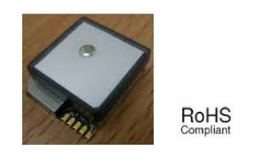
GPS
Figure: Top view of SR-92 Module
The Global Positioning System (GPS) is a satellite navigation system that provides location information anywhere on or near the Earth's surface. It comprises a number of satellites in orbit above Earth. Each satellite continually transmits messages that include the time the message was transmitted, and the satellite position.
On the ground the GPS unit receives these messages and, by comparing the time at which the message was received (on its internal clock) against the time which the message was transmitted, it works out how far away it is from each satellite. In order to calculate its location the GPS unit must receive messages (signals) from a minimum of four satellites.

Slide 15
The different GPS modules available in the market to get GPS information depends upon the user requirement like size, accuracy etc.
The GPS module used in the project is based on the SR-92 IC which is an easy to use ultra high performance smart antenna module with the power control.
The lower size and high performance of the SR-92 enables it for the adaption of hand held operations.
The main features of the SR-92 module which make it convenient for the use in the project are:
Easier adaption with good performance.
Inbuilt antenna with EMC protection.
Built in battery for better performance in hot/warm start ups.
Just connect and play and hazel free device.
Small size with the dimensions of 18x21x7 mm.
High tracking sensitivity of -159dBm.
Hardware power save control pin via GPIO.
Firmware upgradable for best performance.

Slide 16
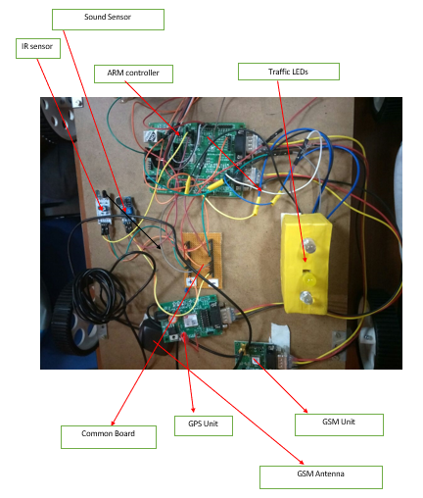
Figure: Hardware Connections

Slide 17
SENSOR INTERFACING
A sensor is a transducer whose purpose is to sense (that is, to detect) some characteristic of its environments. It detects events or changes in quantities and provides a corresponding output, generally as an electrical or optical signal; for example, a thermo couple converts temperature to an output voltage. But a mercury-in-glass thermometer is also a sensor; it converts the measured temperature into expansion and contraction of a liquid which can be read on a calibrated glass tube.
An infrared sensor is an electronic device that emits in order to sense some aspects of the surroundings. An IR sensor can measure the heat of an object as well as detects the motion. These types of sensors measures only infrared radiation, rather than emitting.

Slide 18
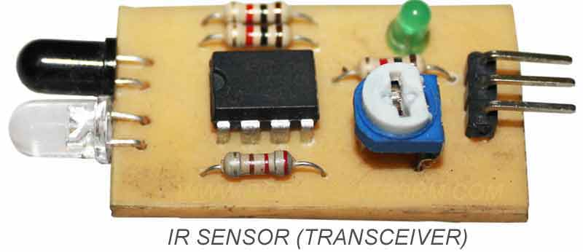
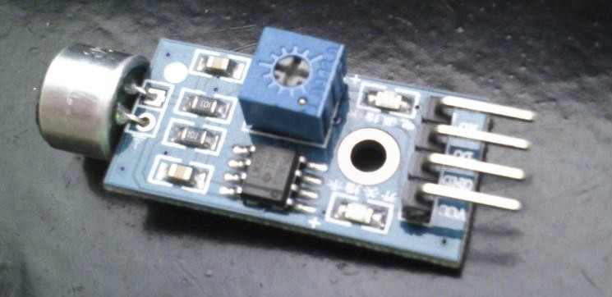
Figure: Infrared Sensor (Transceiver)
The sound sensor module provides an easy way to detect sound and is generally used for detecting sound intensity. This module can be used for security, switch, and monitoring applications. Its accuracy can be easily adjusted for the convenience of usage.
Figure: Schematic Diagram of IR sensor

Slide 19
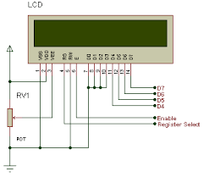
A LCD is a thin, flat panel used for electronically displaying information such as text, images, and moving pictures.
Its uses include monitors for computers, televisions, instrument panels, and other devices ranging from aircraft cockpit displays, to every-day consumer devices such as video players, gaming devices, clocks, watches, calculators, and telephones.
Among its major features are its lightweight construction, its portability, and its ability to be produced in much larger screen sizes than are practical for the construction of cathode ray tube (CRT) display technology.
Figure: LCD Connections to Microcontroller

Slide 20
SOFTWARE DESCRIPTION
PROGRAMMING ENVIRONMENT FOR ARM7: The programming of the micro controller as per the requirement can be done in number of tools available as open source in the market. Among the number of the tools for programming the ARM7 the Keil μ vision is used in the project for writing the code. We are using Keil microvision 2.
FLASH MAGIC: The Flash Magic tool is a open source software that allows us to port the hexadecimal codes in to the microcontroller.
PHILIPS UTILITY: It is used to dump the code into kit. We are using LPC2000 Flash version.
Proteus Software: It is used for Simulation purpose. We are using Proteus version 8.

Slide 21

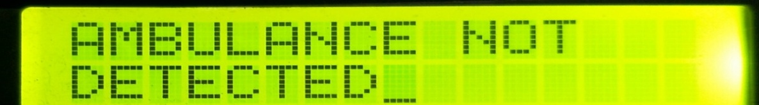
RESULTS
CASE 1: When Ambulance is not detected, the Message “Ambulance Not Detected” is send to Traffic police same message will be displayed in LCD as shown in Figures below ad normal traffic rules continues.
Figure: When Ambulance is not Detected
Figure: When Ambulance is not Detected
CASE 2: When Ambulance is detected without Siren, the Message “Ambulance Not Detected” is send to traffic police and same will be displayed in LCD as Shown in Figures below. And normal traffic operation continues.
Figure: When Ambulance is not Detected
Figure: When Ambulance is not Detected

Slide 22
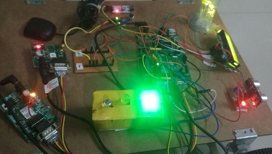

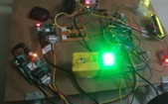

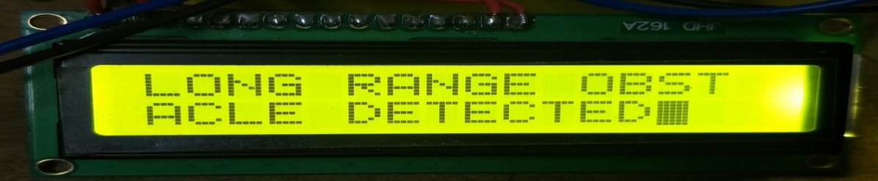
CASE 3:When Ambulance is Detected with Siren, traffic signal changes from Red to Green and the Message “Ambulance is Detected” is send to Traffic police as shown below Figures .
Figure: When Ambulance is Detected with Siren
Figure : When Ambulance Detected with Siren
i. Ambulance is in Long Range
When Long range obstacle is Detected, traffic signal still Green and the Message “Long range Obstacle Detected” is send to Traffic police and same message will be displayed on LCD as shown in Figures below.
Figure: When Ambulance is in Long Range
Figure: When Ambulance is in Long Range

Slide 23
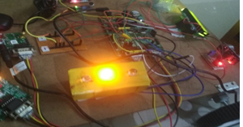

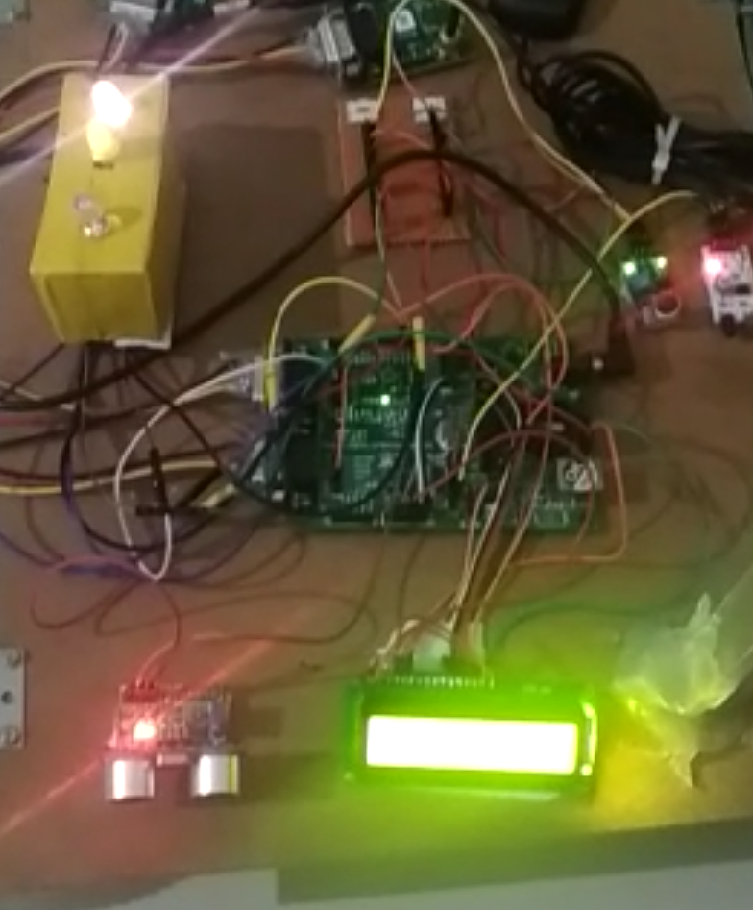
ii. Ambulance is in Short Range
When Ambulance is in Short Range, traffic signal changes from Red to Yellow and the Message “Short Range Obstacle Detected” is send to traffic police and “Short Range is displayed on LCD as shown in Figures below.
Figure: When Ambulance is in Short Range
Figure: When Ambulance is in Short Rage
Case 4: When Ambulance crosses the Traffic pole
When the Ambulance crosses the Traffic pole, IR Sensor detects the Ambulance and traffic signal changes from Green to yellow and sends the Latitude and Longitude message to Hospital as shown in Figures below.
Figure: When Ambulance Crosses the Traffic pole

Slide 24


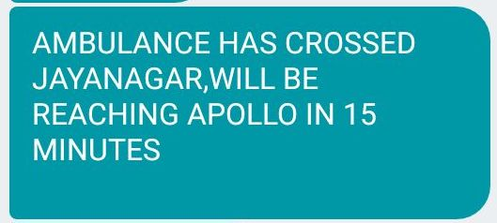
Figure: Longitude information
Figure: Latitude information
Figure : Information about Tracking of Ambulance to Hospital

Slide 25
ADVANTAGES AND APPLICATIONS
APPLICATIONS
Our project has the primary application in Emergency Vehicles Ambulance.
Also, the GPS and GSM systems together keeps broadcasting its location to the hospital authorities which can prepare to receive the patient.
This system can also be extended to Fire Engines.
It also holds a great deal of promise for motor cavalcades.
Also this can be used for Police Vehicles which are chasing a criminal escaping or someone who has broken the rules.

Slide 26
ADVANTAGES
The system is composed of basic components such as GPS, GSM, and sensors which can be easily available.
This system is easily interface to the other components such as IR sensor, Ultrasonic sensor and sound sensors.
The system consists of the latest 64 bit ARM7LPC2148 microcontroller which is easily upgradeable to a bigger setup due to its advanced specifications and we can interface more components easily without any slowing down in real time operation.
The coding is done in embedded C which is easy to understand and the software is easily operatable.
It has a lot of applications in the Emergency situations with any vehicle which has a siren attached and also helps for more efficient operation of the Green Corridor. Important Body Organs or patients can be ferried easily to the hospital.

Slide 27
REFERENCES
[1] Saaid,M.F; Kamuludin, M.A;MegatAli,M.S.A, “Vehicle location finder using GPS and GSM system for mobile, Vehicular electronics and safety” [ICVES] -2014.
[2] QiangLiu; Huapu Lu; HongliangZhang,Bo Zou, “Research & Design Of Intelligent Vehicle Monitoring System Based On GPS / GSM”, ITS telecomm proceedings- 2009
[3] Nagaraja B.G; Rayappa,R; Mahesh. M; Patil C.M,Manjunatha T.C, “Design And Development Of A GSM Based Vehicle Theft Control System, Advanced Computer Control” [ICACC] – 2009
[4] Ahmed,A.A.A;Ahmed A.M.E;Mohammed,A.H; Akram, M.A.A, “Design And Implementation Of Vehicle Tracking And Theft Control System, Computing control” , Networking, Electronics & Embedded system Engg. [ICCNEEE] – 2015.
[5] Chandan Tiwari1,Abbas ali Jalanawala2,Faizan Manyar3,Johnpaul Moka4,A.M Hattarge Automatic Lane Clearance System For Emergency Vehicles “ [IJIRSET]- 2016.
[6] Koushik Mandal1, Arindam Sen1, Abhijnan Chakraborty1, Siuli Roy1,Suvadip Batabyal2, Somprakash Bandyopadhyay3 (contact author: somprakash@iimcal.ac.in “Road Traffic Congestion Monitoring and Measurement using Active RFID and GSM Technology” IEEE Conference on Intelligent Transportation Systems Washington, DC, USA. October 5-7, 2011.

