Slide 1

Empowering Individuals with Amnesia: A Companion for Everyday Life
Amnesia, a condition impacting memory recall, can lead to confusion and frustration. This presentation explores the challenges faced by individuals with amnesia and introduces an innovative app designed to provide specialized support, enhancing daily functioning and independence.

Slide 2
Understanding Amnesia: Two Sides of a Coin
Anterograde Amnesia
Retrograde Amnesia
Difficulty forming new memories. This type of amnesia can be caused by brain injury, stroke, or certain medical conditions. Individuals with anterograde amnesia may struggle to remember events that occurred after the onset of their amnesia.
Difficulty recalling past memories. This type of amnesia often affects memories from a specific period of time in the past. The cause may vary, including head trauma, neurological disorders, or even emotional stress.

Slide 3

Tailoring Solutions for Individual Needs
1
Personalized Assessment
2
Target Behaviors
3
Comprehensive Support
Identifying the specific challenges faced by each individual is the first step. This involves a thorough assessment that rules out other potential issues and determines the most relevant areas of support.
Understanding the specific memory issues faced by each individual helps us determine which features and functionalities will be most beneficial. This personalized approach ensures the app is a tailored solution for every user.
The app's features are designed to address a variety of challenges, including short-term memory difficulties, problems with planning and learning new information, and challenges with daily routines.

Slide 4

Compensation for Memory Loss: Bridging the Gap
Digital -Hippocampus
Reminders & Notifications
Routine Support
This feature allows individuals to store important information like personal details, medical records, and photos of loved ones. This readily available information helps them access key data whenever needed.
The app utilizes timed and location-based reminders to support users in completing daily tasks, attending appointments, and navigating familiar environments. These features offer a crucial safety net, reducing anxiety and enhancing independence.
This feature offers a companion app for caregivers, allowing them to track completed tasks and provide reminders for those tasks that have not yet been completed. This collaborative approach ensures users are supported through daily routines.

Slide 5
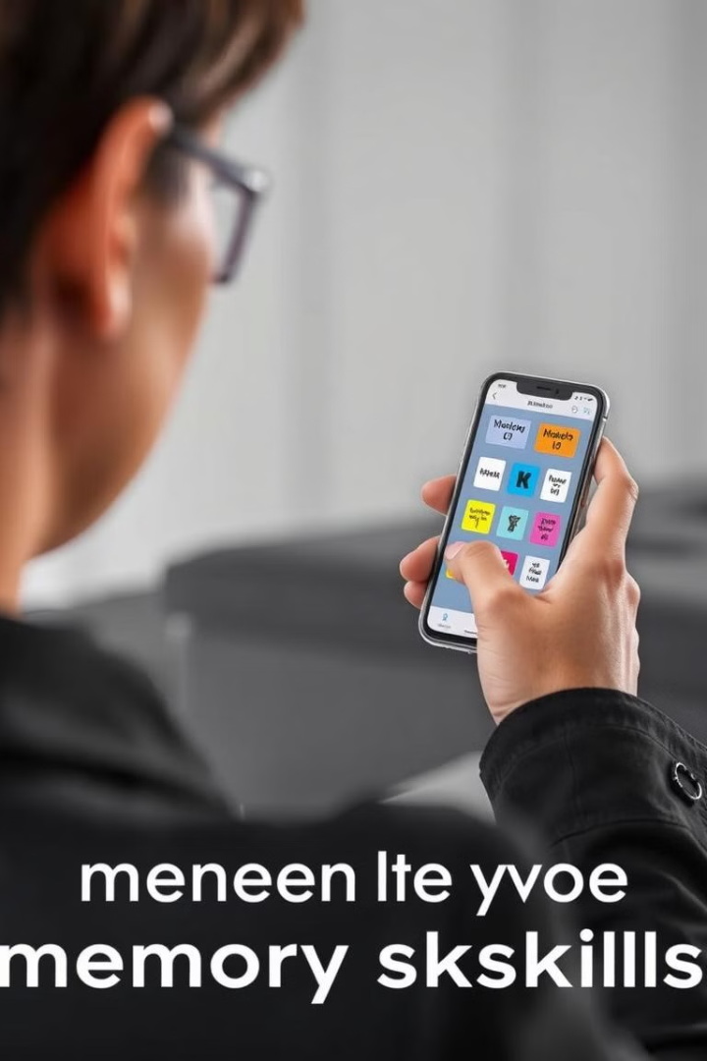


Enhancing Memory: Tools for Learning and Retrieval
Orientation
Diary
The app helps users stay oriented with reminders of the current day, date, year, and even their current location. This feature helps reduce confusion and uncertainty, especially when navigating unfamiliar environments.
The app allows users to maintain a personal diary, enabling them to document their daily experiences through text and images. This feature can help with memory retrieval and potentially improve recall of past events.

Slide 6
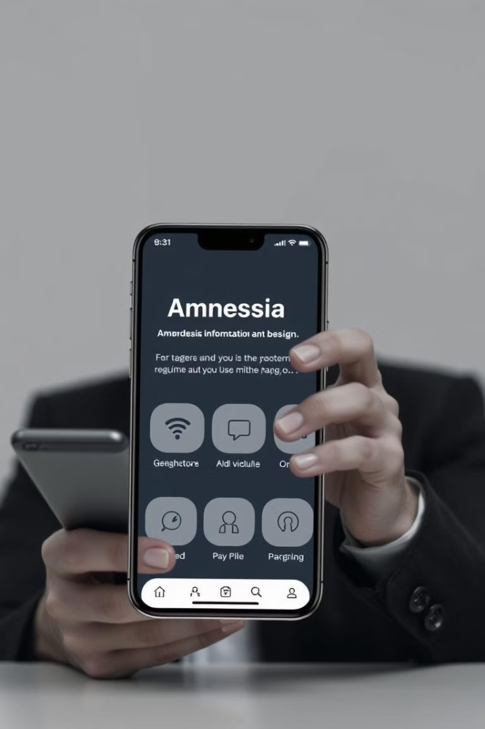
User-Centric Design: Accessibility & Convenience
1
Voice Assistance
The app includes voice-activated commands and speech-to-text capabilities, enabling users to interact with the app even if they have difficulty typing or navigating complex interfaces. This enhances accessibility and promotes independence.
2
Easy Navigation
The app features a user-friendly interface with large buttons, clear text, and intuitive icons. This design prioritizes simplicity and ease of use, minimizing cognitive load and ensuring users can navigate the app efficiently.

Slide 7

A Companion for Confidence & Independence
Through this application, we aim to empower individuals with amnesia to live with more confidence and independence, fostering a sense of agency and control over their daily lives. The app is more than just a tool; it's a companion that provides support and encouragement, helping users overcome the challenges of memory loss and embrace a brighter future.

