Slide 1
Unraveling Patterns in Insurance Charges
Exploring Health Insurance Data
Team Members:
Dhanavikram Sekar, Hariharan Kumar, Indu Varshini Jayapal, Naveen Vinayaga Murthy, Nidhi Choudhary

Slide 2
Agenda
Problem Statement
Data Summary
Univariate Analysis
Multivariate Analysis
Hypothesis Testing
Conclusion
Challenges and Limitations
References

Slide 3
PROBLEM STATEMENT
Problem Statement | Data Summary | Univariate Analysis | Multivariate Analysis | Hypothesis Testing | Conclusion | Challenges | References
Any interesting distribution patterns in the charges incurred?
What are the factors influencing the variability
in insurance costs in the United States?
Notes:
1. Talk how expensive the insurance is in United states and how it varies from person to person

Slide 4
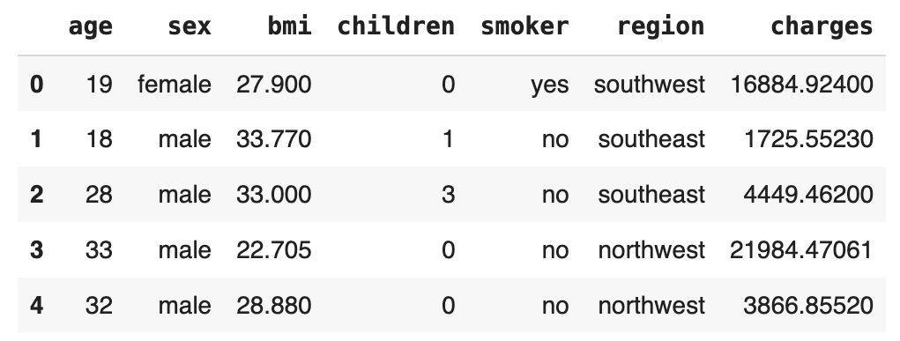
DATA SUMMARY
1337
Problem Statement | Data Summary | Univariate Analysis | Multivariate Analysis | Hypothesis Testing | Conclusion | Challenges | References
Data Source: https://github.com/stedy/Machine-Learning-with-R-datasets/blob/master/insurance.csv
Data Snapshot
Number of records in the dataset
7
Numerical Features
Categorical Features
Features uniquely identifying a data point
Age: 18 to 64
BMI: 15.96 to 53.13
Charges: $1,121 to $63,770
Sex: Male, Female
Children: 0 to 5
Smoker: Yes, No
Region: Northeast, Northwest, Southeast, Southwest
Notes:
1. Github data source
2. Data checks (null values, data types, Duplicates) and we found data was almost clean. Minimal data preprocessing

Slide 5
UNIVARIATE ANALYSES
Problem Statement | Data Summary | Univariate Analysis | Multivariate Analysis | Hypothesis Testing | Conclusion | Challenges | References

Slide 6
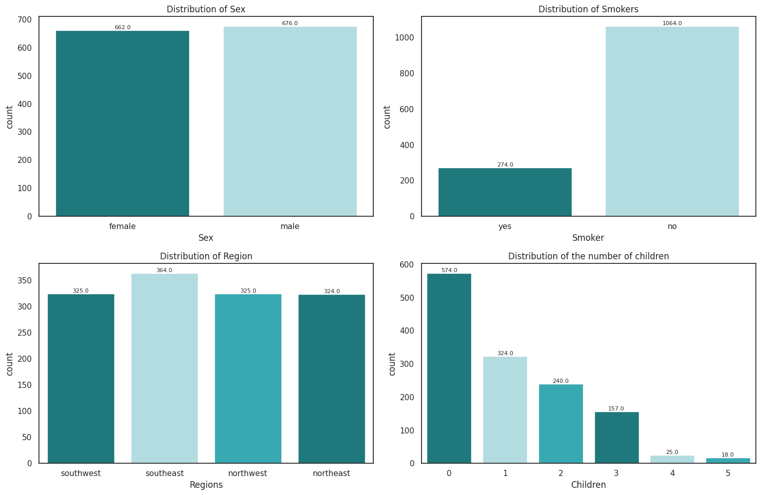
UNIVARIATE ANALYSIS
Problem Statement | Data Summary | Univariate Analysis | Multivariate Analysis | Hypothesis Testing | Conclusion | Challenges | References
Categorical Features
Almost equal representation of male and female observations
Imbalance between smokers and non-smokers, with non-smokers count being ~ 4x the count of smokers
Balanced representation across southwest, northwest, and northeast regions with slightly higher number of observations from the southeast region.
Number of children column is positively skewed
Countplots of Sex, Smokers, Region and Children Features
Notes:
The above visualization of the sex column clearly shows an equal number of samples for both male and female observations
On the other hand, we can see a clear imbalance in the smoker column. Non-smokers count is 4x the count of smokers.
The regions column reveals almost a balanced representation of observations from across the four regions of the United states. Roughly, We have 25% of the sample split across each region. With a slightly higher number of observations by southeast.
However, for the number of children, the samples are heavily skewed, and we can see a positive skewness in the column. A lot of observations have no children, and the number of observations keeps on decreasing as the number of children increases.

Slide 7
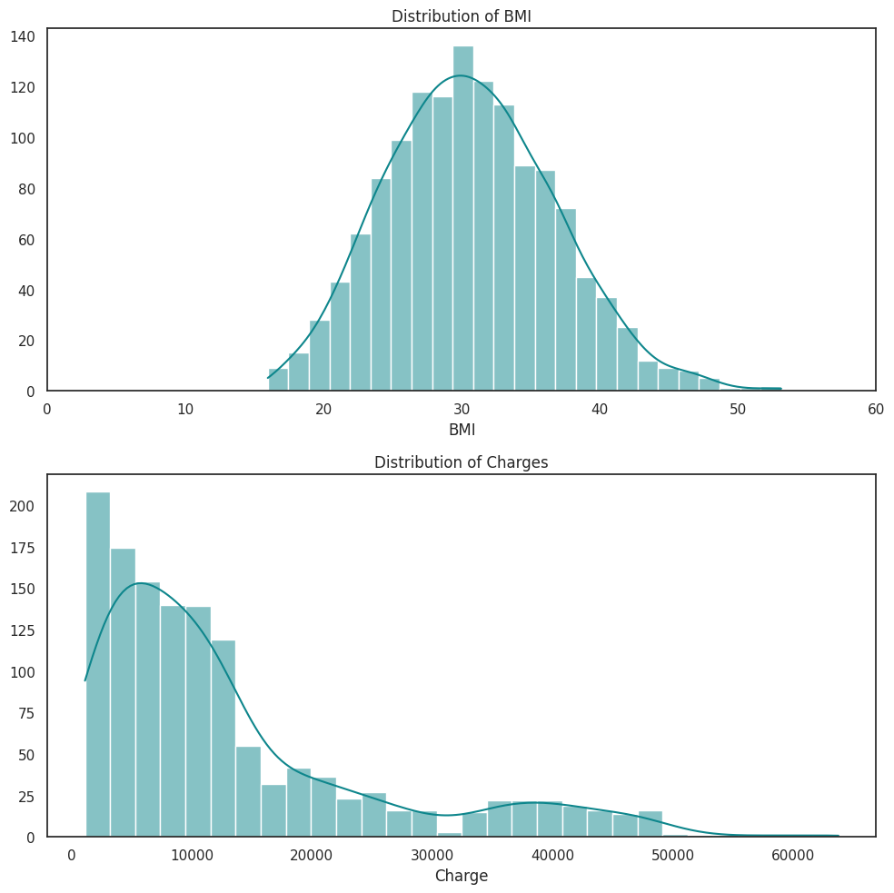
UNIVARIATE ANALYSIS
Problem Statement | Data Summary | Univariate Analysis | Multivariate Analysis | Hypothesis Testing | Conclusion | Challenges | References
Numerical Features
Distribution of BMI is approximately ‘Normal’
This symmetrical distribution indicates that a substantial portion of individuals have BMI around the mean which is ~30
The charges histogram shows that majority of the insurance charges are clustered around the left tail, indicating that it is exhibits right-skewness
This implies that a significant proportion of the individuals incur lower insurance costs with fewer individuals incurring higher costs
Histograms of BMI and Charges Features
Notes:
The histogram for BMI values suggest that the distribution is approximately normal. This normal distribution indicates that the BMI values are spread relatively evenly across the dataset, with no significant skewness or bias towards specific ranges. The symmetry in the distribution implies that a large portion of individuals falls within the middle range of BMI values.
In contrast to BMI, the distribution of charges is not normal. The charges histogram shows a right or positive skew, indicating that majority of observations have lower charges. The right-skewed distribution suggests that there are more individuals with lower medical charges, and the number of observations decreases as the charges increase. This could imply that a significant proportion of individuals in the dataset incur lower healthcare costs, with fewer individuals incurring higher medical expenses. The skewness indicates a tail towards higher charges, signifying a smaller number of observations with comparatively higher healthcare costs.

Slide 8
MULTIVARIATE ANALYSES
Problem Statement | Data Summary | Univariate Analysis | Multivariate Analysis | Hypothesis Testing | Conclusion | Challenges | References

Slide 9
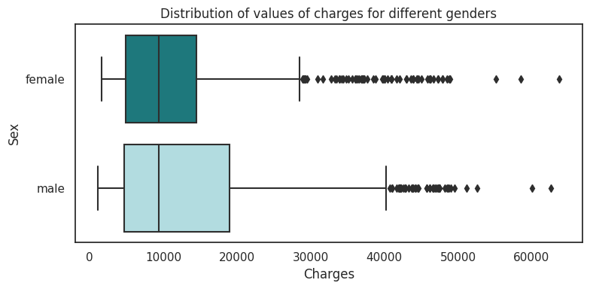
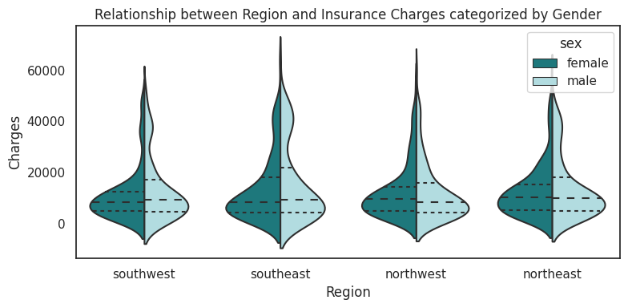
Males tend to have higher charges than Females
Problem Statement | Data Summary | Univariate Analysis | Multivariate Analysis | Hypothesis Testing | Conclusion | Challenges | References
Gender and Charges:
The median charge is similar for both genders
However, a notable difference in the 75th percentile and maximum values suggests that males tend to have higher charges than females
Gender and Region Analysis:
No significant difference in the distribution of charges is observed across genders within different regions
Consistently across all regions, males tend to incur higher charges compared to females, extending the observation from the initial bar plot

Slide 10
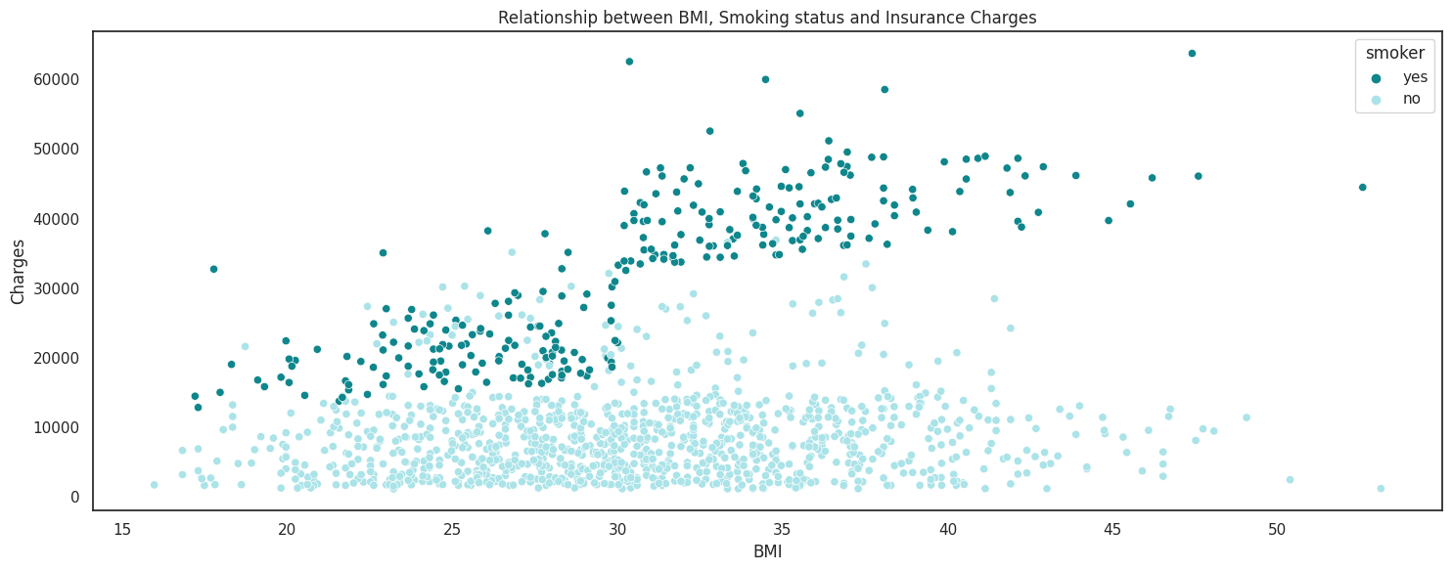
Is there any relationship between BMI, Smoking and Insurance Charges?
Problem Statement | Data Summary | Univariate Analysis | Multivariate Analysis | Hypothesis Testing | Conclusion | Challenges | References
Insights:
Non-smokers generally exhibit lower charges despite having comparable BMI values to smokers
No noticeable relationship is observed between BMI and charges
The correlation matrix of BMI and Insurance Charges shows a low correlation value of approximately 0.2, indicating independence between the two

Slide 11
HYPOTHESES TESTING
Problem Statement | Data Summary | Univariate Analysis | Multivariate Analysis | Hypothesis Testing | Conclusion | Challenges | References

Slide 12
HYPOTHESES TO TEST
01
03
02
04
Problem Statement | Data Summary | Univariate Analysis | Multivariate Analysis | Hypothesis Testing | Conclusion | Challenges | References
Charges and Sex
"The insurance charges for men are greater than those for women."
Charges and Region
"Charges are equal for all regions."
Charges and Smoking
"The charges differ for both smokers and non-smokers."
Smokers and Sex
"The proportion of smokers is the same for both males and females."

Slide 13
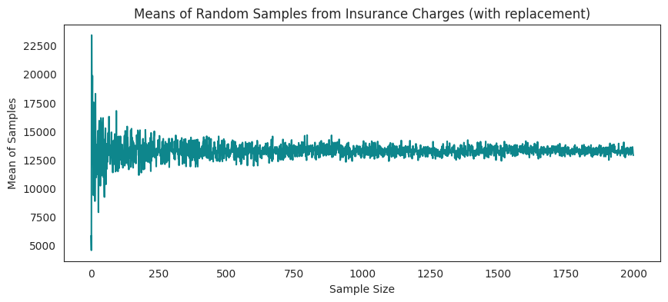
How are we selecting a test for our target variable?
Problem Statement | Data Summary | Univariate Analysis | Multivariate Analysis | Hypothesis Testing | Conclusion | Challenges | References
In the insurance charges column, as the sample size increases, the distribution of sample means approaches normality
T-test is appropriate here as we are dealing with a sufficiently large sample size, and the sample mean aligns with the principles of the central limit theorem

Slide 14
Hypothesis 1: The insurance charges for men are greater than those for women
Problem Statement | Data Summary | Univariate Analysis | Multivariate Analysis | Hypothesis Testing | Conclusion | Challenges | References
H₀ : Charges of both men and women are equal
H₁ : Charges of men is greater than women
One tailed (Right tailed)
Two Sample T-Test
Why did we choose this test?
Test Results
Outcome
Critical Value: 0.05
t Value: 2.1275
P Value: 0.0169
Reject the null hypothesis
Notes:
Null Hypothesis: Charges of both men and women are equal
Alternate Hypothesis: Charges of men is greater than women
Test Name: One tailed (Right tailed) T-Test
Why we used this test:
Critical Value: 0.05
t Value: 2.0975
P Value: 0.0181
Outcome: Reject the null hypothesis. From this we can conclude that the p-value is in the rejection region, we can reject the null hypothesis which states that the charges of men and women are same. We can also conclude by stating that our alternative hypothesis is true which states that charges for male is greater than female.

Slide 15
Hypothesis 2: The insurance charges differ for both smokers and non-smokers
Problem Statement | Data Summary | Univariate Analysis | Multivariate Analysis | Hypothesis Testing | Conclusion | Challenges | References
H₀ : Charges for both smokers and non-smokers are equal
H₁ : Charges for both smokers and non-smokers are not equal
Two tailed Two Sample
T-Test
Why did we choose this test?
Test Results
Outcome
Critical Value: 0.05
t Value: 46.6447
P Value: 1.4067e-282
Reject the null hypothesis
Notes:
Null Hypothesis: Charges for both smokers and non-smokers are equal
Alternate Hypothesis: Charges for both smokers and non-smokers are not equal
Test Name: Two-tailed t-test
Why we used this test
Critical Value: 0.05
t Value: 46.6649
P Value: 8.271435842179101e-283
Outcome: Reject Null Hypothesis. From this we can conclude that the p-value is in rejection region, we can reject the null hypothesis which states that charges for smokers and non-smokers are same. We can also conclude by stating that our alternative hypothesis is true which states that charges for smokers and non-smokers are different.

Slide 16
Hypothesis 3: Insurance charges are equal for all regions
Problem Statement | Data Summary | Univariate Analysis | Multivariate Analysis | Hypothesis Testing | Conclusion | Challenges | References
H₀ : Charges for all regions are equal
H₁ : Charges for all regions are not equal
ANOVA Test
Why did we choose this test?
Test Results
Outcome
Critical Value: 0.05
f value: 2.9696
p value: 0.03089
Reject the null hypothesis
Notes:
Null Hypothesis: Charges for all regions are equal
Alternate Hypothesis: Charges for all regions are not equal
Test Name: ANOVA Test
Why we used this test
Test details like two tailed or one tailed
Critical Value: 0.05
f value: 2.9696
p value: 0.03089
Outcome: Reject Null Hypothesis. From this, we can conclude that the p-value is in the rejection region and the null hypothesis which states charges in all the 4 regions are the same and should be rejected. From our Anova test, we can conclude that our Alternative Hypothesis is true and we can state that regions play a role in charges and they are not equal for all regions.

Slide 17
Hypothesis 4: The proportion of smokers is the same for both males and females
Problem Statement | Data Summary | Univariate Analysis | Multivariate Analysis | Hypothesis Testing | Conclusion | Challenges | References
H₀ : Proportion of smokers in male and female are same
H₁ : Proportion of smokers in male and female are not same
Chi-Square Test
Why did we choose this test?
Test Results
Outcome
Critical Value: 0.05
Chi-square coefficient value: 7.39291081459996
p Value: 0.006548143503580696
Reject the null hypothesis
Notes:
Null Hypothesis: Proportion of smokers in male and female are same
Alternate Hypothesis: Proportion of smokers in male and female are not same
Test Name: Chi Square test
Why we used this test
Test details like two tailed or one tailed
Critical Value: 0.05
chi_sq coeficient value: 7.39291081459996
p Value: 0.006548143503580696
Outcome: Reject Null Hypothesis. From this, we can conclude that the p-value is in the rejection region and the null hypothesis which states the proportion of smokers in males and females are the same should be rejected. From our Chi-Squared test, we can conclude that our Alternative Hypothesis is true and we can state that the proportion of smokers in male and female are not the same.

Slide 18
01
02
CONCLUSION
03
Problem Statement | Data Summary | Univariate Analysis | Multivariate Analysis | Hypothesis Testing | Conclusion | Challenges | References
From both the multivariate analysis and hypothesis testing, we found that males tend to have higher charges than females.
From the hypothesis testing, we found that the charges across the regions are not the same.
Our analysis reveals that gender, smoking status, and geographic location within the United States significantly influence the incurred insurance charges.
Can we conclude that this holds true for the entire population in the United States?
Notes:
From both the multivariate analysis and hypothesis testing, we found that males tend to have higher charges than females.
From the hypothesis testing, we found that the charges across the regions are not the same.
Our analysis reveals that gender, smoking status, and geographic location within the United States significantly influence the incurred insurance charges.

Slide 19
CHALLENGES
Problem Statement | Data Summary | Univariate Analysis | Multivariate Analysis | Hypothesis Testing | Conclusion | Challenges | References
Data Collection
Sample to Population
Procuring the insurance dataset with “Independent and Identically Distributed” datapoints
Dataset is a small sample of the entire population, and the hypothesis testing results are only on this sample and not the population
Notes:
Talk about data collection challenges
Hypothesis testing was done considering buckets inside the sample and not as a comparison between samples and population parameters

Slide 20
REFERENCES
Problem Statement | Data Summary | Univariate Analysis | Multivariate Analysis | Hypothesis Testing | Conclusion | Challenges | References
Data Source: https://github.com/stedy/Machine-Learning-with-R-datasets/blob/master/insurance.csv
https://www.kaggle.com/code/jordanrich/hypothesis-testing-of-health-insurance-data
https://www.kaggle.com/code/mayank2896/insurance-eda-hypothesis-testing
https://www.kaggle.com/code/yogidsba/insurance-claims-eda-hypothesis-testing/notebook
https://docs.scipy.org/doc/scipy/reference/generated/scipy.stats.ttest_ind.html
https://www.reneshbedre.com/blog/anova.html
https://docs.scipy.org/doc/scipy/reference/generated/scipy.stats.chisquare.html
https://machinelearningmastery.com/chi-squared-test-for-machine-learning/
https://intapi.sciendo.com/pdf/10.2478/eoik-2019-0024
https://statisticsbyjim.com/basics/central-limit-theorem/
https://allendowney.blogspot.com/2013/08/are-my-data-normal.html

Slide 21
THANK YOU!

