Slide 1


Conflict Resolution through Machine Learning
Veera Venkata Subramanya Aditya Bhamidipati
Naveen Kumar Vadlakonda
Sneha Gavini

Slide 2

Content
Introduction
Naïve Bayes
Decision Trees
Perceptron
Random Forests
Comparisons

Slide 3
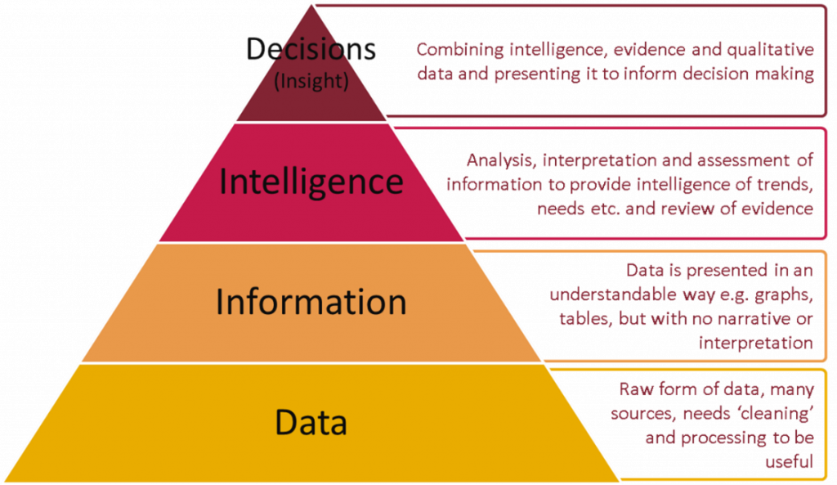
Decision Intelligence
“Decision intelligence is an engineering discipline augmenting data science from social science, decision theory, and managerial science. The application of which provides a framework for best practices in organizational decision-making and processes for applying machine learning at scale.”
The basic idea is that decisions base on our understanding of how actions lead to outputs.

Slide 4

Naïve Bayes
Naive assumption of independence between every pair of features.
Family of probabilistic algorithms that take advantage of probability theory and Bayes' Theorem to predict the tag of a text (like a piece of news or a customer review) and natural language processing (NLP) problems.
For problems with a small amount of training data, it can achieve better results than other classifiers because it has a low propensity to overfit.

Slide 5
Model Experimental Results
As the training data size decreases and testing data size increases the accuracy falls down.
Accuracy values remain almost same when some of the features like age zipcode family are removed.
As the size of dataset decreases accuracy keeps reducing.

Slide 6
Decision Trees
Decision tree is a decision support tool that uses a tree-like graph or model their possible consequences.
A way to display an algorithm that only contains conditional control statements.
Paths from root to leaf represent classification rules. When using a decision tree model on a given training dataset the accuracy keeps improving with more and more splits.

Slide 7
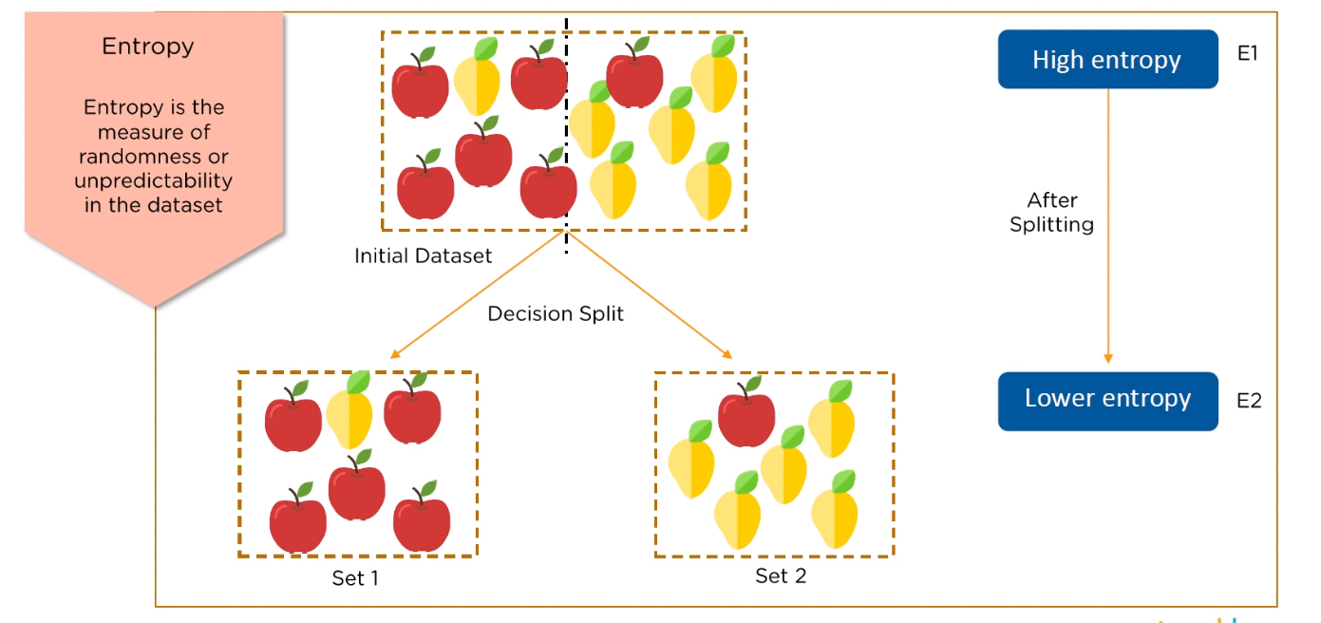
Metrics
Entropy
Entropy is the measure of uncertainty of a random variable, it characterizes the impurity of an arbitrary collection of examples.
The higher the entropy, the more is the crudeness of data, and hence less is the accuracy of the model.
Gini Index
Gini Index is a metric to measure how often a randomly chosen element would be incorrectly identified.
It means an attribute with lower Gini index should be preferred.

Slide 8
Insights
Applications:
Decision Trees will work with classification problems and regression problems. They can predict a categorical value like (red, green, up, down) or a continuous value like 2.9, 3.4 etc.,
Advantages:
Easy to understand
Easy to generate rules
Disadvantages:
Overfitting
Not fit for continuous variabes
Small changes in the training data can result in large changes to decision logic.
When using a decision tree model on a given training dataset the accuracy keeps improving with more and more splits.

Slide 9

Random Forests
Random forests are bagged decision tree models that split on a subset of features on each split.
Random forests is an ensemble method where several decision tree algorithms are built with different subsets of the training data and then find the most repeated or common answer to an instance.
The algorithm also utilizes bootstrap aggregating, also known as bagging, to reduce overfitting and improve generalization accuracy

Slide 10
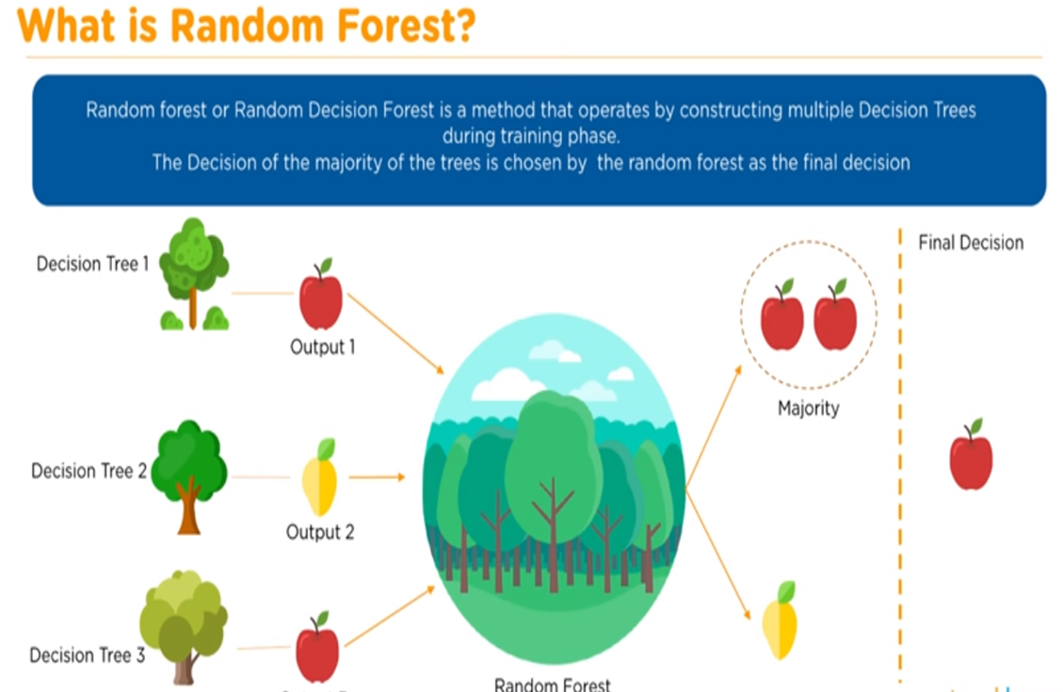
Better classification Model
Random forests is the best classification method compared to any other as the algorithms averages predictions over many individual trees.

Slide 11
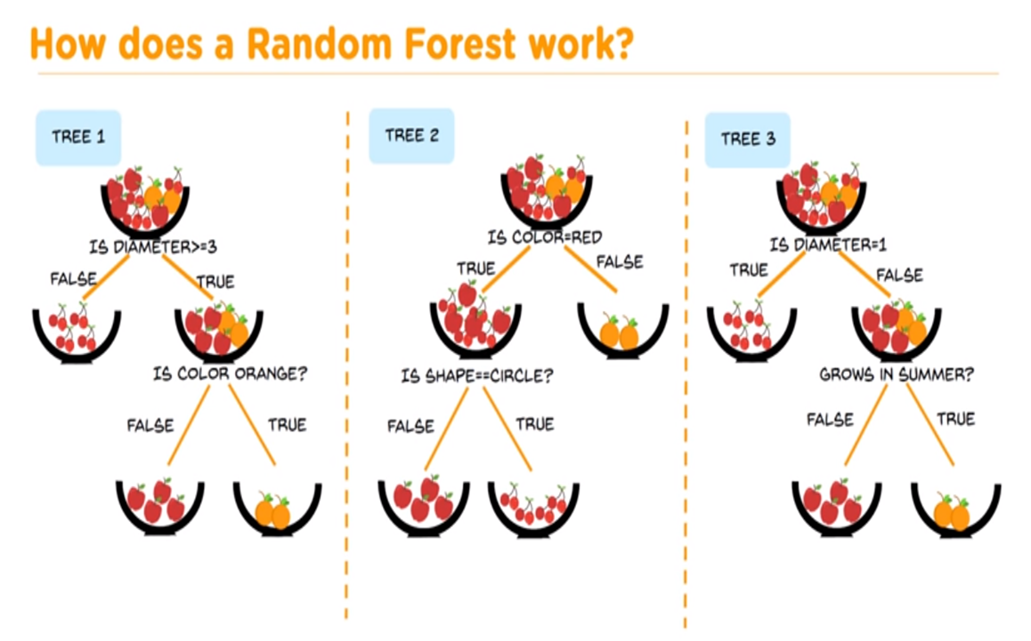

Slide 12
Insights of Random Forests
Applications
Random Forest is intrinsically suited for multiclass problems.
Works well with a mixture of numerical and categorical features. When features are on the various scales, it is also fine.
Pros
No over fitting
Best results
Cons
Training a large number of deep trees can have high computational cost and use a lot of memory
Predictions are slower, which may create challenges for applications

Slide 13
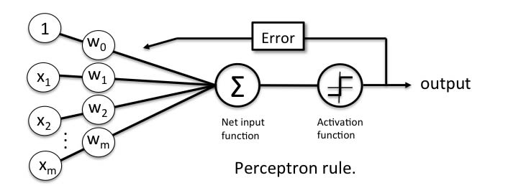
Perceptron Rule
The Perceptron receives multiple input signals, and if the sum of the input signals exceeds a certain threshold, it either outputs a signal or does not return an output.

Slide 14
Perceptron
Perceptron is a linear classifier (binary). Also, it is used in supervised learning. It helps to classify the given input data.
Perceptron Learning Rule states that the algorithm would automatically learn the optimal weight coefficients. The input features are then multiplied with these weights to determine if a neuron fires or not.

Slide 15
Applications
Classify data by recognizing patterns.
Detect anomalies or novelties, when test data does not match the usual patterns.
Approximate a target function–useful for predictions and forecasting.

Slide 16
Observations from the models evaluated
Based on size of dataset
Number of features
Train - Test Split
Notes:
Performed lot of data set engineering to observe the variations in accuareices

Slide 17
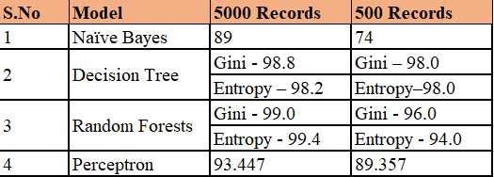
Comparisonof Models
Accuracy variation on number of records

Slide 18
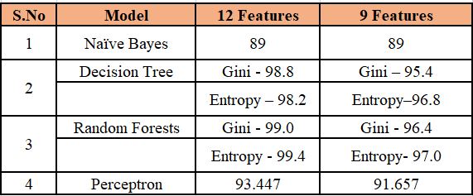
Comparison of Models
Accuracy Variation on number of features
Notes:
Family, age, securities

Slide 19
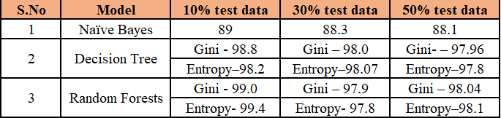
Comparison of models
Variation of accuracy based on size of test data.
Notes:
Behaviour As expected

Slide 20
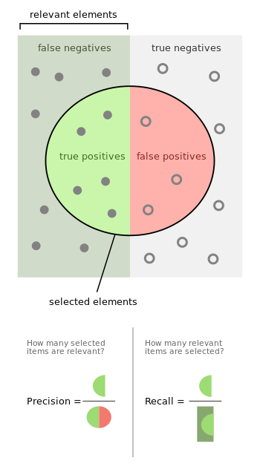
Evaluation Metrics
Precision is a measure of result relevancy.
P = tp/(tp + fp)
Recall is a measure of how many truly relevant results are returned.
R = tp/(tp + fn)
F1-score is defined as the harmonic mean of precision and recall.
F1=2 ∗ (P ∗ R)/(P + R)

Slide 21
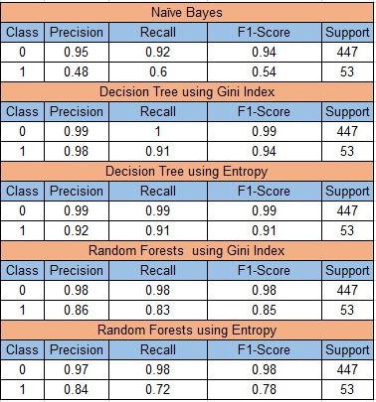
Comparison of metrics of various models

Slide 22

Conclusion and Future Scope

