Slide 1
Multi MAILBOX
SNEHA & NAVEEN KUMAR

Slide 2
Description
Problem Statement:
Checking emails regularly during the day in different tabs can be a time consuming way to
keep inbox at manageable levels. So, the effective approach is to easily access multiple Inbox
concurrently.
Solution:
This Project deals with managing of multiple Email Inbox view in a very creative and user
Friendly manner.

Slide 3
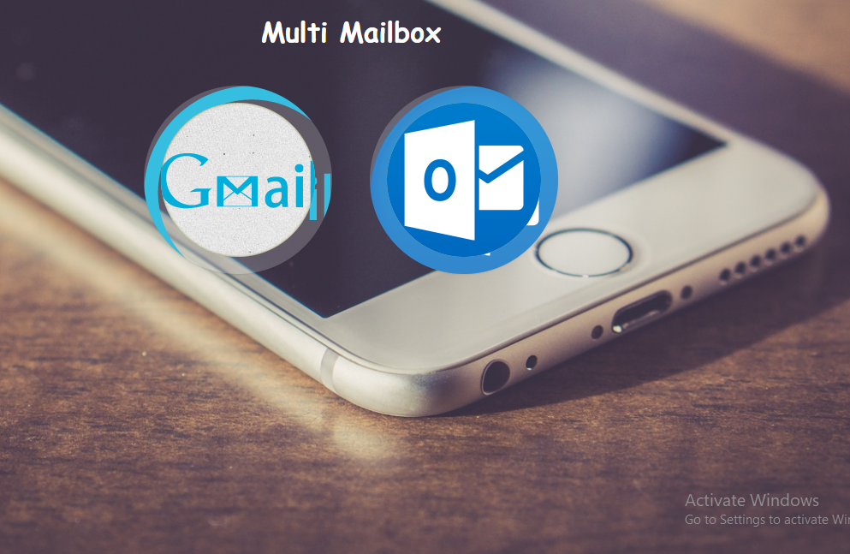
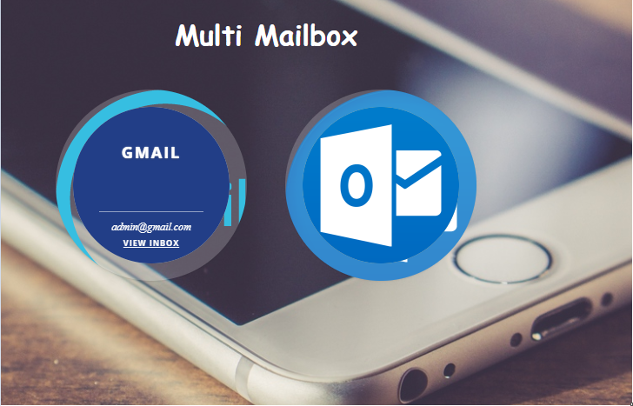
Home PAGE –UI

Slide 4
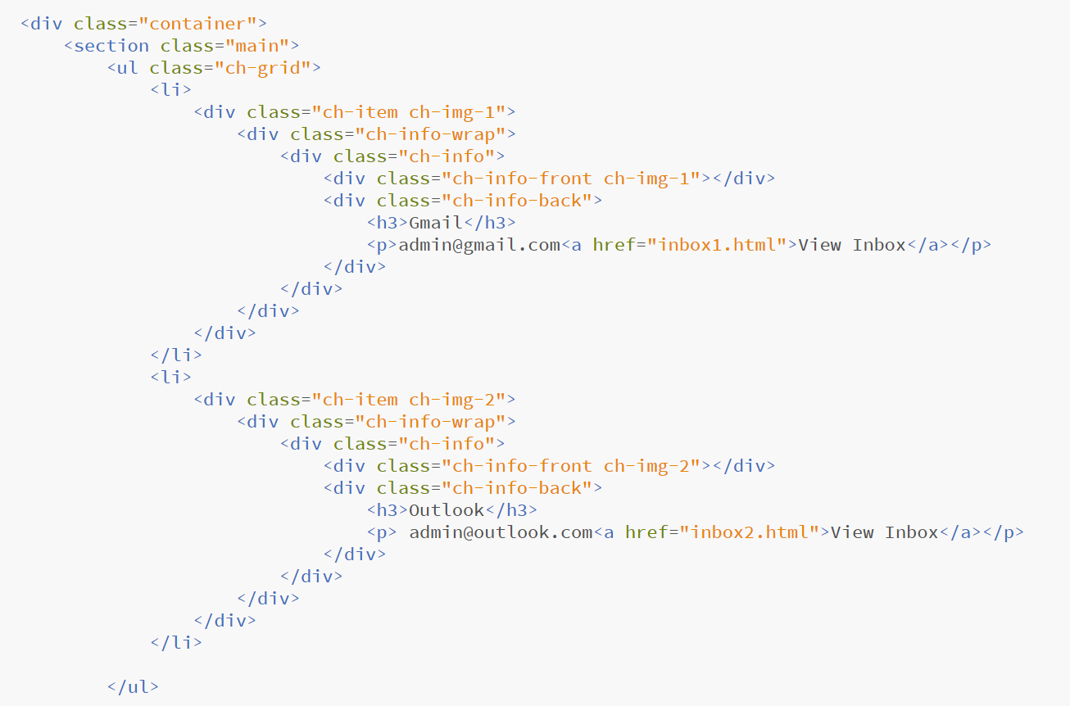
HTML code

Slide 5
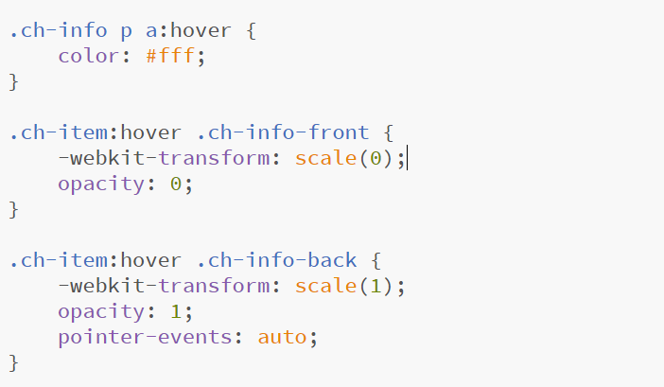
Image hover code

Slide 6
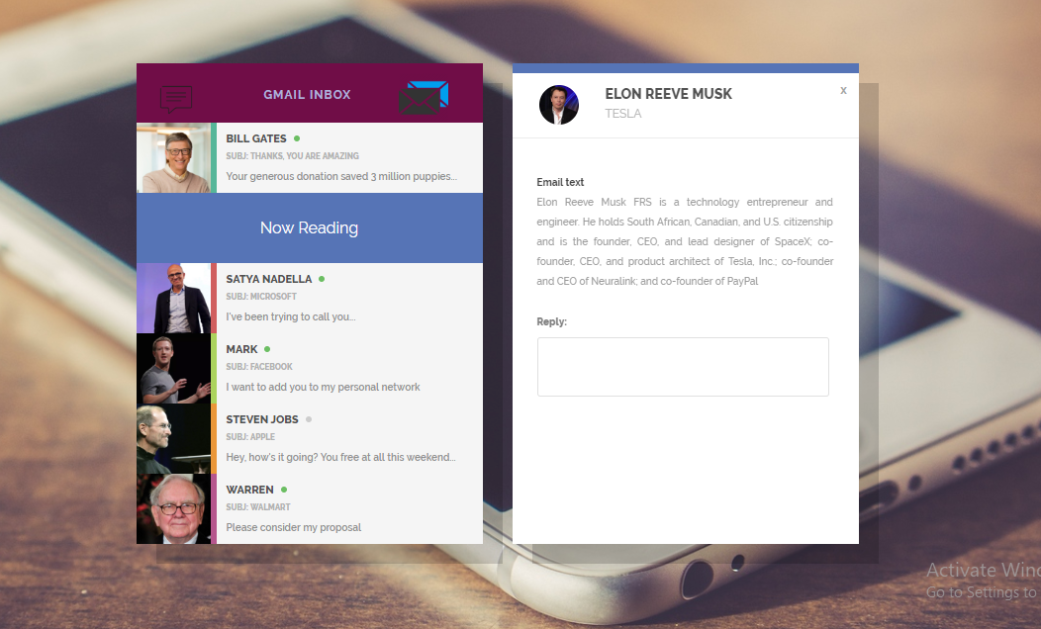
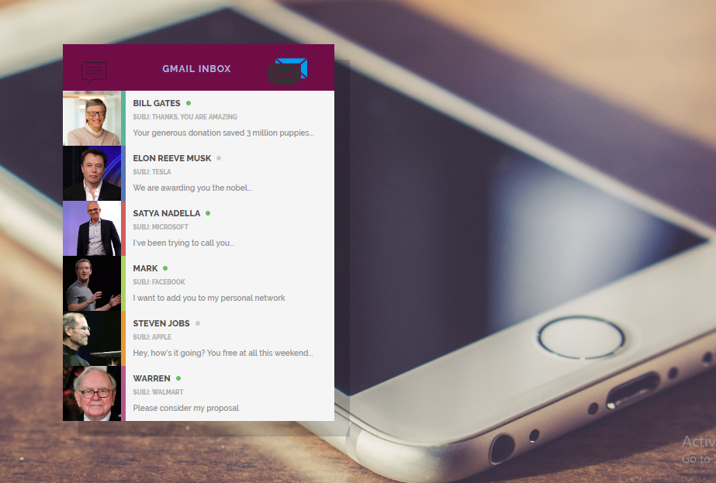
INBOX UI

Slide 7
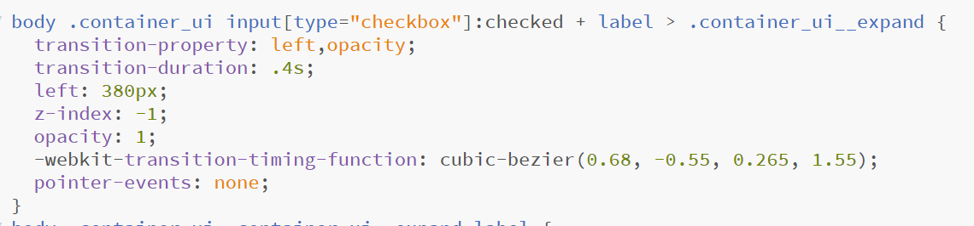
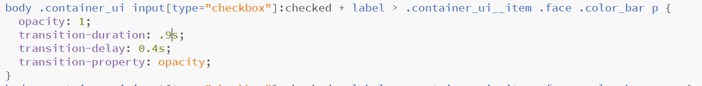
INBOX VIEW – ON checked HOVER CHANGE code

Slide 8


