Slide 1
Fuzzy pooling

Slide 2
agenda

Slide 3
agenda
Introduction to CNN

Slide 4
agenda
Introduction to CNN
Implementation of Pooling based on Fuzzy Theory

Slide 5
agenda
Introduction to CNN
Implementation of Pooling based on Fuzzy Theory
Results

Slide 6
Convolution Neural Network (CNN)

Slide 7
Convolution Neural Network (CNN)
A convolutional neural network (CNN) is a type of artificial neural network used primarily for image recognition and processing.

Slide 8
Convolution Neural Network (CNN)
A convolutional neural network (CNN) is a type of artificial neural network used primarily for image recognition and processing.
CNNs are used in many applications, including:
Image Classification
Video labeling
Text Analysis
Health Risk Assessments
Depth Estimation of Self-Driving Cars
and so on

Slide 9
Components of cnn

Slide 10
Components of cnn
CNN is mainly based on two operations
i) Convolution - which implements feature extraction through filtering
ii) Pooling - which implements the dimensionality reduction.

Slide 11
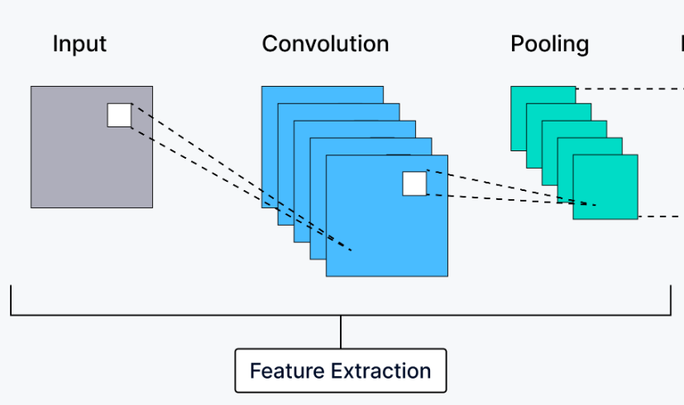
Components of cnn
CNN is mainly based on two operations
i) Convolution - which implements feature extraction through filtering
ii) Pooling - which implements the dimensionality reduction.

Slide 12
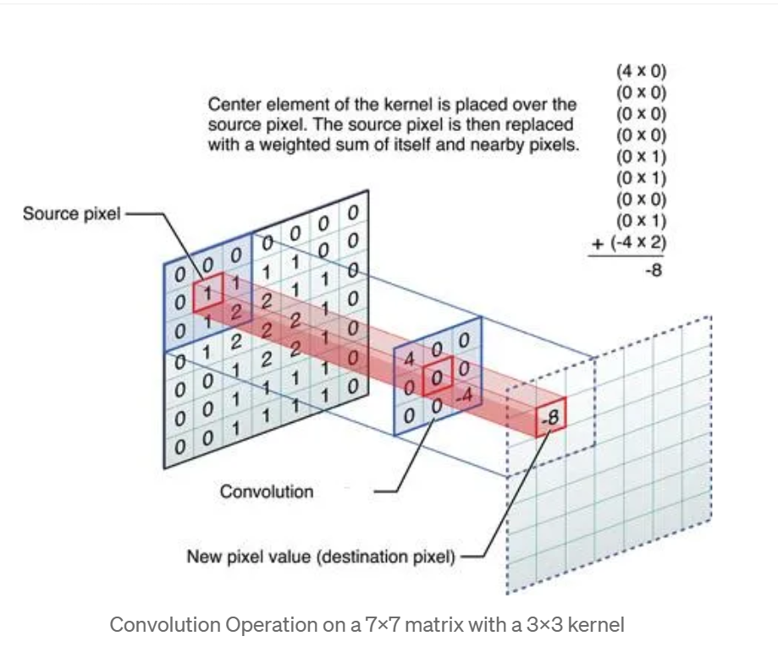
Example of Convolution
Confidence-building strategies

Slide 13
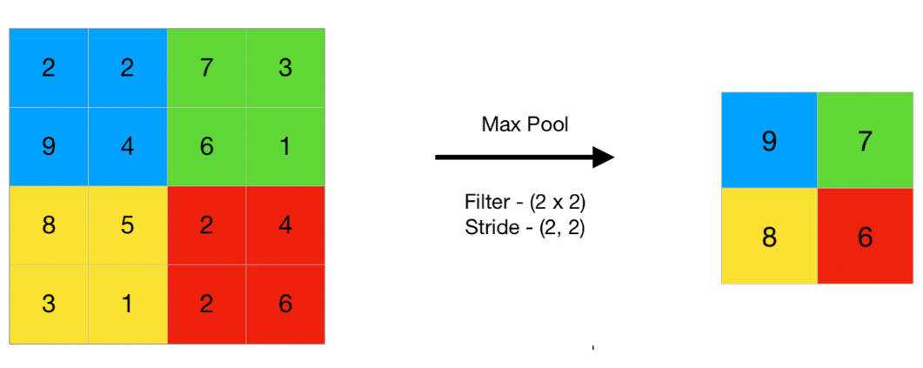
Example of pooling

Slide 14
In this paper we learnt a novel pooling operation based on type-1 fuzzy sets to cope up with the local imprecision of the feature maps.

Slide 15
In this paper we learnt a novel pooling operation based on type-1 fuzzy sets to cope up with the local imprecision of the feature maps
We will use Fuzzy Pooling layer in replacement of the current Crisp Pooling layers of CNN Architectures except that everything else remains the same.

Slide 16
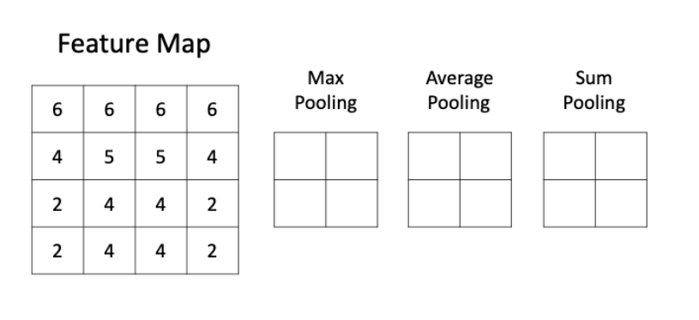
Confidence-building strategies

Slide 17
Confidence-building strategies

Slide 18
Confidence-building strategies
Instead, we will use Fuzzy Pooling…

Slide 19
Architecture of fuzzy pooling

Slide 20
Architecture of fuzzy pooling
Fuzzification
Aggregation
Defuzzification

Slide 21
Fuzzification

Slide 22
Fuzzification
Fuzzification is the process of converting a crisp input value to a fuzzy value.

Slide 23
Fuzzification
Fuzzification is the process of converting a crisp input value to a fuzzy value.
In this fuzzy pooling process, we will define membership functions for small, medium, and large values to quantify each patch's intensity levels.

Slide 24
Small membership function

Slide 25
Small membership function
Input close to 0 -> 1
Primarily characterized by lower numerical values

Slide 26
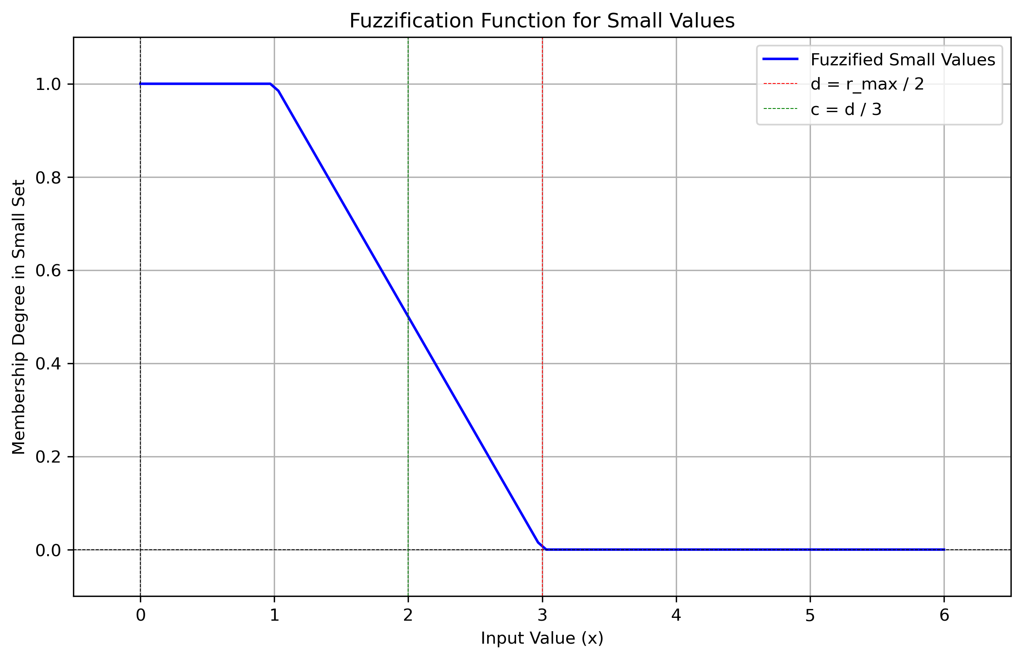
Small membership function
Input close to 0 -> 1
Primarily characterized by lower numerical values

Slide 27
Medium membership function

Slide 28
Medium membership function
Input close to 3.0 -> 1
Primarily characterized by values around the midpoint

Slide 29
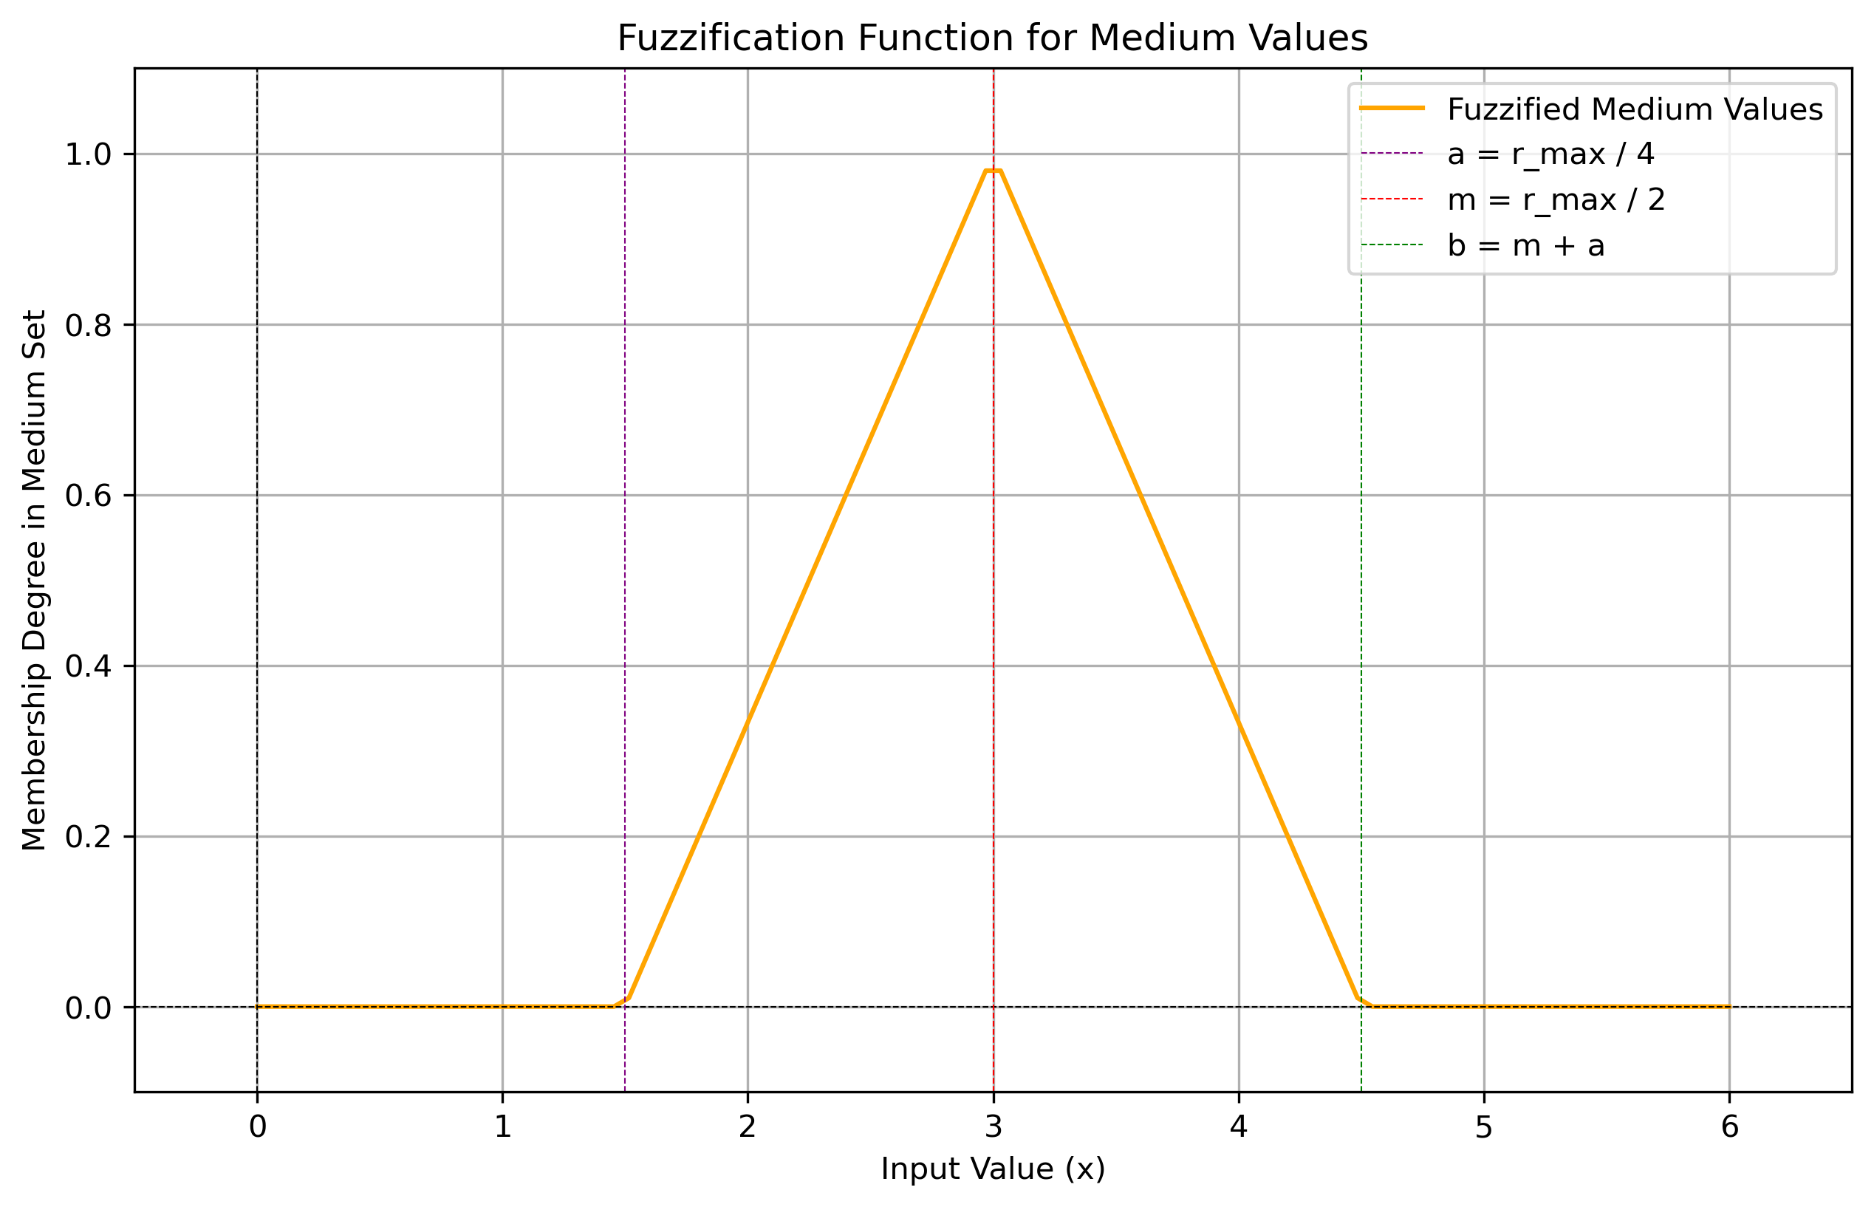
Medium membership function
Input close to 3.0 -> 1
Primarily characterized by values around the midpoint

Slide 30
Large membership function

Slide 31
Large membership function
Input close to 6.0 -> 1
Primarily characterized by higher numerical values.

Slide 32
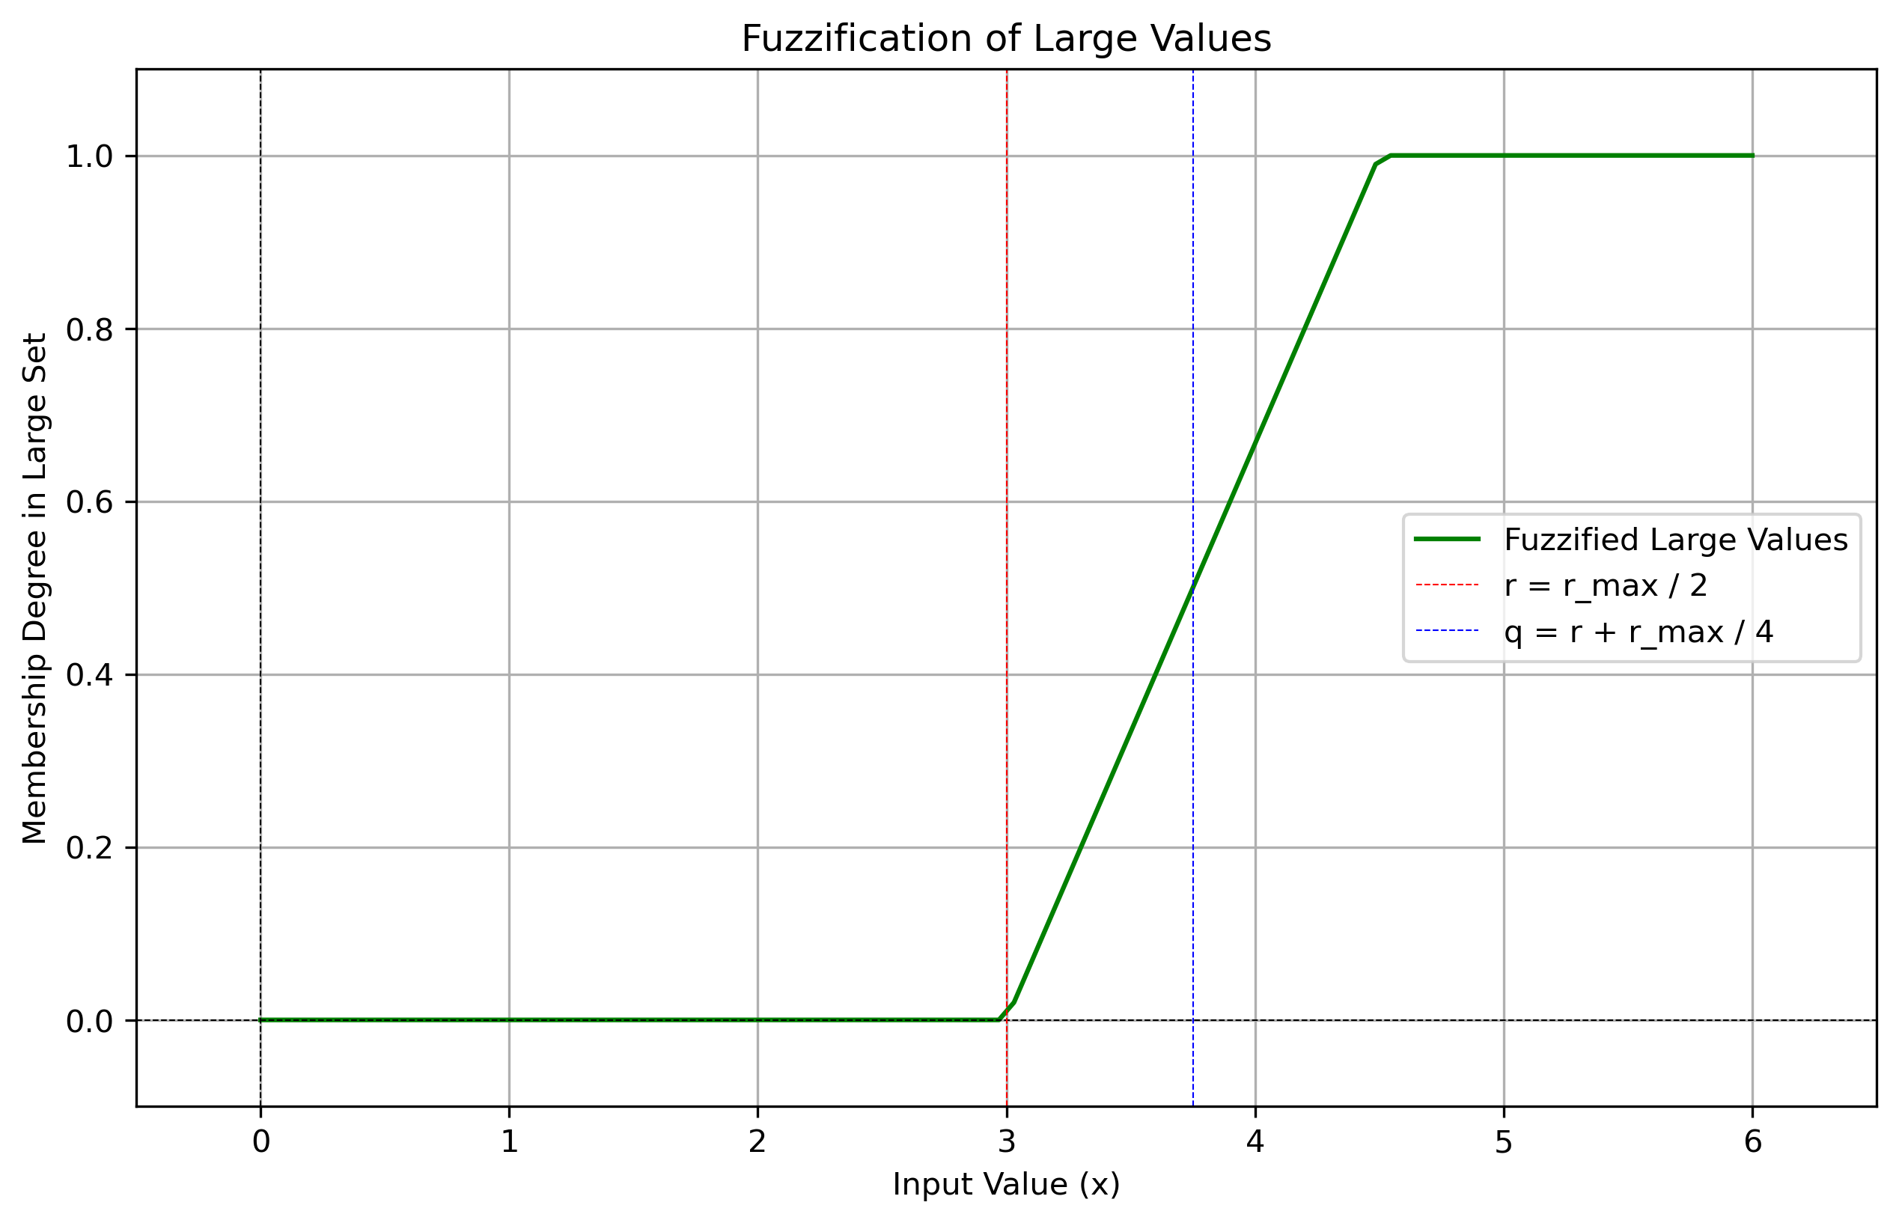
Large membership function
Input close to 6.0 -> 1
Primarily characterized by higher numerical values.

Slide 33
Recap: Why are we doing Three different membership function?

Slide 34
Recap: Why are we doing Three different membership function?
Classifying inputs into different membership values through fuzzy sets allows for handling uncertainty and vagueness in real-world concepts, leading to improved decision-making and flexibility in classification.

Slide 35
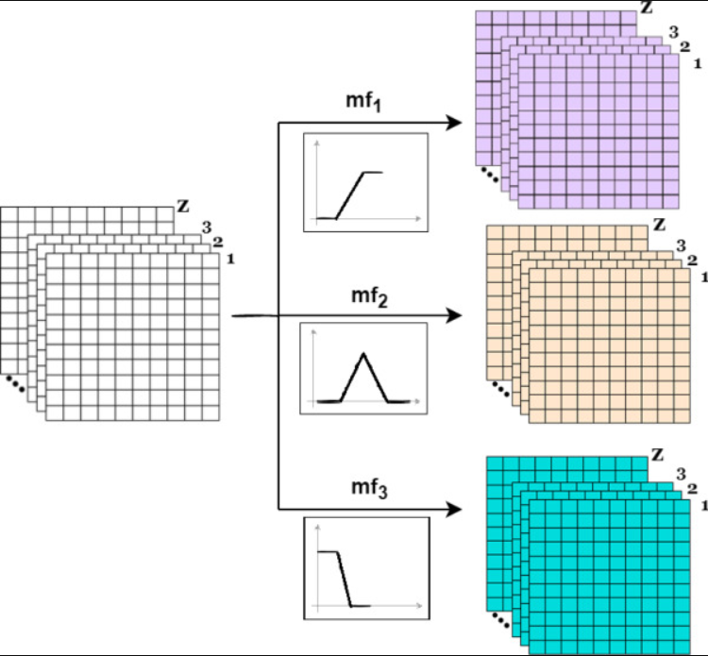
CRISP VALUES ARE CONVERTED INTO A FUZZY VALUE

Slide 36
AGGREGATION

Slide 37
AGGREGATION
In fuzzy logic, aggregation is the process of combining fuzzy sets that represent the outputs of each rule into a single fuzzy set.

Slide 38
AGGREGATION
In fuzzy logic, aggregation is the process of combining fuzzy sets that represent the outputs of each rule into a single fuzzy set.
We have used the sum operator in fuzzy aggregation to combine multiple membership values into a single value

Slide 39
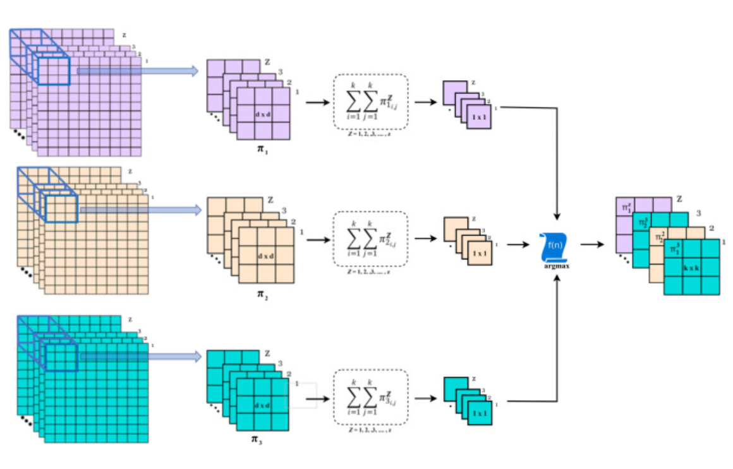

Slide 40
defuzzification

Slide 41
defuzzification
The defuzzification stage reduces the dimensionality of patches. We have used Center of Gravity (COG) as defuzzification method.

Slide 42
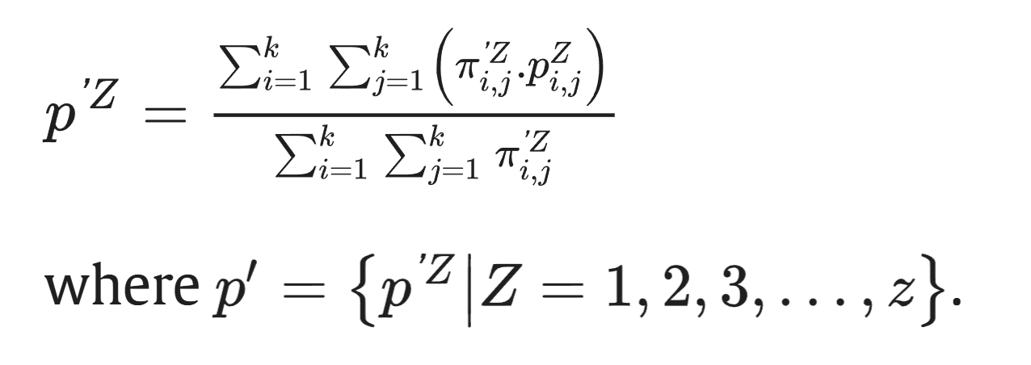
defuzzification
The defuzzification stage reduces the dimensionality of patches. We have used Center of Gravity (COG) as defuzzification method.

Slide 43
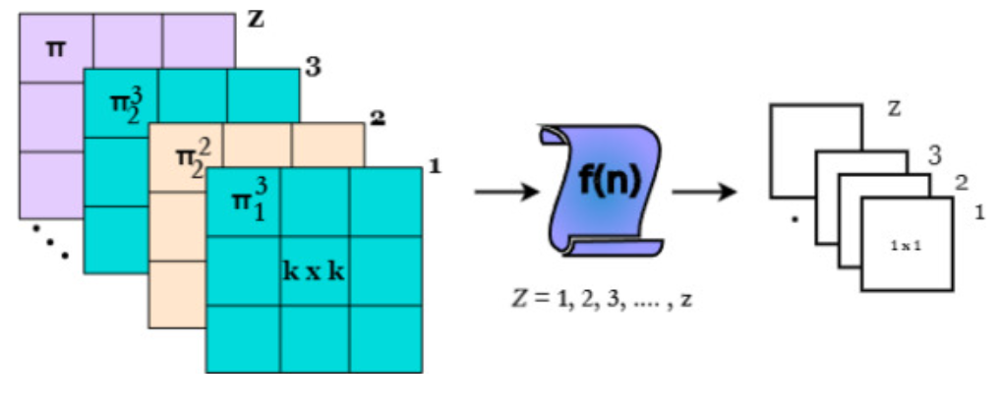

Slide 44
What Next?

Slide 45
What Next?
The defuzzified output matrix can then be fed into the next layer of the convolutional neural network (CNN).

Slide 46
What Next?
The defuzzified output matrix can then be fed into the next layer of the convolutional neural network (CNN).
This could be another convolutional layer, or it could be followed by flattening and connecting to fully connected (dense) layers.

Slide 47
results

Slide 48
results
We worked with the Fashion MNIST dataset, which consists of 28x28 grayscale images of various clothing items.

Slide 49
results
We worked with the Fashion MNIST dataset, which consists of 28x28 grayscale images of various clothing items.
The results obtained by different pooling method are as follows:

Slide 50
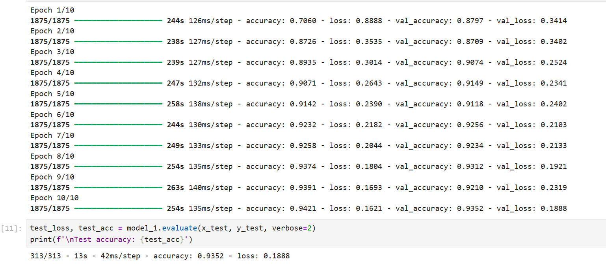
Test accuracy using MAX pooling

Slide 51
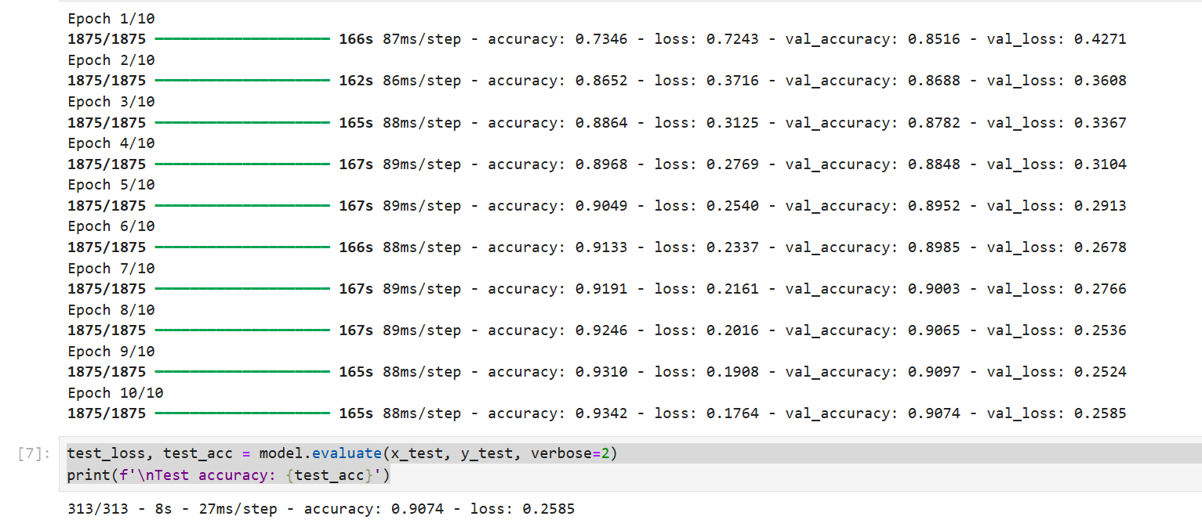
Test accuracy using fuzzy pooling

Slide 52
Thank you

