Slide 1

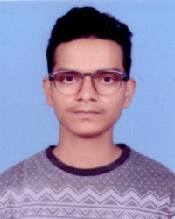
Profile Without Work Experience
Name: Naveen Varshney
DOB: 19/01/2002
Qualification: M.Sc.(Data Science) Final Year.
Skills: Statistical Analysis, Bayesian Data Analysis, Multivariate Data Analysis, Python, R, MySQL, Tableau, MS Office, Statistical Analysis, Deployment.
Projects:
A study on consumer perception towards online food delivery apps (02/2021 - 04/2021)
Handwritten Digit Recognition using ML (07/2022 - 08/2022)
Income Prediction Model using ML (09/2022 - 10/2022)
Sentiment Analysis of customer reviews using NLTK (11/2022)
Hobbies: Cricket, Theater, Current Affairs, etc.

