Slide 1


Slide 2

Idea Brief
The proposed solution involves creating a website that can only be utilized by certain police officers. It will be categorized based on the position of the officer, such as PSI, PI, ACP and DySP.
The website visualizes an analytical dashboard that monitors key performance indicators such as response times, crime and crime clearance rates across different police stations.
An automated alerting system is also utilized on the website in order to alert the officers for non-completion of work.
Machine learning algorithms (please refer to Tech Stack) are utilized to analyze historical data and predict future trends in crime rates, resource utilization and workload distribution.
An AI model is developed for dynamic resource allocation that will adjust staffing levels, patrol routes and task assignment. The AI model provides an optimized resource that can be allocated and utilized effectively.
The goal of this solution is to give police departments useful information for making strategic decisions and allocating resources.

Slide 3


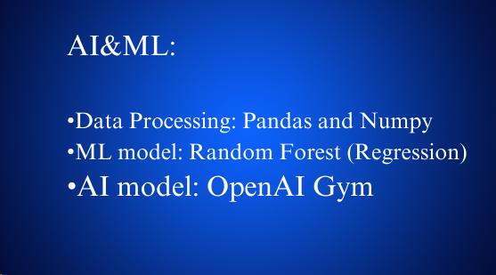
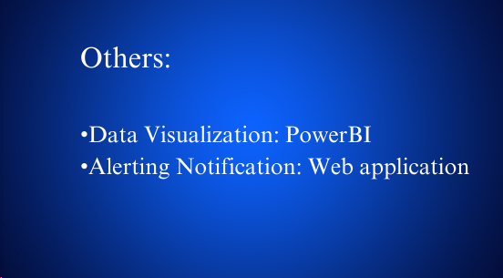
Tech Stack Used

Slide 4
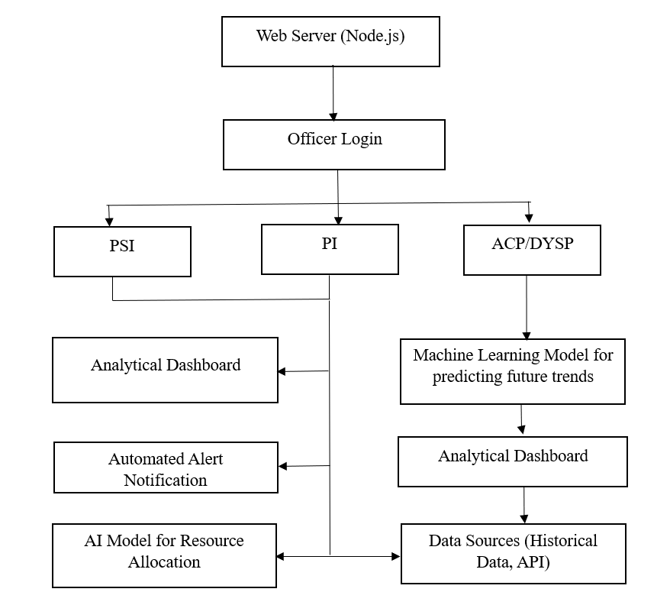
Architecture Design

Slide 5
What positive and unique solutions your idea have?
Predictive Performance Forecasting and Dynamic Resource Allocation: Using previous KPI data, the dashboard forecasts police performance by integrating a machine learning algorithm. Because of this predictive skill, police forces may allocate resources and make proactive decisions by anticipating problems and tailoring their plans appropriately. An AI model is used for dynamic resource allocation.
Real-time Monitoring and Alerts: The dashboard's real-time monitoring features let managers keep tabs on ongoing police operations, rank key occurrences, and assign resources appropriately. When performance falls short of expectations, automated notifications can let stakeholders know so they can take prompt remedial action.
Interactive Data Visualization: The dashboard includes user-friendly interactive data visualizations, including graphs, charts, and maps, that let users examine KPIs and performance trends. At all organizational levels, this encourages improved comprehension of complicated data and makes data-driven decision-making easier.

Slide 6
Summary
The proposed solution aims to completely transform police department operations by utilizing modern technology to improve performance evaluation, resource allocation, and strategic decision-making. The foundation of this solution is an extensive website that can only be accessed by authorized police personnel. The officers are arranged according to their roles, which include Assistant Commissioners of Police, Deputy Superintendents of Police, Police Inspectors, and Police Sub-Inspectors.
The main feature of the website is an analytical dashboard that shows key performance indicators (KPIs) that are vital to law enforcement activities in real time. These key performance indicators (KPIs) span several police stations and include response times, crime rates, criminal clearance rates, and other pertinent data. Officers at all levels can monitor performance, see patterns, and make well-informed choices thanks to the dashboard's clear and straightforward presentation of the data.
The website is equipped with an automatic notification system to guarantee proactive management of remaining duties and tasks. When work items are past due or not yet completed, this system sends out notifications to the officers, allowing for immediate action and solving problems. This function improves accountability and guarantees that important activities are completed on time to preserve operational efficiency.

Slide 7
Machine learning algorithms are used to evaluate past data and predict future patterns, allowing the police force to fully utilize the data at its disposal. These algorithms give cops useful information about crime rates, resource usage, and task distribution, allowing them to plan ahead and deploy resources more wisely. Furthermore, based on predictive analytics, an AI model for resource allocation constantly modifies work assignments, patrol routes, and personnel levels to maximize resource efficiency and operational effectiveness.
All things considered, this system gives police forces proactive management tools, smart resource allocation, and actionable insights that boost efficiency, increase public safety, and build community confidence. Law enforcement organizations may efficiently accomplish their purpose of community safety and adapt to changing problems by utilizing technology to its maximum potential.

