Slide 1
WGAN vs. WGAN-GP on CIFAR-10
Katravath Naveen | Roll No. 24CS3027 | Assignment DL-078
Based on Gulrajani et al., NeurIPS 2017

Slide 2
Problem Statement & Objectives
GAN training can be unstable and sensitive to critic constraints.
Compare WGAN weight clipping with WGAN-GP gradient penalty.
Train both methods on all 50,000 CIFAR-10 training images.
Compare losses, generated samples, and approximate FID.

Slide 3
Dataset & Model Setup
CIFAR-10: 32×32 RGB images; 50,000 training images.
Latent dimension: 100; batch size: 64; 3 epochs per main method.
Generator: transposed convolutions; critic: convolutional layers.
Images normalized to [-1, 1].

Slide 4
Methods Compared
WGAN clipping: RMSprop, learning rate 5×10⁻⁵, critic weights clipped to [-0.01, 0.01].
WGAN-GP: Adam, learning rate 1×10⁻⁴, gradient penalty λ=10.
Both methods use 5 critic updates per generator update.
WGAN-GP penalizes critic gradient norms instead of clipping parameters.

Slide 5
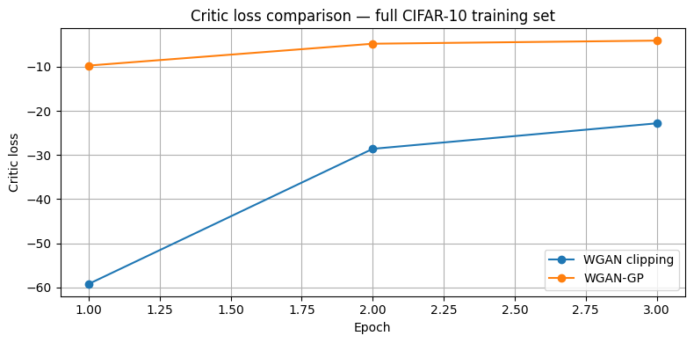
Critic Loss Comparison
Loss curves from the executed notebook; loss is a training signal, not a quality metric.

Slide 6
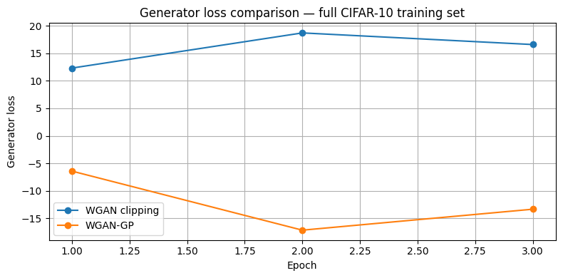
Generator Loss Comparison
Three-epoch main comparison.

Slide 7
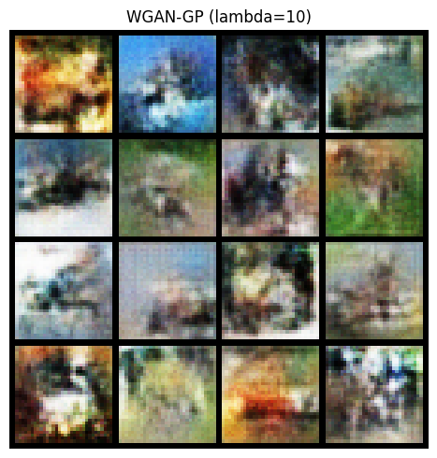
Generated Image Samples
Example WGAN-GP generated sample grid (λ=10).

Slide 8
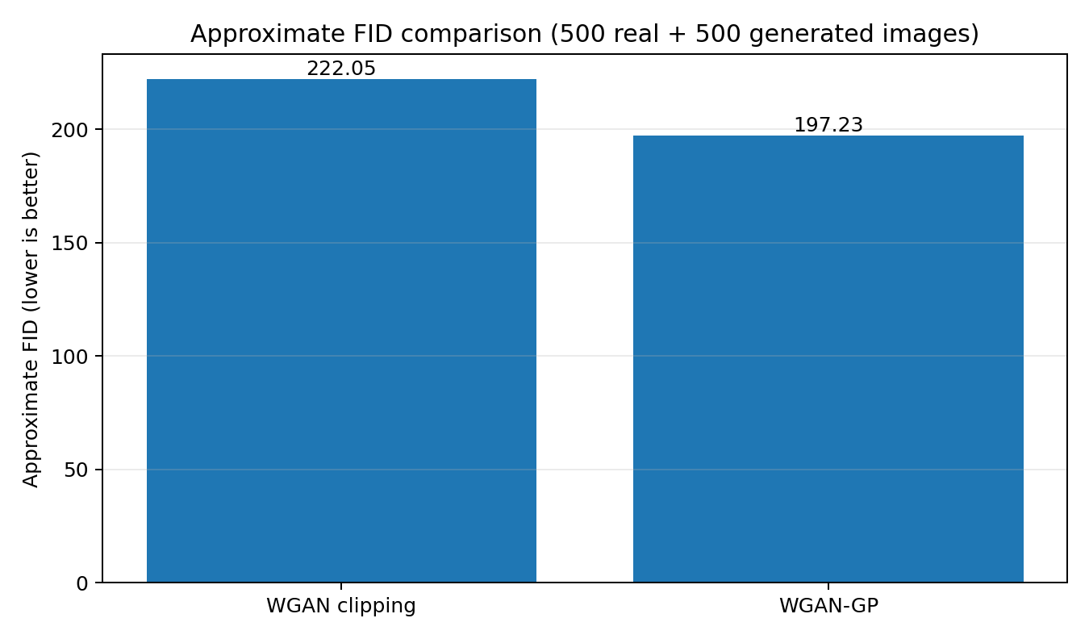
Approximate FID Results
FID estimated using 500 real test images and 500 generated images; lower is better.

Slide 9
Results & Interpretation
WGAN clipping: critic -22.8178; generator 16.5960; FID 222.05.
WGAN-GP: critic -4.0736; generator -13.3430; FID 197.23.
WGAN-GP FID is lower by 24.82 points in this run.
Preliminary finding: three epochs and 500-image FID evaluation.

Slide 10
Conclusion & Future Work
Both methods were trained on the full 50,000-image CIFAR-10 training split.
WGAN-GP showed the lower approximate FID in the submitted run.
Extend training, use more FID samples, and repeat with multiple seeds.
Reference: Gulrajani et al., “Improved Training of Wasserstein GANs,” 2017.

