Slide 1


INSIGHTS FROM WAVECON TELECOM TRANSFORMATION
5G Surge: Revealing Wavecon’s Revenue Potential

Slide 2
Chapter Guide
Introduction
5G launch impact on Wavecon’s Revenue
Post 5G analysis : Identifying lagging KPIs
Post 5G launch : Performance of Plans (Revenue
Leaders & Underperformers)
Post 5G Strategy : Evaluating plan Viability
Unveiling Retired Plans
Market share : value analysis & Active user Penetration

Slide 3
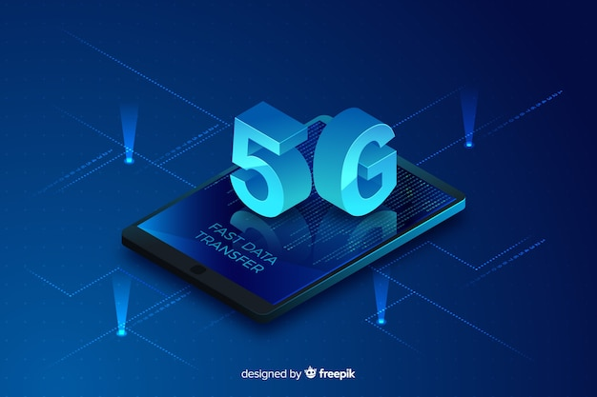
Introduction
In this digital landscape where connectivity is measure for progress Wavecon launched its 5G services across 15 key urban centers along with other telecom providers.
Our presentation embarks on capturing the essence of 5G impact on Wavecons metrics like revenue, KPI’s.
Here we uncover intricate relationship between technology and Business.

Slide 4

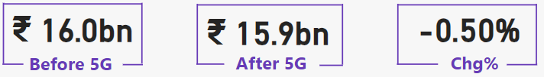
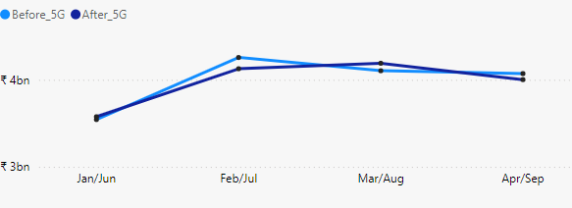
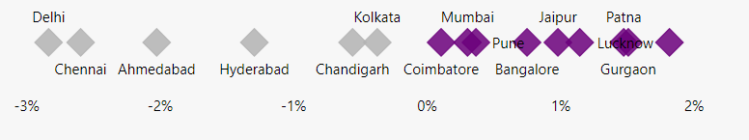
5G launch impact on Wavecon Revenue
Out of 31.9bn of Wavecon total revenue,16bn was from before 5G launch and 15.9bn from post 5G launch
Revenue Trend
Revenue of Wavecon after 5G launch surged peak during August than in July.
While the revenue before 5G launch was high in Feb and dropped slightly in March.
Wavecon Revenue change percentage after 5G launch is more from Tier II cities like Gurgoan, Lucknow, Patna, Jaipur when compared to Metropolitan cities.
Revenue change% across cities

Slide 5
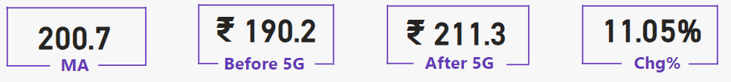
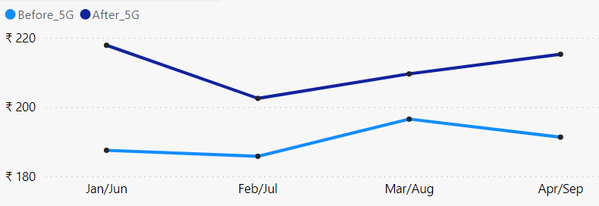

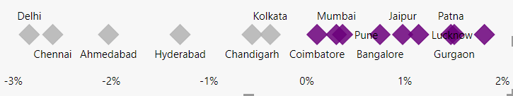
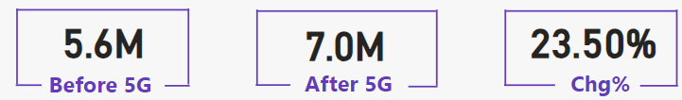
Post 5G analysis: Identifying Lagging KPI’s
Average revenue per user (ARPU)
Apart from Revenue we look at three KPI’s – ARPU,TAU & TUsU
Avg revenue per user after 5G launch has increased. ARPU got decline in July but since then it
has consistently increased.
TAU after 5G launch has declined (some common reasons might be Coverage shifts, Pricing & plans
Device compatibility, User experience, Transition
period)
Two tier cities were on the positive side of TAU change% compared to metropolitan cities.
Surprisingly TUsU after5G launch were increased that might be due to pricing and value perceptions
& market competition.
ARPU trend
Total Active users (TAU)
TAU Trend
Total Unsubscribed users (TUsU)

Slide 6


Performance of plans (revenue leaders and underperformers)
Effective plans after 5G deployment by Wavecon
A total of network and data plans for wavecon after launching 5G were 13.
P1 has always been super performer in terms of revenue generated before & after 5G launch (4.2bn).
In addition to this P2 and P11 stood out as high
performing options/packages showcasing robust
financial gains (3.1bn).
P1,P2 and P11 plans exhibited strong performance
in Mumbai, Delhi and Kolkata with the majority of
their revenue originating from these cities.
Plans that struggled to perform following 5G rollout
Plans 5,6 and 7 experienced downturn in revenue
post 5G launch.
These three plans combinedly generated over
1.3 billion after 5G launch .
Cities like Patna, Coimbatore, Chandigarh were
the bottom cities that generated lower revenue
for all the Plans.

Slide 7
Evaluating Plan Viability
Unveiling Retired Plans
Based on the positive revenue trend of Plans 1,P11 and P12 we can infer that these plans are
more viable and likely to thrive.
Combined revenue of these three plans post
5G launch was 5.3billion.
The likelihood of these three plans P1,P11 and
P12 in overall Wavecon plan 5G Success and
sustainability is more.
Except for the above plans , all the remaining
plans saw a decrease in revenue trend but P7
seen a significant decline in revenue compared
to other plans.
Wavecon offers a portfolio of 13 packages .Notably those with extended validity periods exhibit a magnetic pull, attracting users and yielding substantial revenue.
Conversely plans with limited time validity fail to
ignite the same financial spark.
P8 – Daily savior (1GB/day) validity 1 day is a
retired plan after 5G launch as consumers feel
insufficiency in terms of both data and validity
duration.
P9 – Combo top up 14.95 min talk time & 300MB data
Consumers shifted away from this plan and
doesn’t find attractive by them as Wavecon offers
similar kind of plan in P5 (Rs 99 full talk time
combo) so P9 plan is discontinued.
P10 – Big combo pack (6GB/day) validity 3 days.
This a good and bad combination plan. Pretty
good data per day but the validity period is less
hence consumers found it unappealing.

Slide 8
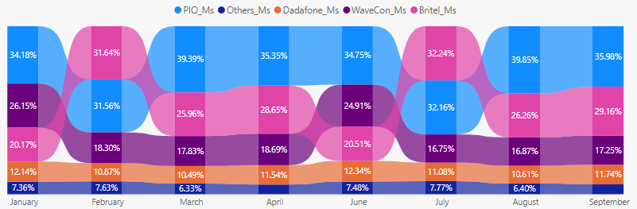
Market share : (Value analysis & Active user penetration (AUP)
Market players of 5G services in these 15 key urban centers are PIO, Dadafone, Wavecon, Britel and others.
Key indices in Market share value analysis are Revenue, Active User penetration,Usub users and ARPU. For all
these indices PIO and Britel combined Market share
is 60% approx. While wavecon has a market share of
20% approx.
Clearly in Mumbai where revenue after 5G launch is
highest (4.9 Bn), Wavecon has two formidable
competitors in terms of market share (PIO & Britel).
While in tier-2 cities were market share revenue is lower
compared to metro cities , Wavecon performed
competitively with market second player Britel .
Mumbai stands first in top 5 cities of Active user penetration
Here both PIO & Britel are having a competitive edge than
Wavecon. Wavecons AUP metric stands steady at 3rd place
in Mumbai for 8 months.

Slide 9

Recommendations
Some of the strategic options for Wavecon to enhance their Revenue and Market share for its 5G services :
Differentiated Service plans; like premium plans with exclusive benefits for business users
or Data heavy plans for content creators.
Network (5G) coverage expansion ; to underserved areas; broader footprint attract more
subscribers and increases market share.
Content partnerships; partnering with streaming services, gaming platforms and content
creators.
Enterprise solutions ; target businesses with tailored 5G solutions, positioning Wavecon
a reliable partner in emphasizing security and scalability.
Innovative USE cases ; showcasing 5G potential beyond faster speeds, highlight applications
like augmented reality (AR), VR and telemedicine.
Customer education and awareness ; like hosting webinars, workshops and community
events. Address misconceptions and build trust.
Launch Captivating Ad campaigns; leverage social media and influencers.

