Slide 1

Car Sales Dataset
Name : Naveen Kumar
Roll no. : 2106650
Branch : CSE-B , 8th semester
College: Rayat Bahra Institute of Engineering and Nano – Technology, Hoshiarpur

Slide 2
Name of slide | Slide Number
INTRODUCTION | 3
OBJECTIVE | 4
DATA CYCLE | 5
DATA CLEANING | 6
DATA TRANSFORMATION | 7
DATA ANALYSIS | 8
CONCLUSION | 9

Slide 3
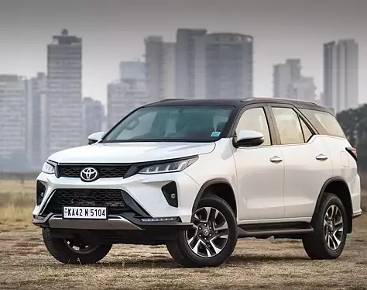
INTRODUCTION ON DATA ANALYSIS
What is Data Analysis? Data analysis is the process of collecting, organizing, and interpreting data to discover useful information, make decisions, and draw conclusions.
Types of Data Analysis:
Descriptive Analysis: Summarizing and describing past data.
Diagnostic Analysis: Identifying the root causes of events.
Predictive Analysis: Forecasting future outcomes.
Prescriptive Analysis: Suggests actions to achieve desired outcomes.
Type of Analysis Done in This Project:
Descriptive Analysis – We analyze historical car sales data to understand total sales, brand market value , most selling and sales trends.

Slide 4

OBJECTIVES
To monitor and analyze overall car sales performance across different models and brands.
To identify top-performing brands and models based on total sales and units sold.
To evaluate the effectiveness of prices and insights.
To generate data-driven insights for improving business strategies and decision-making.

Slide 5
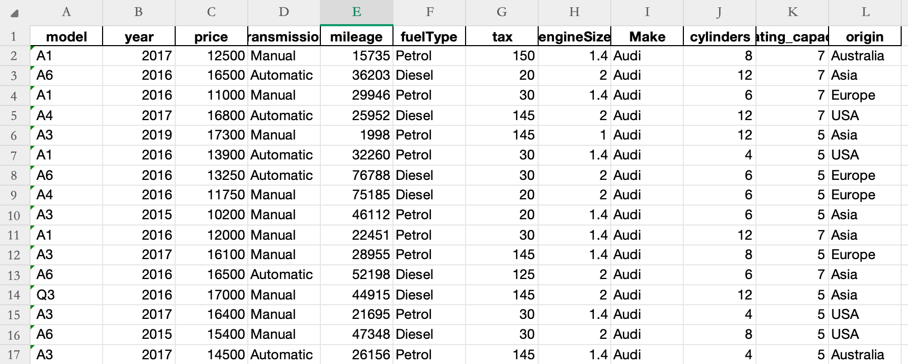
DATA CYCLE
Steps Followed in this Project:
Data Collection – Collected Car sales data from Kaggle.
Data Understanding - Understood which columns are numeric (like sales, quantity), categorical (like brand, price and fuel type).

Slide 6
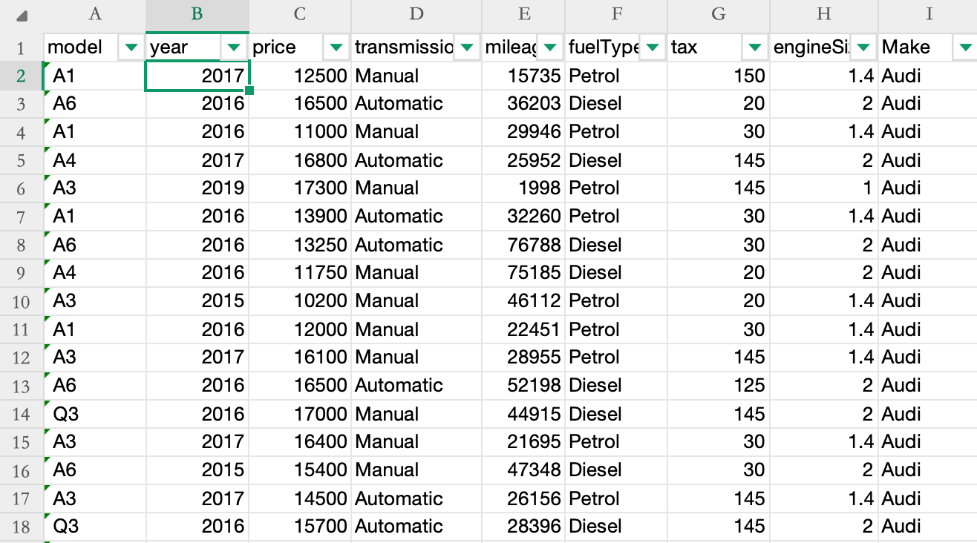
Data Cleaning
In this we have some null values and duplicate values and some column is not relevant to our insight like Cylinder , Origin and seating Capacity so we clean the data according to our Dataset.

Slide 7
DATA TRANSFORMATION
Created calculated fields such as Total Sales to aggregate overall revenue across various time periods and product categories.
Developed Brand Market Value metrics by analyzing sales performance, customer reach, and pricing strategies for each brand.
Calculated Market Share per Maker using proportionate sales values and total industry sales data to evaluate brand competitiveness.
Built Sales Trend fields to monitor growth patterns across regions and product lines.
Integrated dynamic measures to reflect real-time changes in sales data, improving responsiveness of the calculated fields.
Used advanced DAX formulas and data modeling techniques to ensure calculated fields are scalable and optimized for performance.

Slide 8
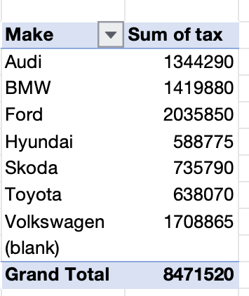
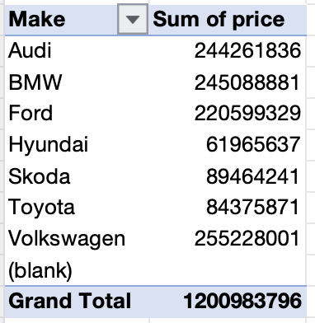
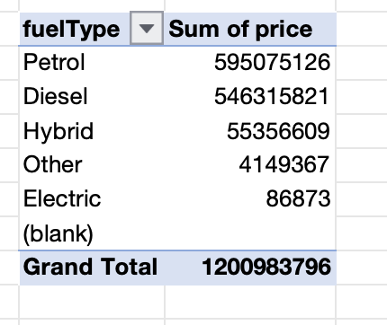
DATA ANALYSIS
Data analysis focuses on extracting meaningful insights from that data to support decision-making.
In this Project data analysis is done through Pivot Tables.

Slide 9
CONCLUSION
The Car Sales Dashboard offers a clear overview of sales performance, customer satisfaction, and trends over time.
A total of 1201M Car units sold generated showing strong market performance.
This dashboard is a powerful tool for decision-making and business growth.
It helps identify key growth opportunities and areas needing improvement.
By leveraging insights from the dashboard, businesses can stay ahead in a competitive market.

Slide 10

THANKYOU

