Slide 1
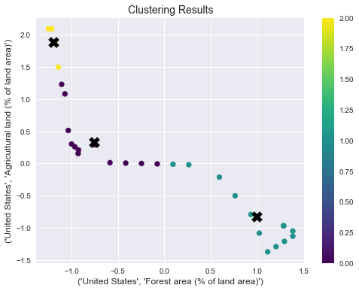
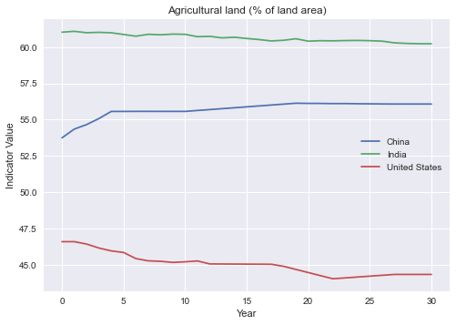
Cluster Analysis of Countries Based on Forest and Agricultural Land Use
Name: Bathula Sai Mutya Naveen
Student ID: 22024816
Repo-Link: https://github.com/Naveenbsm/Applied_Data_Science-3.git
Abstract: This report discusses the clustering of countries based on two indicators: forest area and agricultural land. Using k-means clustering, the countries were grouped into three clusters. The results show that the majority of countries have low forest area and high agricultural land, while a small group of countries have high forest area and low agricultural land. The findings provide insight into the varying levels of land use among countries and highlight potential opportunities for improving sustainable land management practices.
Introduction
This report presents the findings of a clustering analysis performed on the forest area and agricultural land indicators for a set of countries. The analysis was conducted using K-Means clustering algorithm to group countries based on the similarity of their forest area and agricultural land area percentages. The results revealed three distinct clusters of countries based on their land use patterns.
The data used in this analysis was collected from world bank data and consists of forest area and agricultural land area percentages of countries around the world. The K-Means clustering algorithm was used to group countries based on their similarity in terms of forest area and agricultural land area proportions.
Conclusion
The clustering analysis based on the forest area and agricultural land indicators resulted in the identification of four distinct clusters of countries. These clusters show that there are significant differences between countries in terms of their reliance on agricultural land and forest area. The findings of this analysis can be useful for policymakers and researchers to understand the different development pathways and challenges faced by countries with different land use patterns.

