Slide 1
ICICI Bank – Staff Augmentation
Aug-Feb 2020

Slide 2
The Synopsys team
Naveen H N | Security Consultant | naveenhs@synopsys.com
Ved Sumedha Prabhu | Security Consultant | vsprabhu@synopsys.com

Slide 3
Agenda
Assessment overview
Approach and Objectives
Scope
Overview
Significant observations
SQL Injection
Unrestricted File Upload
XML Entity Expansion (Billion Laughs Attack)
Stored Cross-Site-Scripting (XSS)

Slide 4
Assessment overview – Approach and Objectives
What is SAST (Static Application Security Testing):
Methodology that analyzes application source code, byte code and binaries for coding and design conditions that are indicative of security vulnerabilities that make an organization’s applications susceptible to attack.
Business objective
Identify vulnerabilities in the source code
Suggesting remediation for the vulnerabilities reported
Documenting the vulnerabilities identified in the form of a report (ICICI format)
To recommend on processes to be followed by an application developer for implementing secure coding guidelines.

Slide 5
Assessment overview - Scope
Scope
Total of 26 applications were reviewed, namely:
CFS (Channel Financing System)
CMSWEB
DFS (Dealer Funding System)
Direct Banking Tracker
EAI (Enterprise Application Interface)
E-Settlement System
FCRM
FX NOOP
ICICI Application Integration
iHelpdesk
iValue
LOP (Loan on Phone )
FRS Regulatory Reporting- United Kingdom
Employee Loan Repayment System
SMS Gateway
CSGL
WBG-Credit Monitoring Dashboard
New CMART
ICICI Financial Data Warehouse
eReconciliation
LAMS (Logical Access Management System)
NRISR (NRI Speed Remittances)
CAR (Customer Authentication Relationship)
Money2India
SmartForm-CA
Retail Mobile Banking Canada
Retail Mobile Banking UK
iMobile IBMWorklight
Corporate Tablet Banking application (iBizz HD)

Slide 6
Overview
Description | Oct-Nov
Total number of applications assessed | 26
Total number of applications with one or more Critical/High finding | 9
Total number of vulnerabilities discovered | 100*
Number of distinct vulnerabilities that can only be found in SAST | 16*
Number of distinct vulnerabilities that should be found in a Penetration Test (PT) | 15*

Slide 7
SQL Injection
What?
The database has no way of distinguishing between the developer's intended SQL syntax and any SQL syntax included from user-supplied input. If the executes queries are executed in response, the data from the database can be dumped to the browser. The business impacts vary from disclosing of passwords of users in the system, loss of integrity by modifying sensitive information, authentication bypass (in cases where unsanitized credentials are passed in the database)
Application observations
Application Name: iHelpdesk, NRISR, Money2India, CSGL, DFS(Dealer Funding System)

Slide 8
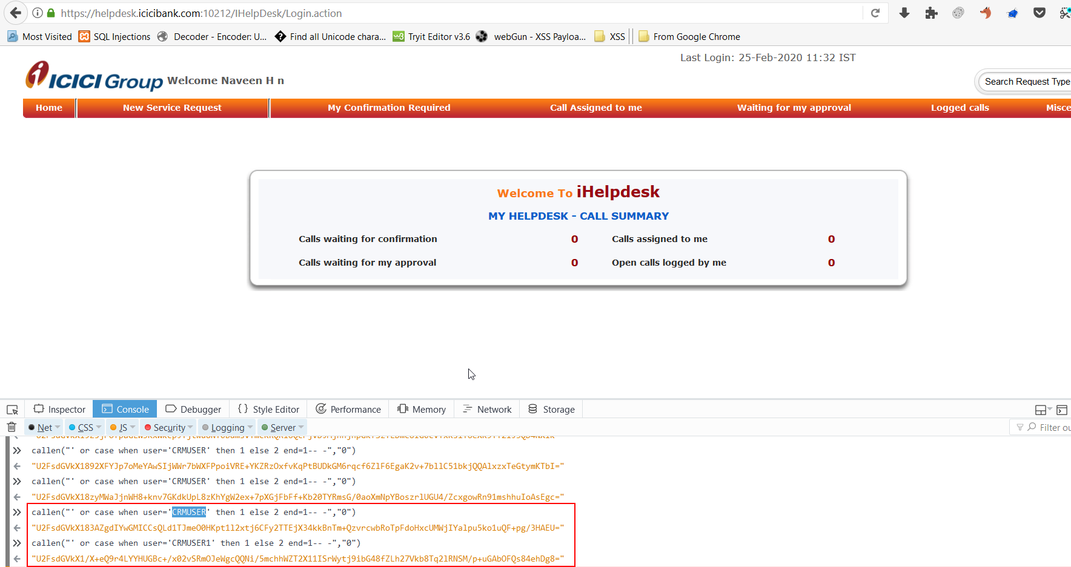

Slide 9
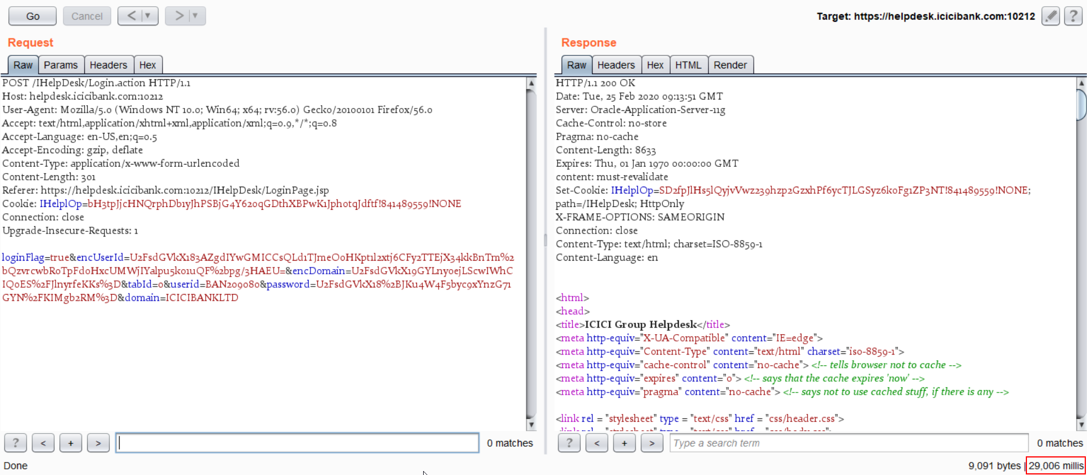

Slide 10
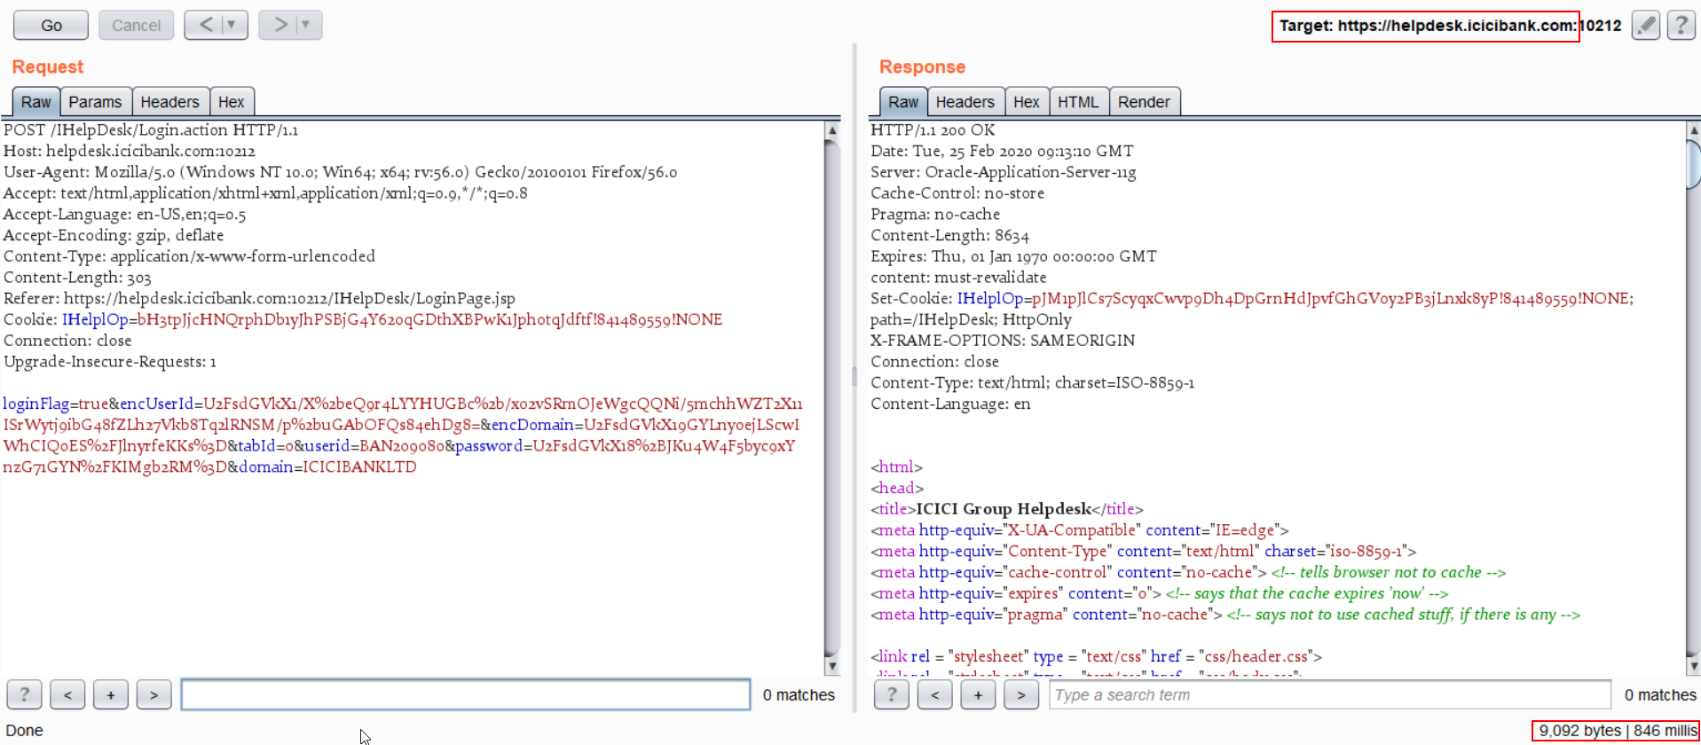

Slide 11
Unrestricted File Upload
What?
Attacker can upload server files through the file upload functionality consequences which vary from complete system takeover, an overloaded file system or database, forwarding attacks to back-end systems, client-side attacks, or simple defacement.
Application observations
Application Name: CMSWEB, NRISR, WEB-Credit Monitoring Dashboard
File type validations (if any): No check on file being uploaded

Slide 12
XML External Entity Expansion
What?
XML external entity injection (also known as XXE) is a web security vulnerability that allows an attacker to interfere with an application's processing of XML data. It often allows an attacker to view files on the application server filesystem, and to interact with any backend or external systems that the application itself can access.
XML entity expansion makes use of the DOCTYPE tag to define the injected entities. XML parsers can usually be configured to disable support for this tag. You should consult the documentation for your XML parsing library to determine how to disable this feature.
Application observations
Application Name: iHelpdesk (TIER 4), NRISR (TIER 1)

Slide 13
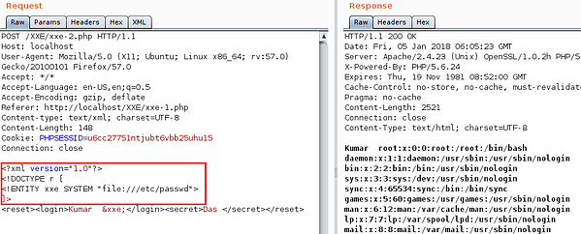
Example showing extraction on passwords in Linux system using XXE vulnerability. (Example taken from google)

Slide 14
Stored Cross-Site Scripting (XSS)
What?
The application stores user-input data in database as it is and later uses this information to display into the browser.
An attacker can exploit this by injecting JavaScript payload and can gain sensitive information of another user.
Application observations
Application Name: CFS (Channel Financing System)

Slide 15
Impact: SQL Injection
SQL injection allows an attacker to modify the structure of a SQL query executed by the application. Depending on the type of SQL server in use, the attacker may be able to modify existing queries or append entirely new queries to the existing query. The modified query can access any portion of the database with the same entitlements that the database connection is granted, potentially leading to:
Loss of confidentiality when an attacker gains access to unauthorized information
Loss of integrity through modification of other users' information, log files, and any other sensitive information
Loss of availability when an attacker deletes other users' data, executes commands that take down the database server, or performs a denial of service attack that fills the database and subsequently exhausts the database server's storage
Authentication bypass through modification of SQL queries that verify a user's credentials
Authorization bypass from gaining access to or altering data in ways the application's business logic does not allow

Slide 16
Impact: Unrestricted File Upload
Failing to restrict file uploads affects the security of the operating environment in a number of ways. Attackers commonly use file upload functionality to upload viruses or malware onto trusted servers. In addition to spreading malware, attackers can upload source code files (.aspx and .jsp for example) which may be rendered as valid application pages to end users. Additionally, if users are able to upload files of any size or at any frequency, an attacker may abuse this functionality to exhaust the server's disk space.

Slide 17
Impact: XML External Entity Expansion
Attacker formed external entities can be used to retrieve files on the web server directly. External entities can also be used to send and retrieve information from another server. These server-side request forgeries can be leveraged to deliver an attack to another server, retrieve a malicious document type definition (DTD) file on an attacker hosted machine, and exfiltrate data. Allowing an XML parser to build documents from any external entity can result in the exposure of sensitive data, such as system files and user credentials , normally not accessible via the application.
An attacker may be able to supply a relatively small XML document containing a large number of internal recursive DTD (Document Type Definition) references which would be expanded by the parser into a large quantity of text in memory. The time required to process these DTD references and the large amount of memory consumed by the process may lead to a denial of service condition on applications that utilize the XML parser. During such an attack, legitimate application users would experience extensive delays or be completely unable to access the application.

Slide 18
Impact: Stored Cross-Site Scripting (XSS)
Stored Cross-Site Scripting vulnerabilities give the attacker control of HTML and JavaScript running the user's browser. The attack can alter page content with malicious HTML or JavaScript code. The attacker can arbitrarily alter page content displayed to the victim and can execute application functions using the victim's application identity if the victim is authenticated to the application. An often-cited example use of a Stored Cross-Site is where the attacker sends himself/herself the victim's session identifier. With this session identifier, the attacker can then perform application functions using that user's identity for the duration of that session.

Slide 19
Strategic Recommendations – ISG
Educate the developer about the need of following secure coding guidelines

Slide 20
Thank You

