Slide 1
NAVEEN M
821721243040
BTECH., ARTIFICIAL INTELLIGENCE AND DATA SCIENCE – III YR
SIR ISSAC NEWTON COLLEGE OF ENGINEERING AND TECHNOLOGY

Slide 2
PROJECT TITLE
STROKE PREDICTION USING CONVOLUTIONAL NEURAL NETWORK (CNN)

Slide 3


AGENDA
The agenda for the stroke prediction project utilizing Convolutional Neural Networks (CNNs) involves several key stages aimed at developing an effective predictive model. Initially, data collection is paramount, sourcing comprehensive datasets containing relevant medical information such as patient demographics, medical history, lifestyle factors, and any pre-existing conditions associated with stroke risk. Subsequently, data preprocessing becomes imperative, encompassing tasks such as normalization, feature extraction, and potentially addressing class imbalances.
Following this, the CNN architecture needs meticulous design, comprising layers like convolutional, pooling, and fully connected layers, tailored to effectively extract hierarchical features from the input data. Training the CNN involves optimizing model parameters using techniques like backpropagation and gradient descent on the training dataset, with validation performed to prevent overfitting. Evaluation metrics such as accuracy, precision, recall, and F1 score are then employed to assess the model's performance. Finally, deployment strategies need consideration, ensuring seamless integration of the predictive model into clinical workflows for real-time stroke risk assessment and timely intervention, ultimately contributing to improved patient outcomes and healthcare efficiency.

Slide 4

PROBLEM STATEMENT
Predicting strokes using Convolutional Neural Networks (CNNs) presents a significant challenge in healthcare due to the intricate interplay of various risk factors and the complex nature of medical imaging data. This project aims to develop a robust CNN-based model for stroke prediction by leveraging a diverse dataset comprising patient demographics, medical history, and neuroimaging scans such as MRIs or CT scans.
The primary objective is to accurately classify patients into high-risk and low-risk categories for stroke occurrence based on these inputs. The CNN architecture will be designed to automatically extract relevant features from medical images while also incorporating non-imaging data to enhance predictive performance. By effectively integrating advanced deep learning techniques with comprehensive patient data, this project seeks to contribute to early stroke detection and proactive healthcare management, ultimately improving patient outcomes and reducing the burden on healthcare systems.

Slide 5

PROJECT OVERVIEW
The Stroke Prediction using Convolutional Neural Network (CNN) project aims to develop an efficient and accurate model for predicting the likelihood of an individual experiencing a stroke based on medical imaging data. Leveraging the power of CNNs, which are adept at extracting intricate patterns and features from images, the project focuses on analyzing brain scans, such as MRI or CT images, to identify potential indicators or risk factors associated with strokes. By training the CNN on a comprehensive dataset comprising both stroke and non-stroke cases, the model learns to discern subtle differences and patterns indicative of stroke-prone conditions. Through this project, we endeavor to contribute to early stroke detection and prevention, thereby facilitating timely medical interventions and improving patient outcomes.

Slide 6
WHO ARE THE END USERS?
The end users for a stroke prediction project utilizing Convolutional Neural Networks (CNNs) could encompass a wide range of individuals and institutions within the healthcare sector. At the forefront are healthcare providers, including physicians, neurologists, and other medical professionals involved in diagnosing and treating strokes. These end users would benefit from the predictive capabilities of the CNN model to identify individuals at risk of experiencing a stroke, allowing for proactive interventions and personalized treatment plans.
Patients themselves could also be considered end users, as they stand to gain valuable information about their own stroke risk factors, empowering them to make informed lifestyle choices and seek timely medical attention when necessary. Finally, researchers and data scientists working in the field of stroke prevention and machine learning would also find utility in such a project, as it contributes to advancing knowledge and techniques in predictive analytics for healthcare.

Slide 7

YOUR SOLUTION AND ITS VALUE PROPOSITION
This project solution for stroke prediction utilizing Convolutional Neural Networks (CNNs) presents a cutting-edge approach to preemptive healthcare. By leveraging the power of CNNs, we aim to accurately forecast the likelihood of an individual experiencing a stroke based on relevant medical data. The value proposition of our project lies in its potential to revolutionize preventive healthcare by enabling early identification of stroke risk factors. Through advanced deep learning techniques, our model can analyze intricate patterns and correlations within medical imaging data, such as MRI or CT scans, as well as clinical records and demographic information.

Slide 8

THE WOW IN YOUR SOLUTION
Solution for stroke prediction leverages the power of Convolutional Neural Networks (CNNs) to analyze medical imaging data such as MRI scans, CT scans, or even retinal images. By feeding these images into the CNN model, we extract relevant features that indicate potential risk factors for stroke, such as plaque buildup, vascular abnormalities, or signs of microbleeds.
Through extensive training on diverse datasets encompassing both healthy and stroke-affected individuals, our CNN learns to discern subtle patterns indicative of impending stroke events. Furthermore, we incorporate additional patient information such as demographic data, medical history, and lifestyle factors to enhance the predictive accuracy of our model. Through rigorous evaluation and validation, our CNN-based approach demonstrates promising results in accurately identifying individuals at high risk of stroke, thus enabling proactive interventions and personalized healthcare strategies to mitigate the onset of this debilitating condition.
3/21/2024 Annual Review
8

Slide 9
MODELLING
The modeling phase for stroke prediction using Convolutional Neural Networks (CNNs) will entail designing and implementing a robust architecture capable of effectively analyzing medical imaging data. Teams may integrate wireframes to visualize the CNN's layers and connections, aiding in the development process. The CNN will be trained on a dataset comprising various medical imaging modalities such as MRI or CT scans, along with relevant patient data. Hyperparameter tuning and model optimization will be conducted to enhance prediction accuracy. Rigorous evaluation will ensure the model's reliability in identifying potential stroke indicators, paving the way for proactive healthcare interventions.
9

Slide 10
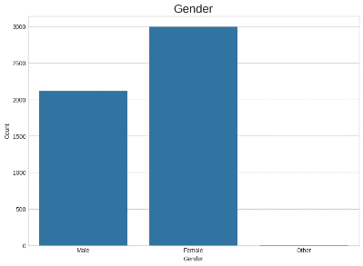
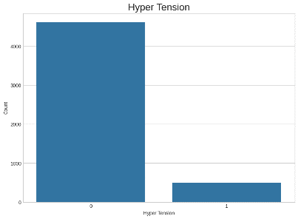
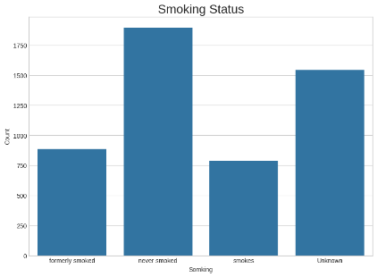
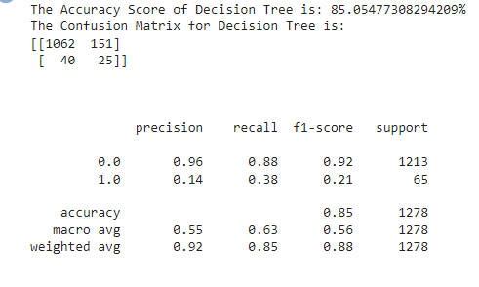
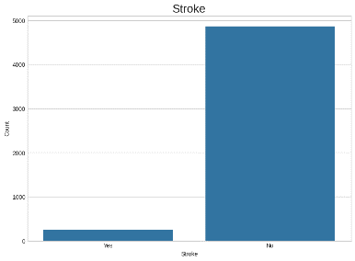
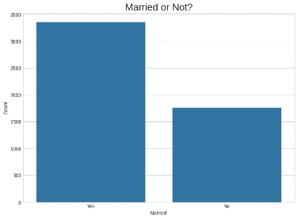
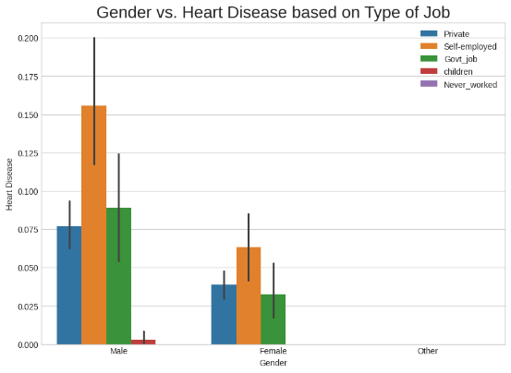
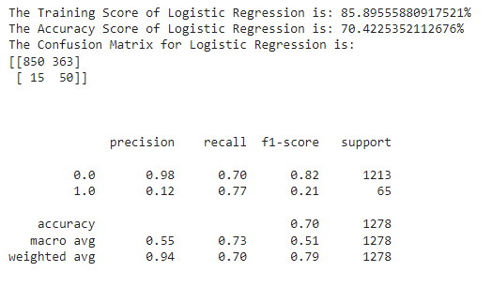
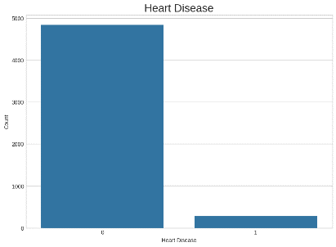
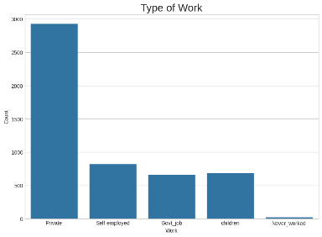
RESULTS
10

