Slide 1
KrushikaDhara: Novelty & Uniqueness
Solving the Integration Gap in Indian Agriculture
Through Offline-First Edge AI & Bluetooth Mesh Networks

Slide 2
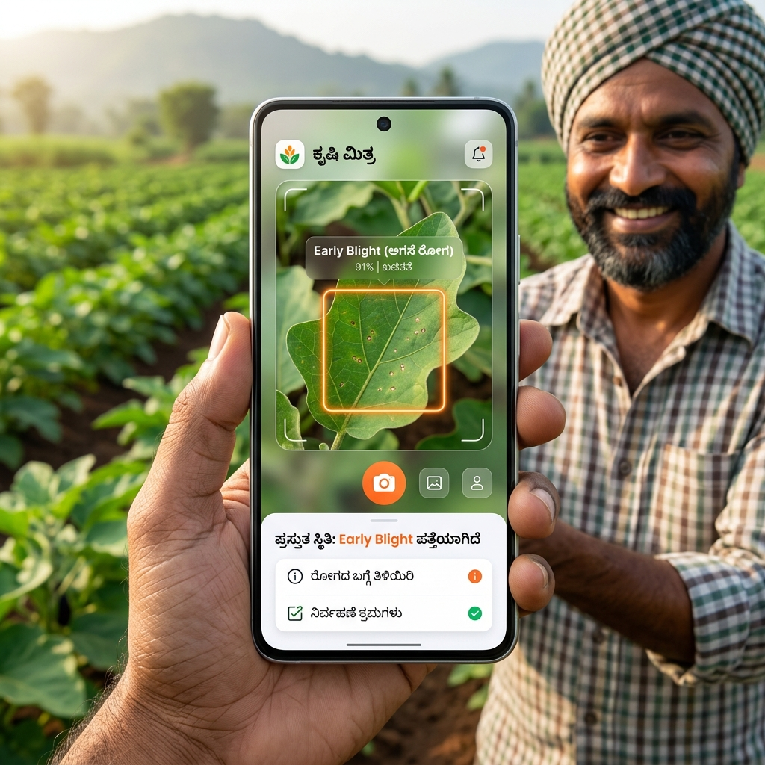
1. Solving the 'Integration Gap'
Current Limitations in Research:
• Most agri-tech research produces isolated models (only disease detection, or only yield).
• Farmers suffer from 'app fatigue' trying to use 10 different tools.
KrushikaDhara's Unique Approach:
• Unifies 9 advanced modules into a single, cohesive workflow.
• Combines Disease Detection, Yield Estimation, RAG-Advisory, P2P Rental, and Market Prices.
• Built entirely on free-tier infrastructure, ensuring zero recurring cost for NGOs.

Slide 3
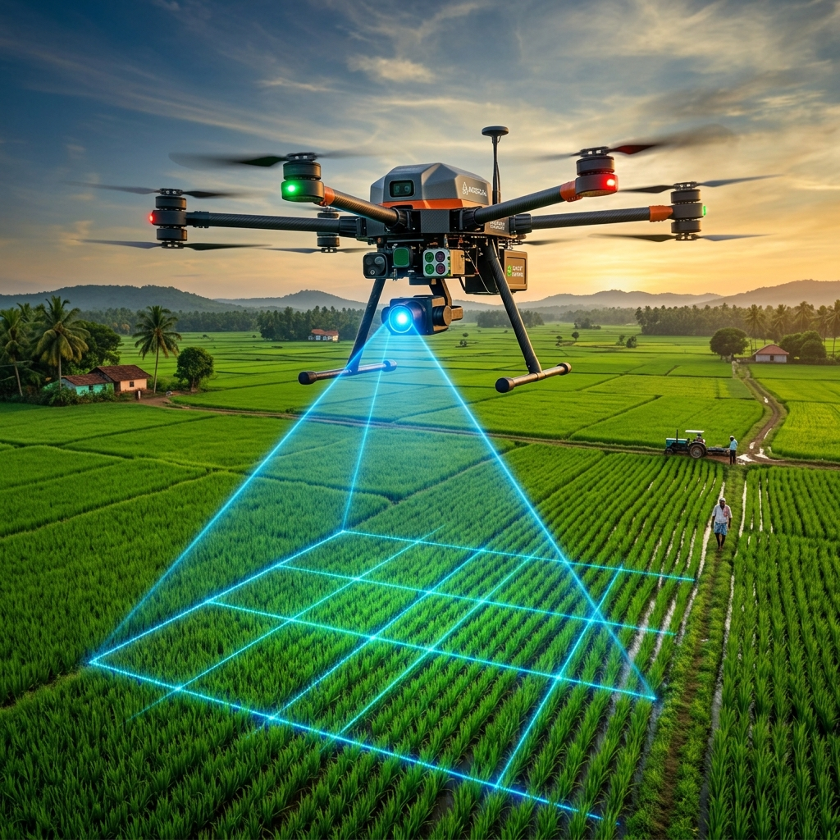
2. Multi-Tiered AI (Edge + Aerial Fusion)
Tier 1: Micro-Level (Edge AI)
• INT8-quantised YOLOv8 runs directly on the farmer's smartphone.
• Zero internet required, median latency of just 178.4ms.
Tier 2: Macro-Level (Aerial Fusion)
• Fuses high-res Drone imagery with Sentinel-2 satellite NDVI data.
• Generates highly accurate per-acre yield estimates and pest hotspot maps.

Slide 4
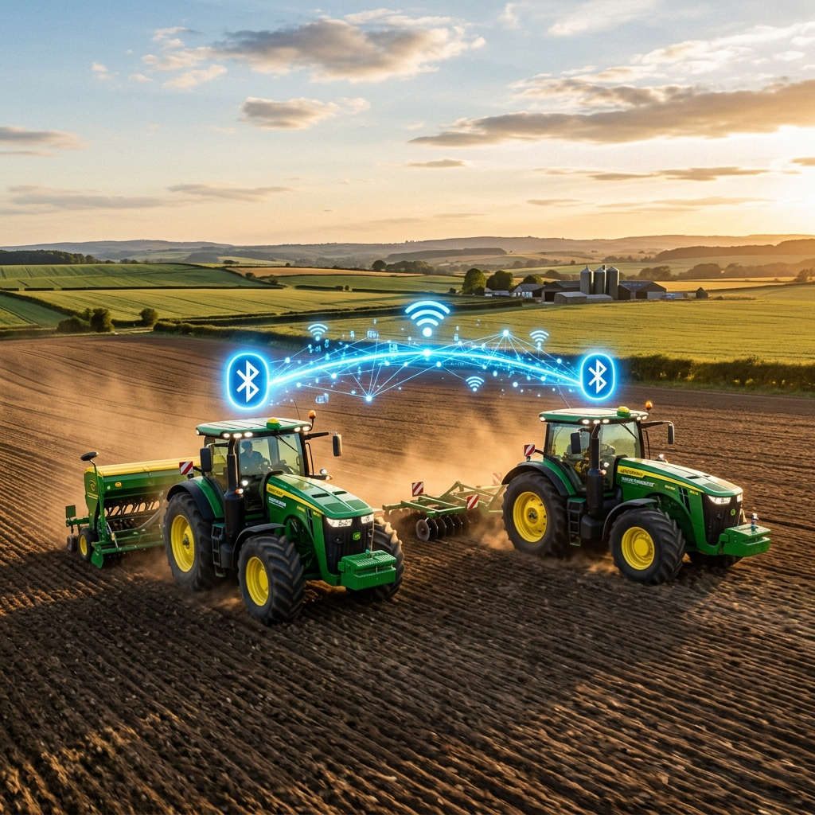
3. Equipment Rental: The 'Online' Mode
Firebase Realtime Database & Geohashing:
• When a farmer has 4G/3G connectivity, the app operates using a standard Firebase backend.
• It converts GPS coordinates into Geohashes (short grid strings).
• If a farmer searches for a 'Tractor', the app instantly matches them with any listed tractors within their specific Geohash grid (e.g., 5-10 km radius).

Slide 5
4. Equipment Rental: Offline Bluetooth Fallback
Traditional apps break completely in rural areas without signal. KrushikaDhara fails over to a Bluetooth/WiFi-Direct Mesh using flutter_nearby_connections.
• Broadcasting: A farmer's phone locally broadcasts a tiny, encrypted Bluetooth beacon containing equipment details (e.g., 'Power Tiller, ₹500/hr, Contact: 98765XXXXX').
• Peer Discovery: If another farmer walks within ~50-100 meters and searches, their phone picks up the Bluetooth broadcast directly.
• Mesh Hopping: If Farmer A and C are far apart, but B is in the middle, B acts as an invisible 'bridge', passing the listing from A to C.
• Offline Handshake: Farmers find the listing on-screen via Bluetooth and can complete the rental by walking over or making a standard 2G voice call.

Slide 6
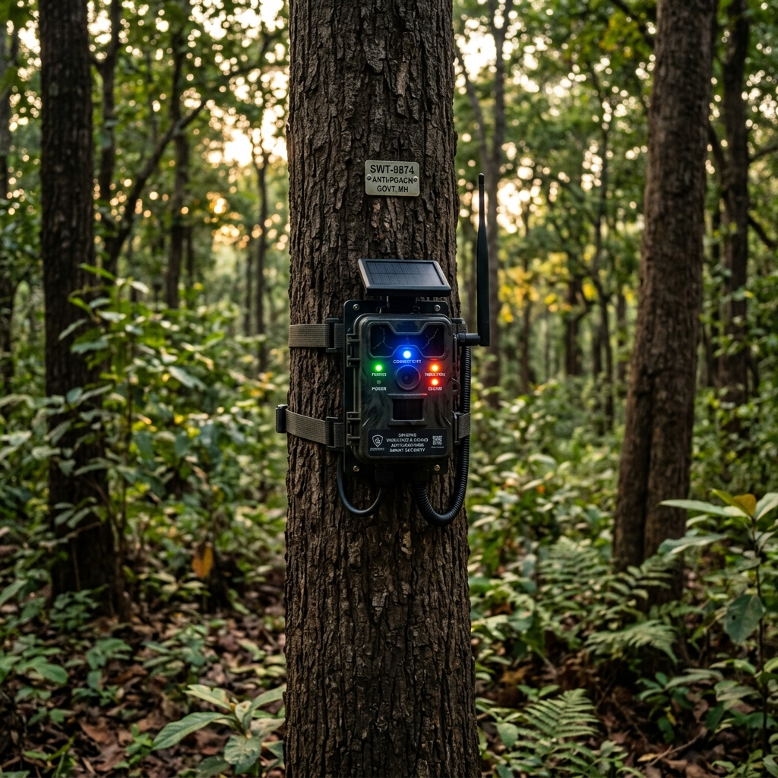
5. IoT Sandalwood Anti-Poaching System
The 'Unified Dashboard' Advantage:
• Unlike standalone security apps, KrushikaDhara integrates high-value crop security directly into the farmer's primary agricultural dashboard.
Multi-Sensor Data Fusion:
• Fuses Acoustic (chainsaw sound) and Vibration (accelerometer) sensors to virtually eliminate false positives caused by wind or animals.
TinyML Edge Processing:
• AI runs locally on the tree's microcontroller. Instead of streaming battery-draining audio to the cloud, it transmits a tiny 1-byte alert signal instantly over LoRa/Mesh.

Slide 7
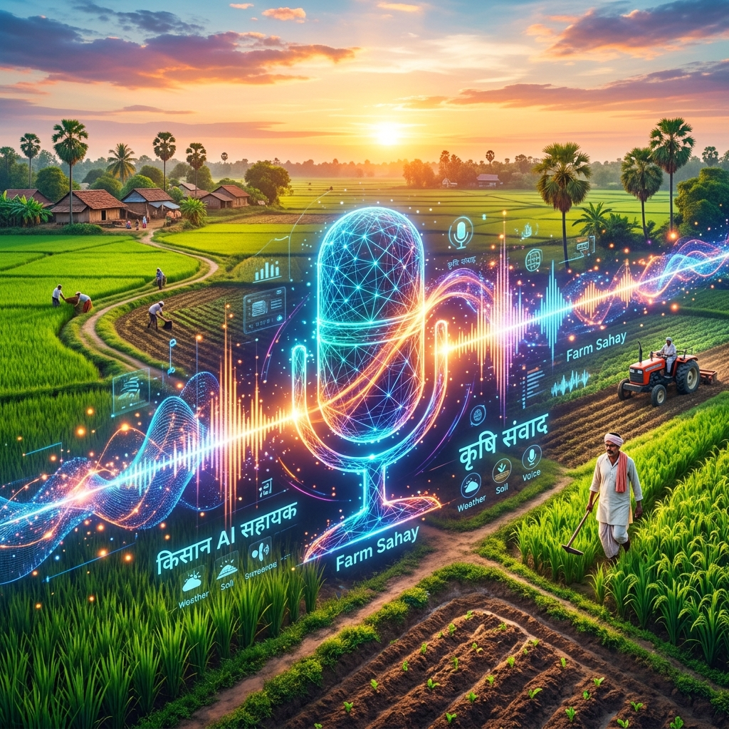
6. Vernacular RAG Advisory System
Eliminating the Literacy Barrier:
• Text-based LLMs exclude farmers who cannot read or type in English/Hindi.
Bhashini Voice Pipeline:
• Integrates Bhashini (ASR + NMT + TTS) for native Kannada voice interactions.
• Farmers speak their questions, and the system replies entirely via voice.
Hallucination-Free Responses:
• Uses Retrieval-Augmented Generation (RAG) strictly grounded in official Karnataka welfare scheme documents.

