Slide 1
KrushikaDhara: Novelty & Uniqueness
Solving the Integration Gap in Indian Agriculture
Through Offline-First Edge AI & Bluetooth Mesh Networks

Slide 2
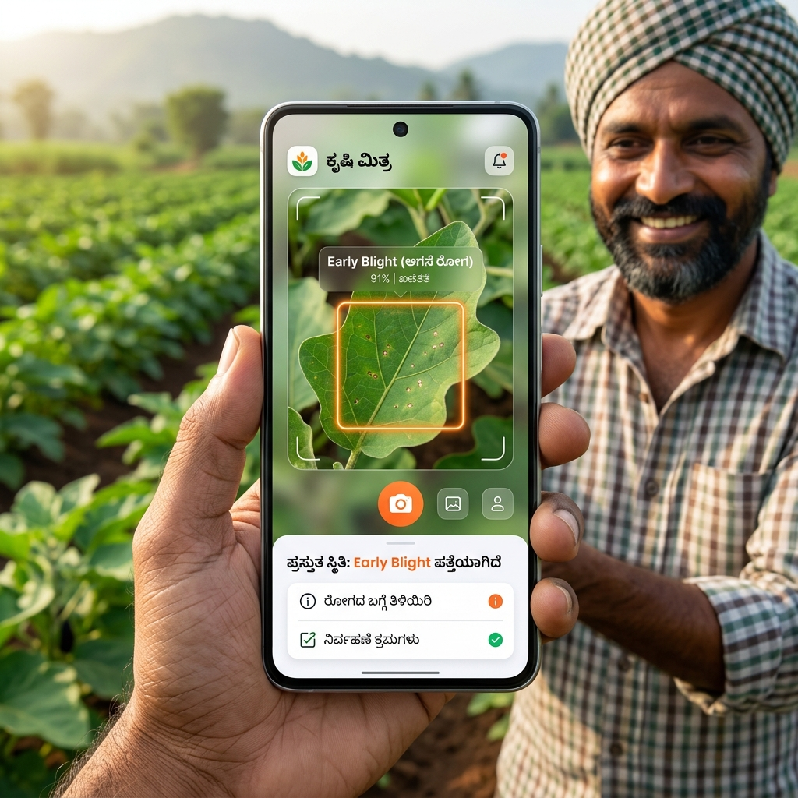
1. Solving the 'Integration Gap'
Current Limitations in Research:
• Most agri-tech research produces isolated models (only disease detection, or only yield).
• Farmers suffer from 'app fatigue' trying to use 10 different tools.
KrushikaDhara's Unique Approach:
• Unifies 9 advanced modules into a single, cohesive workflow.
• Combines Disease Detection, Yield Estimation, RAG-Advisory, P2P Rental, and Market Prices.
• Built entirely on free-tier infrastructure, ensuring zero recurring cost for NGOs.

Slide 3
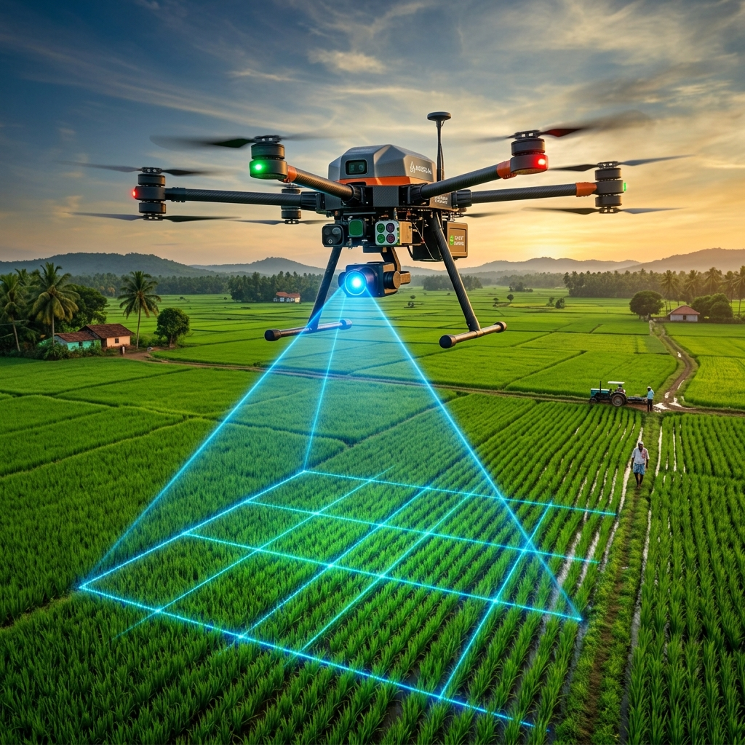
2. Multi-Tiered AI (Edge + Aerial Fusion)
Tier 1: Micro-Level (Edge AI)
• INT8-quantised YOLOv8 runs directly on the farmer's smartphone.
• Zero internet required, median latency of just 178.4ms.
Tier 2: Macro-Level (Aerial Fusion)
• Fuses high-res Drone imagery with Sentinel-2 satellite NDVI data.
• Generates highly accurate per-acre yield estimates and pest hotspot maps.

Slide 4
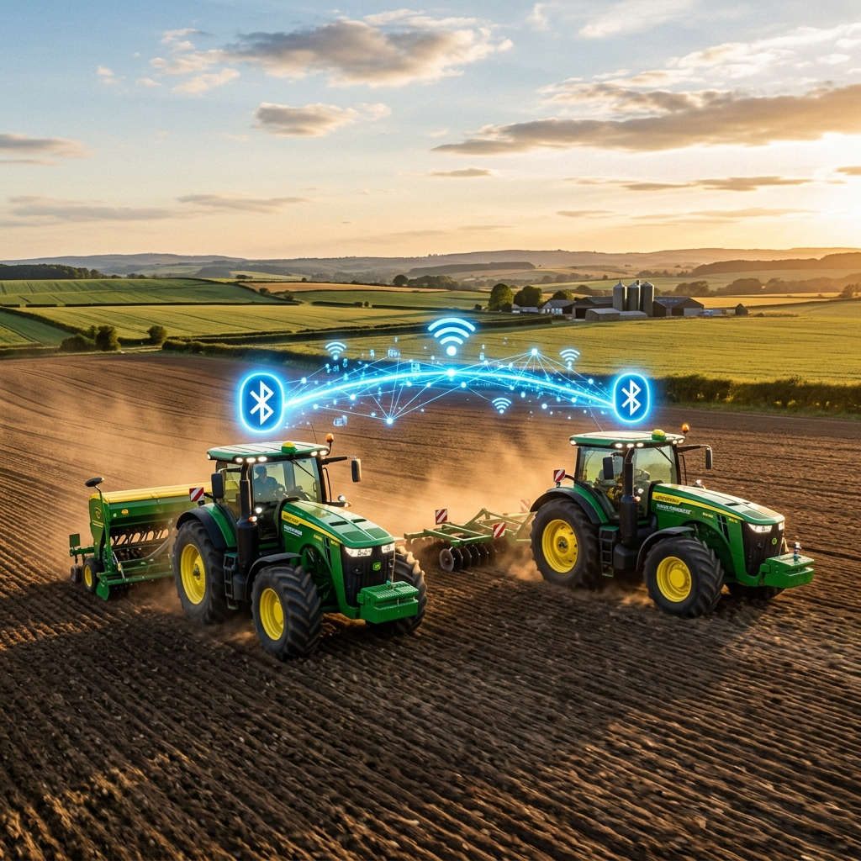
3. Bluetooth Mesh Equipment Rental
The Connectivity Challenge:
• Traditional rental apps break when a farmer loses 4G signal in the field.
The Offline Fallback Mechanism:
• Uses Firebase Geohashing when online.
• Fails over to a Bluetooth/WiFi-Direct Mesh when offline.
• Farmers broadcast equipment listings directly to nearby phones without a cell tower.
• Allows true Peer-to-Peer (P2P) resource pooling, completely bypassing infrastructure failures.

Slide 5
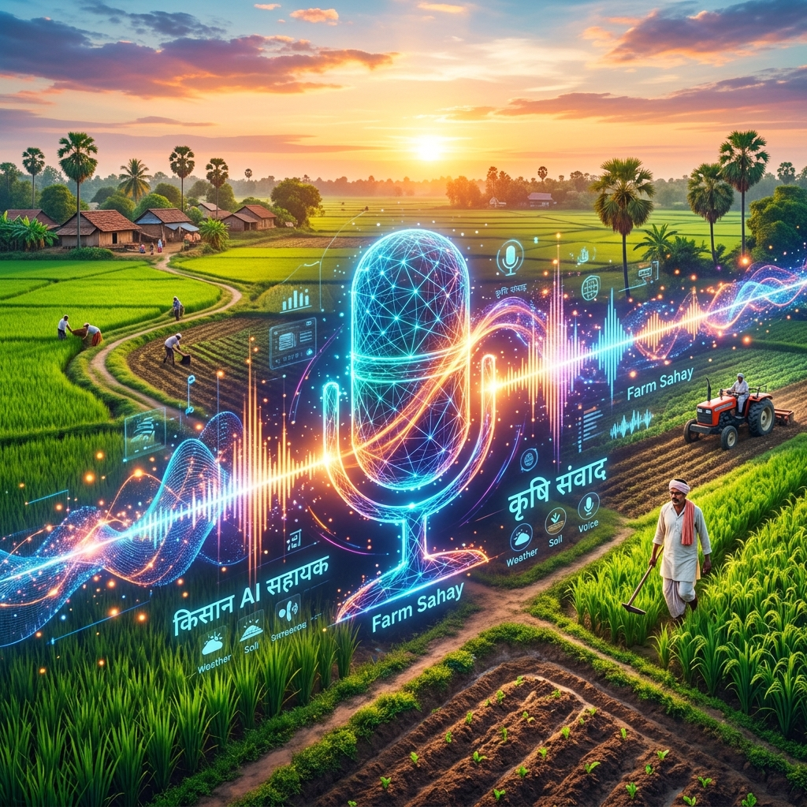
4. Vernacular RAG Advisory System
Eliminating the Literacy Barrier:
• Text-based LLMs exclude farmers who cannot read or type in English/Hindi.
Bhashini Voice Pipeline:
• Integrates Bhashini (ASR + NMT + TTS) for native Kannada voice interactions.
• Farmers speak their questions, and the system replies entirely via voice.
Hallucination-Free Responses:
• Uses Retrieval-Augmented Generation (RAG) strictly grounded in official Karnataka welfare scheme documents.

