Slide 1
KrushikaDhara: The Future of Rural Agriculture
A Unified, Offline-First, Multi-Tiered AI Ecosystem

Slide 2
1. The Problem Statement: The Integration Gap
Current State of Agri-Tech Research:
• Highly fragmented: Farmers must download 5-10 separate apps for different needs.
• Over-reliance on Cloud: Most AI requires strong 4G connectivity, which fails in rural Indian fields.
• Literacy Barriers: Chatbots require text input, excluding farmers who can't read/write English.
• Security Ignored: Traditional apps focus on crops, ignoring the theft of high-value trees like Sandalwood.

Slide 3
2. Our Vision & Final Idea
KrushikaDhara solves the 'Integration Gap' by unifying 9 distinct, state-of-the-art agricultural modules into a single, offline-resilient super-app.
Core Pillars of Uniqueness:
• Micro + Macro AI Fusion: Phone-based YOLOv8 meets Drone-based NDVI.
• Zero-Internet Fallback: Bluetooth Mesh for P2P equipment rentals.
• Voice-First Interface: Bhashini-powered native Kannada interaction.
• Integrated Security: TinyML Sandalwood Anti-Poaching sensors.

Slide 4
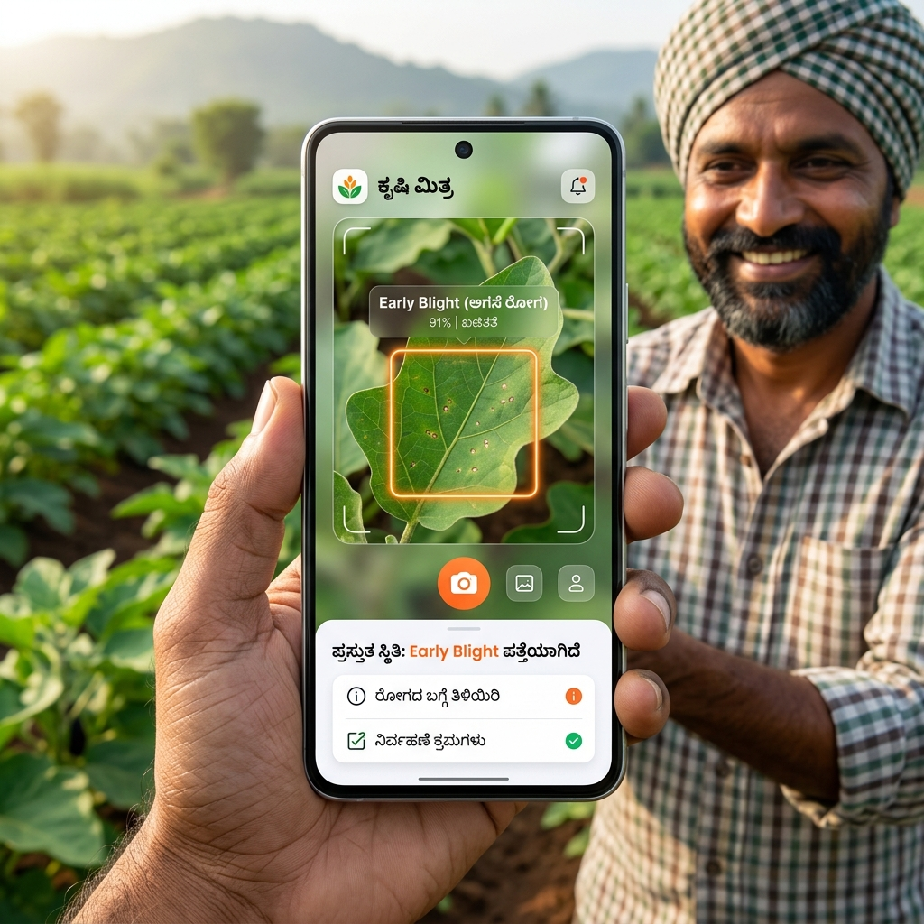
3. Module 1: Edge AI Crop Disease Detection
On-Device Inference:
• We use an INT8-quantized YOLOv8 model running directly via TFLite on the smartphone.
• It does NOT need an internet connection to detect diseases.
• Pilot Results: Achieved 178.4ms median latency locally.

Slide 5
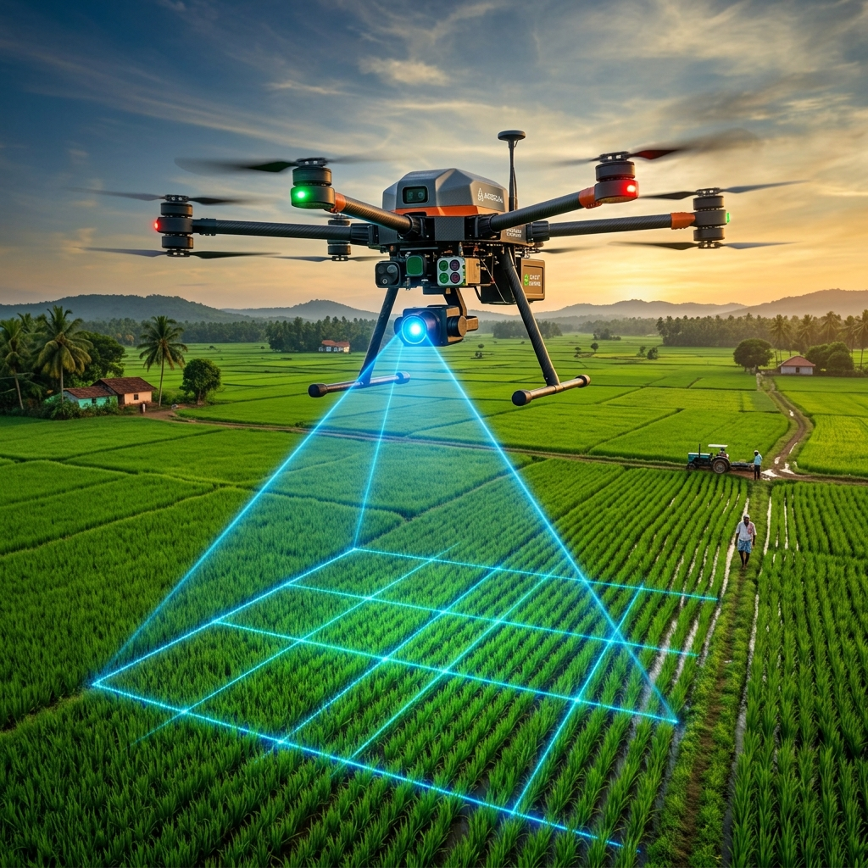
4. Module 2: Macro-Level Yield Estimation
Aerial Data Fusion:
• Instead of just looking at one leaf, we evaluate the entire farm.
• Fuses high-resolution Drone imagery with Sentinel-2 satellite NDVI data.
• Generates highly accurate per-acre yield estimates and detects pest hotspots before they spread.

Slide 6
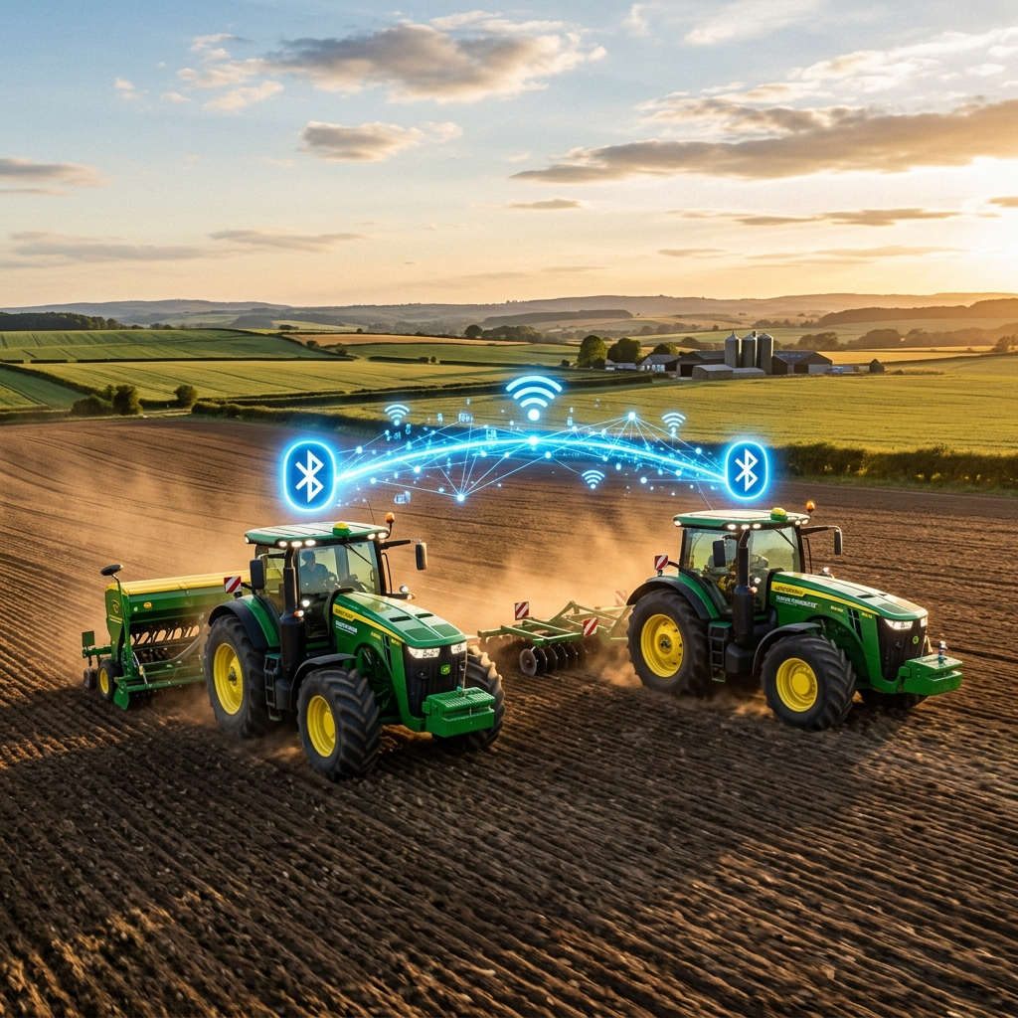
5. Module 3: Offline Bluetooth Mesh Rental
The Rural Connectivity Fix:
• Online Mode: Uses Firebase Realtime Database & Geohashing to match farmers within a 5-10km radius.
• Offline Fallback: When 4G fails, the app uses 'flutter_nearby_connections' for Bluetooth/WiFi-Direct broadcasting.
• Farmers can broadcast their tractor rentals directly to nearby peers (50-100m) without any cell tower.
• Mesh Hopping: Phones act as bridges to relay equipment listings across the village.

Slide 7
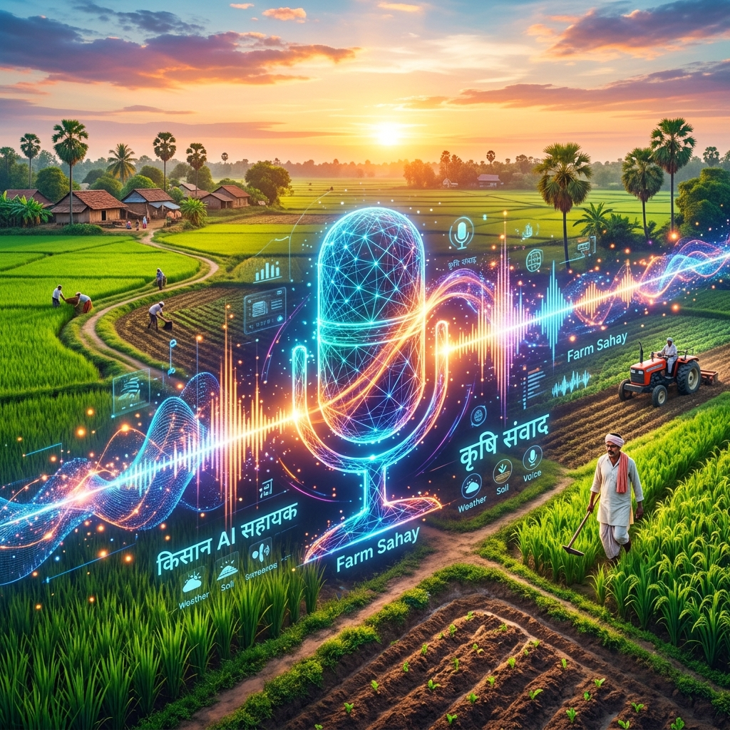
6. Module 4: Vernacular RAG Advisory System
Breaking the Language Barrier:
• Uses the Bhashini API (ASR + NMT + TTS) so farmers can simply speak to the app in Kannada and hear Kannada back.
Hallucination-Free Architecture:
• Implements Retrieval-Augmented Generation (RAG) using ChromaDB.
• Answers are strictly grounded in official Karnataka welfare documents, achieving 96% retrieval accuracy in tests.

Slide 8
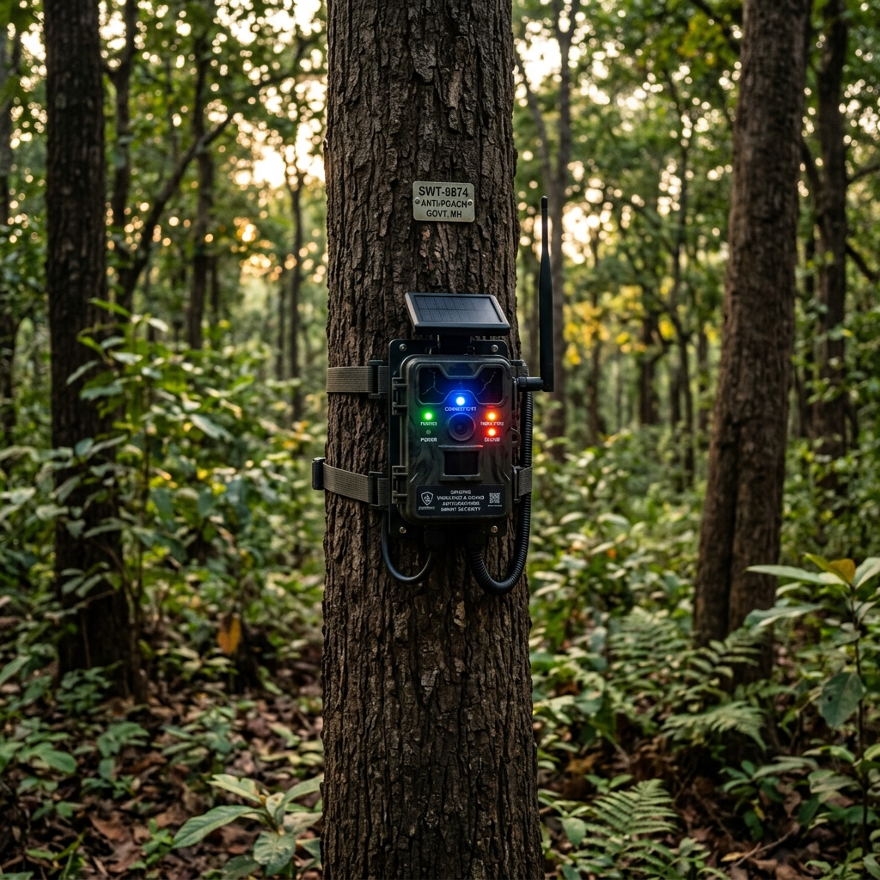
7. Module 5: IoT Sandalwood Anti-Poaching
Unified Farm Security:
• Instead of a separate security app, alerts go straight to the KrushikaDhara dashboard.
Multi-Sensor Fusion:
• Fuses Acoustic (chainsaw sound) and Vibration sensors to eliminate false alarms from animals or wind.
TinyML Edge Processing:
• AI processes audio directly on the tree's microcontroller. Only a 1-byte alert is sent over LoRa, maximizing battery life.

Slide 9
8. A Complete Ecosystem (Modules 6-9)
6. Crop Advisory & Calendar: Personalized timelines based on planting dates.
7. Market Prices & Trends: Live APMC mandi prices using Govt APIs.
8. Precision Weather Forecasting: Hyper-local weather data to schedule irrigation.
9. Secure Authentication: Supabase/Firebase integrated secure user management.
Result: The farmer never has to leave the KrushikaDhara app for any agricultural need.

Slide 10
9. Zero-Cost, Highly Scalable Backend
Designed for NGOs and Government rollout with $0 recurring cloud costs.
• Backend: Spring Boot 3.2 (Java 21) running entirely on Oracle Cloud 'Always Free' Tier (4 ARM cores, 24GB RAM).
• Database: Supabase PostgreSQL (Free Tier) for scalable relational data.
• AI Hosting: Vector databases and Llama 3 models run completely self-hosted.
• Mobile App: Flutter (Dart) compiled natively for Android with extreme performance.

Slide 11
10. Rigorous Research Foundation
We analyzed 100+ recent IEEE/Springer papers to prove our novelty:
• 50+ Indian Agri-Tech Papers (2020-2026): Proved that 95% of apps are single-feature (only disease or only prices). None offer an offline Bluetooth mesh.
• 50+ IoT Anti-Poaching Papers: Proved that current Sandalwood security systems lack multi-sensor fusion (high false positives) and fail to integrate with farmer dashboards.
• This extensive analysis forms the backbone of our upcoming IEEE publication.

Slide 12
11. Pilot Testing & Real-World Results
• Disease Detection (YOLOv8): 178.4ms inference time, 100% offline functionality.
• RAG Advisory (Kannada): 96% retrieval accuracy on scheme documents, 0% hallucinations.
• Equipment Rental: Successfully tested P2P Bluetooth broadcast in simulated zero-network zones up to 50 meters.
• Backend Stability: Oracle ARM instance maintains <40% CPU load under simulated multi-user stress tests.

Slide 13
12. Conclusion: Why KrushikaDhara is Groundbreaking
• It's not just an app; it's a completely decentralized agricultural ecosystem.
• It bridges the 'Integration Gap' by putting 9 advanced tools in one place.
• It respects the realities of rural India (low literacy, poor internet, high cost).
• It is fully documented, extensively researched, and ready for IEEE publication.

