Slide 1

User Authentication System
Faculty Coach name: Robert A. Gilliland
Team Members
Naveen Krishna Sudanagunta
Vamsi Krishna Raju Challagali
Venkata Sai Varun Kiran Kamineni

Slide 2
Introduction
The user authentication project aims to provide a secure and reliable authentication mechanism for users accessing a web application. In the digital age, the security of user data and access control to web applications are paramount. User authentication systems play a critical role in ensuring secure access to resources and protecting sensitive information from unauthorized access. This project aims to develop a user authentication system to address these security concerns effectively. The key features of the user authentication project include:
User Registration: Allows users to register by providing their email, first name, last name, and password. Upon registration, a verification email is sent to the user's email address.
Email Verification: Users receive a verification email containing a unique verification token. They must click on the verification link to verify their email address and activate their account.
Login: Registered users can log in using their email and password. Upon successful login, users are authenticated and redirected to their homepage.
Session Management: Sessions are used to maintain user authentication across multiple requests. A session is created upon successful login and destroyed upon logout or session timeout.
Session Timeout Handling: Sessions have a predefined timeout period. If a user remains inactive for the specified duration, the session expires, and the user is redirected to the login page.

Slide 3
Problem Statement Develop a user authentication system using Node.js, Express.js, and MongoDB to provide secure access to web applications. The system should allow users to register with an email and password, verify their email through a verification code, and securely login to access protected resources.
User Registration:
Users should be able to register with a valid email and password.
The system should verify if the email is not already registered.
Upon successful registration, a verification code should be sent to the user's email for email confirmation.
Email Verification:
Users should receive a verification code via email upon registration.
Users must confirm their email by clicking on the verification link.
After email verification, the user account should be marked as verified in the system.
User Login:
Registered users should be able to securely login using their email and password.
The system should authenticate user credentials against stored data.
Upon successful login, users should be granted access to protected resources.
Password Security:
User passwords should be securely hashed before storage in the database.
The system should employ a strong hashing algorithm (e.g., bcrypt) to protect passwords from unauthorized access.
User Interface:
The user interface should include intuitive and user-friendly forms for registration and login.
Registration and login forms should be responsive and accessible across different devices.

Slide 4
Deliverables & Evaluation Criteria
Implementation of user registration, email verification, and user login functionalities.
Integration with MongoDB for data storage and retrieval.
User interface design for registration and login forms.
Documentation outlining the system architecture, implementation details, and usage instructions.
Evaluation Criteria
Functionality: Does the system meet the specified requirements for user registration, email verification, and user login?
Security: Are user passwords securely hashed and stored? Is email verification implemented to confirm user identity?
Usability: Is the user interface intuitive and user-friendly? Can users easily register and login to access protected resources?
Robustness: How well does the system handle edge cases and error scenarios? Is error handling implemented effectively?
Documentation: Is the documentation comprehensive and well-organized, covering system architecture, implementation details, and usage instructions?

Slide 5
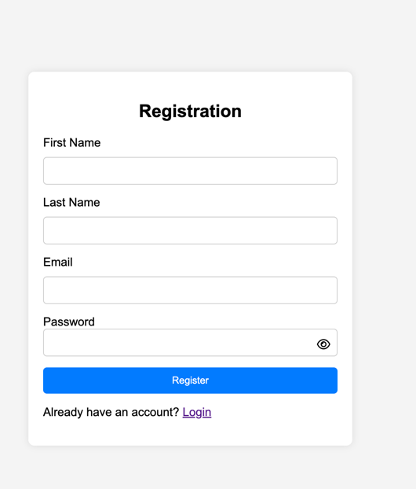
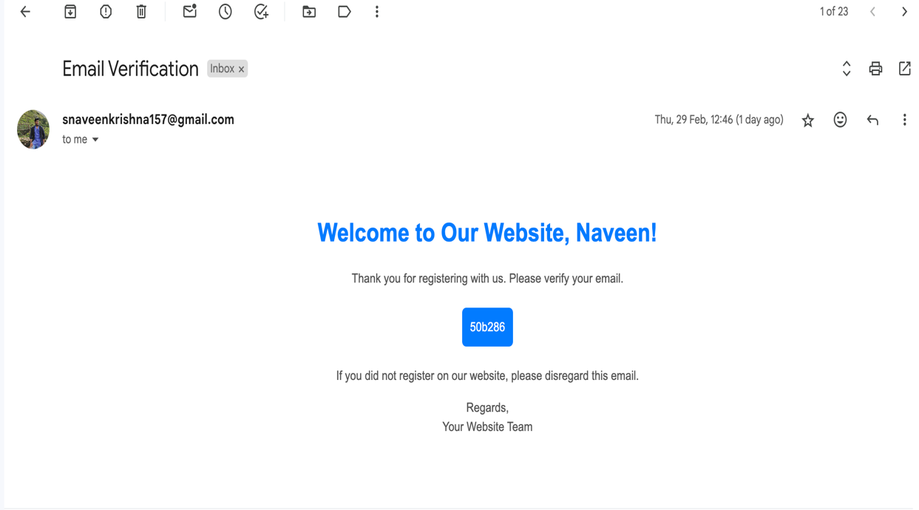
Experiments

Slide 6
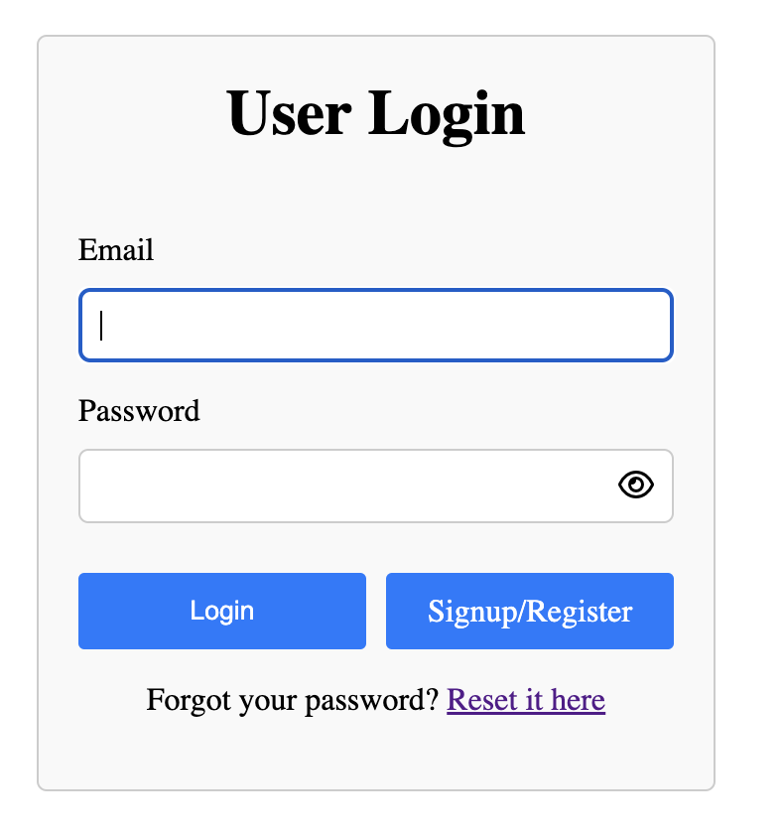
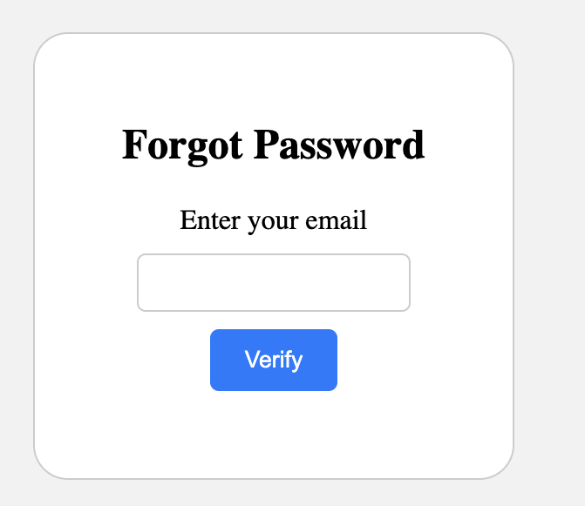
Experiments

Slide 7
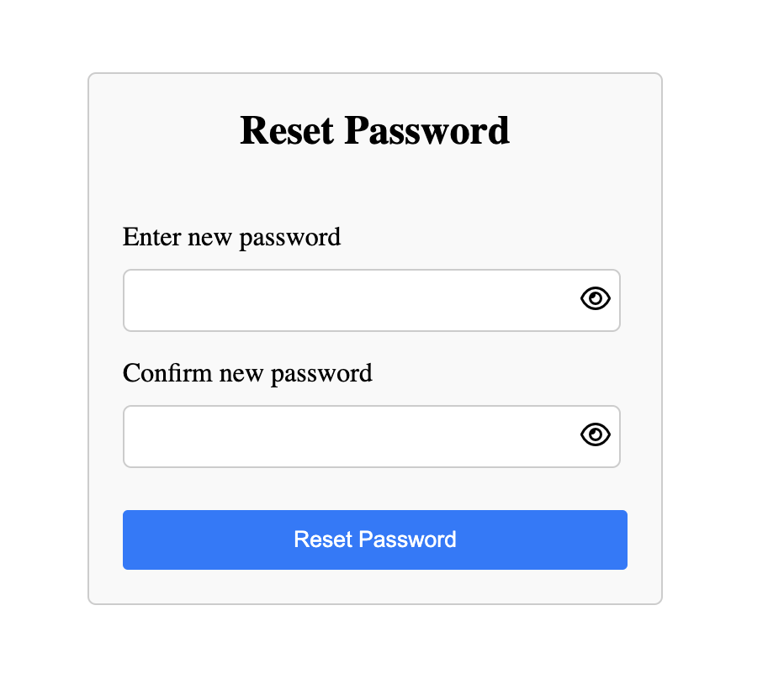
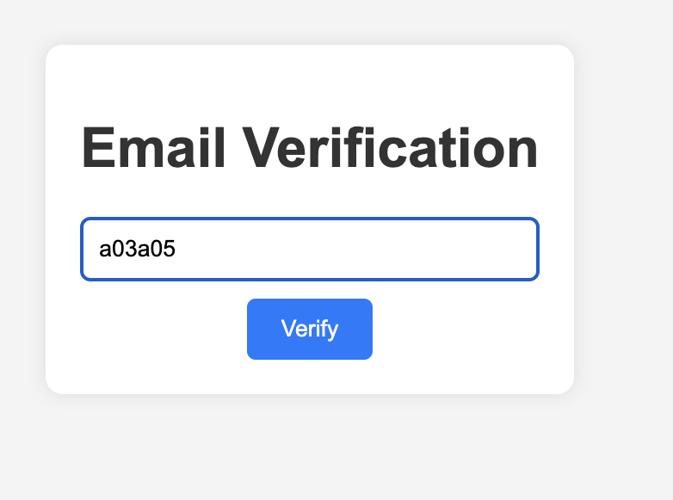
Experiments

Slide 8
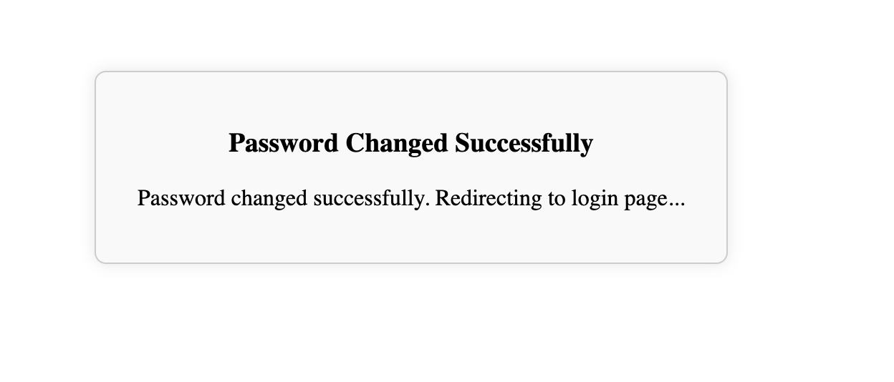
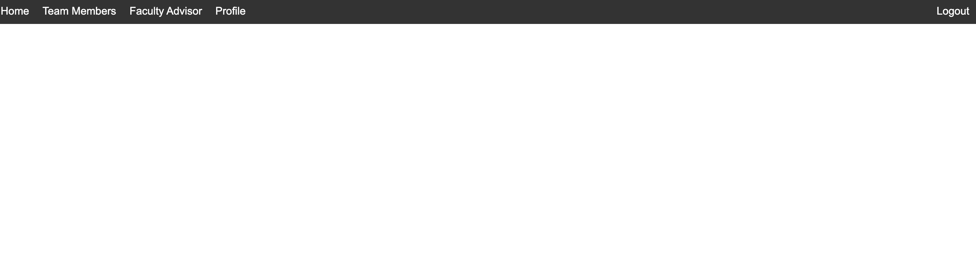
Experiments

Slide 9
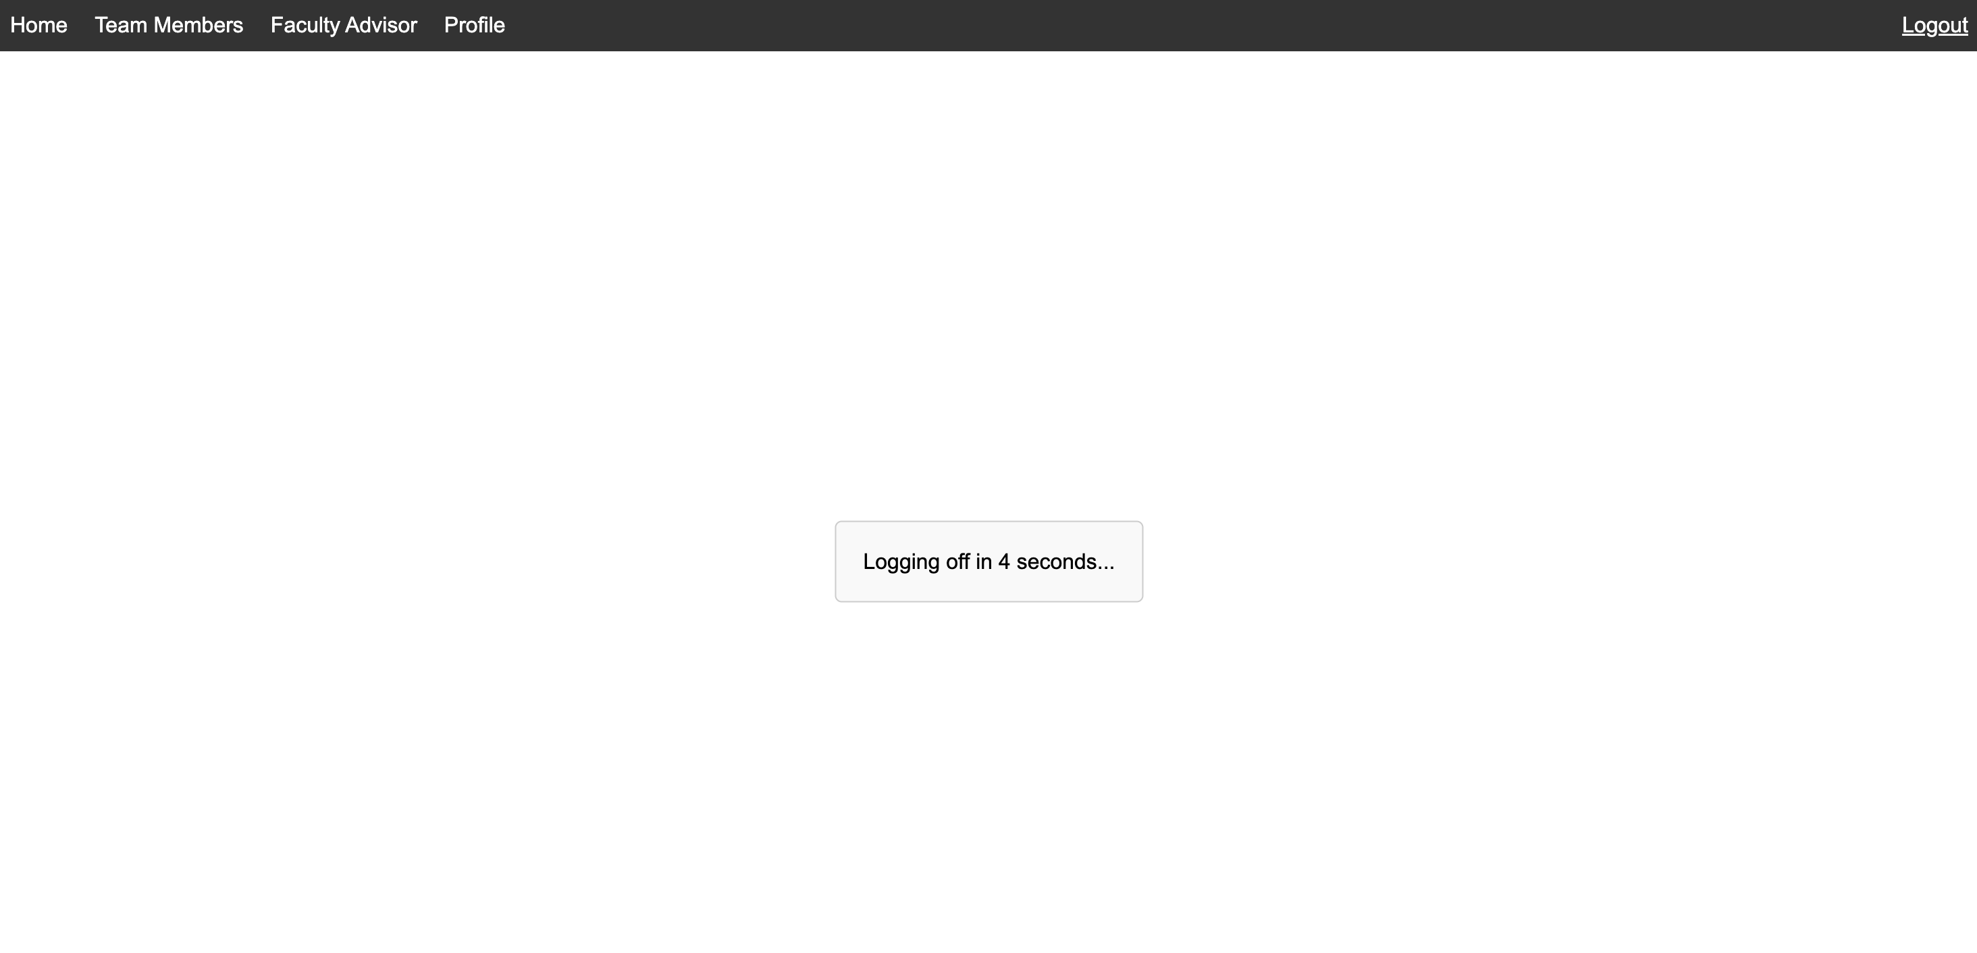
Experiments

Slide 10

Conclusion
The successful development of a user authentication system meeting the specified requirements will demonstrate proficiency in secure web application development and user authentication mechanisms. This project will contribute to enhancing security and access control in web applications, ensuring the protection of user data and resources.

