Slide 1
CLASS
Property
Getter/Setter
Constructor
Functions/methods

Slide 2
Order
Restaurant
Customer
Menu
phoneNumber
emailId
address
name
Delivery
Class -> Template or Blueprint of an object
Object -> An instance of a class.

Slide 3
OOP Feature
Inheritance – code reuse
Abstraction – hiding implementation details
non abstract class is called a Concrete class
3. Polymorphism – behaving differently in different environments/circumstances
Compile time -> method overloading
Run time -> method overriding
Loosely coupled
4. Encapsulation : data binding/data hiding -> class , properties,getter/setter, access modifier

Slide 4
Inheritance
Animal
Human
Bird
Cat
Dog
Code reuse . Base class contains the common behaviour / properties

Slide 5
Color
numberOfWheels
Model
Make
typeOfVehicle
fuelType
Vehicle
Car
Bike
Bus

Slide 6
Bank
String accountNumber;
String accountType;
String ifscCode;
String branchAddress;
double withdraw(String accountNumber,double amount)
void deposit(String accountNumber,double amount)
CITI
HDFC
Interface gives 100% abstraction (provided you don’t have a default method)
Abstract class gives 0-100% abstraction.

Slide 7
Abstraction
Abstract class
Interface - > contracts. It contains only methods without a body (partially true)
MobileOps - >
void makeCall(String phoneNumber)
void turnOnWifi(String wifiName)
void takePhoto()

Slide 8
Access modifiers to control visibility of property/method:
default
public
private
protected
Association
Aggregation
Composition

Slide 9
Exception Handling
Exception be can be handled but error can not be.
Checked Exception : Compile time
Unchecked Exception : Runtime

Slide 10
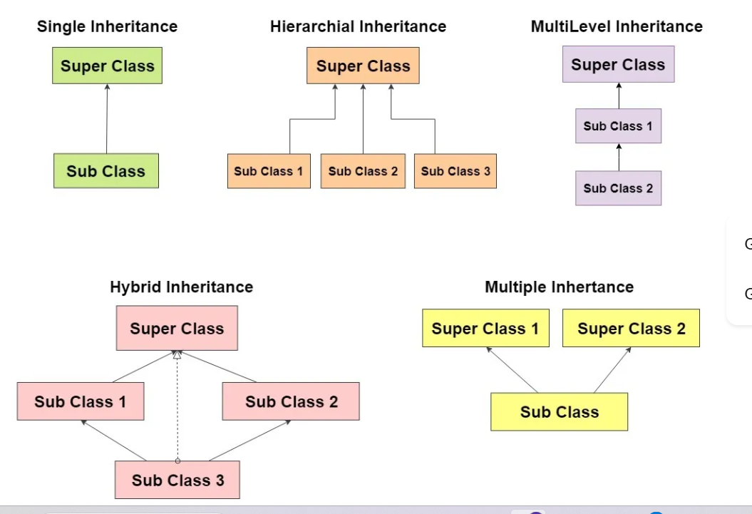

Slide 11
Ex1: Create a package called com.wipro.oop. Create a class called Restaurant having some properties , constructors , getters/setters,toString method.
Create a package called com.wipro.oop.test and create a class RestaurantTest having a main method. Instantiate the Restaurant class and print it.
Ex2: Create three classes Circle, Rectangle and Square . Now identify the common properites of these sahpes and put thos in a parent class called Shape. Extend the classes from Shape. Add constructor,getters/setters ,toString to the Shape class. Create a class called ShapeTest having a main method. Instantiate Rectangle /Circle/Square objects and print them.
Ex3: Create an interface called BankOps having methods:
void deposit(double amount,String accNumber);
double withdraw(double amount,String accNumber);
Create two Clasess HDFC implements BankOps
Citi implements BankOps
Provide different implementation in these two classes. Create a test class called BankTest having main method and test these functionalities.

Slide 12
Ex4: Create an abstract class called Animal and child classes called Human, Bird, Dog . Identify the properties and functionalities/behaviours that are common to the child classes and put them in the Animal class. Then extend Animal in all the child classes provide implementations for abstract method and test it.
Ex5: Create a class called Converter having methods called int convert (int a), int convert (int a,int b), double convert (double a). In the test class instantiate this Converter class and call all these methods separately.
Ex6: Create an interface called PaymentMethod having a method called void pay(double amount).
Create two concrete classes called Gpay and PhonePay, implementing the above interface.
Then in the test class create an Object of PaymentMethod to point to either Gpay or PhonePay and call the pay method.
Ex7: Create a String variable called fName and set it to null; Try to use toUpperCase function on that object you will encounter a null pointer exception. With try/catch handle that exception.

Slide 13
Ex8: Create a function called changeCurrency that would take a number . If the number is zero it will generate a NumberFormatException with a message Invalid Number. If the number is not zero
then multiply the input number with 80 and return the resultant number. Use throw,throws in changeCurrency and using try/catch handle the exception.

Slide 14
Break up to 1:45 PM

