Slide 1
demo1
nonStatic
staticData
demo2
StaticData
nonStatic

Slide 2
Wrapper Class
int -> Integer
double-> Double
float -> Float
short -> Short

Slide 3
Java Collection Framework: Collection of Classes and Interfaces for different data structures and algorithms.
Java Generic
Reuse ArrayList for different data types
Type safety
Java Generics -> Works only with Classes
ArrayList :
It contains duplicate items
It maintains insertion Order

Slide 4
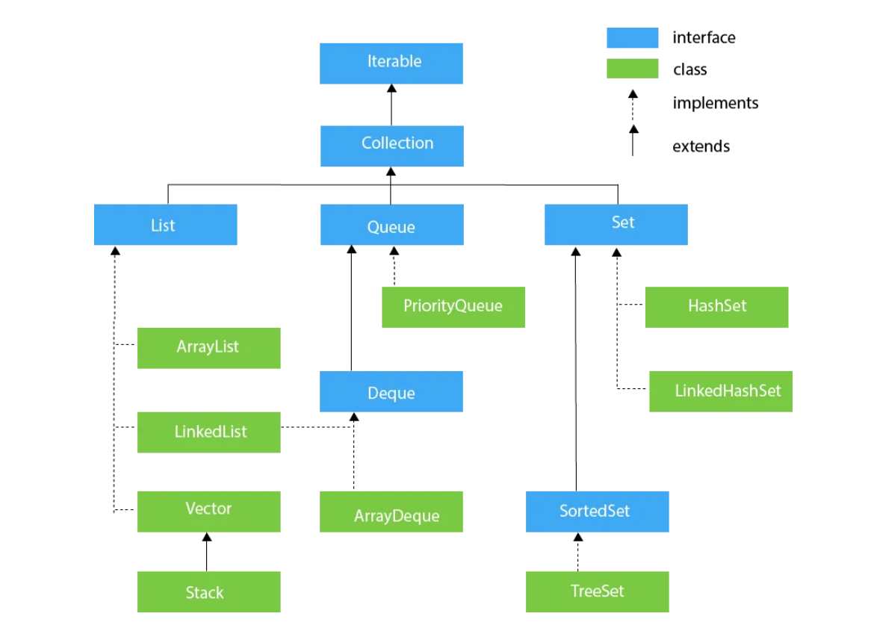

Slide 5
Gen
S1
S2
HA1
A1
Gen
S3
S1
S2
HA1
A1
ArrayList -> Read operation / Not recommended for write operations

Slide 6
Gen
S1
S2
HA1
A1
S3
LinkedList -> Write operation / Not recommended for read operations

Slide 7
Geography
Maths
Physics

Slide 8
3
2
1
Queue -> FIFO
New elements are added at the end
Elements are removed from the front
Duplicates allowed
Null any number of times
SET -> No duplicates
-> Null one time only

Slide 9
LIST :
Maintains insertion order
Duplicates allowed
multiple null values allowed
Queue:
Does not maintain insertion order (Except LinkedList)
Duplicates allowed
multiple null values allowed
Set:
Does not maintain insertion order (except LinkedHashSet)
Duplicates not allowed
null values allowed only once

Slide 10
Ex1: Create a custom exception to called InvalidMonthException . Create a method called checkMonth that takes an integer as a parameter if the value exceeds 12 or it is less than 1 then you throw InvalidMonthException. Handle the exception in the main method in a test class.
Ex2 : Generic Box Class: Create a generic class Box that can store any type of object. Implement methods to add and retrieve the object.
Ex3: Create an ArrayList of integers and add 5 elements to it. Remove the element at index 2 and add a new element at the end.
Ex4: Difference of Sets: Create two Sets of integers and find their difference.
Ex5: Create a List having duplicate data (integer/string) then write a program to remove duplicates from it.
Ex6: Create a program that stores currency code (like USD) and their names (United States Dollar) in a map that should be sorted by names. Print both key and values in the format of “USD- United States Dollar”

Slide 11
Ex7 : Create a class called Employee having empId (String) , empName(String), empAge(int),empSalary(double). Create a list of employees and sort that list by descending order of salary.
Ex8: Create separate sorting classes to sort by empId,empName,empAge sort the employee list by these sorting classes.
Ex9: Try to remove the employees from the list who earn more than 80000. Use CopyOnWriteArrayList
Ex10: Create a Local date object for 1st November 2023 and print it like 01-11-2023
Ex11: Write a program that takes a birth date as input and calculates the person's age in years.
Ex12:Write a program that takes two dates as input and calculates the difference between them in days, months, or years.
Ex13:Given a date find out if that is a leap year or not.

Slide 12
7.5
8
8.1
8.5

Slide 13
Break up to 4:15 PM

