Slide 1


Introduction to HTML
HTML, or Hypertext Markup Language, is the standard language used to create and structure web pages. It provides the basic building blocks for web development, allowing you to create and organize content on the internet.

Slide 2
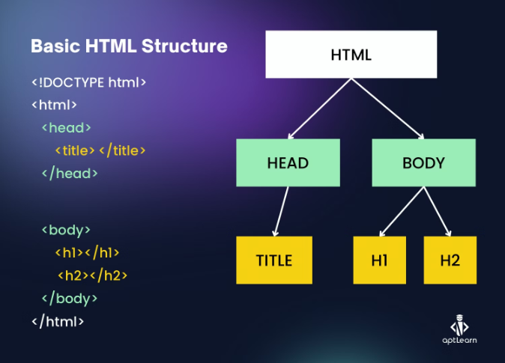
HTML Structure
Head
The head section contains metadata, such as the page title, and links to external resources like stylesheets and scripts.
Body
The body section holds the visible content of the web page, including headings, paragraphs, images, and more.
Tags
HTML uses tags to define the structure and meaning of page elements, enclosed within angle brackets like <html>.

Slide 3

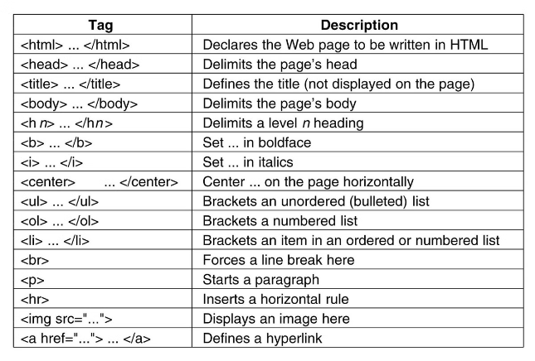
HTML Tags
1
Headings
Headings range from <h1> to <h6>, with <h1> being the largest.
2
Paragraphs
The <p> tag is used to create paragraphs of text.
3
Links
The <a> tag creates hyperlinks to other web pages or sections within the same page.
4
Images
The <img> tag is used to insert images into a web page.

Slide 4

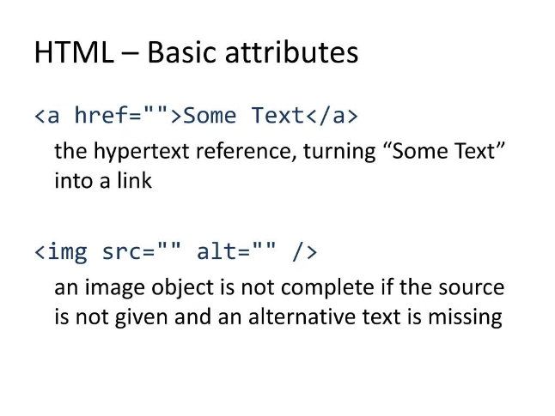
HTML Attributes
id
Uniquely identifies an element on the page.
class
Allows you to apply styles to multiple elements at once.
src
Specifies the source of an image or other media file.
href
Defines the destination of a hyperlink.

Slide 5
HTML Elements
Semantic
Structural
Media
Semantic elements like <header>, <nav>, and <article> give meaning to the content.
Structural elements like <div> and <span> are used to group and organize content.
Media elements like <img>, <video>, and <audio> are used to embed multimedia on a web page.

Slide 6

HTML Headings
H1
Hierarchy
The top-level heading, used for the main title of the page.
Headings should be used in a logical, hierarchical order to provide a clear structure to the page.
1
2
3
H2-H6
Sub-headings that help organize and structure the content.

Slide 7

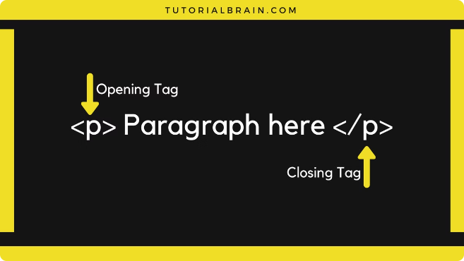
HTML Paragraphs
Semantic Meaning
The <p> tag represents a paragraph of text, giving it semantic meaning.
Formatting
Paragraphs are block-level elements, meaning they will start on a new line and take up the full width of their container.
Spacing
Paragraphs are automatically spaced apart, with a margin between them.
Accessibility
Properly structured paragraphs improve the accessibility and readability of web content.

Slide 8


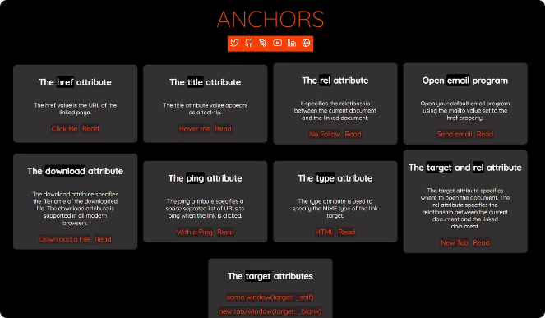


HTML Links
Internal Links
Links that navigate to other pages on the same website.
External Links
Links that direct users to pages on a different website.
Bookmarks
Links that jump to a specific section within the same page.

Slide 9
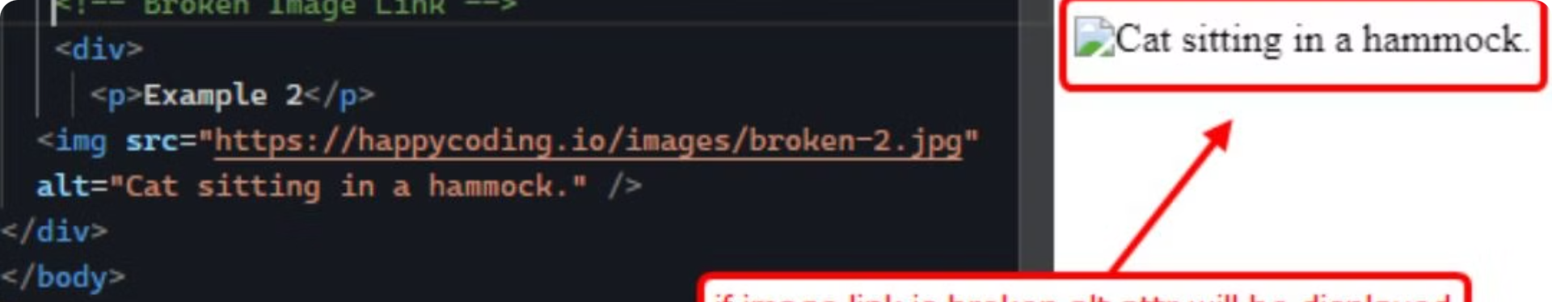



HTML Images
src Attribute
alt Attribute
Size
Specifies the URL or file path of the image.
Provides alternative text for the image, important for accessibility.
Images can be resized using CSS or the width and height attributes.

Slide 10
HTML Lists
Unordered Lists
Ordered Lists
Definition Lists
Use the <ul> tag
Use the <ol> tag
The <dl> tag is used to create a list of definitions, with <dt> for the term and <dd> for the definition.
Displays bullet points by default
Displays numbered items
Useful for sequential steps
Great for itemized lists

Slide 11
Thank you

