Slide 1

Academic Year 2025 - 26
MINI PROJECT
Phase - 1 Review
PROJECT TITLE
EXAM SCHEDULE WEB APP
NAVEENPRABHU S
7376231MZ126

Slide 2
AIM & OBJECTIVES OF THE PROJECT
(Problem Statement)
AIM :
To develop a web-based system for managing exam schedules efficiently.Customers find it difficult to discover and shop from local businesses efficiently.
To create a platform for tracking student marks and academic performance.
To provide performance analysis and study improvement suggestions.
OBJECTIVE :
To allow admins to add, update, and delete exam schedules department-wise.
To enable students to record, view, and analyze their marks subject-wise.

Slide 3
LITERATURE SURVEY
Sl.No. | Journal Paper Title with Author | Works carried out ( with details of Methods/ Materials/ Software/ Algorithms / fabrication / techniques/ components used ) | Information gathered relevant to your project
1 | Anil Kumar, S. Ramesh, P. Venkatesh Title: Web-Based Student Information Management System Year: 2021 | Developed a web-based academic management system Frontend using HTML, CSS, JavaScript Backend using PHP and MySQL Role-based login system for Admin, Staff, and Students | Importance of role-based authentication Structured database design for academic systems Secure login using session handling
2 | Priya Sharma, Rahul Verma Title: Secure Authentication System Using JWT in Web Applications Year: 2022 | Implemented authentication using JSON Web Tokens (JWT) Backend using Node.js and Express.js MongoDB used for storing user credentials Password encryption using bcrypt Token-based authorization for protected routes | JWT is more secure and scalable than traditional sessions Stateless authentication improves performance Proper middleware improves API security Password hashing is essential for data protection

Slide 4
CHOICE OF COMPONENTS / MODULES / METHODS / TECHNIQUES EQUIPMENT USED FOR PROJECT DEVELOPMENT
COMPONENTS:
Frontend Technologies Used :
Framework: HTML, CSS, React.js
Programming Language : JavaScript
Backend Technologies Used
Backend Platform: Node.js, Express.js
Database: MongoDB Compass
Authentication: JWT (JSON Web Token)
Tools: Figma, GitHub, VS Code

Slide 5
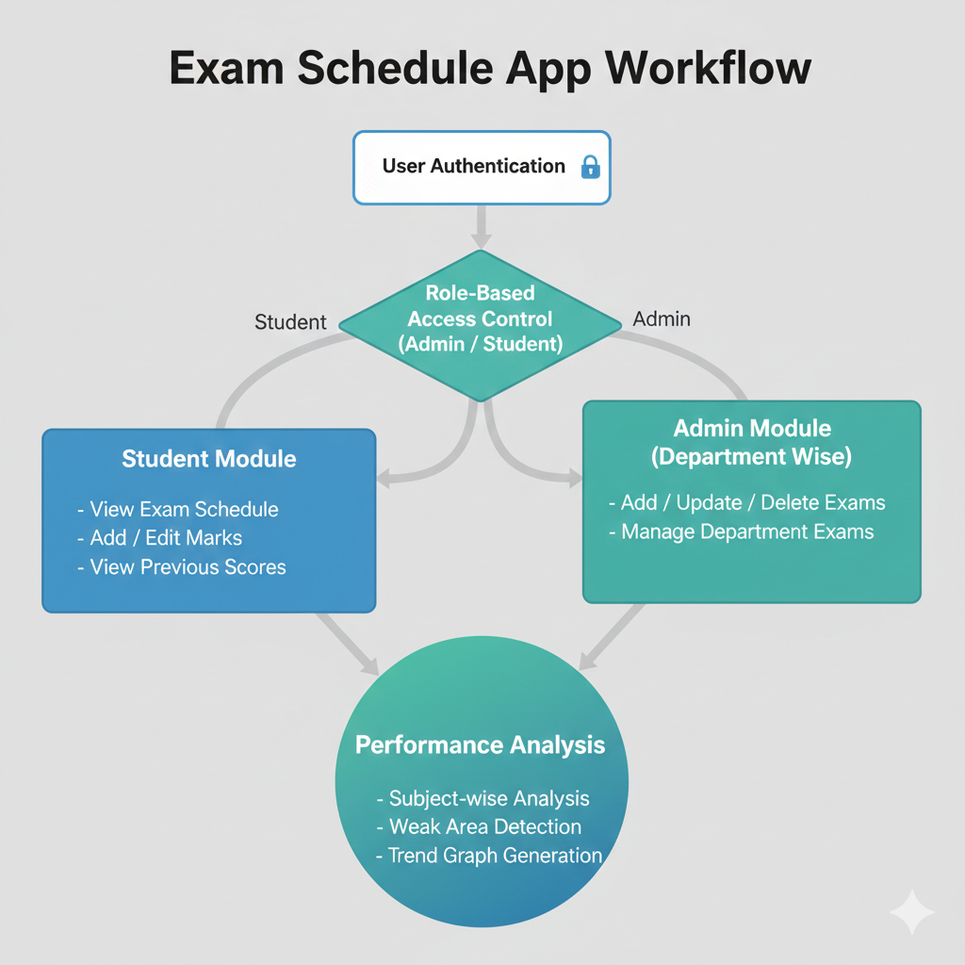
PROPOSED METHODOLOGY

Slide 6
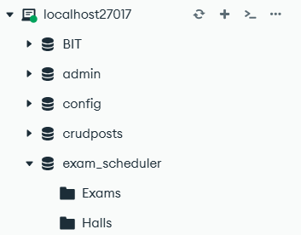
DB Schema

Slide 7
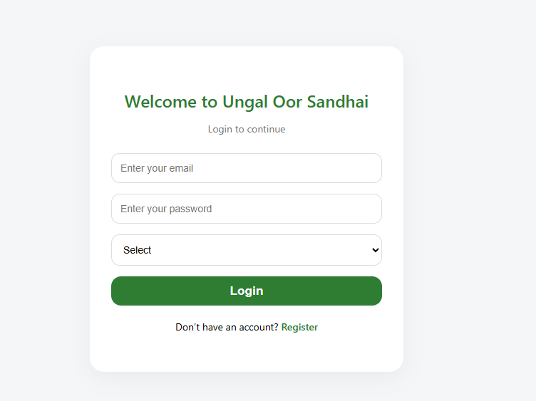
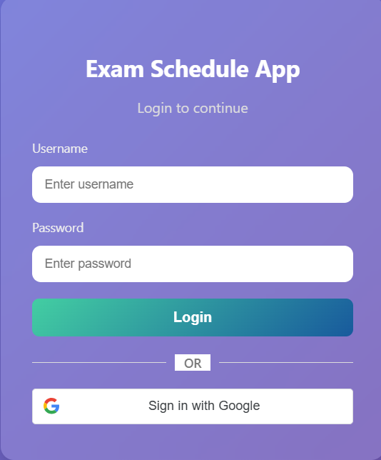
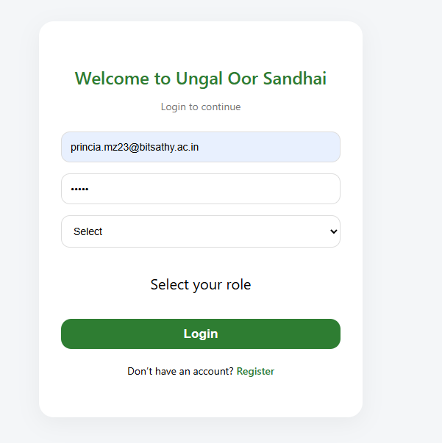
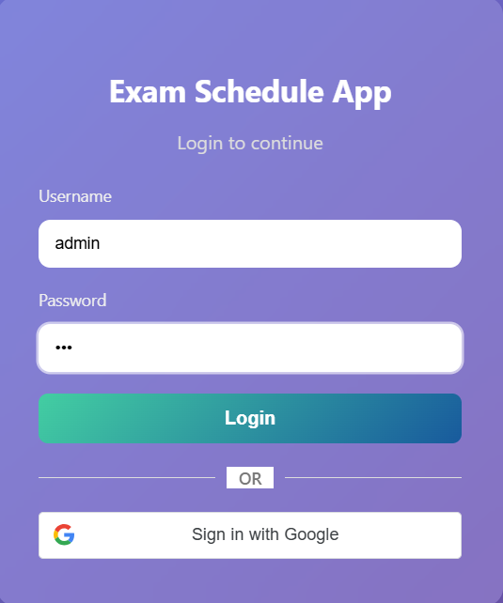
DESIGN(S) (HARDWARE / SOFTWARE ARCHITECTURE)

Slide 8
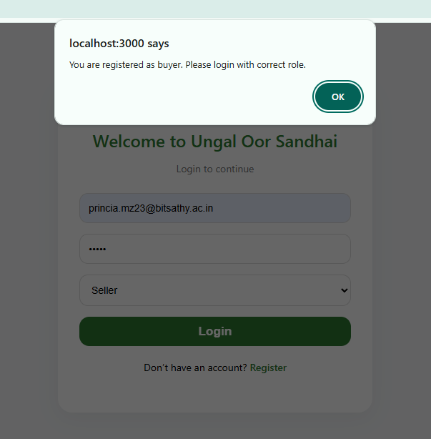
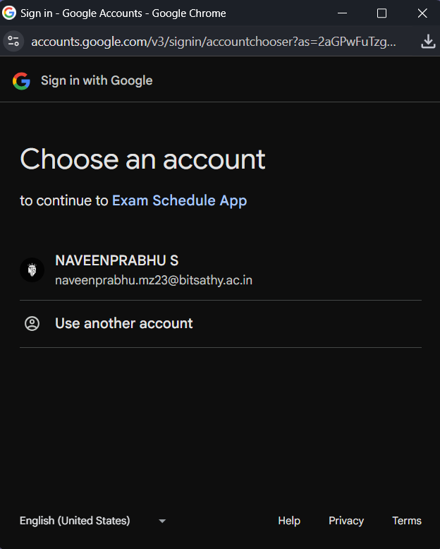
DESIGN(S) (HARDWARE / SOFTWARE ARCHITECTURE)

Slide 9
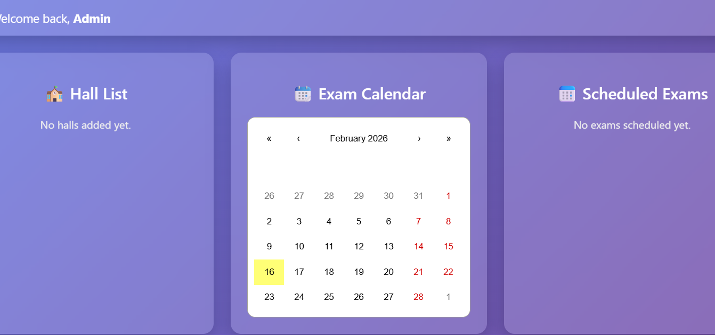
DESIGN(S) (HARDWARE / SOFTWARE ARCHITECTURE)

Slide 10
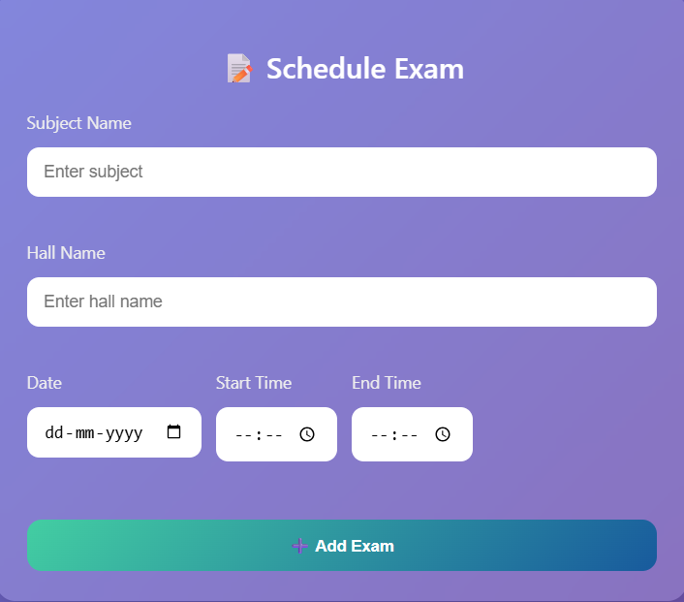
DESIGN(S) (HARDWARE / SOFTWARE ARCHITECTURE)

Slide 11
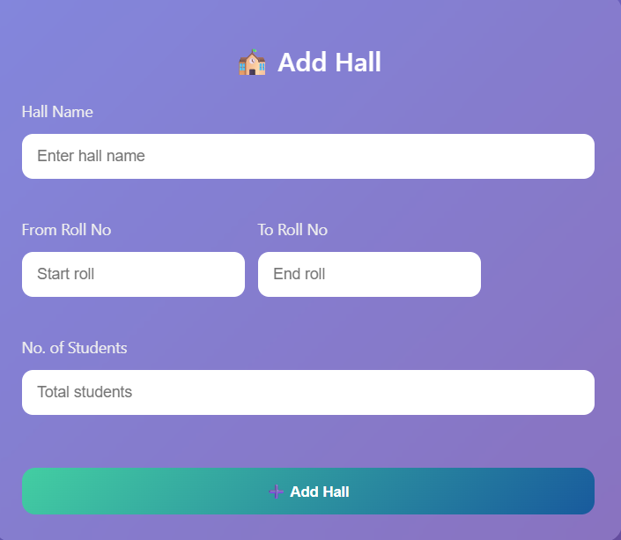
DESIGN(S) (HARDWARE / SOFTWARE ARCHITECTURE)

Slide 12
REFERENCES
( Journal Papers/ Books / Patent)
Journal
Sharma, P., & Gupta, A. (2019). Student Performance Analysis Using Data Analytics Techniques. International Journal of Advanced Research in Computer Science
Books
Ethan Brown, Learning React: Functional Web Development with React and Redux, O’Reilly Media.
Patent
System and Method for Academic Performance Tracking Using Web-Based Applications – US Patent Publication.
Secure Role-Based Authentication System for Educational Platforms – Indian Patent Application.

Slide 13
Github Link : Github
Figma Link :Figma

