Slide 1

Employee Information System
Sai Naveen Reddy Syamala (2788875)
Likith Roshan Chinnabathini (2786602)
Kalyan Naga Venkata Ram Sai Annam (2788985)

Slide 2
Contents
Abstract
Introduction
Development methodology
Architectural design
Design pattern
Diagrams
Testing
Code review
Demo

Slide 3
Abstract
Employee information system is an application used for managing the information of employees within a small company or an organization.
It can store and display information such as name, department, salary and also other personal information.
It has an added advantage of writing an employees review and displaying the working hours of an employee.
Grandeur employee management system is a suitable one for coordinating with human asset modules by tending to correct needs.
It can also information such as the general company guidelines to be followed by an employee.
In an ideal system, you can allow employees to look up and review their own information

Slide 4
Introduction
The Employee Information Management has been developed to override the problems prevailing in the practicing manual system.
This software is supported to eliminate and, in some cases, reduce the hardships faced by this existing system.
Moreover, this system is designed for the particular need of the company to carry out operations in a smooth and effective manner
The application is reduced as much as possible to avoid errors while entering the data.
No formal knowledge is needed for the user to use this system.
Thus, by this all it proves it is user-friendly and used only for record keeping of an employee.
Basically, the project describes how to manage for good performance and better services for the clients

Slide 5

Development methodology
An iterative and incremental approach to software development, Feature-Driven Development
(FDD) is derived from the Agile methodology and is considered one way to implement it. Similar to Waterfall, FDD is typically viewed as an older methodology, a sort of precursor to modern Lean/Agile implementations.
FDD still focuses on the goal of delivering working software frequently and is an especially client-centric approach, making it a good fit for smaller development teams.
Features are a foundational piece of FDD. Features are client-valued pieces of work that, according to the FDD approach, should be delivered every two weeks.

Slide 6
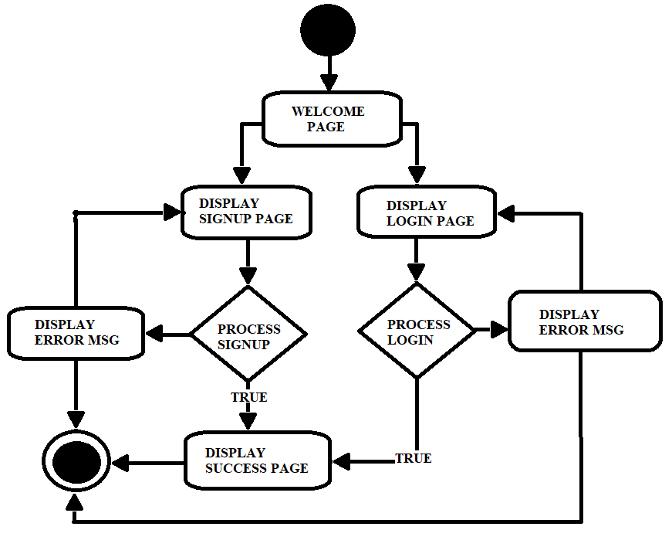
Architectural design
We used Model View Controller (MVC) design pattern
It specifies that an application consists of a data model, presentation model, and control information.
The pattern requires to have each and every object should be different.
MVC is like an architectural pattern, but not for complete application.
MVC mostly implicates to the UI (user interface) / interaction layer of an application. Only deploying this is not enough for a project but also you need business logic layer, maybe some service layer and data access layer.
The Model contains only the pure application data, but no logics.
The View presents the model’s data to the user.
The Controller acts as a bridge between view and model. Through this mechanism, the action is populated atomatically.

Slide 7
Design pattern
We used singleton pattern for the implementation of our course project.
The reason why we chose it is:
There are only one-to-one functions on our project which occur at a time referring to the main class.
As there is no need for multiple function callings and initialization, this pattern became our design pattern to make it very simple for our project.
This project solely depends on the webpage and the database connectivity to intake the changes happening dynamically according to the user input through the instance of class which is already created even it is not used.

Slide 8

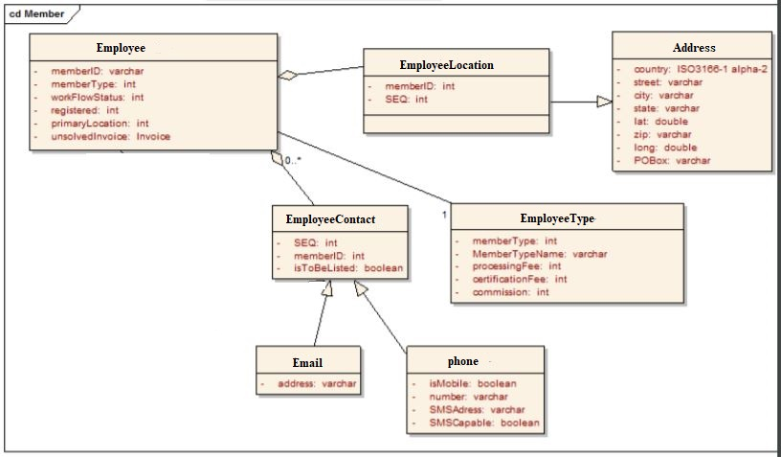



Class Diagram

Slide 9
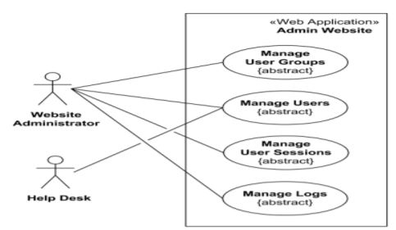
Use Case Diagram

Slide 10
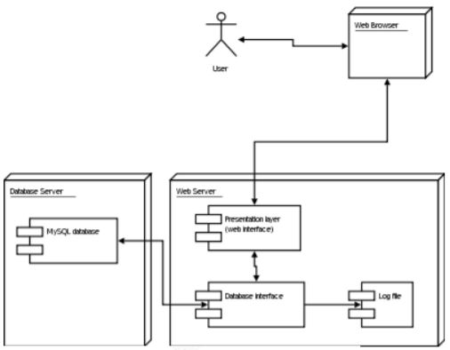
State Diagram

Slide 11
Testing
As we are dealing with the basic website and database connection project, most of the testing part in done manually.
We tried testing the single modules of a program and checked that unit at interface and how it communicates with other modules rather than getting into the statement level.
Outputs for a given set of input combinations are pre-calculated and are generated by the module.
Then, after testing all the single units/modules, we assembled all the modules to check the collective working of the project.
If any errors are found associated with the objective to make test modules and built a program structure that has been detected by design. Therefore, the incoming errors are isolated by manual testing.

Slide 12
System requirements
Hardware requirements:
CPU : CORE I3/I5/I7
PROCESSOR SPEED : 2 GHz
PROCESSOR : BUILT IN TOTAL
RAM : 4 GB
Software requirements:
Programming language: Python 3.7
Framework: Flask
Database: MySQL
IDE: Visual Studio Code

Slide 13
Advantages
Provides computerized system for maintaining records.
More efficient & reliable.
Less time consuming and easy to use.
Huge data storage with less computer memory.
Avoid human errors & efforts for maintaining daily data.
Avoid data manipulation.
Also avoids data inconsistency & redundancy.

Slide 14
Limitations
This software will run on single pc.
Employee login is yet to be created.
Not over network connection.

Slide 15
Scope
Can be converted into a full-fledged employee maintenance and working platform.
Employee version of same site can be advanced.

Slide 16

Demo

Slide 17

Thank you!

