Slide 1


Flipkart Sales Analysis Dashboard
A data analytics project exploring sales performance, profitability, customer behavior, and regional trends across Flipkart's product catalog.
DATA ANALYTICS PROJECT
CREATED BY NAVEEN SAINI
Notes:
1

Slide 2


Project Overview
This project analyzes Flipkart sales data to build an interactive dashboard supporting data-driven business decisions — covering sales performance, profitability, customer behavior, product trends, and regional insights.
Dataset
Tools
Output
1,000 orders across 5 product categories and 4 regions
Microsoft Excel — Pivot Tables, Pivot Charts & Dashboard Design
Interactive dashboard with KPIs, trend visuals, and actionable insights
Notes:
2

Slide 3








Business Objectives
Eight analytical objectives guided this project — from tracking revenue and profit trends to understanding payment behavior and customer satisfaction.
Sales & Profit Performance
Monthly Trend Monitoring
Track overall revenue and profitability across the dataset.
Identify seasonal patterns and peak sales periods.
Top-Performing Products
Category Evaluation
Surface highest-revenue SKUs across categories.
Compare performance across product categories.
Regional Sales Comparison
Customer Ratings
Analyze contribution from North, South, East, and West regions.
Assess satisfaction levels by category.
Payment Preferences
Actionable Insights
Understand which payment methods customers prefer.
Translate findings into strategic recommendations.
Notes:
3

Slide 4





Dataset & Methodology
Dataset Fields
Tools & Techniques
Order ID
Product Name
Microsoft Excel
Category
Region
Pivot Tables and Pivot Charts for data aggregation and visualization.
Sales Amount
Profit Amount
Customer Rating
Payment Method
Dashboard Design
Interactive layouts with filters, KPIs, and visual summaries.
Order Date
Analytical Techniques
Trend, category, regional, profitability, and customer behavior analysis.
Notes:
4

Slide 5
Key Performance Indicators
The dashboard captures five core KPIs providing a quick health check of Flipkart's sales performance.
₹75.2M
₹15.0M
1,000
Total Sales
Total Profit
Total Orders
Aggregate revenue across all 1,000 orders
Net profit generated across all categories
Orders in the analyzed dataset
₹75.2K
3.0
Average Sale
Avg. Rating
Average transaction value per order
Mean customer satisfaction score
Notes:
5

Slide 6
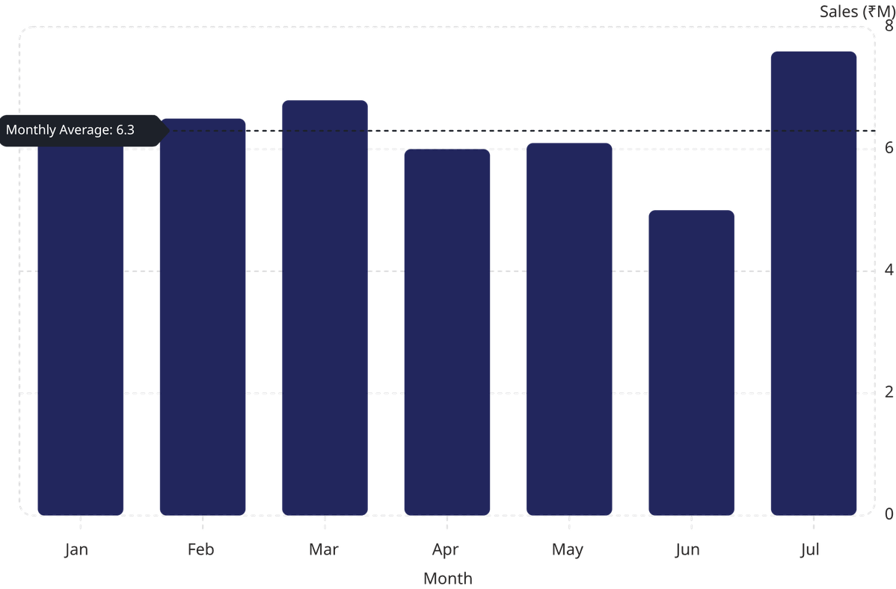

Sales & Profit Trend Analysis
Monthly Sales Performance
July recorded the highest sales at ₹7.6M, while June saw the lowest at ₹5.0M — a 52% swing. Monthly profit ranged from ₹0.99M to ₹1.5M, with July also leading in profitability.
Key Insight: The mid-year dip in June presents a clear opportunity for targeted promotional campaigns to sustain revenue momentum.
Notes:
6

Slide 7
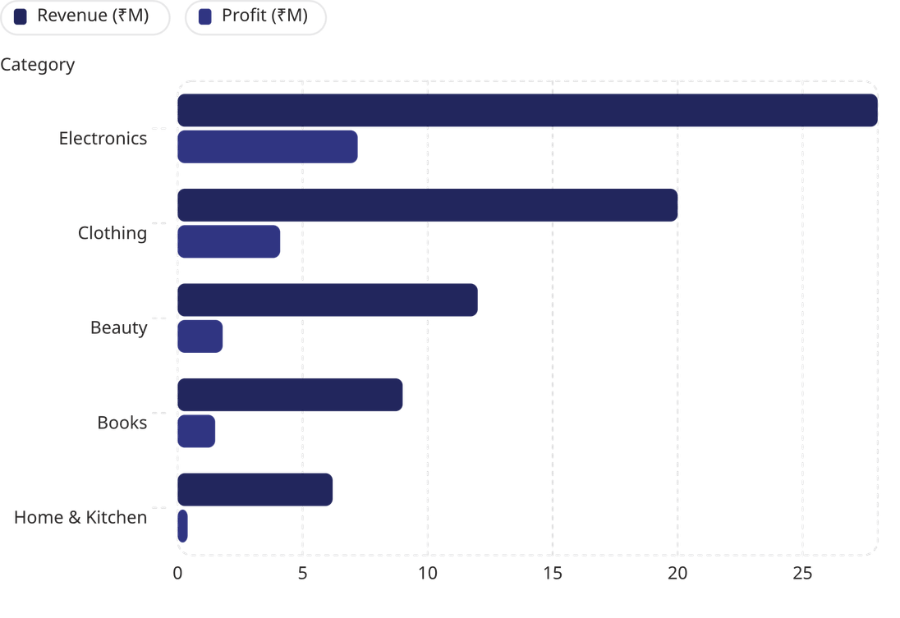
Category & Product Performance
Category Breakdown
Electronics dominates both revenue and profit, contributing over 37% of total sales. Clothing holds a strong second place. Beauty and Books show moderate performance, while Home & Kitchen lags behind.
Top Revenue Products
📘 Educational Books
💻 Laptop
💡 Table Lamp
Notes:
7

Slide 8
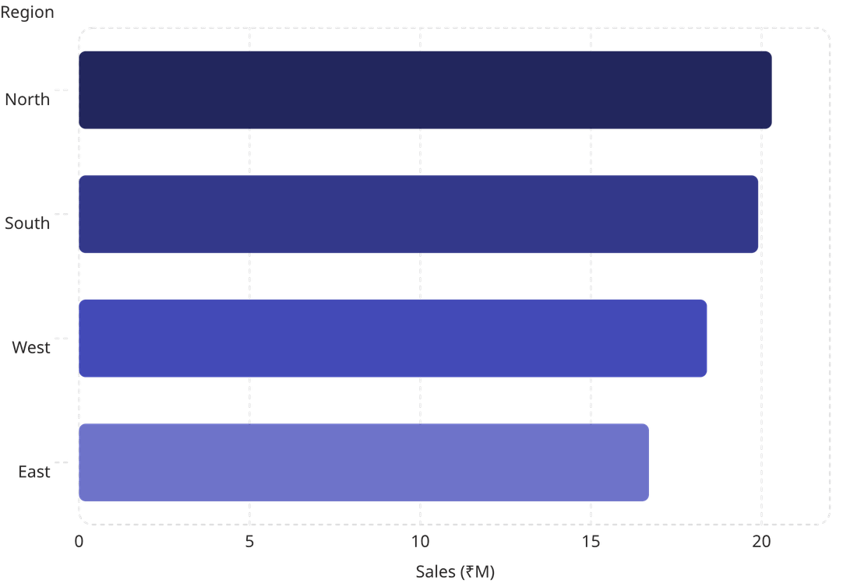

Regional Sales & Customer Ratings
Regional Performance
The North Region leads with ₹20.3M in sales, closely followed by South (₹19.9M). East contributes the least at ₹16.7M — a 22% gap versus North, signaling untapped potential.
Customer Ratings by Category
Overall average: 3.0 / 5.0. Books and Home & Kitchen received the highest ratings, while Beauty scored the lowest — a clear area for quality improvement.
Notes:
8

Slide 9
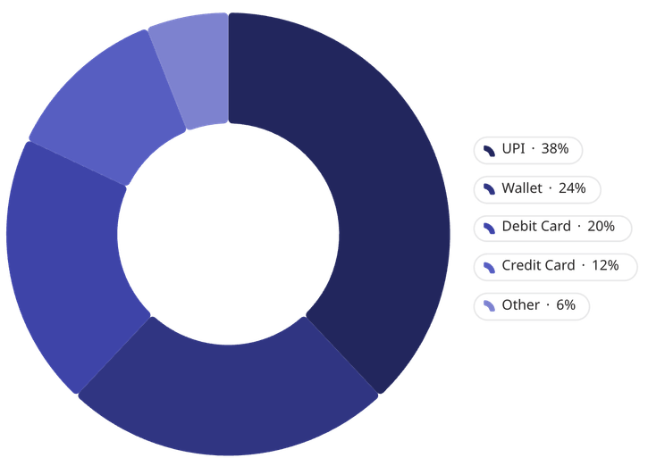

Payment Preferences & Key Insights
Payment Behavior
UPI dominates at 38% of transactions, reflecting India's digital payment shift. Wallet and Debit Card remain popular; Credit Card usage is comparatively lower.
Key Business Insights
Electronics is the top revenue and profit driver
North Region contributes the highest sales
July is the strongest sales month
UPI dominates customer transactions
Customer ratings indicate improvement opportunities in some categories
Notes:
9

Slide 10
Recommendations & Conclusion
📦 Expand Electronics
⭐ Improve Ratings
🗺️ Strengthen Regions
Increase inventory and promotions for the highest-revenue category.
Address quality gaps in Beauty and lower-rated categories.
Target marketing in East and West to close the regional gap.
💳 Promote Digital Payments
🔁 Drive Retention
Expand UPI and wallet incentives to boost conversion.
Introduce loyalty programs and personalized offers.
This dashboard delivers a comprehensive view of sales, profit, customer behavior, products, and regions — enabling data-driven decisions and business growth.
THANK YOU
QUESTIONS & DISCUSSION
NAVEEN SAINI
Notes:
10

