Slide 1
Salary Prediction Model
Predicting salaries based on years of experience using Linear Regression
Presenter: NAVEEN SHUKLA(batch-8)

Slide 2
Project Overview
• Objective: To build a machine learning model that accurately predicts an employee's salary given their years of experience.
• Problem Solved: Helps HR departments, hiring managers, and job seekers establish fair compensation expectations based on trends.
• Approach: Utilized Simple Linear Regression to model the linear relationship between experience and compensation.

Slide 3
Data and Preprocessing
• Dataset: Salary_dataset.csv
• Variables:
- Independent Variable (X): YearsExperience
- Dependent Variable (Y): Salary
• Data Preparation:
- Data parsed and reshaped into arrays
- Training Set (75%) and Testing Set (25%)

Slide 4
Technical Implementation
• Algorithm: Linear Regression
• Core Technologies (Python):
- pandas & numpy: data manipulation
- scikit-learn: training model and evaluation
- matplotlib: visualization
• Workflow: Load Data → Split Data → Fit Model → Make Predictions → Evaluate

Slide 5
Model Performance
• Evaluation Metric: R-squared (R²) Score
• Meaning: Proportion of variance in salary explained by experience
• Result: R² = 0.9756
• Conclusion: Model explains about 97.56% of salary variance, showing a strong linear relationship.

Slide 6
Data Visualization
Insert Scatter Plot Image Here
• Red Dots: Actual salary data points
• Blue Line: Linear regression best-fit line
• Takeaway: Data points closely follow the line, confirming high prediction accuracy (R² ≈ 0.9456).

Slide 7
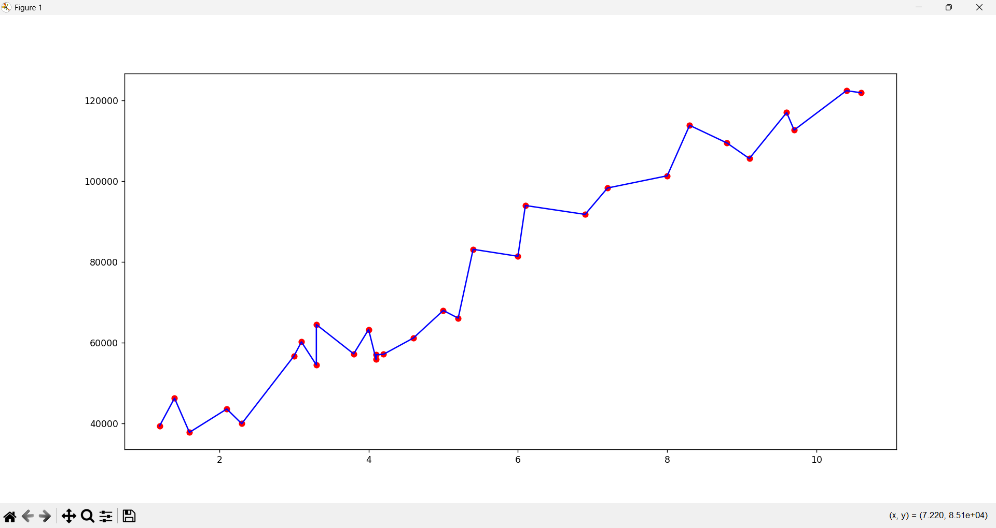
Regression-Line

