Slide 1
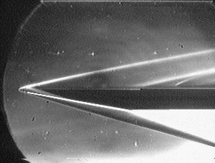
Mach 7 Hypersonic Ramp
Hareesh Chinthakuntla (231010028)
B Naveen Teja (208070266)

Slide 2
Contents
Introduction
Problem Statement
Grid
Boundary Conditions
Results and Discussions
Conclusion

Slide 3
Motivation:
In recent times, there has been a rapid surge in research on hypersonic flows, particularly in making jets go even faster. Working with topics related to hypersonic flow is incredibly fascinating. Additionally, we are focused on understanding the shocks formed by ramps due to flow interaction. This exploration holds the potential to learn more about real-world scenarios.

Slide 4
Introduction
Under hypersonic flow, when the flow reaches the starting point of a ramp, an oblique shock is produced, which deflects the upstream streamlines uniformly. Oblique shocks are often used in engineering applications because they result in more favorable post-shock conditions than normal shocks. Oblique shocks have fewer losses than normal shocks. In high-speed inlets, oblique shocks are used to compress the air going into the engine. The air pressure is increased without using any rotating machinery.

Slide 5
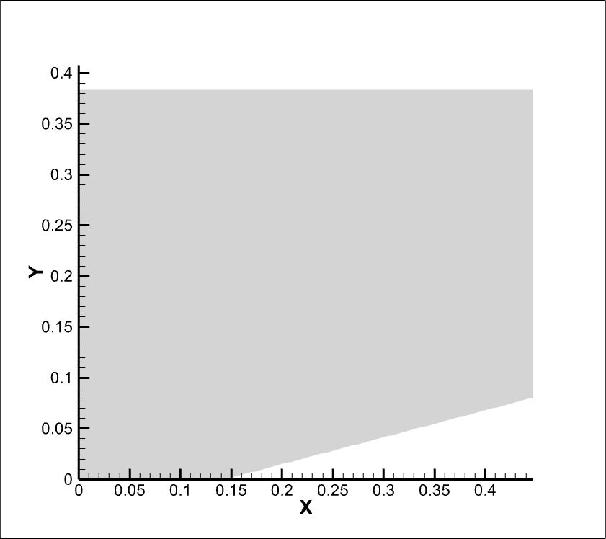
Problem Statement
Air flow from left to right at mach number 7.0 .
The Ramp is inclined at an angle of 15°.
Both the upper and lower surfaces are walls.
The pressure given is 14.7psia or 101352.9 Pa.
Temperature given is 520 R or 15.6°C.

Slide 6
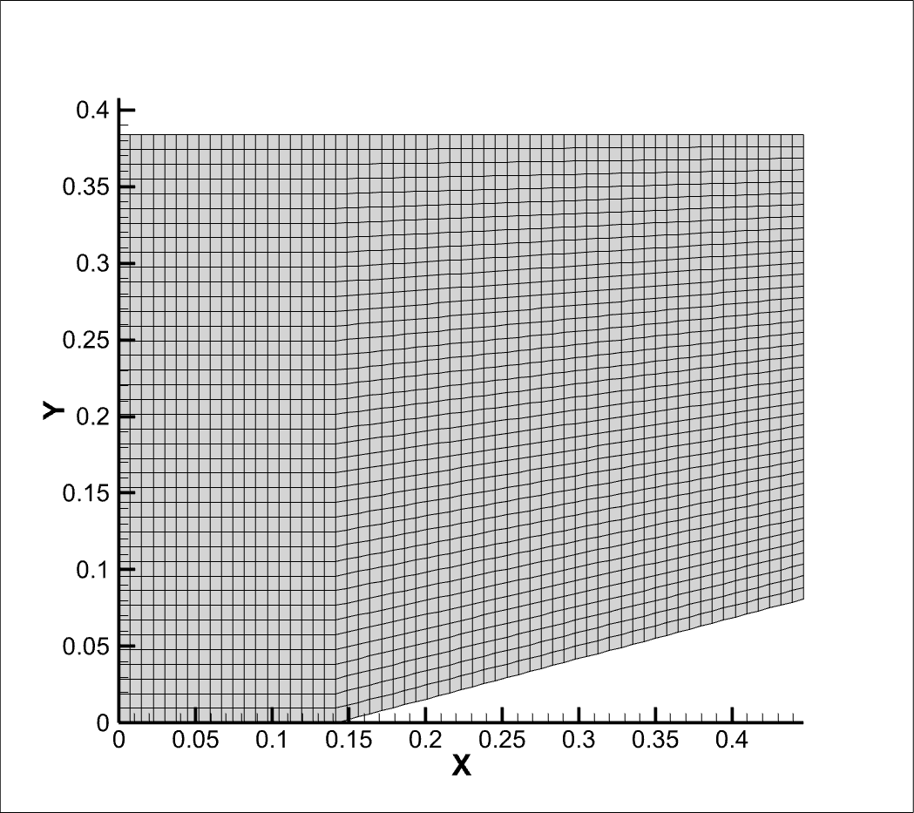


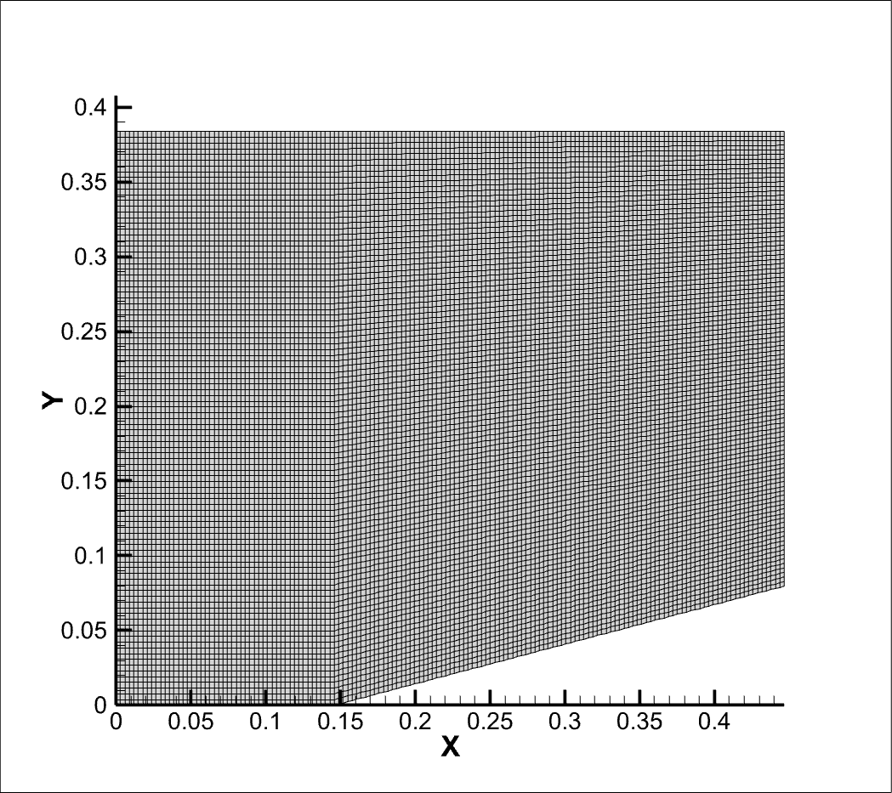

Grid generation
61 x 41
91 x 61
121 x 81
151 x 101
181 x 121

Slide 7
Boundary Conditions
 | U Velocity m/s | V Velocity m/s | Density Kg/m^3 | Pressure Pa
Inlet | 2383.6976 | 0.0 | 1.225 | 101352.9
Outlet | Neumann | Neumann | Neumann | Neumann
Upper Wall | 0.0 | 0.0 | Neumann | Neumann
Lower wall | 0.0 | 0.0 | Neumann | Neumann

Slide 8
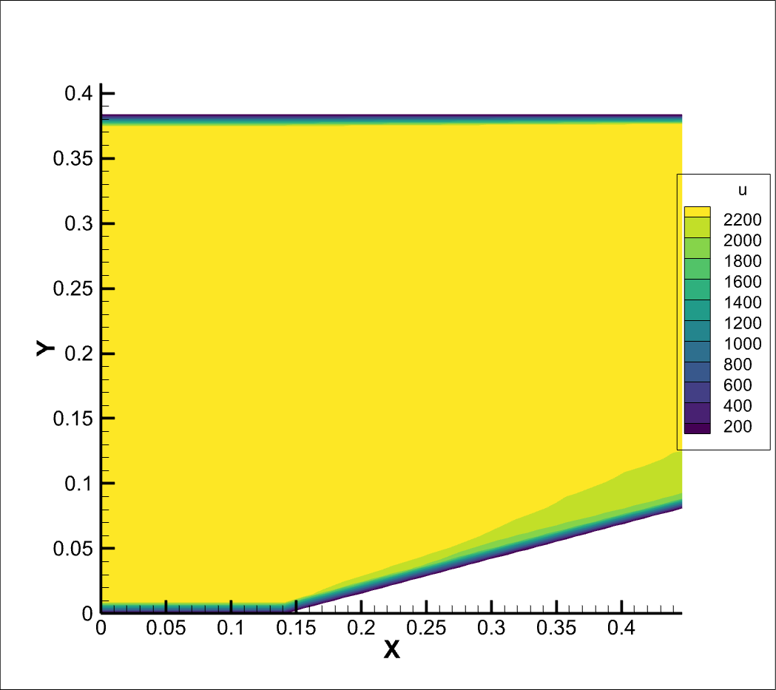
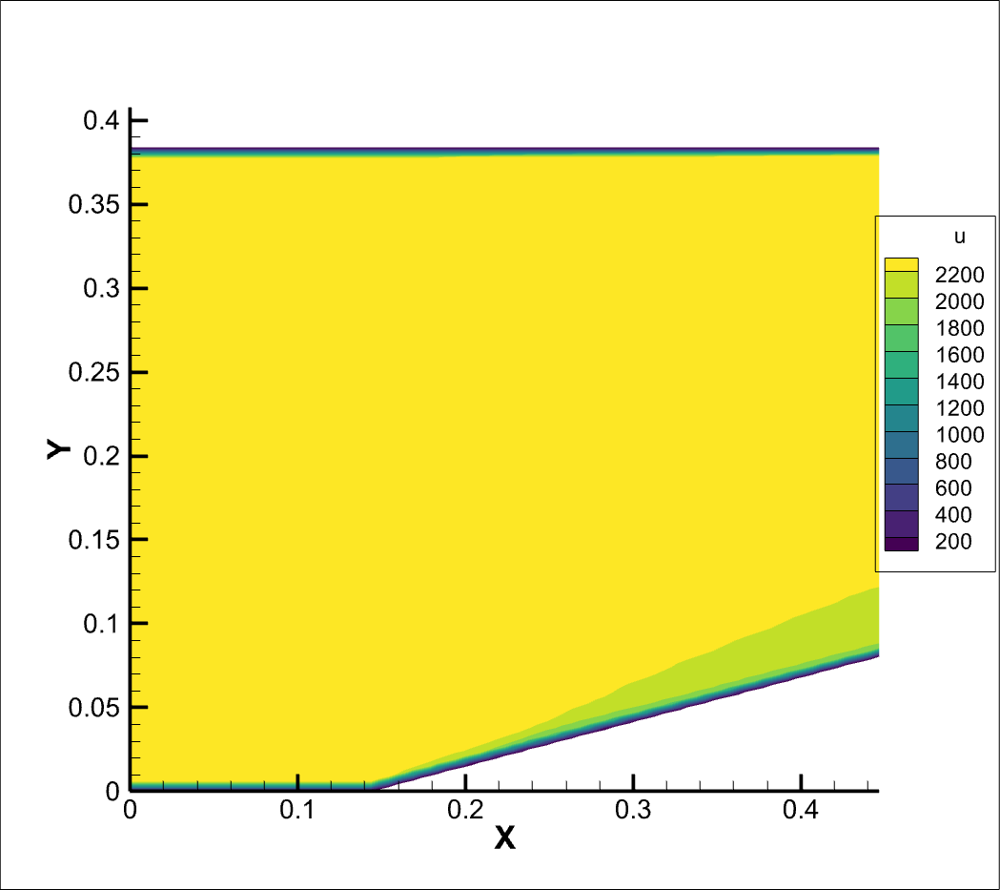
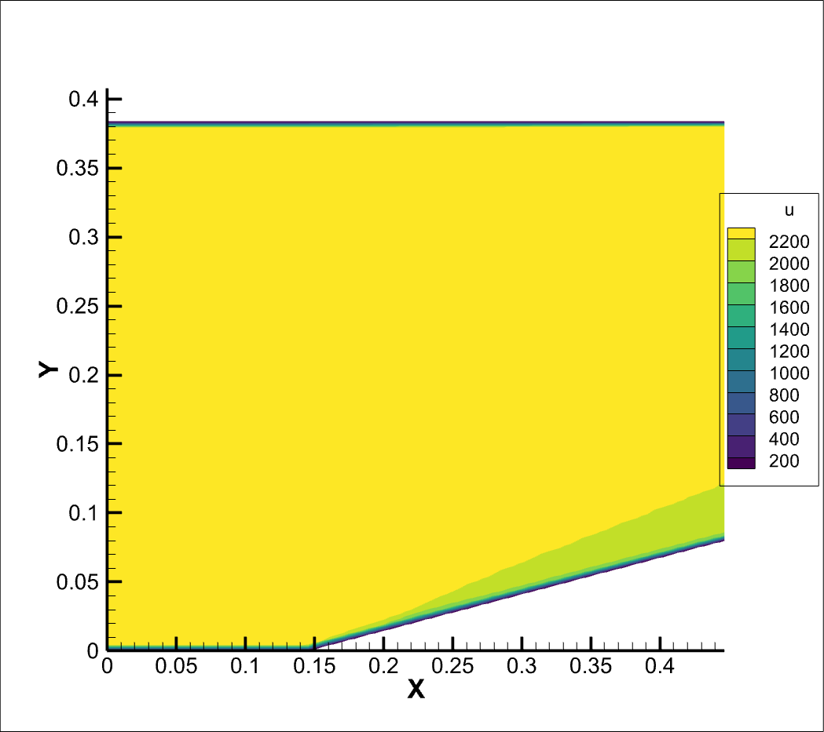
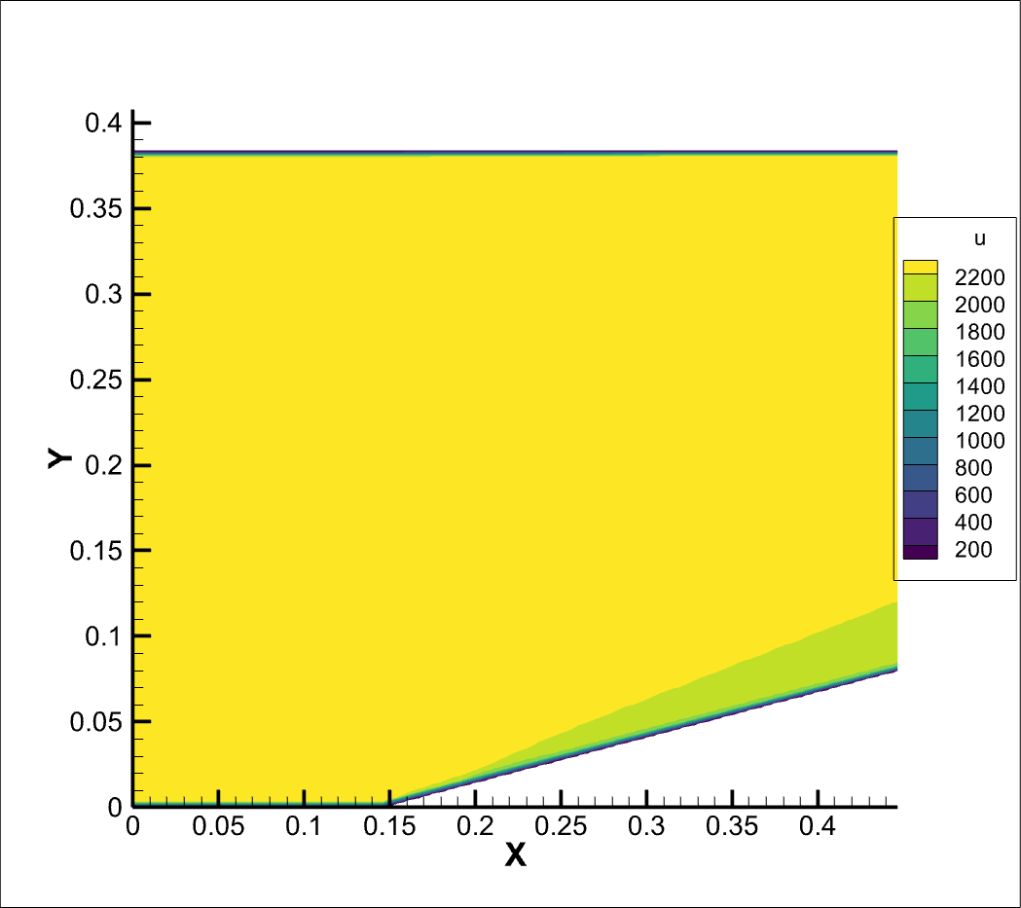

Results and Discussions

Slide 9

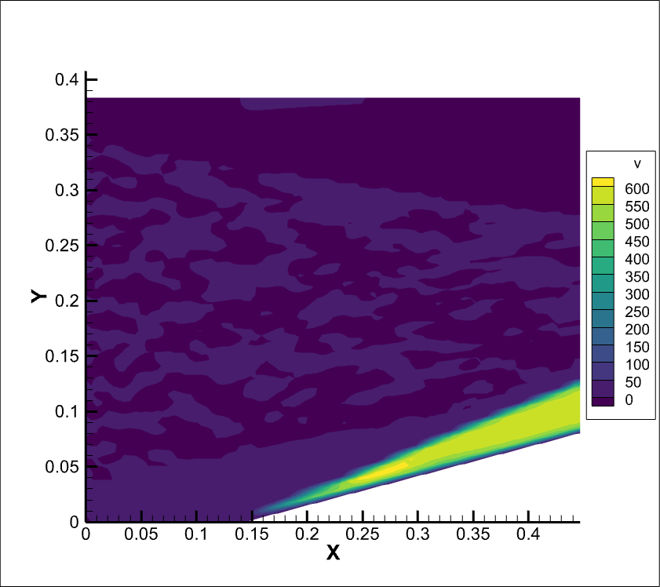
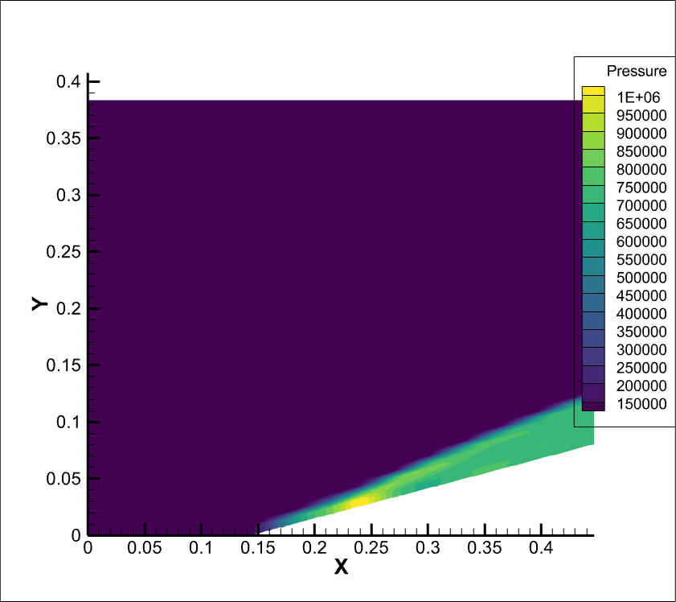
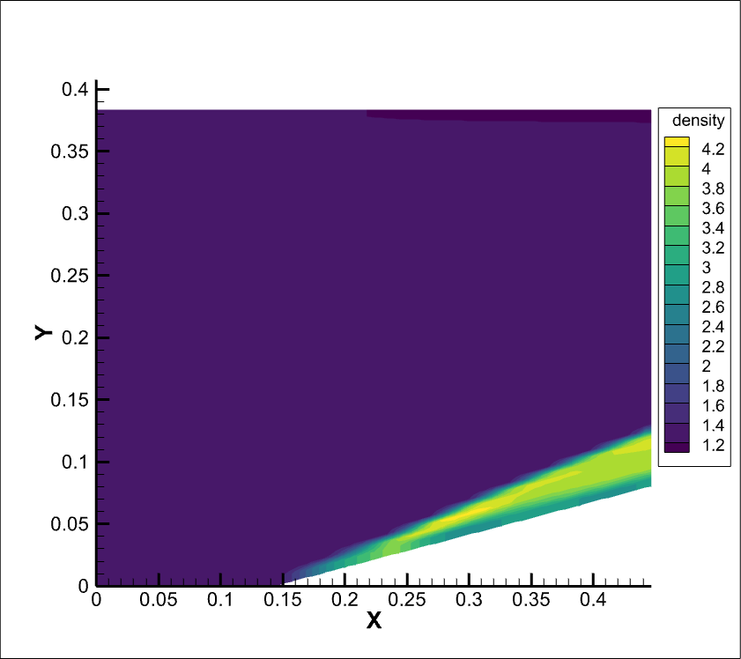
Results and Discussions

Slide 10
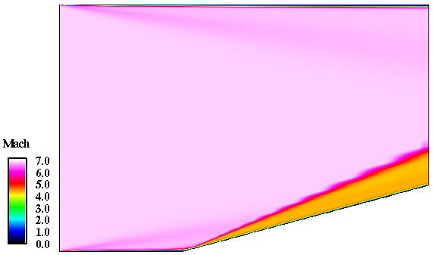
Comparison of results:

Slide 11
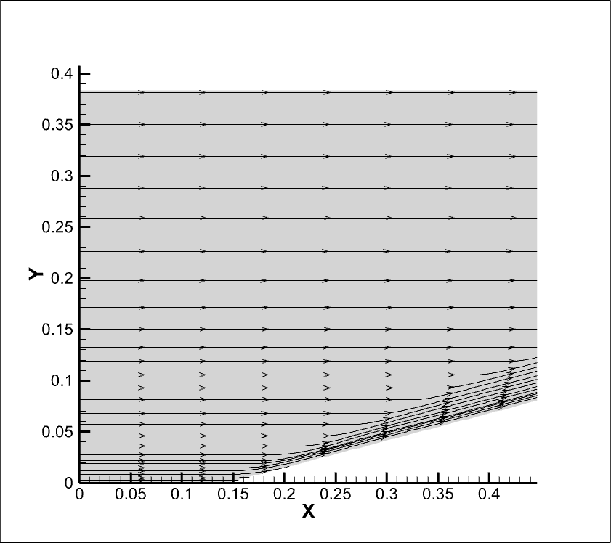
Results and Discussions

Slide 12
Conclusion
We were able to approach the problem statement using different approach. At this current approach we were able to get good simulations for flow with mach number 7 over a ramp of 15 degrees. We observed the formation of oblique shock from the start of ramp, and it is bending the upstream flow towards the inclined surface. We also observed how the number of iterations, number of grid points effect the time of computation and quality of results.

Slide 13

Thank you

