Slide 1

Laptop Price Prediction using Machine learning
Naveesha Srivastava
209301372
Section - F

Slide 2

Contents 1. Introduction 2. Dataset description 3. Data Visualization 4. Algorithm used 5. Result Analysis

Slide 3
1. INTRODUCTION
Problem statement for Laptop Price Prediction
This project focuses on building a model to predict the price of the laptop based numerous user configuration attributes like brand and model, RAM, ROM, GPU, CPU, size, weight, etc.
First and the foremost task it to clean the dataset which needs a lot of feature engineering, and preprocessing.

Slide 4
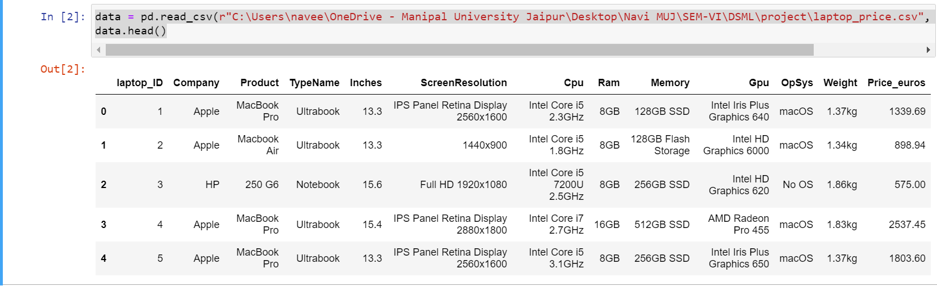
2. DATASET DESCRIPTION
Table below contains data about various laptops and their prices depending on their configuration. Sample data were obtained from Kaggle.com

Slide 5
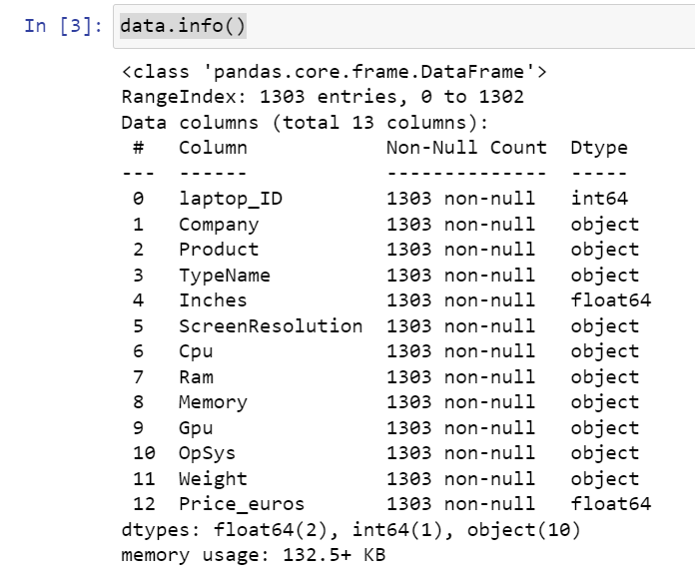
Dataset information Tuples: 1303 Data columns: 13

Slide 6
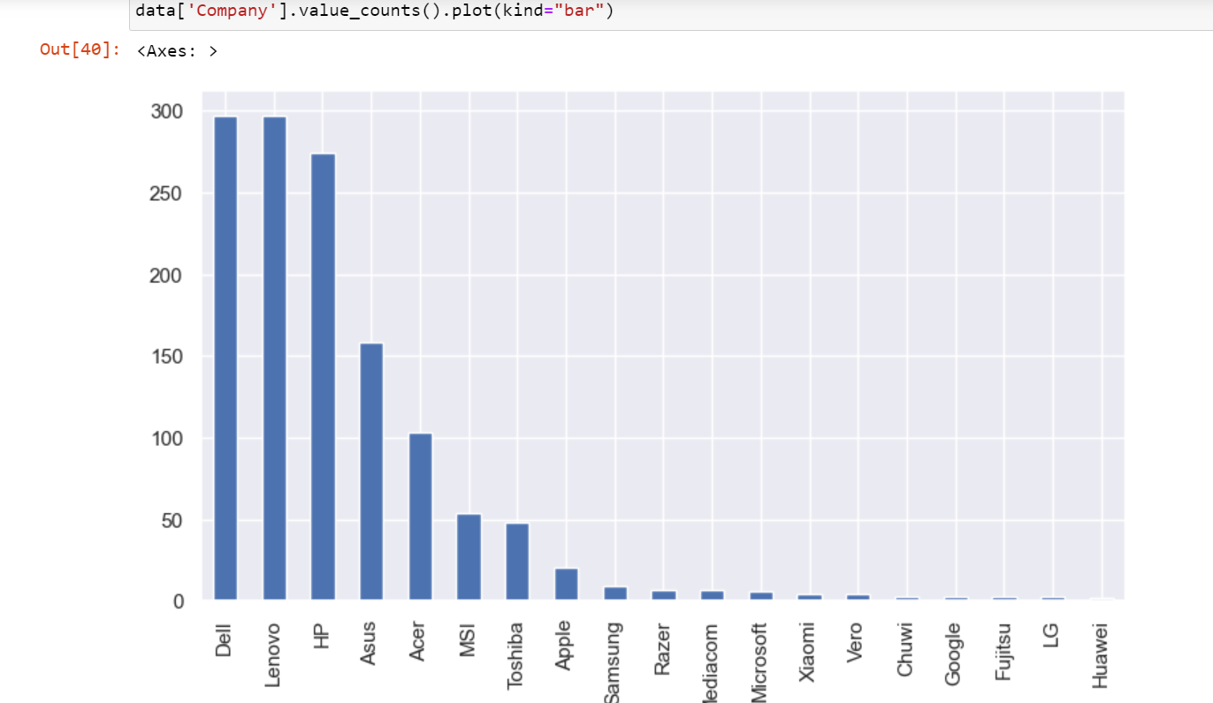
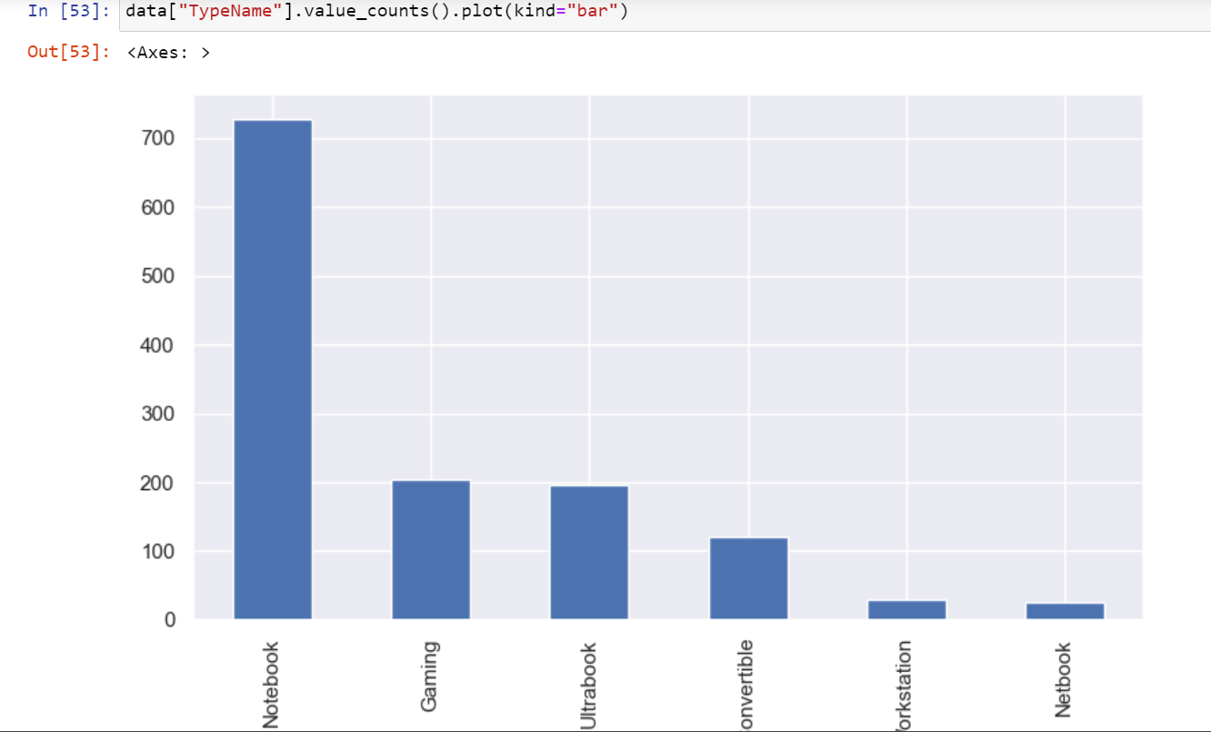
4. DATA VISUALIZATION
1. Frequency count of each unique value in the "Company" column of the "data" data frame.
2. Frequency count of each unique value in the "TypeName" column of the "data" data frame.

Slide 7

3. ALGORITHM USED
Machine learning pipeline uses an ensemble of regression models to predict the target variable. Here's a breakdown of the pipeline:
Step 1: Data pre-processing using Column Transformer. It applies One-Hot Encoder to categorical columns specified in the transformers list and passes through the remaining columns.
Step 2: Ensemble of regression defined in Voting Regressor. The following models are used:
Random Forest Regressor
Gradient Boosting Regressor
XGB Regressor
Extra Trees Regressor
The Voting Regressor combines the predictions of these models by averaging their outputs.

Slide 8
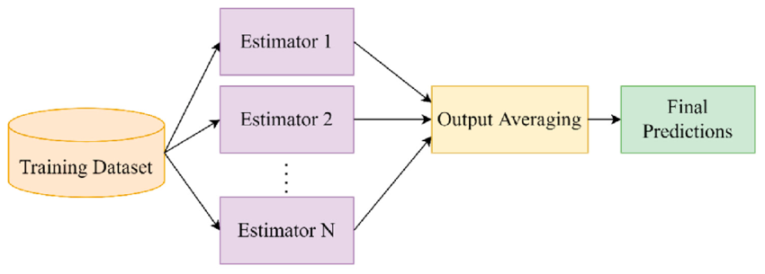

Slide 9
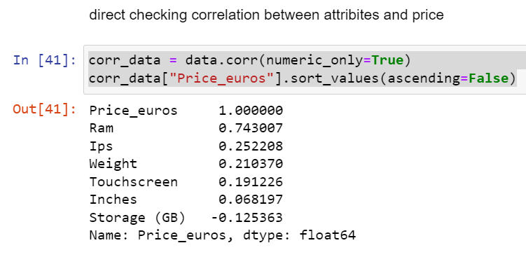
5. RESULT ANALYSIS 1. Correlation
It is observed that maximum correlation of price is with Ram which is 0.734

Slide 10
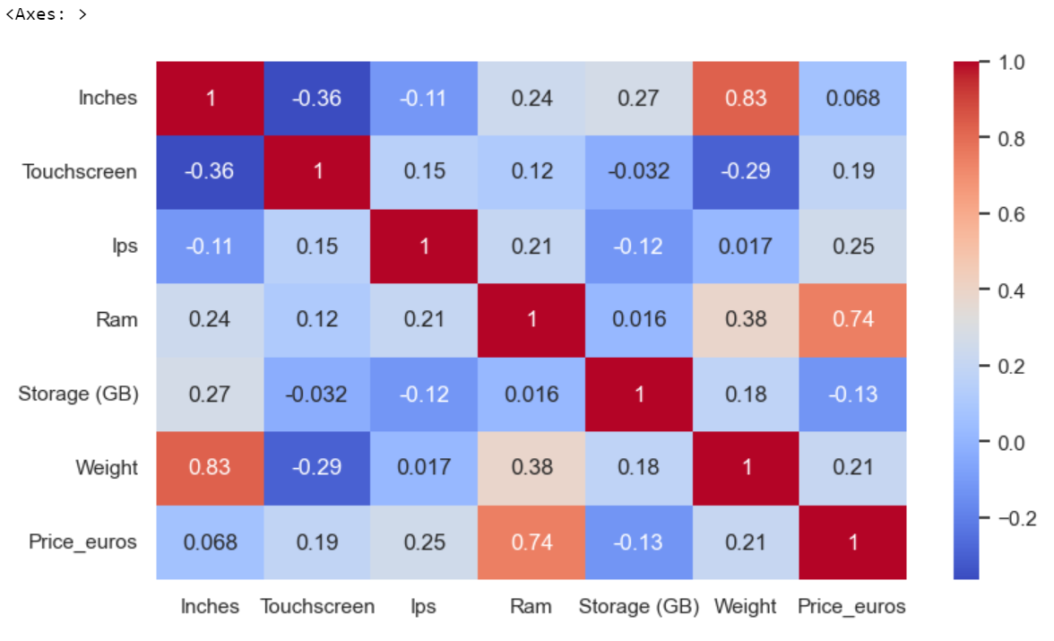
Heatmap

Slide 11
Evaluation Parameter for three train test ratio 70:30, 80:20, 60:40 Table filled with VotingRegressor Algorithm:
Algorithms→ Measures↓ | Train test ratio 1 | Train test ratio 2 | Train test ratio 3
MAE | 0.1477 | 0.1534 | 0.1567
MSE | 0.0372 | 0.04 | 0.0409
RMSE | 0.193 | 0.2 | 0.2024
R2 | 0.8945 | 0.888 | 0.8835

Slide 12
Thank YOU
DSML PROJECT PRESENTATION
CS3203
Course Instructor: Mr. Tarun Jain

