Slide 1

MINOR PROJECT - 2023 SENTIMENT ANALYSIS OF AMAZON PRODUCT REVIEWS
Under the guidance of Mentor:
Ms. Vibha Jain
Naveesha Srivastava
209301372
Section – F
B. Tech CSE - 3rd Year

Slide 2

Contents 1. Introduction 2. DATASET DESCRIPTION 3. ALGORITHM & TECHNIQUES 4. Result Analysis 5. Conclusion

Slide 3
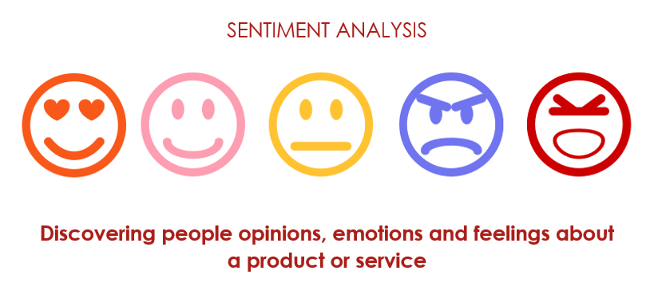
1. INTRODUCTION
What is Sentiment Analysis ?
Sentiment analysis is a natural language processing (NLP) method which is utilized to predict whether data is positive, negative, or neutral.
In this project, we particularly look at sentiment analysis of an Amazon product based on the customer reviews. Each review corresponds to a rating from 1 to 5. The goal of sentiment analysis is to determine the overall emotional tone of a review.
According to recent statistics, 77% of consumers read product reviews before buying on Amazon.

Slide 4
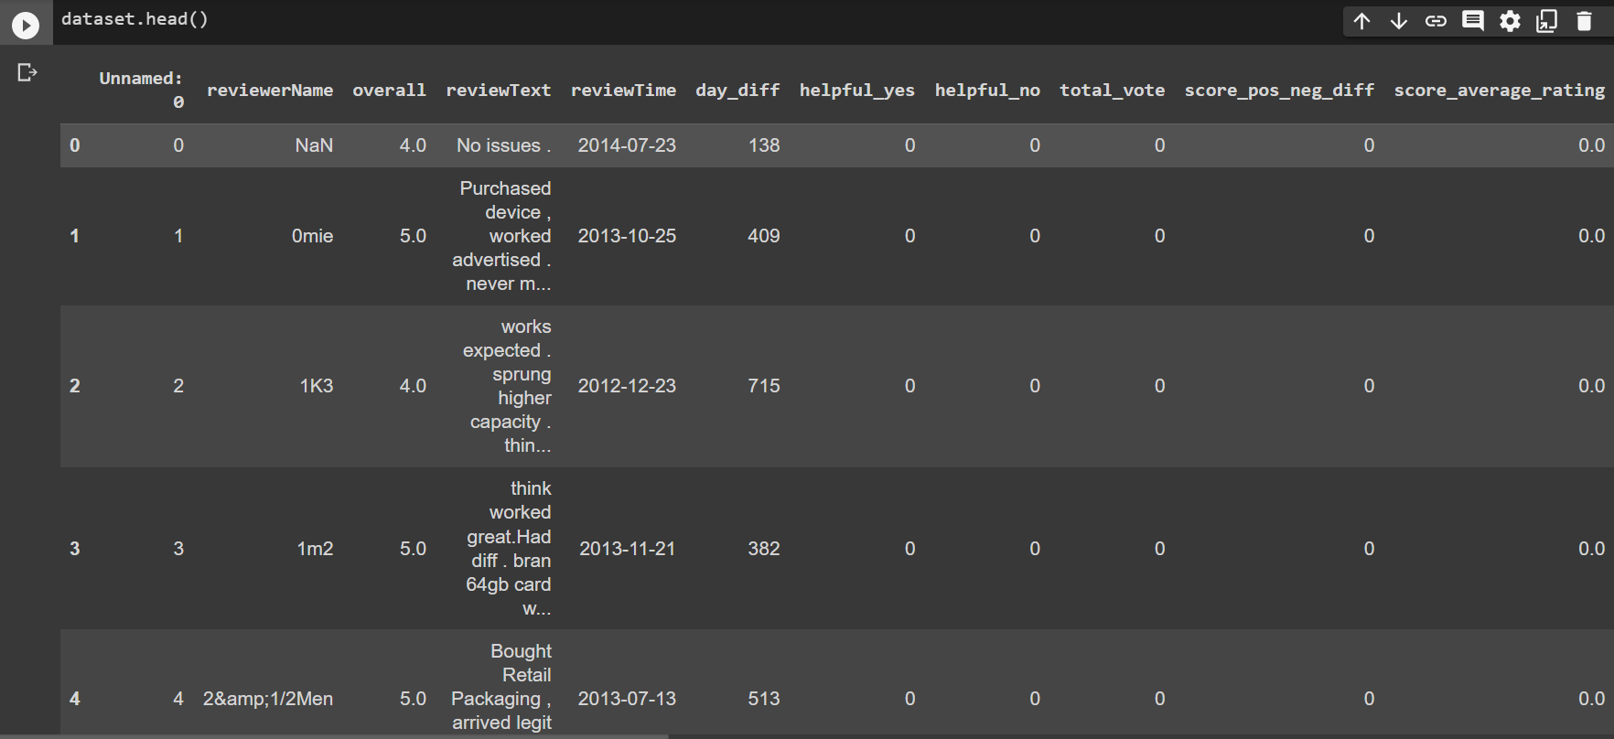
2. DATASET DESCRIPTION
Table below contains data about the customer’s review details of an electronic product from Amazon. The major focus is on customer review and its corresponding rating for the sentiment analysis. Sample data is obtained from Kaggle.com

Slide 5
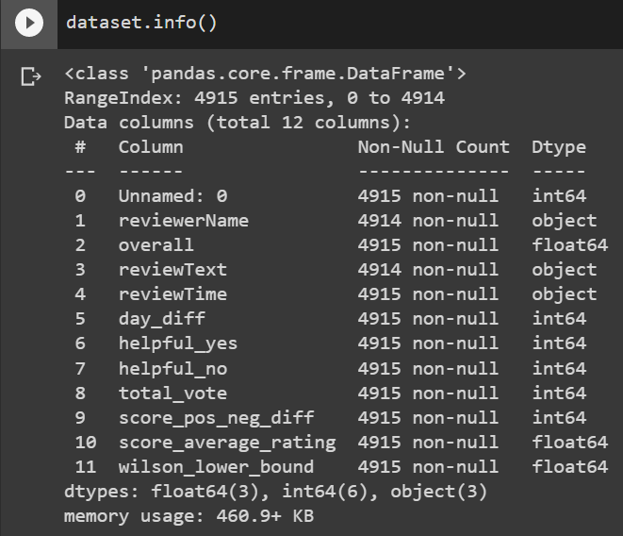
Dataset Information Number of tuples: 4915 Data columns: 11 Link: https://www.kaggle.com/datasets/tarkkaanko/amazon

Slide 6
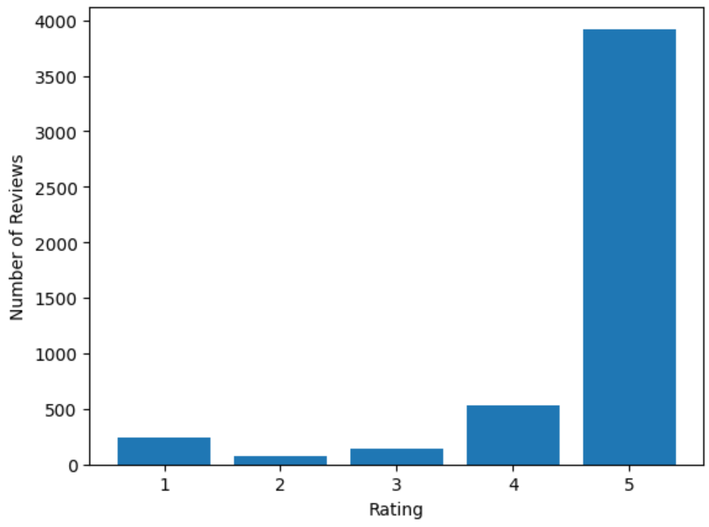
This graph depicts the frequency count of number of reviews per rating from 1 to 5 the dataset offers.

Slide 7

3. ALGORITHM & TECHNIQUES
DATA CLEANING AND PRE-PROCESSING
MODEL IMPLEMENTATION AND TESTING

Slide 8
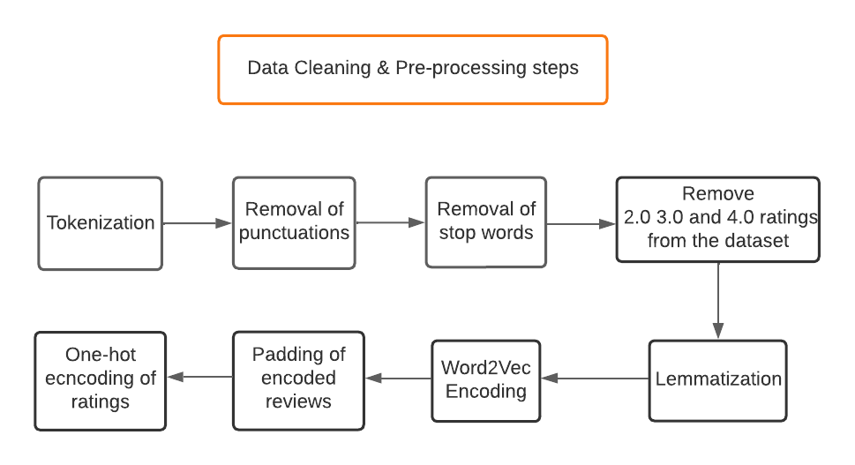

Slide 9
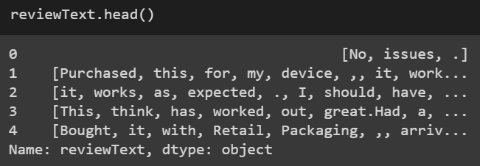
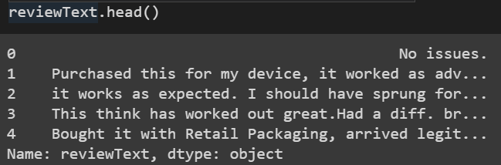
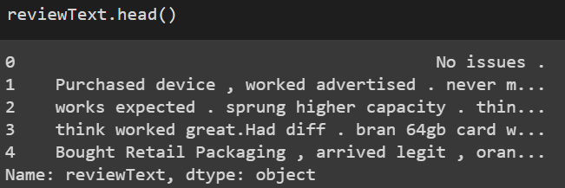
1. Tokenization
2. Removal of punctuations
3. Removal of stop words

Slide 10
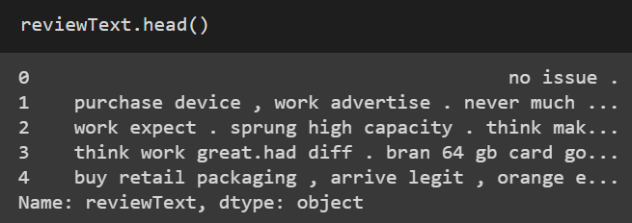
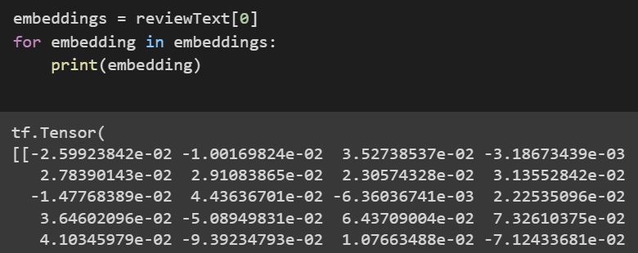
4. Lemmatization
5. Word2Vec Encoding
6. One-hot encoding : Technique used to convert categorical data into numerical data.
In this case, the ratings are categorical, either '5.0' or '1.0'. The one-hot encoding will represent these two categories as binary vectors, [1, 0]: for 5 or [0, 1]: for 1

Slide 11
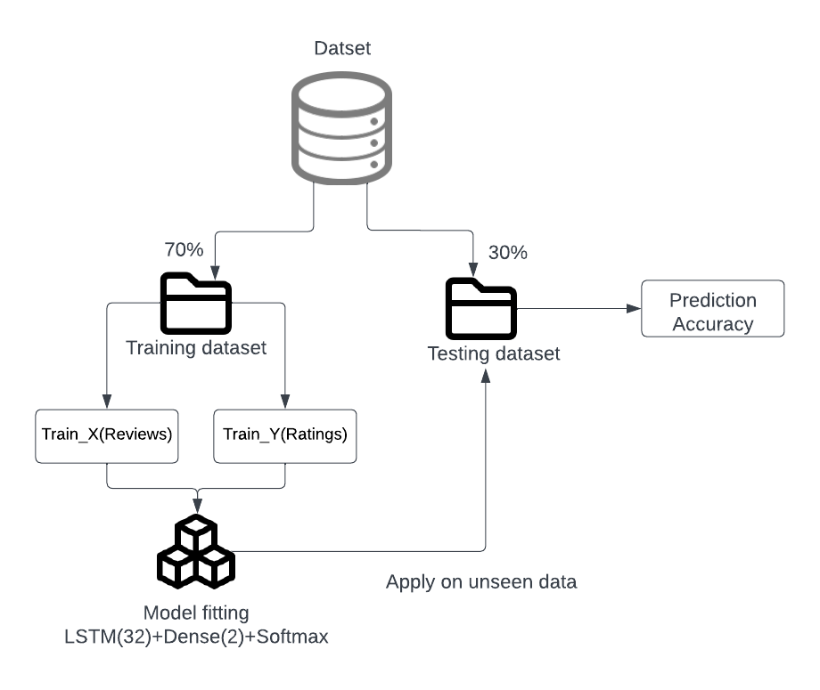
MODEL IMPLEMENTATION
Train-test dataset ratio- 70:30
Deep Learning Model:
RNN - LSTM
Recurrent Neural Network(RNN) can remember the previous computation of information and can reuse it by applying it to the next element in the sequence of inputs. A special type of RNN is long short-term memory (LSTM), which is capable of using long memory as the input of activation functions in the hidden layer.

Slide 12
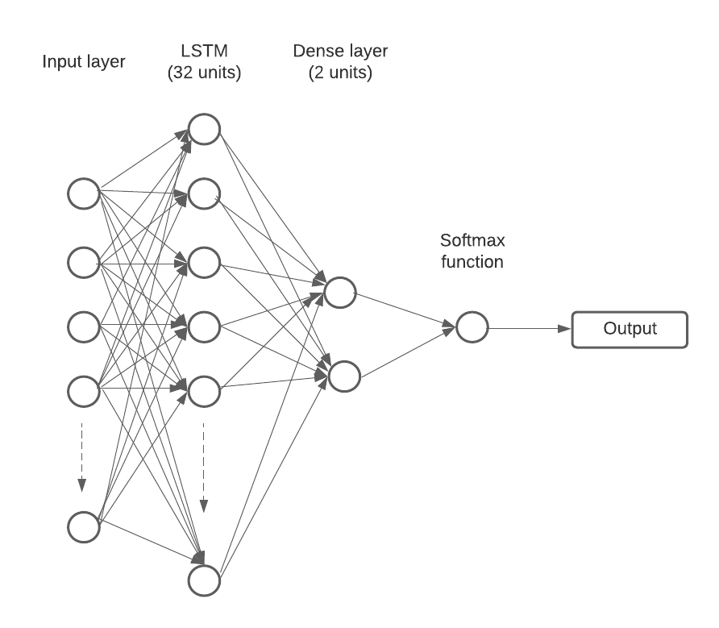
The LSTM layer takes as input a sequence of word embeddings, and produces as output a hidden state vector that represents the information learned from the input sequence.
A sequential model object is created and adds an LSTM layer with 32 units. Then, a dense layer with 2 units and a softmax activation function(it converts a vector of value to a probability distribution.)

Slide 13
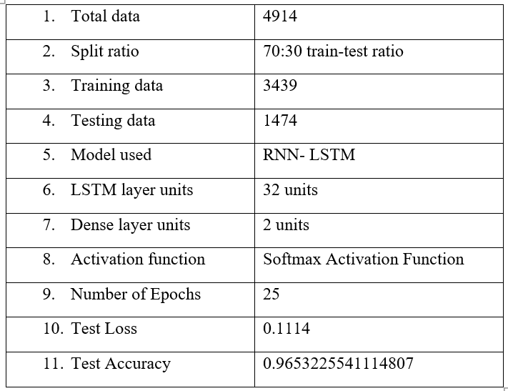
4. RESULT ANALYSIS
Parameters and results:

Slide 14
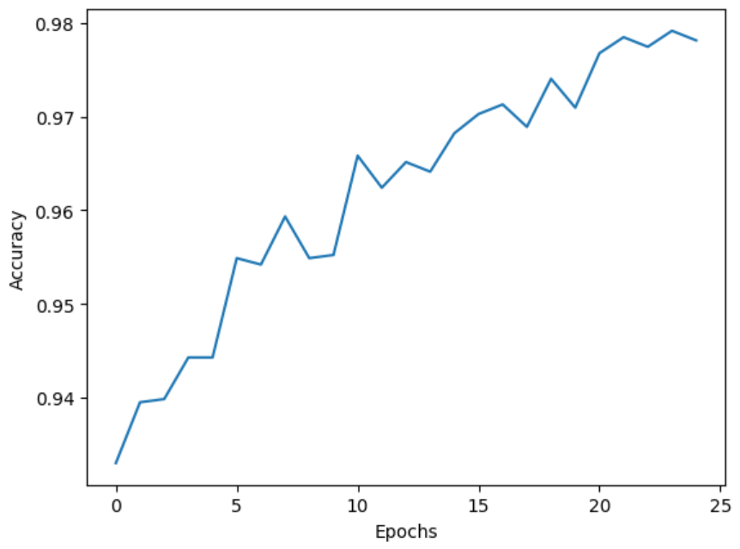
Figure 1 Accuracy score plotted against each epoch. The model reached its highest peak with the accuracy score of 0.9789

Slide 15
Other results:
Precision: [0.97478992 0.74]
Recall: [0.98891731 0.55223881]
F1 Score: [0.98180279 0.63247863]
In the results, the precision, recall, and F1 score values are given in the form of 1-D arrays, where the first element corresponds to the "positive" class (in this case, a rating of 5) and the second element corresponds to the "negative" class (in this case, a rating of 1).
Precision: ratio of true positive predictions to the total number of positive predictions.
Recall: ratio of true positive predictions to the total number of actual positive instances.
F1 score: harmonic mean of precision and recall.

Slide 16
5. CONCLUSION AND FUTURE SCOPE
The proposed system using LSTM, succeeded in obtaining an accuracy of 96.53 %.
Future Scope:
There is a scope to improve the dataset quality by removing the biasness in the data. Approximately 80% of the reviews are 5-star rated. This will give more accurate results on how efficient the model is.
Analysis of emoticons is another challenge to be handled, because it has been observed that a lot of reviews contains emoticons, which directly imply the true sentiment of the text. Studying relationship between sequence of emoticons is also a challenging yet necessary task for better analysis.
Multilingual text analysis is yet another challenge in Sentiment Analysis.

Slide 17
Thank YOU
MINOR PROJECT PRESENTATION
CS3270
JAN-MAY 2023

