Slide 1
Sam’s shoe store Business Analysis and strategy consultant
Presented by,
Team Analytic Avengers
Name: Aafreen Shan Asmath
Student ID:x23231335@student.ncirl.ie
Name: Naveen Kumar Ramesh
Student ID:x23103922@student.ncirl.ie
Name: Sai Teja Pursarla
Student ID:x23193638@student.ncirl.ie

Slide 2
Introduction
This report presents a comprehensive analysis of Sam's Shoe Store's business operations, focusing on key factors affecting its profitability and revenue generation. Through detailed exploration and examination of sales data, profit margins, product performance, customer behavior, and market trends, this report aims to provide actionable recommendations to address existing challenges and capitalize on growth opportunities.The report begins by outlining the business problem faced by Sam's Shoe Store, highlighting the need for assistance in analyzing its operations and identifying factors limiting profitability. It then proceeds to describe the implementation of Customer Relationship Management (CRM) strategies to enhance customer engagement and retention.The core of the report lies in the Data Exploration & Analysis section, where a detailed examination of sales, profits, product performance, and customer demographics is conducted. Using tools such as Tableau for data visualization, various aspects of the business are analyzed, including profits by state, product sales and profitability, cost of production, marketing expenses, revenue trends, and customer classification.Based on the findings from the analysis, the report concludes with a set of actionable recommendations aimed at optimizing Sam's Shoe Store's operations, improving cost management, enhancing customer engagement, and driving long-term profitability and growth. These recommendations encompass strategies for regional targeting, product optimization, cost management, seasonal planning, online sales improvement, and customer-specific marketing initiatives.By implementing these recommendations and leveraging the insights gained from the analysis, Sam's Shoe Store can position itself for success in the competitive shoe retail industry. Through strategic decision-making and proactive measures, the business can enhance its competitiveness, drive revenue growth, and achieve sustainable success in the marketplace.

Slide 3
Business Problem
The management team from the Sam’s shoe store requires assistance in their analysis of their business process and identifying the problems that limiting the overall profitability of the shop’s total revenue. There has been in increase of shops grown recently in the United States. So we will be mainly focusing on the business’s last year total sales, profits and other potential contributing factor. With these evaluation and investigation, we can able to provide better assistance to the business by analyzing the data we got from the IT department of the Sam’s shoe store.

Slide 4
Tools :
Salesforce CRM
Power BI
Tableau

Slide 5
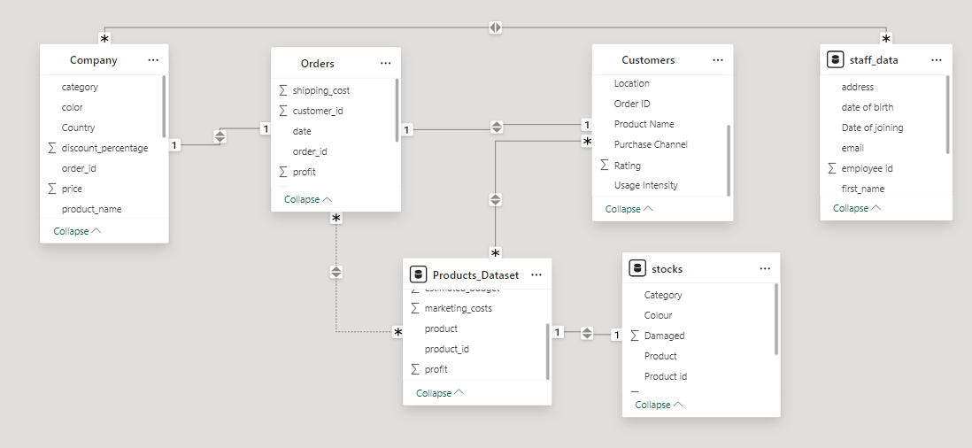
Data collected:
The data we gathered from the management team has a variety of data representing the relationships between overview of the company, total orders in the year 2022 to 2023 and its details, Customer information and the classification of products, inventory management and data on the company staff.

Slide 6
Data Exploration & Analysis
With the help of data exploration and analysis of the large amount of data we collected, we are using the tool Tableau for the data visualization and then we can able to easily evaluate and understand the total information in the dataset. The data we gathered consists of all the products sales, profits, complete information on the store from 2022 to 2023 with each product classifications selling in the store.
Profits by States analysis
Product vs Sales & Profit
Analysis for Profit, COP and Marketing costs
Analysis of Profit Vs Revenue
Analysis of Purchase type of products
Customer classification analysis

Slide 7
Conclusion & Recommendations
In conclusion, based upon the findings, we can able to make several optimizations on the store performance and improve the competitiveness among the other leading business in the market. Initially, the business has to cover the underperforming regions by implementing locational strategies to capitalize high performing markets by doing several marketing campaigns and promotional activities with addressing the challenges. As we can see there is a large competitive base for the products, Trainers and Sport shoes, as so many successful brands already having a huge market on the sale of the products. In order to compete with those huge brands, we should implement several product improvements, pricing strategies and introducing special features which improves the customer satisfaction of the product usage. Thirdly, by optimizing the cost management, particularly in production and marketing can also improve the profit margins and the overall financial performance. This includes renegotiating supplier contracts, optimizing marketing expenditure, and investing in cost-effective promotional activities. With strategic inventory management and seasonal planning can help to navigate the profits movement across each month and make strategic planning and inventory management to capitalize the peak seasons and control lower runs. Additionally, enhancing the online shopping experience by expanding the digital marketing efforts will increase the ecommerce market and eventually increases the online sales. Lastly, making certain campaigns on with specific to the location based and customer specific marketing will attract more customer eventually increasing the sales and profit of the business. By making equal collection of the gender based products and store ambiance with relevant marketing strategies will help to attract the customer base equally and direct long term sales growth.
In summary, by implementing these suggestions and leveraging the insights gained from the analysis, the Sam’s shoe store can optimize its operations, improve profitability, and strengthen its competitive position in the market, ultimately driving sustainable growth and success in the shoe retail industry.

