Slide 1
Machine Learning Transfiguration: Evolving Predictions across Cars price, Air Quality, and Electric Vehicles
Naveen Kumar Ramesh
M.Sc Data Analytics
x23103922@student.ncirl.ie
PRESENTATION Video link: link

Slide 2
Dataset collection
Dataset 1: Car Price Dataset: For the study, as mentioned we are using the Car Price Prediction dataset, it consists of a a detailed collection of information related to various car brands and models, providing essential attributes such as production year, price, mileage, and additional specifications. The datasets consists total of 18 columns and 19,238 rows, each data represents a unique car model and its associated features.
Dataset 2: Global air pollution Dataset: The Global Air Quality Index dataset from Kaggle comprises country and city data alongside Air Quality Index (AQI) values and categories, including those for carbon monoxide (CO), ozone, particulate matter (PM) 2.5, and nitrous oxide (NO2). It aims to predict PM AQI 2.5 values using other parameters. Columns like CO AQI value and category, ozone AQI value and category, and NO2 AQI value and category provide insights into specific pollutants and their respective AQI classifications. This comprehensive dataset serves as a foundation for analyzing air quality across various locations, aiding in understanding pollution levels and their impacts globally.

Slide 3
Dataset collection
Dataset3 : EV population Dataset: The EV population dataset (Figure 3) includes the data of number of BEVs and PHEVs registered with the Washington Department of Licensing State. The dataset contains the important factors such as country, model year, age, type of EV, electric range and other parameters. Several approaches have been performed in the previous studies while examining the relevant works in the field of EV market evaluation to make the model to perform with better accuracy. Some conventional models, like decision trees and logistic regression have been used in this dataset because they are transparent and easy to interpret the data when analysing the factors influencing EV population.

Slide 4
Car Price Prediction EDA Analyzing Trends and Preferences in the Automotive Market
Key Findings
Top Car Categories Analysis
Distribution of car expenses within each category.
Popularity of colors and gearbox types.
Insights from Visualizations
Customer preferences regarding car model and color.
Implications for future developments and marketing strategies.
Gearbox Preference Analysis
Trends in gearbox types preferred by consumers.
Potential implications for future vehicle design.

Slide 5
GLOBAL AIR pollution Analyzing Trends between the parameters affecting the air pollution
Key Findings
Data Summary and Cleaning
Initial data processing steps, including handling null values and outliers.
Correlation Analysis
Significant correlations between pollutants, highlighting key contributors to air pollution.
Pollution Level Visualization
Visual representations of AQI levels for different pollutants.
Importance of AQI in assessing air quality and health risks.

Slide 6
Overview of the EV population dataset and its significance in understanding electric vehicle sales trends. - EDA
Most Sold EV Models
Bar Plot for EV Model Sales
Visualization showcasing the most sold EV models in Washington state.
Confirmation of Tesla as the dominant EV manufacturer, particularly for Battery Electric Vehicles (BEVs).
Presence of Plug-in Hybrid Electric Vehicle (PHEV) models from manufacturers like Chevrolet and Chrysler.
Preference for BEVs vs PHEVs
Pie Chart for BEV vs PHEV Sales
Illustration of the percentage distribution of BEVs and PHEVs in total EV sales.
Clear preference for BEV models among consumers.
Implications for future EV market strategies and forecasting.

Slide 7
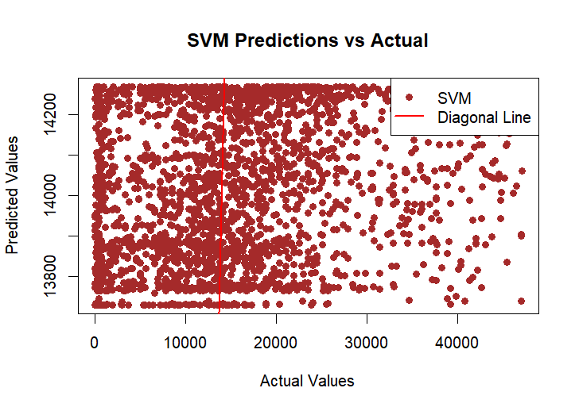
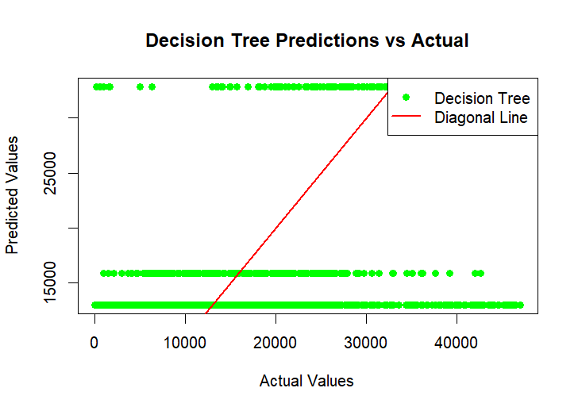
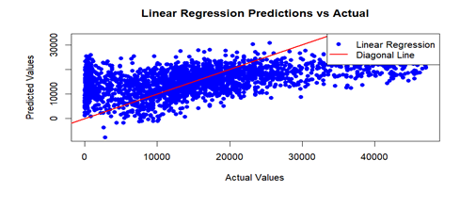
Car Price Prediction Analysis Evaluation of Predictive Models
Brief overview of the Car Price Prediction dataset
Mention the use of three distinct algorithms: Linear Regression, Decision Tree, and Support Vector Machine (SVM)

Slide 8
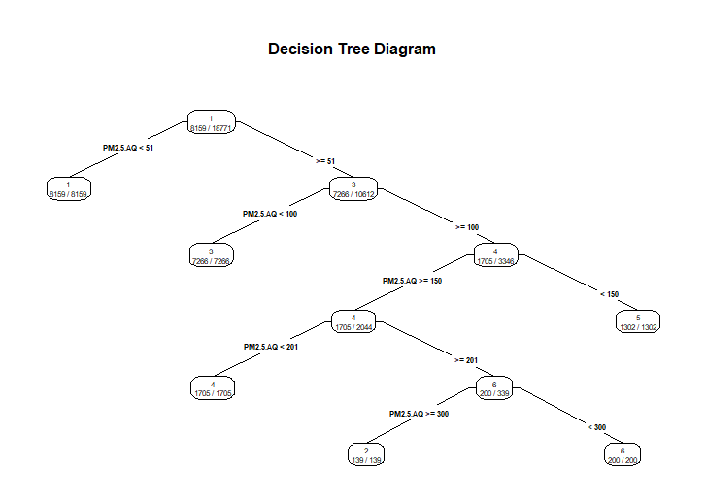
Global Air Pollution Classification Analysis Evaluation of Decision Tree Classifier and Gradient Boosting Model
Brief overview of the Global Air Pollution dataset
Explanation of the classification problem: predicting the PM 2.5 AQI category variable
Mention of the models used: Decision Tree Classifier and Gradient Boosting

Slide 9
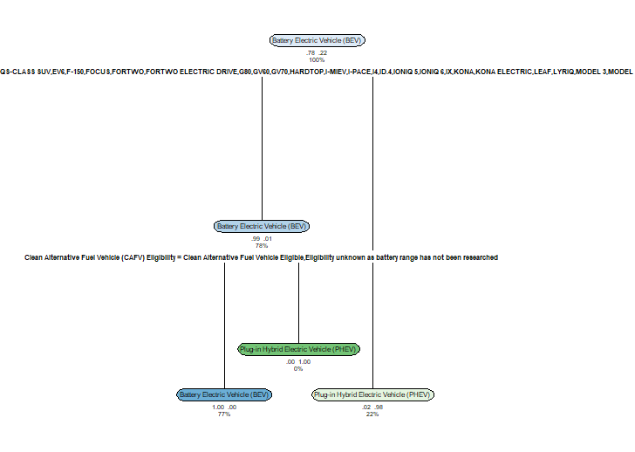
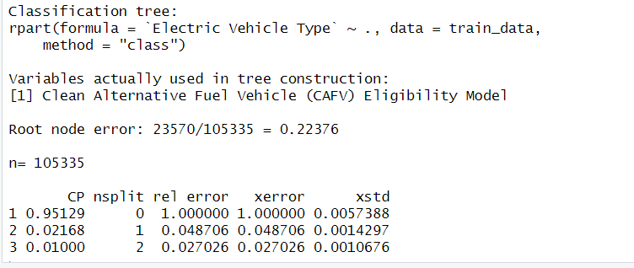
EV Population Model Analysis Estimation of Factors Affecting EV Market Price and Sales
Overview of the EV Population dataset
developing a model to predict factors affecting market price and sales of EV population. Decision tree model

Slide 10
Conclusion:
To conclude the model, this analysis and study include three different areas: car price prediction, global air pollution and EV population datasets. Valuable and Important discoveries were found with every exploratory data analysis (EDA) project by visualizing the patterns, trends, distributions, and connections among the factors present in the datasets. With the help of the EDA, we made a thorough analysis of the most popular automobile classifications, car colours, and gearbox types and other factors in order to estimate car prices. Other visualizations such as Pie charts, bar charts, and scatter plots were used to improve detailing of the dataset's important linkages. The regression models such as Linear Regression, Decision Tree, and Support Vector Machine (SVM) were subsequently evaluated for the first dataset, it was found that the Decision Tree model had the best predictive accuracy for this particular prediction problem by estimating the value of R square and RMSE values.
Regarding the analysis of Global air pollution, the EDA examined the amount of pollution gases present in the atmosphere has been clearly calculated. With the help of the detailed insights, we can able to fully understand the factors and relationships of the variables. With the evaluation of the analysed parameters, we can able to successfully develop models Gradient Boosting and Decision trees. Overall, as the accuracy of the Gradient boost model shows a accuracy of 97%, which represents the performance of the model is so much better. In order to investigate EV population classification, a full and complete analysis of EV model type sales classification, the correlation between the factors, and the influence of EV sales with respect to the makers have been completely understood and evaluated.

