Slide 1
INFO3111: Week 1, Day 2
Week 1, Day 2
I stink, therefore I need a shower (René Descartes joke)
Through the graphics pipeline armed with only gun and camera
What on Earth is a Rasterizier? A “shader”? A “uniform variable”?
If I only had a vertex

Slide 2
Win32 (vs console) and freeGLUT
A “windows” app has a winmain entry
“console” has main
OpenGL is just the 3D API, so it doesn’t “care”
We can do a “win32” version, but they we are restricted to only a “windows” app
Note: Windows FULLY supports OpenGL, despite what Microsoft might suggest
OpenGL is a “C” API (not C++, not magic, etc.)

Slide 3

René Descartes

Slide 4
René Descartes
Mathematician and philosopher 17th C
“I think, therefore I am”
Story goes that he was looking at a fly walking on the ceiling of his room, and wondered how he could describe its location

Slide 5
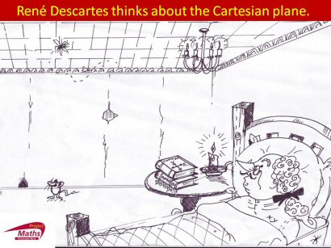
http://www.projectmaths.ie/node/61

Slide 6
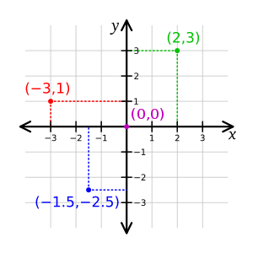
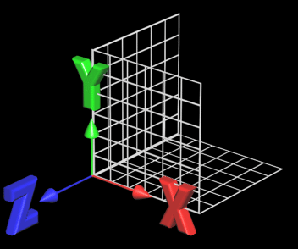
This lead to the “Cartesian-coordinate-system”
Can extend to three degrees…

Slide 7
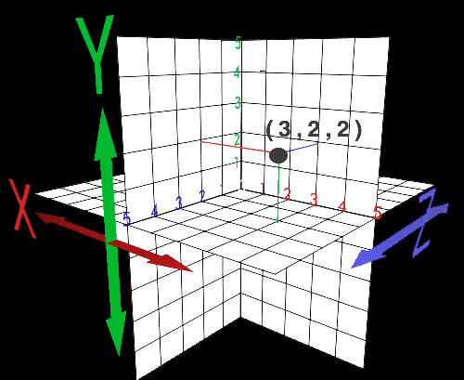
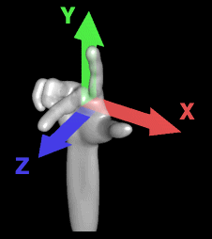
The idea of “Handedness” is which direction the “Z” goes

Slide 8
So?
This means that any point in space can defined by three coordinates:
X, Y, and Z
A set of three coordinates can be called a “vertex”
A set of three vertices is a triangle
Which is also a type of “primitive”
…but there are other types (later…)
And, we can create pretty much anything we want with triangles…

Slide 9
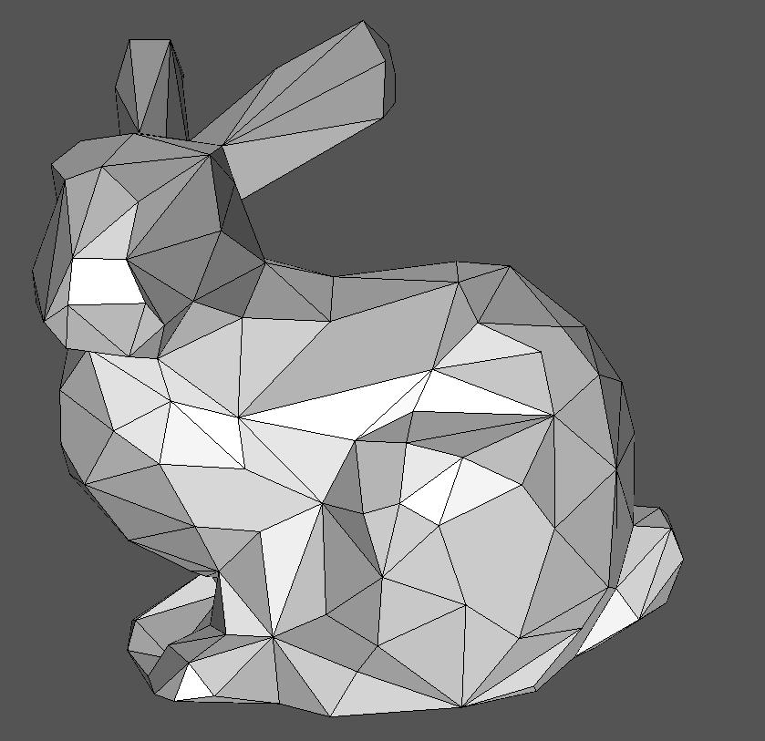
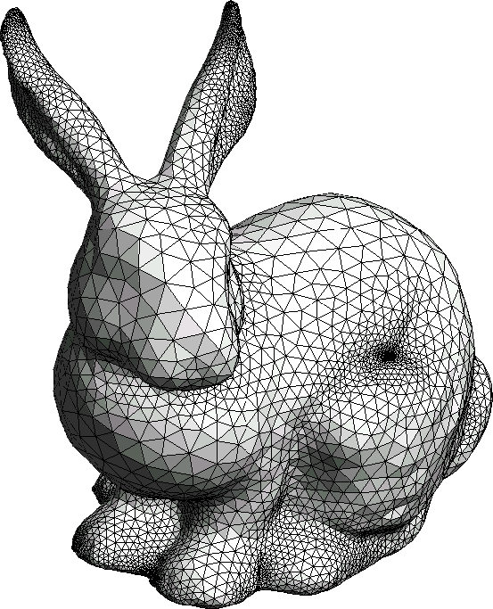
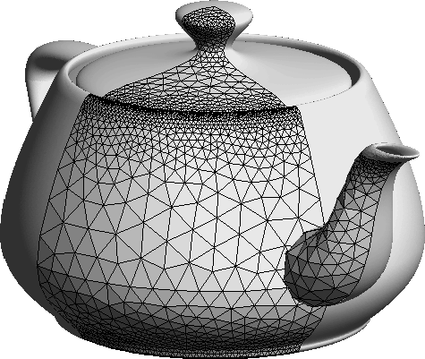

Slide 10
So?
This means that any point in space can defined by three coordinates:
X, Y, and Z
A set of three coordinates can be called a “vertex”
A set of three vertices is a triangle
Which is also a type of “primitive”
…but there are other types (later…)
And, we can create pretty much anything we want with triangles…

Slide 11
Summary
The world can be defined by coordinates
Also called a vertex
Three coordinates (vertices) make a triangle
Triangles can define pretty much everything
The “handness” of a coordinate system:
Explain which way the axes go (+ / -)
Which is the front (or winding…more on this later)

Slide 12
The ‘frame buffer’
System
Memory
System
Memory
CPU
“Video
Memory”
Video
Controller
Monitor
“Frame
Buffer”
The solution was to give the CPU
and the Video Controller
access to different parts or memory
System Bus
Other devices:
keyboard
disks
The memory the Video Controller
accesses is called the “Frame Buffer”

Slide 13
The ‘frame buffer’
CPU
System
Memory
“Frame
Buffer”
Video
Controller
Monitor
System Bus
The CPU may or may not have
access to the Frame Buffer
Other devices:
keyboard
disks

Slide 14
Video Controller → GPU
As CPUs got faster and more complex…
…so did the Video Controllers
Started ‘off loading’ some tasks:
Making windows
Drawing shapes (triangles, circles, etc.)
Filling in large coloured regions
Animating Buttons, etc.
Complex 3D math calculations
Began to be called “Graphics Processors”

Slide 15
GPUs
GPUs are designed for graphics
Special functions
Additional circuitry
CPUs are designed for general use
In general, GPUs are much faster than CPUs for graphics (up to 100x +)
Nowadays, the CPU doesn’t really do any graphics processing at all.

Slide 16
How much fast are GPUs than CPUs???
Intel processor specifications: http://ark.intel.com/
nVidia:
Titan: http://www.geforce.com/hardware/desktop-gpus/geforce-gtx-titan/specifications
Quadro: http://www.nvidia.com/object/quadro_fx_product_literature.html

Slide 17
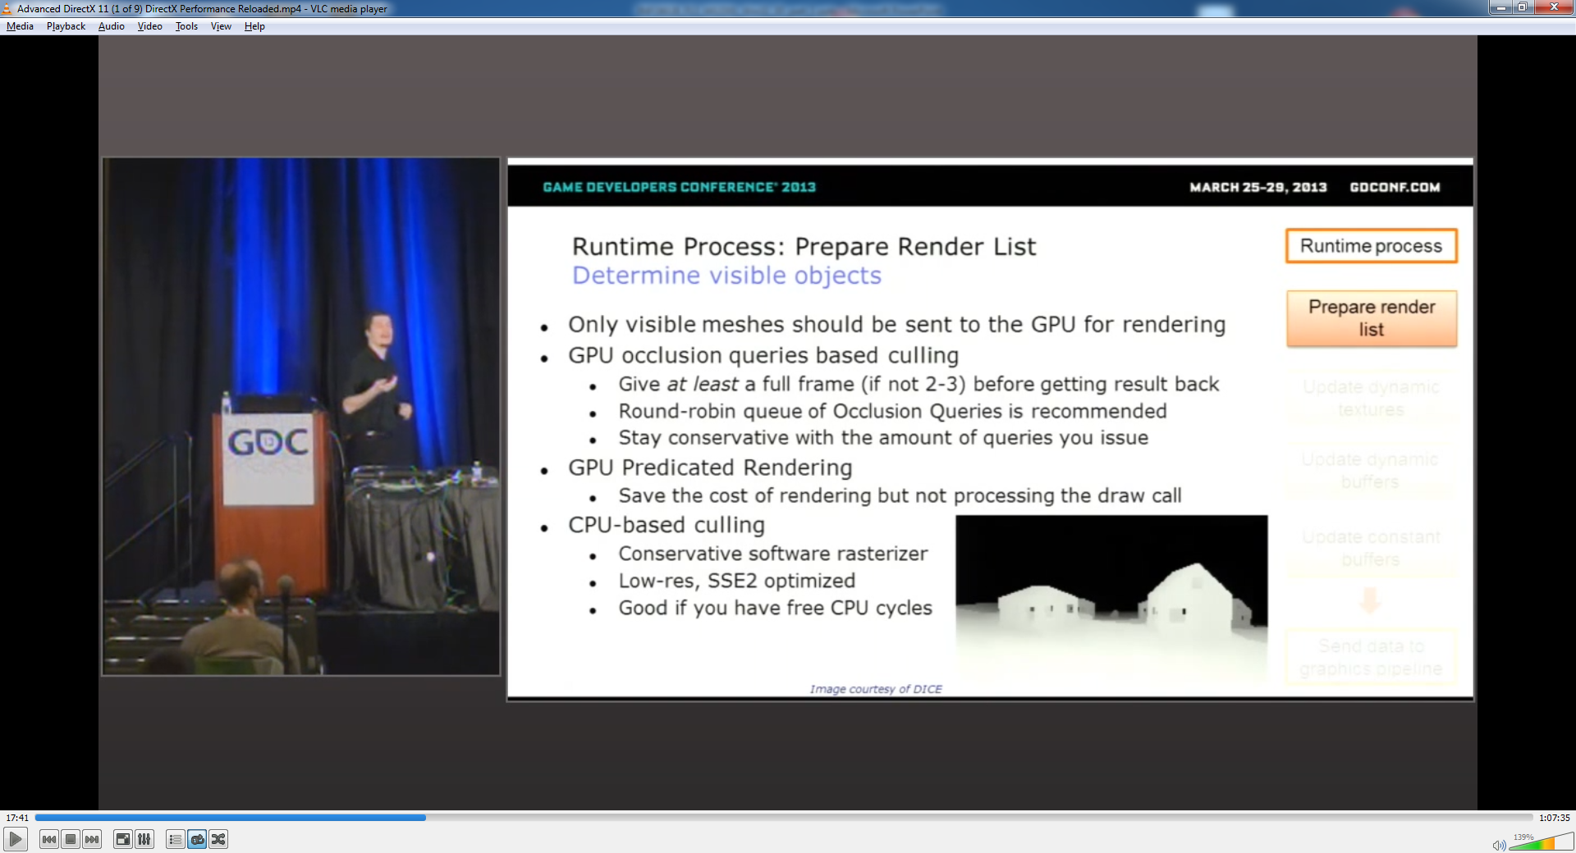
How much fast are GPUs than CPUs???
From “Advanced DirectX 11 (1 of 9) DirectX Performance Reloaded” at GDC 2013

Slide 18
Current graphics architecture
So?
Video
Memory
GPU
Additional
Circuitry
Monitor
“Frame
Buffer”
Note:
CPU and GPU have independent memory
Video driver allows CPU access to GPU (GPU commands)
CPU has no direct access to frame buffer
CPU
“Bridge”
System
Memory
System Bus

Slide 19
Current graphics architecture
Video
Memory
GPU
Additional
Circuitry
Monitor
“Frame
Buffer”
If GPU changes, the commands that are send by CPU change also:
draw circle, line, etc.
There is no standard
CPU
“Bridge”
System
Memory
System Bus

Slide 20
Graphics Languages
Since there is no ‘standard’ GPU commands (i.e. the low-level ‘hardware’ commands), we need to ‘abstract’ this (through an API)
Win32 supports:
GDI/GDI+ (Graphics Device Interface)
DirectDraw and Direct3D (DirectX)
OpenGL
DOS supports:
none!
(Application Programming Interface)
(Must write to each GPU (Intel, NVIDIA, 3Dfx, etc.) separately

Slide 21
Modern GPUs
Like CPUs, as GPUs got more powerful, the hardware became more general purpose.
This lead to the ability to “program” different parts of the GPU to do different things.
Initially, this was only take advantage of by the driver, but since the GPUs were already becoming more general purpose, there was a push to make the graphics pipeline itself become more general
This was already the case with graphical systems like ray-tracing and commercial products like Renderman

Slide 22
Modern GPUs
This lead to “shader languages” which described the “shading” – the actual rendering processing – that the GPUs were doing.
Initially, like with CPUs, this was in assembly language and was very vendor and GPU specific.
But, again like CPUs, this became somewhat standardized and generalized.
One thing to keep in mind, though, is that GPU programming is quite different that CPU programming, even though some of the shading language may look superficially similar.

Slide 23
Graphics Languages
The good news is that there are now several “high level” languages that can be used to describe most of the graphics commands:
Cg (which is almost identical to HLSL)
HLSL (High Level Shading Language), which we use
GLSL (OpenGL Shading Language), which is an OpenGL standard
Note that most of the rest of the API (outside of the actual shading language) is different:
DirectX and OpenGL are similar, but quite different
DirectX can use HLSL or Cg
OpenGL can use GLSL or Cg
And even the non-graphical functions of a GPU can be programming using high level languages (this is called GPGPU, for General Purpose GPU programming)

Slide 24
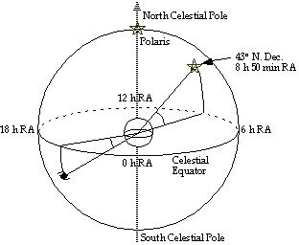
Coordinate Systems
No matter what the API, all graphics systems use a ‘coordinate system’
Several kinds:
Cartesian (x, y, z)
Polar (magnitude & direction)
OpenGL/DX uses Cartesian

Slide 25
Who?
René Descartes (1596-1650: France)
Mathematician (Cartesian coordinate system)
Philosopher (“I think therefore I am”)
Gambler
General
Duelist (swords)

Slide 26
Cartesian coordinates
With a 2D Cartesian system, we:
Can place points (coordinates) on a grid
Can have them represent shapes
11
If they are part of a shape, a humble coordinate is now a “vertex”
10
(9,10)
9
8
(12,8)
7
(3,7)
“Y” axis
6
5
4
3
(6,3)
2
(This shape has 4 “vertices”)
1
1
2
3
4
5
6
7
8
9
10
11
12
13
14
15
Note that “X” is always shown first
“X” axis

Slide 27
3D Cartesian coordinates
More dimensions can be added…
Depth can be added
Called the ‘Z’ axis
Again, if they describe a shape, they are vertices
11
10
9
8
Now each coordinate or vertex has three components: X, Y, and Z
7
“Z” axis
6
“Y” axis
5
1
2
3
4
5
6
7
8
9
10
11
12
13
14
15
4
3
(6,2,4)
2
1
Note that “X” is still shown first,
and “Z” is shown last
1
2
3
4
5
6
7
8
9
10
11
12
13
14
15
“X” axis

Slide 28
The world
In DirectX/OpenGL:
All the things (shapes) we want are drawn using vertices
We use viewports and projections to see the shapes

Slide 29
Projection and Viewport
All the shapes are in the “World”
We specify a volume that we can ‘see’ – called a projection
What part shows up on the screen is the viewport
11
10
9
8
7
“Z” axis
6
“Y” axis
5
1
2
3
4
5
6
7
8
9
10
11
12
13
14
15
4
3
2
1
1
2
3
4
5
6
7
8
9
10
11
12
13
14
15
“X” axis

Slide 30
Viewports
Window width
Viewport width
Window height
Viewport height

Slide 31
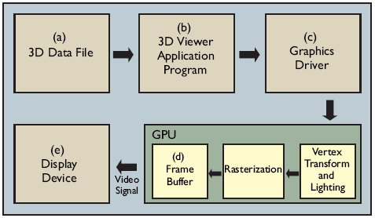
Simplified graphics pipeline

Slide 32
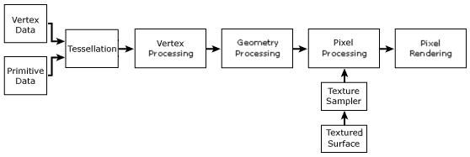
Simplified Graphics pipeline (GL3.x/DX10)
Vertex data (a bunch of vertices and triangles – or equivalent) go down a “vertex stream”
They are “processed” (“drawn”) on screen (or a back-buffer)
What about the rest of the diagram…?
Soon my young padawan… soon.

Slide 33
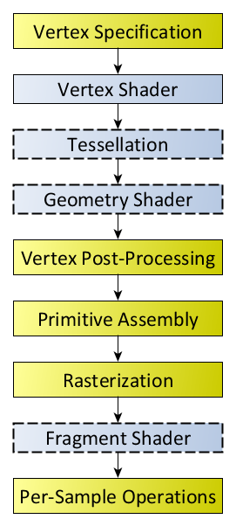
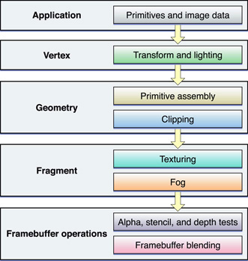
GL 3.x (below) and 4.x (right) pipeline

Slide 34
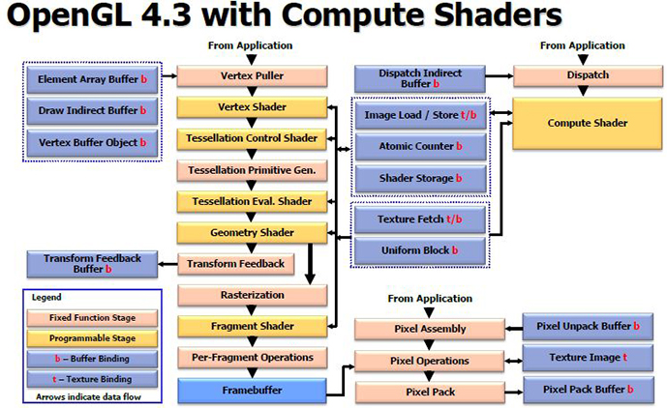
GL 4.3 pipeline
From: http://www.brightsideofnews.com/Data/2012_8_6/Khronos-Announces-OpenGL-ES-30-and-OpenGL-43-and-More!/OpenGL4.3ShaderPipeline.JPG

Slide 35
Rasterizier?

Slide 36
Rasterization
A “vertex buffer” is a memory location where vertices are stored.
A “vertex stream” is when this data is fed into the “rasterizer” to be drawn
This can be in the CPU or the GPU
More on this later
Think of it like a “fancy array,” a database, or a file - in other words, you just can’t “touch” it, you have to “lock and load it!” Oh yeah!

Slide 37
Vertexes
A basic vertex can hold the 2D (x,y) or the 3D (x,y,z) location in space.
But, they can (and will) hold a lot more than just the (x,y,z) location:
Transparency (alpha), textures, colours, shading, reflectivity, etc.
Next week, we will be doing just that, actually.
(in fact, they can hold whatever we want them to… they are just data…but shhh, don’t tell anyone…)

Slide 38
Primitives
We say the word “primitive” earlier
Remember that graphics cards today are heavily optimized for triangles
They are a type of “primitive”
There are other types, too
In the past, there was a lot of effort that went into trying to convert triangles into these
But, there really isn’t a lot of difference any more
And, it’s sometimes difficult to transform
However, there are also “points” and “lines”
… and “quads” if you are in OpenGL land….

Slide 39
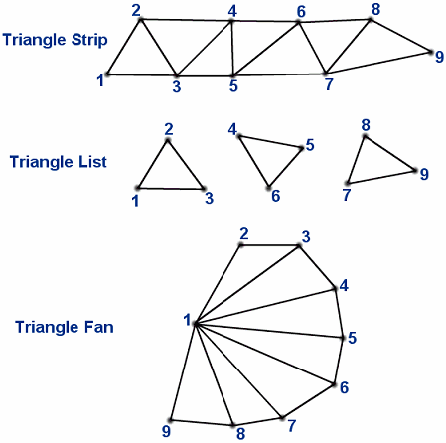
Triangles, fans, oh my!!

Slide 40
Indexed vs non-indexed models
We could store the triangles individually
i.e. Every three vertices = 1 triangle
But that would involve a lot of repetition, perhaps
Or we could “index” the vertices
This is where the vertices are stored in an array
And only stored once
They are each given an “index”
Then the triangles refer to the index, not the actual vertex locations

Slide 41
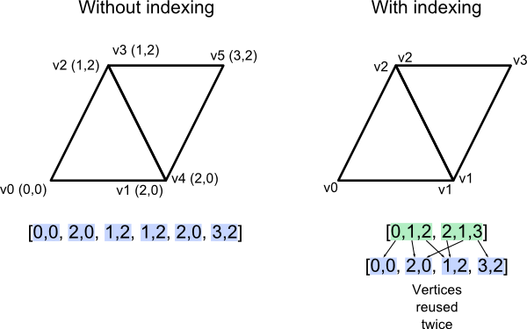
Indexed vs non-indexed models

Slide 42
Shaders
We will spend a fair bit of time in this course on “shaders”
Essentially, this is the programming language of the video card itself
There are several kinds and several kinds of languages
It takes the data from the buffers (like the vertex buffer) and “does something” with them to show fancy things on screen
Really, that’s all it does

Slide 43
Shaders
However, saying that is sort of like the founder of Pixar saying:
“There are a few billion pixels in a Pixar movie and all we do is determine what color each one is on each frame.”
Uh huh.
But, they really just transform data
In the process, then provide:
Transformations, colour, textures, lighting, etc.
Whatever you can imagine.

Slide 44
C++ things… classes (hopefully is review)
C++ is “C with classes”
A “class” is essentially a C “struct” but with methods
Everything is “private” by default, unless you declare it as “public”
(or “protected”… which we will talk about later…)
Convention:
Place all classes into “header” (aka “.h” files)
NEVER put code into a header file; code goes into “cpp” files.
Scope operator (“::” indicates the method belongs to that class, otherwise it’s just a “global” function.

Slide 45
C++ things… classes (hopefully is review)
ALWAYS use header guards
Tip:
Always create a default constructor
Always use a virtual destructor (prevents memory leaks if you inherit this class)
Don’t worry about:
Preventing copying
Preventing inheriting
Blah, blah, blah.
General rule of thumb:
If you are trying to make your class “idiot proof:”
You aren’t going to be able to do that, so don’t bother
You are working with idiots, so fix that instead
Get the darn thing to work, then do the “fancy” stuff

Slide 46
3D model formats
There’s lots of them.
We are going to look at a very simple one called PLY
It was one of the original types of files.

Slide 48


Slide 49


Slide 50
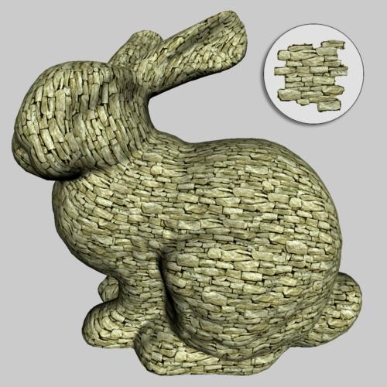

Slide 51
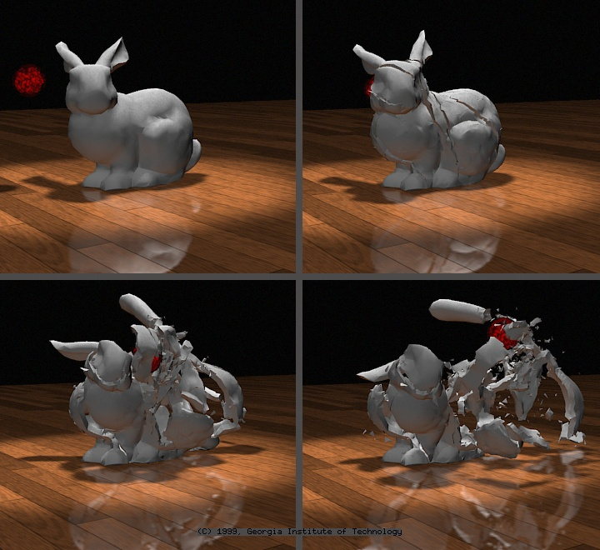

Slide 52
