Slide 1
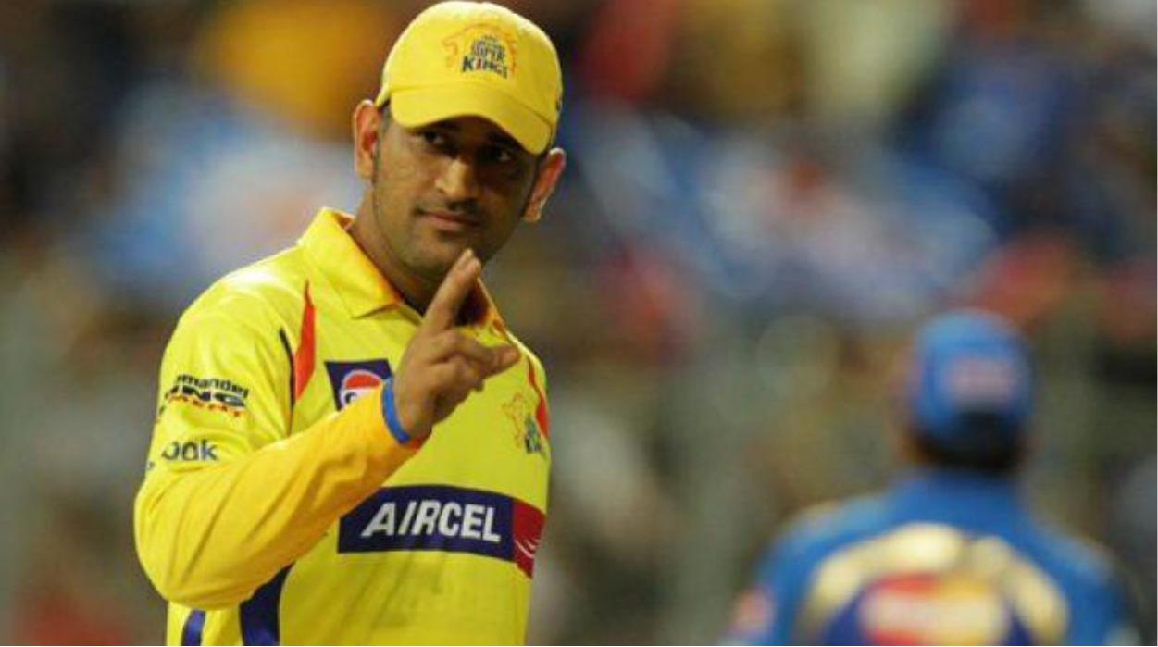
IPL EDA
by Naveen N Jan 19 Batch

Slide 2
Intro to Indian Premier League
Cricket is a bat-and-ball game played between two teams of eleven players each on a cricket field, at the centre of which is a rectangular 20-metre (22-yard) pitch with a target at each end called the wicket (a set of three wooden stumps upon which two bails sit).
Each phase of play is called an innings, during which one team bats, attempting to score as many runs as possible, whilst their opponents bowl and field, attempting to minimise the number of runs scored.
When each innings ends, the teams usually swap roles for the next innings (i.e. the team that previously batted will bowl/field, and vice versa).
The teams each bat for one or two innings, depending on the type of match. The winning team is the one that scores the most runs, including any extras gained (except when the result is not a win/loss result).

Slide 3
IPL Format
Currently, with eight teams, each team plays each other twice in a home-and-away round-robin format in the league phase. At the conclusion of the league stage, the top four teams will qualify for the playoffs. The top two teams from the league phase will play against each other in the first Qualifying match, with the winner going straight to the IPL final and the loser getting another chance to qualify for the IPL final by playing the second Qualifying match. Meanwhile, the third and fourth place teams from league phase play against each other in an eliminator match and the winner from that match will play the loser from the first Qualifying match. The winner of the second Qualifying match will move onto the final to play the winner of the first Qualifying match in the IPL Final match, where the winner will be crowned the Indian Premier League champions.

Slide 4

IPL Teams

Slide 5
Problem statement
Notebook focuses on explaining summary of the data available in the IPL dataset in visual form. I have explored graphs using different plotting methods and packages. I have also tried to explore different methods to extract data from the dataset using NumPy and Panda. Following libraries are used in Python 3 in the process.
pandas
numpy
matplotlib.pyplot
seaborn

Slide 6
What did I do?
Import packages and data into Python notebook
Data Cleaning Rename column, non-digit character, convert column to numeric datatype
Pre profiling to identify the variable types and data
Post profiling
Ask questions and summarize data in visual form
Conclusion
Thanks to all people who wrote kernal on the IPL data set. With the help of kernel I was able to code my first EDA. It was a very great learning experience. Refered to Insaid training materials to get basic correct/

Slide 7
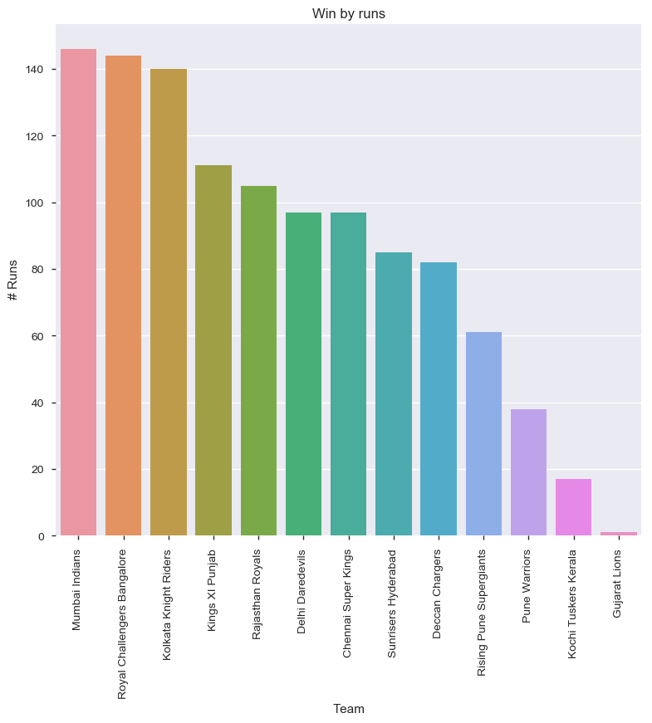
Top 10 teams who won by max runs

Slide 8
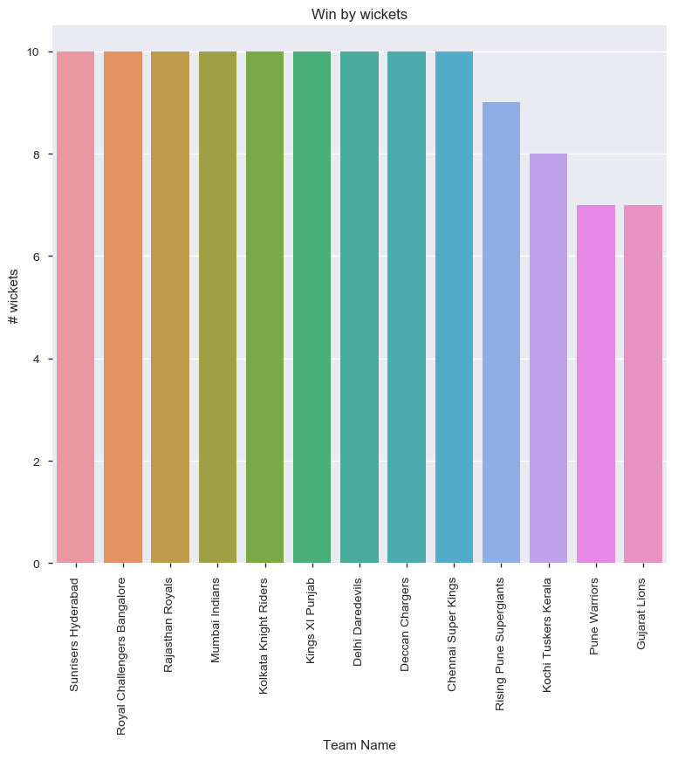
Top 10 team who won by wickets

Slide 9
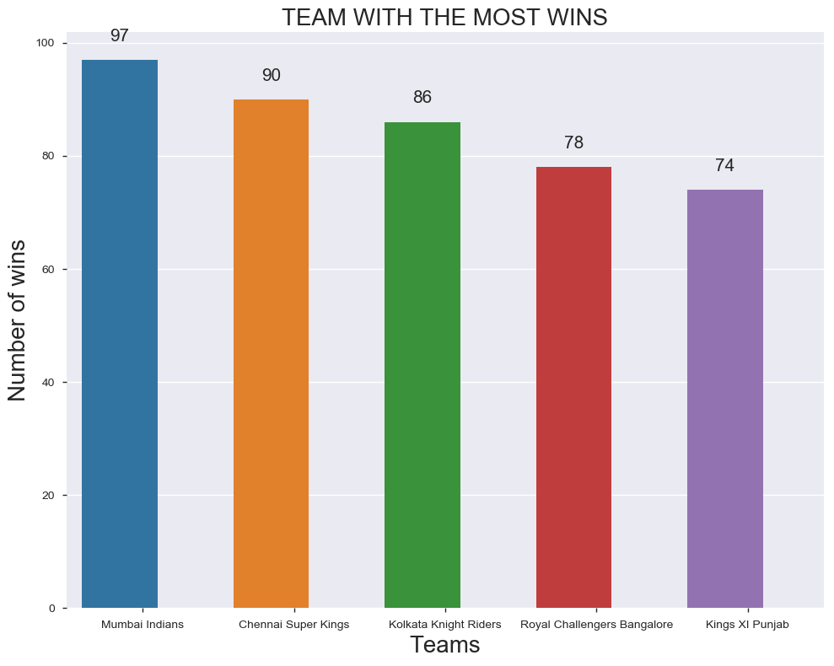
The most successful IPL Team

Slide 10
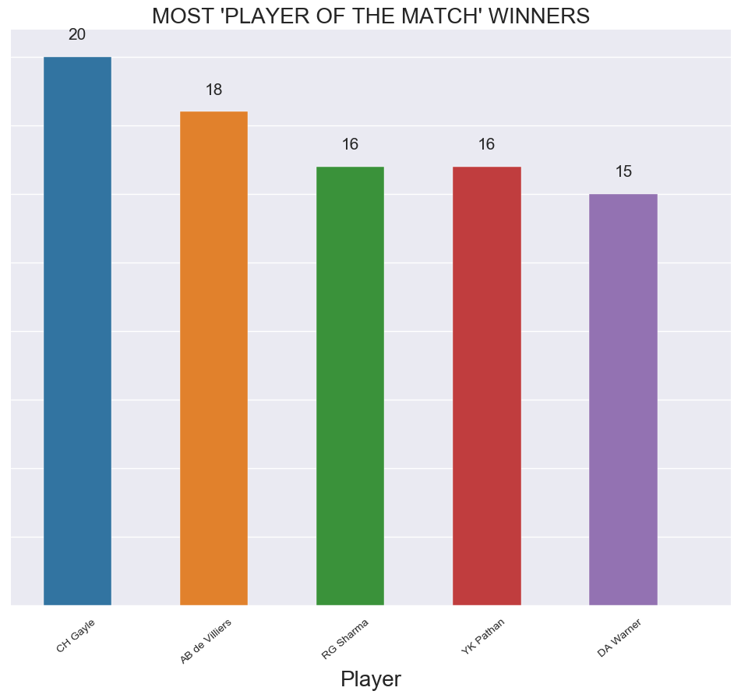
Most 'Player of the match' Winners

Slide 11
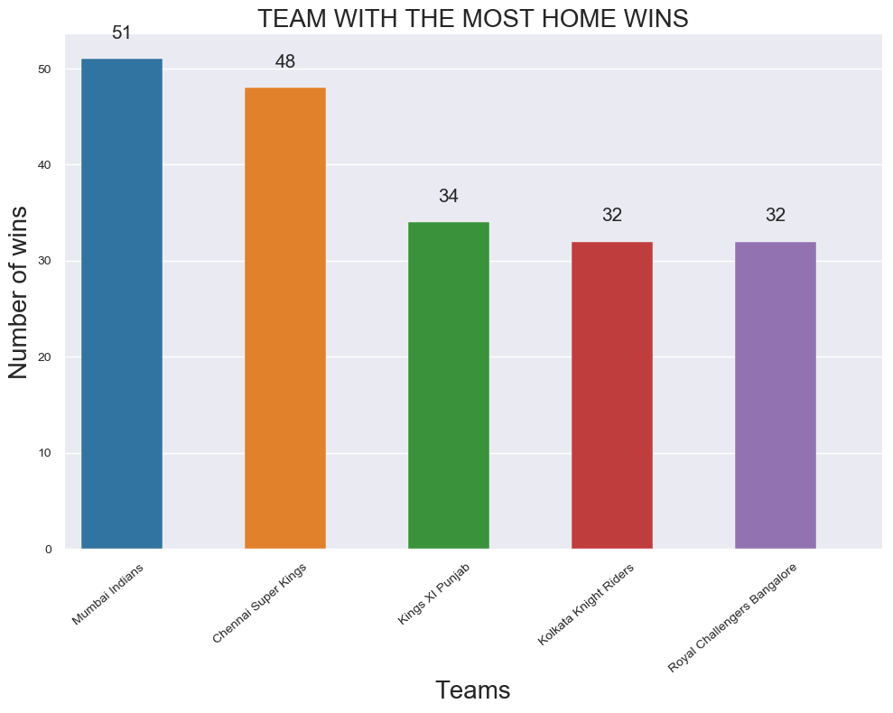
Team with Most home wins

Slide 12
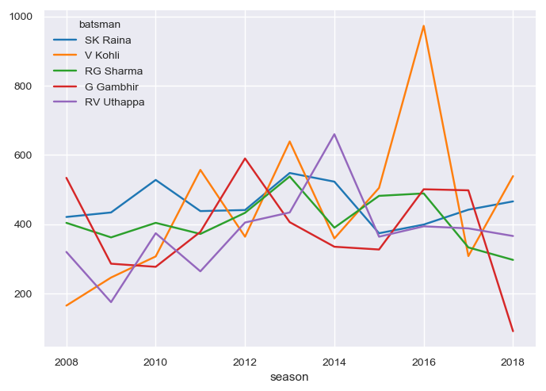
Performance of top 5 batsmen over seasons
V.Kohli show a steady improvement over season and RG Sharma and RV Uthappa have shown a downfall

Slide 13
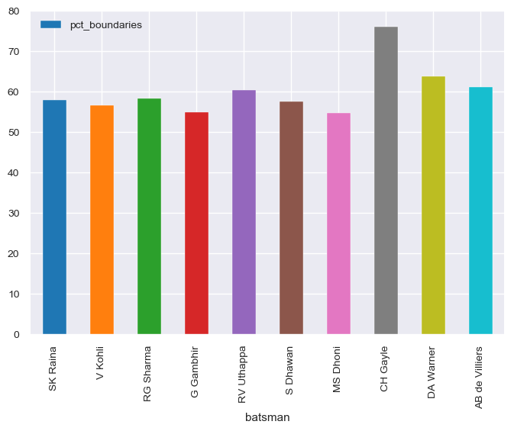
Percentage of total runs scored through boundaries for each batsman
The average for top batsmen is around 58-60% with exception of CH Gayle at 76%. Interestingly, MS Dhoni who is known for helicopter shots(6s) gets close to 45% of his runs through singles

Slide 14
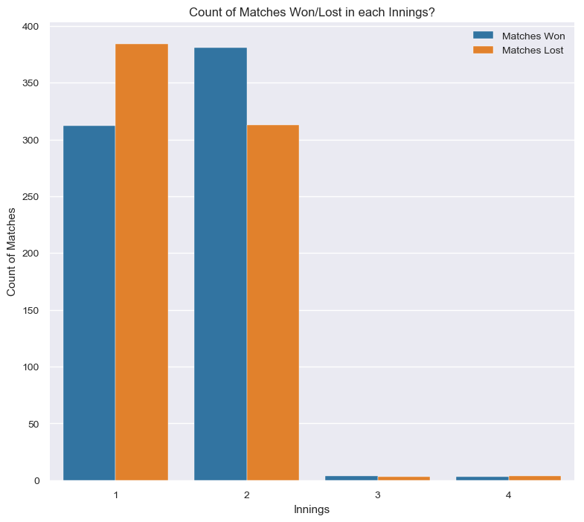
Number of matches won in each innings

Slide 15
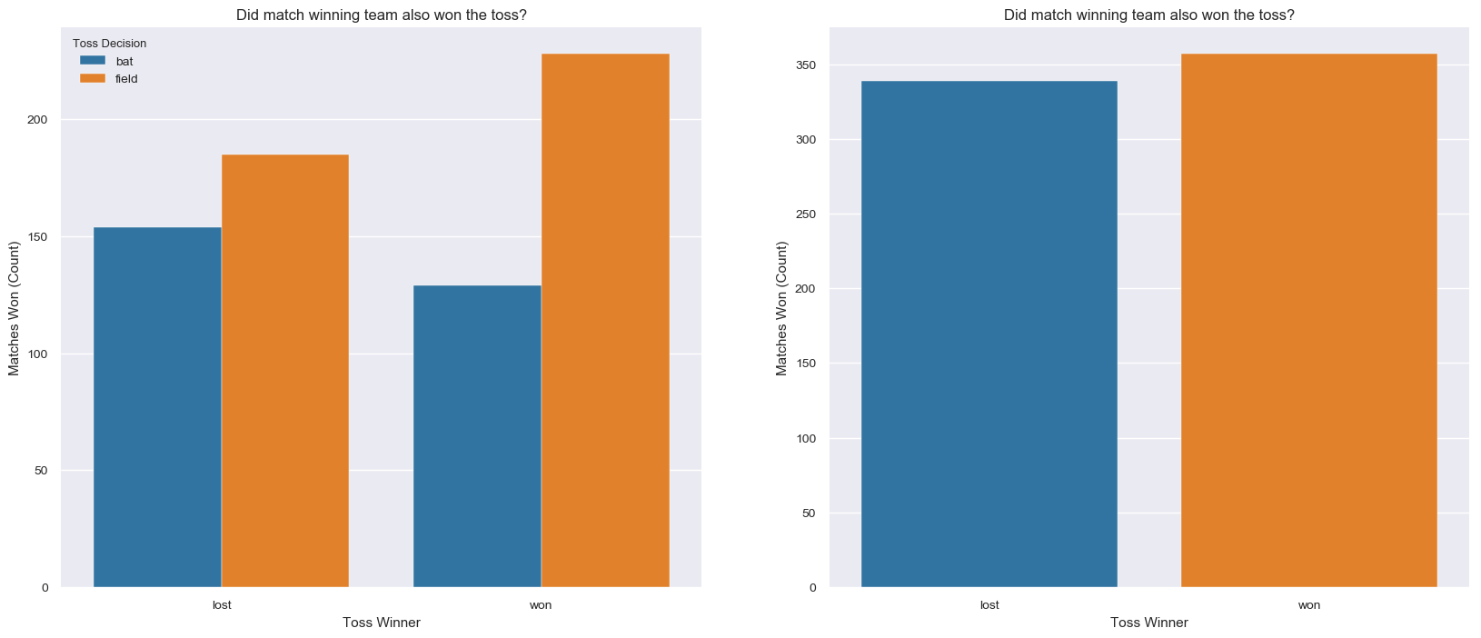
Impact of toss on the match outcome
It is clear that the most number of matches are won by teams when they decided to field first after winning the toss.

Slide 16
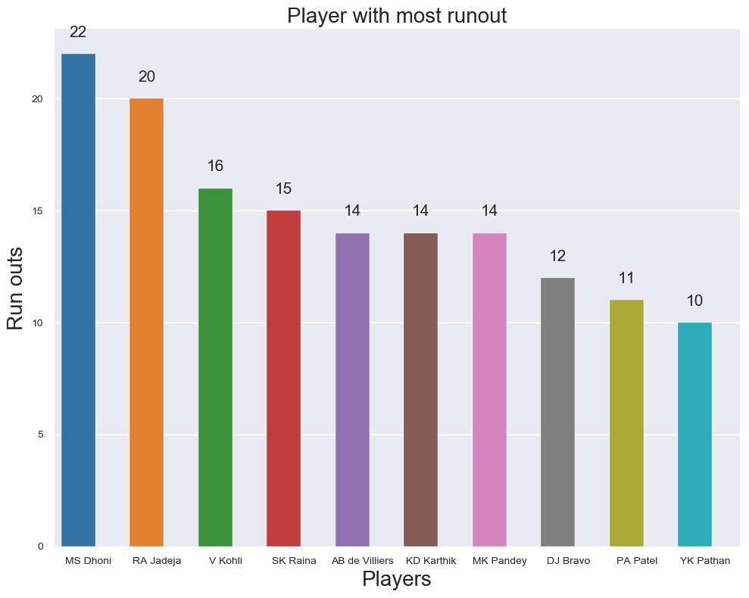
Top 10 fielder who did most runout

Slide 17
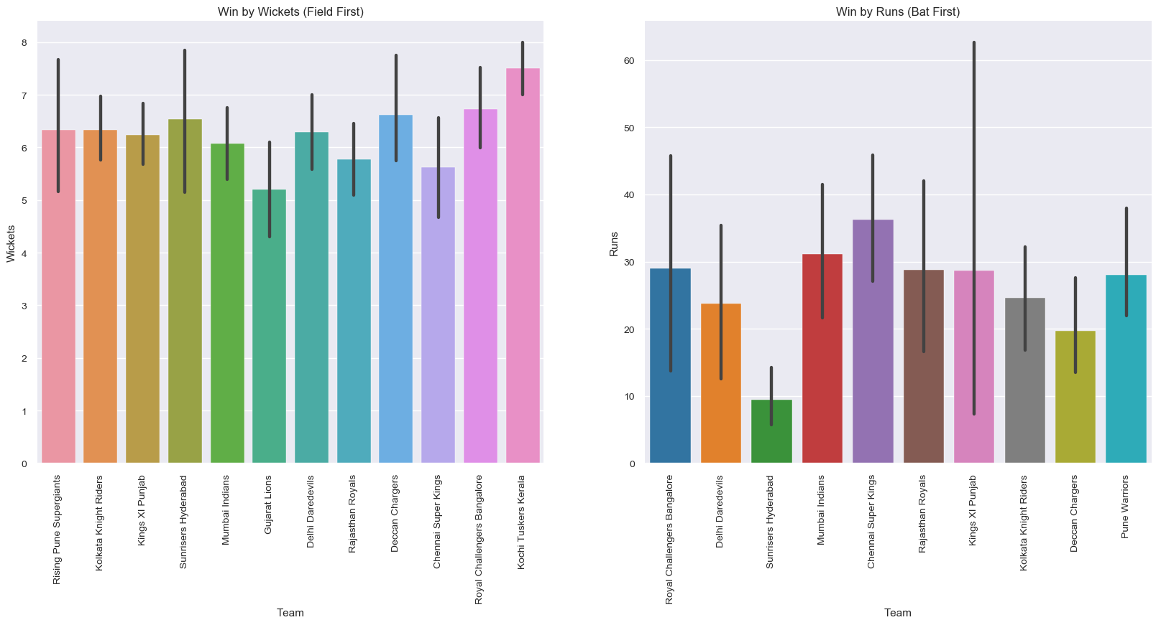
How did teams perform when chasing or defending the score?
Sunrisers Hyderabad have the least win by runs average. Hence, they found it relatively hard to defend the score.
Kochi Tuskers Kerala and Sunrisers Hyderabad have the highest average of win by wickets. They comfortable chased the scores in the matches they won saving a lot of wickets which means they have a strong top order.
Every team was able to chase score by saving at least 5 wickets on average.

Slide 18
Conclusion
Use of packages like __matplotlib and seaborn__ to develop better insights about the data.
Python (Expressions and packages like NumPy and Pandas) are very crispy in terms of its syntax and the second thing is, It doesn’t need to be tens and hundreds of line to bring out a valuable insight, just a few lines could do the magic :
If you’re asking the right questions.

