Slide 1
DegreeWorks Application Prototype Presentation.
MSIS720 – IS Project (DegreeWorks)
FINAL PRESENTATION
Streamlined Academic Viewing Process For Students.
Presented by:
GUDIMILLA NAVEEN KUMAR.
.
.

Slide 2
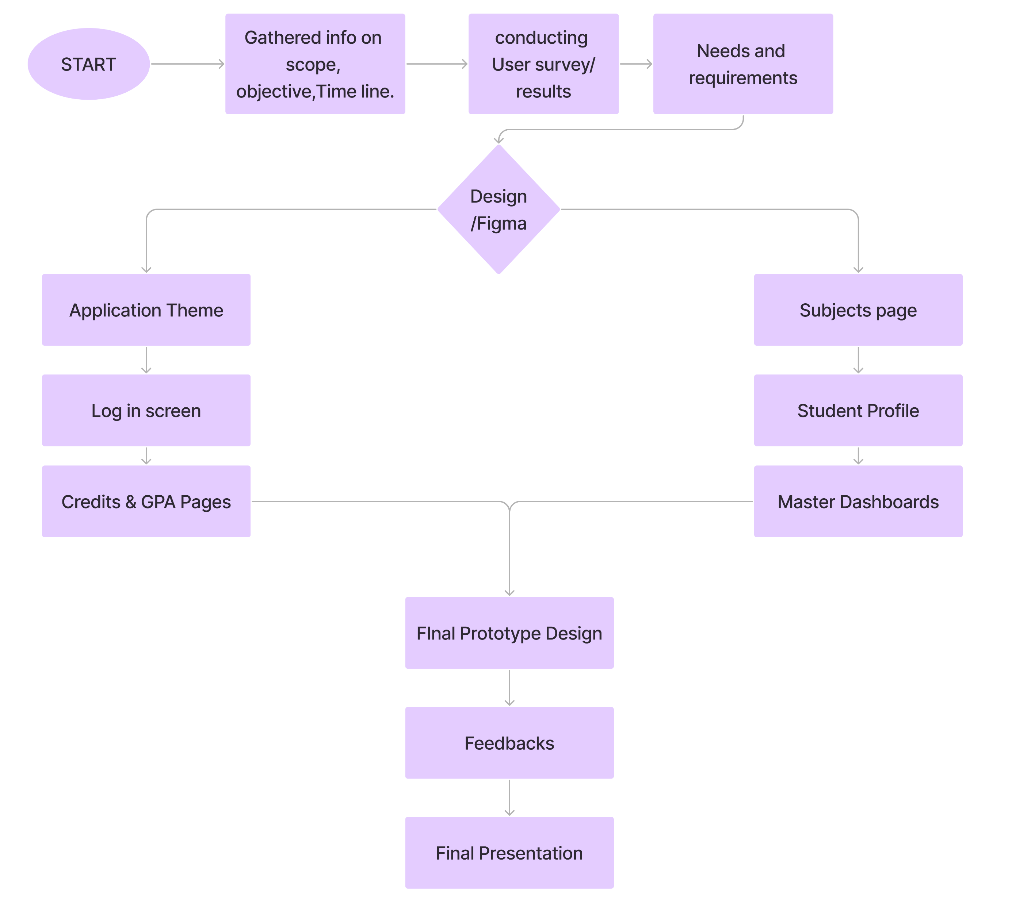
JOURNEY

Slide 3
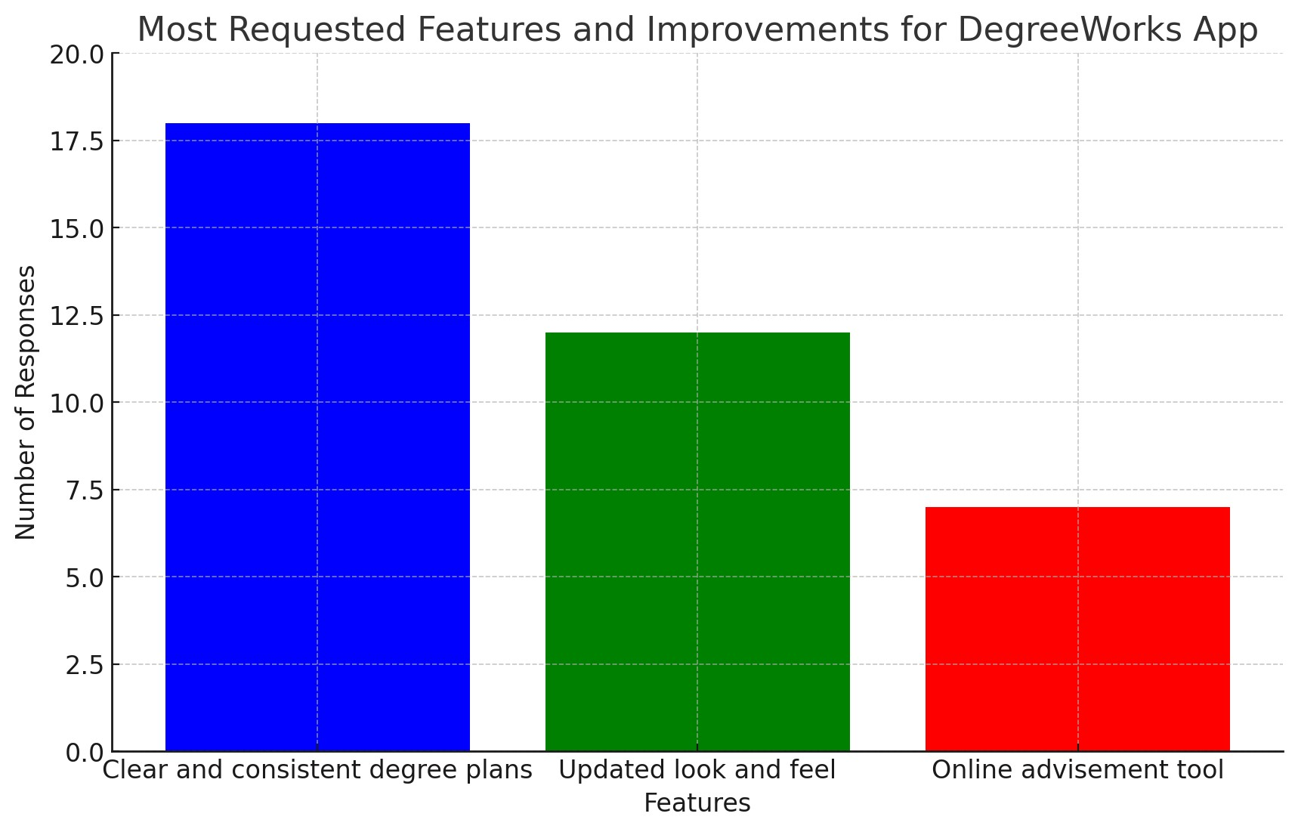
Pre Design Survey Insights: Conducted surveys to identify core student needs—emphasis on clear UI and reliable functionality.

Slide 4

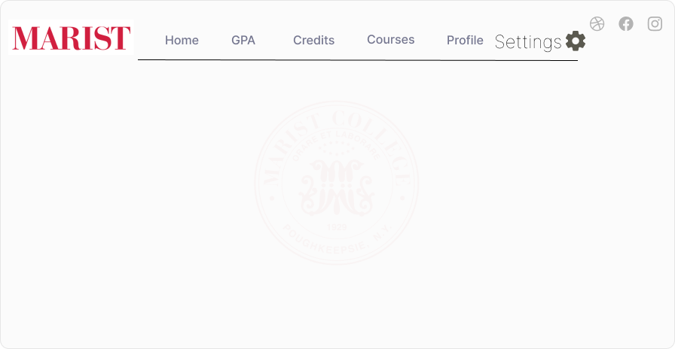
Design Process and Development
Design Evolution : Started with Theme for clear and user attractive design.

Slide 5
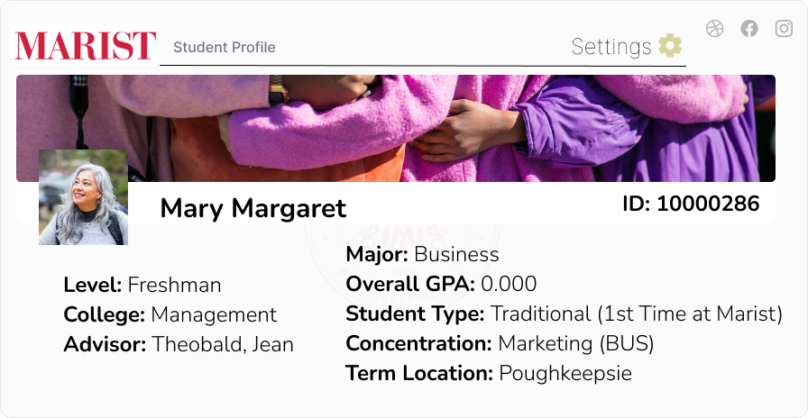
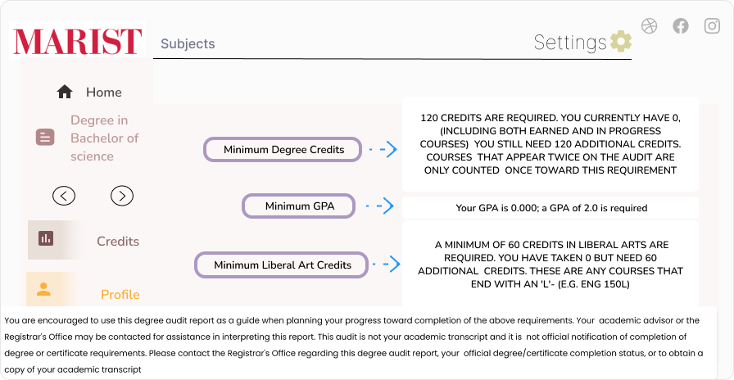
KEY FEATURES
Designated
Student Profile page
Designated
Subjects page

Slide 6
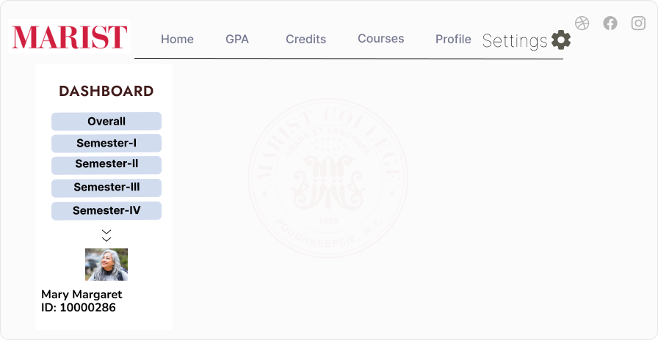
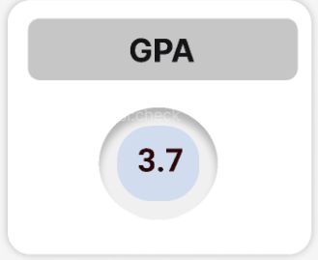
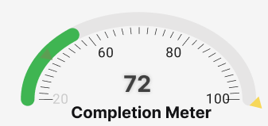
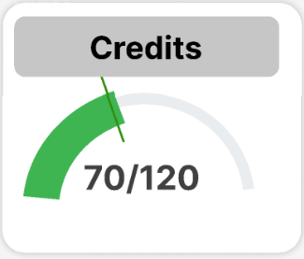
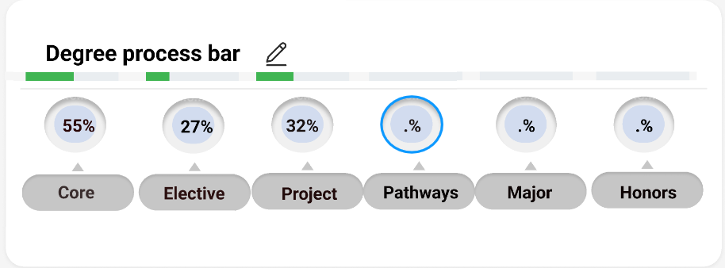
About Master Dashboard

Slide 7
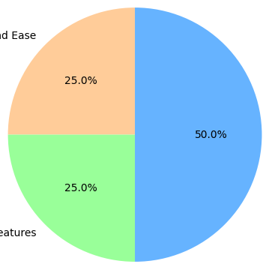
POST PROTOTYPE FEEDBACK INSIGHTS.
Positive Feedback.
Interface Clarity and Ease of Navigation: Mentioned in multiple feedbacks highlighting clear layout, easy navigation, and responsive design.
Useful Features: GPA tracker, degree progress bar, credit audit.
Suggested Enhancements Grouped by Category.
Personalization Features: Deadline reminders, notifications for grades/assignments, personalized calendar sync.
Usability Enhancements: Dark mode, 'what-if' analysis tool, tutorial for new users.
Academic Integration: Sync with academic calendar, include extracurricular activities.
10 SAMPLE SIZE

Slide 8
CONCLUSION & MOVING FORWARD
Project Conclusion:
"Successfully gathered and implemented user feedback to enhance the DegreeWorks app."
"Improved interface clarity and navigation, integrated key features like GPA tracking and Master Dashboard“
Next Steps:
"Continued development to incorporate more personalized features like deadline reminders and dark mode."
"Plan for ongoing user feedback sessions to refine functionality and user interface."
Prototype Walkthrough
https://www.figma.com/proto/0VVl6W5f2ACr1RO5qWEA2N/Degree-works-application?page-id=0%3A1&type=design&node-id=113-242&viewport=303%2C110%2C0.21&t=cCEOGkMStKfJIuq3-1&scaling=contain&mode=design

Slide 9
Questions and Acknowledgments
Invite for Questions: Open the floor for any questions from the audience to foster engagement and feedback.
Acknowledgments: Thank you to all stakeholders, team members, and participants for their invaluable input and support throughout the project lifecycle.

